Slide 1
ELECTROCHEMISTRY

Slide 2
Galvanic cells
Electrochemical cells fall into one of two basic types
Galvanic cells convert chemical energy into electrical energy (batteries)
Electrolytic cells convert electrical energy into chemical energy.

Slide 3
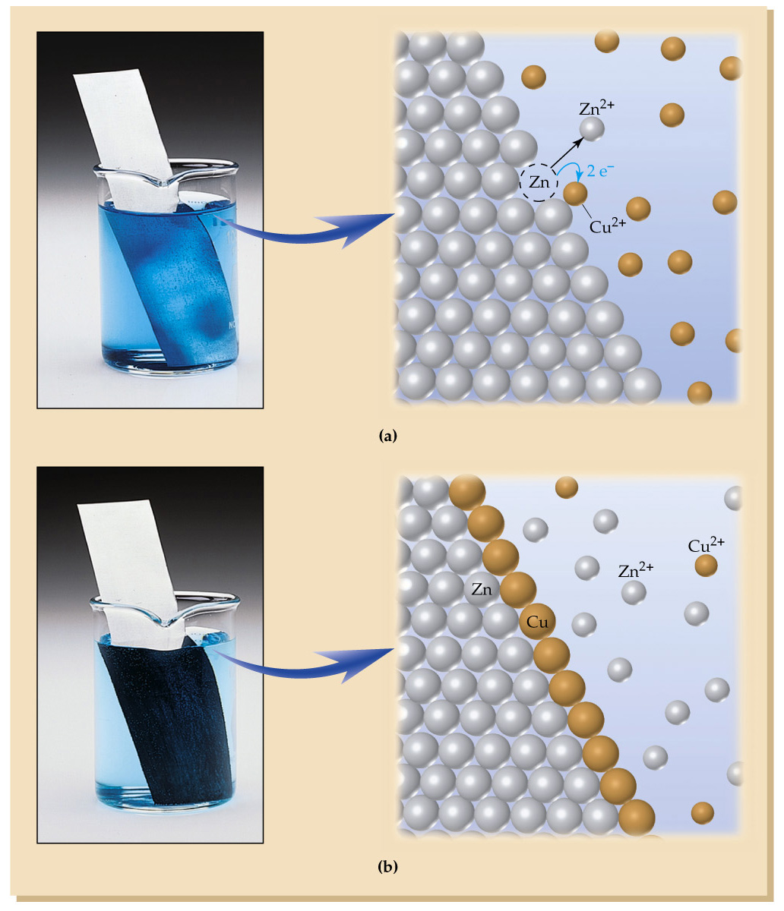
Here we put a piece of zinc metal into a Cu²⁺ ion solution. A reaction occurs where we get Zn²⁺ ions and solid copper deposited on the zinc surface.

Slide 4
This is an oxidation-reduction (redox) process where electrons are transferred from one chemical to another. One chemical loses electrons in a process called oxidation, while the other chemical gains electrons in a process called reduction.

Slide 5
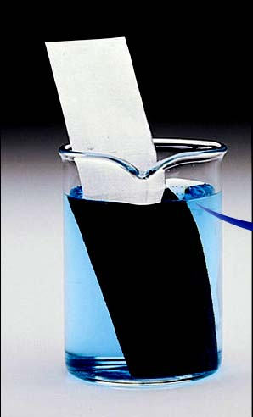
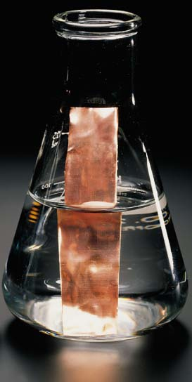
Zinc in Cu²⁺ solution is spontaneous
Since we actually see this reaction occurring, this reaction must be spontaneous!
The reverse reaction, where we put copper metal into a Zn²⁺ ion solution is non-spontaneous!

Slide 6
Redox reaction
Zn (s) + Cu²⁺ (aq) → Zn²⁺ (aq) + Cu (s)
we can see that each zinc atom
gives away 2 electrons
to a copper (II) ion to give us a
copper atom and a zinc (II) ion
in the spontaneous reaction!

Slide 7
Half-reactions
To clarify the redox process, we often break a redox reaction down into two separate steps (half-reactions). In one half-reaction, a chemical loses electrons (is oxidized)
Zn (s) → Zn²⁺ (aq) + 2 e⁻
We call this the oxidation half-reaction.
Notice that we are effectively treating electrons as a “product” of the half-reaction.
In the other half-reaction, we look at the reduction half-reaction, where a chemical gains electrons (is reduced)
Cu²⁺ (aq) + 2 e⁻ → Cu (s)

Slide 8
Half-reactions
The sum of these half-reactions must give us the overall reaction of interest.
Zn (s) → Zn²⁺ (aq) + 2 e⁻
Cu²⁺ (aq) + 2 e⁻ → Cu (s)
Zn (s) + Cu²⁺ (aq) + 2 e⁻ → Zn²⁺ (aq) + 2 e⁻ + Cu (s)
Zn (s) + Cu²⁺ (aq) → Zn²⁺ (aq) + Cu (s)

Slide 9
Half-reactions
Why do we call them “half-reactions”?
Each half-reaction is written so we can see what is happening to the electrons in the overall reaction.
In reality a half reaction CANNOT occur by itself to any great extent.
The lost electrons in the oxidation half-reaction MUST go somewhere.
The gained electrons in the reduction half-reaction MUST come from somewhere.
Two half-reactions ALWAYS work together to give an overall reaction that can occur to a great extent.

Slide 10
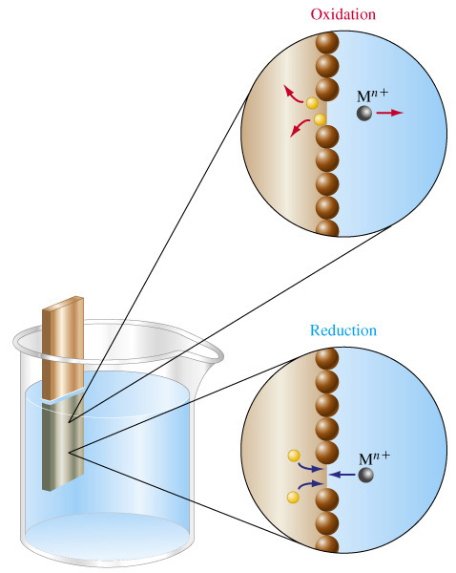
Half-reactions
The electrons stay on the metal electrode and are NEVER found in solution!

Slide 11
Since the chemicals are in direct contact with each other, the electron transfer occurs directly and we can’t use the electrons to do anything useful.
How can we separate the chemicals but allow the electrons to transfer indirectly so we can use them?

Slide 12
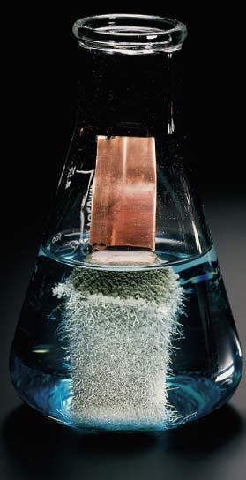
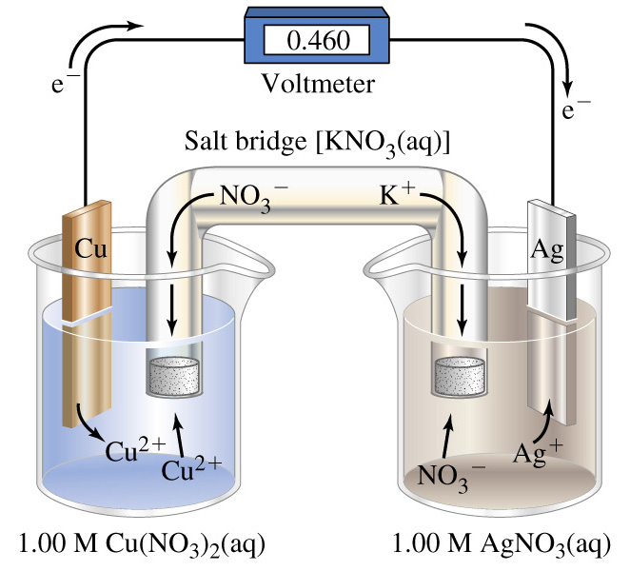
Copper in Ag⁺ solution is spontaneous

Slide 13
The half-reactions
to take place in separate containers
(called half-cells).
Since a half-reaction cannot take place by itself we need to connect the half-cells together. It turns out that we must make a circuit (two connections!) for the entire galvanic cell to work.

Slide 14
The left half-cell has a solid copper electrode in a Cu²⁺ ion solution, while the right half-cell has a solid silver electrode in a Ag⁺ ion solution.
A wire can connect the two solid electrodes for the electrons to move through. To connect the two solutions so that ions can move between the half-cells requires us to use a salt bridge, which is just another solution of ions.

Slide 15
Oxidation occurs at the copper electrode, which we give the special name
ANODE
Since the anode collects the electrons that are lost, it has a negative charge and positive copper ions leave the anode!
Cu (s) → Cu²⁺ (aq) + 2 e⁻

Slide 16
Electrons move from the
ANODE
to the silver electrode through the wire
We can get them to do something useful, like light a bulb!

Slide 17
Reduction occurs at the silver electrode, which we give the special name
CATHODE
Since the cathode collects the positive silver ions so they can gain the electrons, the cathode has a positive charge!
Ag⁺ (aq) + e⁻ → Ag (s)

Slide 18
Positive ions leave the anode while the cathode collects positive ions.
Alternatively, negative ions collect at the anode and move away from the cathode
The ions are free to move through the salt bridge and are REQUIRED to complete the circuit!

Slide 19
Overall, negative charges (electrons and negative ions) are moving clockwise
Overall, positive charges (positive ions and electron “holes”) are moving counterclockwise

Slide 20
The overall reaction is exactly the same as when we place solid copper in a Ag⁺ solution, but since we have separated the half-cells, we can look at the separate half-reactions as they occur.
Cu (s) → Cu²⁺ (aq) + 2 e⁻
2 x [Ag⁺ (aq) + 1 e⁻ → Ag (s)]
Cu (s) + 2 Ag⁺ (aq) + 2 e⁻ → Cu²⁺ (aq) + 2 e⁻ + 2 Ag (s)
Cu (s) + 2 Ag⁺ (aq) → Cu²⁺ (aq) + 2 Ag (s)
Note # of e⁻ must balance!

Slide 21
Shorthand notation for galvanic cells
Drawing a diagram for a galvanic cell or describing it as we did in the previous problem is too time-consuming to do on a regular basis.
We can use a shorthand notation!
Cu (s) + 2 Ag⁺ (aq) → Cu²⁺ (aq) + 2 Ag (s)
Cu (s) | Cu²⁺ (aq) || Ag⁺ (aq) | Ag (s)

Slide 22
Cu (s) | Cu²⁺ (aq) || Ag⁺ (aq) | Ag (s)
A single vertical line indicates a change in phase, like that between a solid electrode and the solution its immersed in.
A double vertical line indicates a salt bridge.
What is not shown in the shorthand (but is always implied) is the wire connecting the two electrodes to complete the circuit.

Slide 23
Cu (s) | Cu²⁺ (aq) || Ag⁺ (aq) | Ag (s)
If we read the shorthand notation from left to right it says:
“A solid copper anode is in a solution of copper (II) ions which is connected by a salt bridge to a solution of silver (I) ions into which a solid silver cathode has been placed. The electrodes are connected by a wire.”

Slide 24
We ALWAYS choose to write the cell notation with the oxidation reaction first and then the reduction reaction.
This means the leftmost chemical in the notation is ALWAYS the anode, while the rightmost chemical is ALWAYS the cathode.
Additionally, the electrons ALWAYS flow from left to right through the wire, which is the way we read the shorthand.

Slide 25
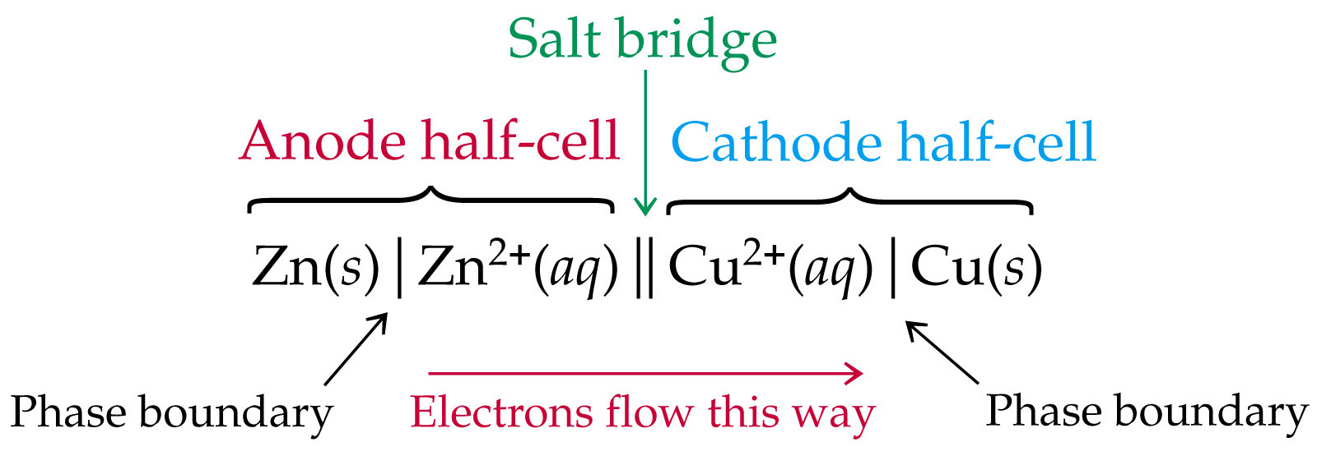
NOTATION
(through the wire connecting the electrodes)

Slide 26
Galvanic cells – Easy as ABC
Anode → Cathode
Negative → Positive
Oxidation → Reduction
Left → Right
“The anode is the negative electrode where oxidation takes place. We put it on the left in shorthand notation.”
“The cathode is the positive electrode where reduction takes place. We put it on the right in shorthand notation.”

Slide 27
Other shorthand notation considerations
Sometimes gases are involved in galvanic cells.
Including them in the shorthand is easy once we realize the gas is just a separate phase and must be separated from other phases by a vertical line.

Slide 28
Other shorthand notation considerations
Consider this reaction
Cu (s) + Cl₂ (g) → Cu²⁺ (aq) + 2 Cl⁻ (aq)
Since we CAN’T use a gas as an electrode we need some solid substance to do that job. In this case we bubble the gas by a carbon rod
The cell notation with the carbon acting as the cathode is
Cu (s) | Cu²⁺ (aq) || Cl₂ (g) | Cl⁻ (aq) | C (s)

Slide 29
Other shorthand notation considerations
Cu (s) | Cu²⁺ (aq) || Cl₂ (g) | Cl⁻ (aq) | C (s)
We can also be more specific by giving concentration and pressure data for any of the aqueous or gaseous chemicals of the system.
e.g. Cu²⁺ (aq, 0.58 M)
and Cl⁻ (aq, 0.34 M)
and Cl₂ (g, 0.89 bar)

Slide 30
Problem
Write the shorthand notation for a galvanic cell that uses the reaction
Fe (s) + Sn²⁺ (aq) → Fe²⁺ (aq) + Sn (s)
Fe (s) | Fe²⁺ (aq) || Sn²⁺ (aq) | Sn (s)

Slide 31
Problem
Write a balanced equation for the overall cell reaction and give a brief description of the galvanic cell represented by
Pb (s) | Pb²⁺ (aq) || Br₂ (l) | Br⁻ (aq) | Pt (s)
Pb (s) + Br₂ (l) → Pb²⁺ (aq) + 2 Br⁻ (aq)
The reduction of Br₂ to Br⁻ occurs on the surface of a Pt cathode

Slide 32
Cell potentials for cell reactions
Electrons move from the copper anode through the wire to the silver cathode because it is energetically favourable for the electrons to move!
An electron in a siver atom has less free energy than the same electron in a copper atom.
Much like a ball wants to roll down a hill so it ends up where it has the lower potential energy, an electron wants to move to the atom where it has the lower free energy.

Slide 33
Potential
The difference in the free energy for the electrons in the anode and the cathode is somewhat like the slope from the top to the bottom of the hill.
If the hill is “steep”, the ball experiences more of the force of gravity than it does on a “gentle” hill.

Slide 34
Potential
The equivalent of the force of gravity to the difference in the free energy of electrons in different atoms is called the electromotive force (emf) –
also known as the cell potential (E)
or the cell voltage (V).
Like a ball on a steep hill, electrons are under a “greater” force to transfer from the anode to the cathode when the cell potential has a larger magnitude.

Slide 35
Potential
Because there is a free energy difference for an electron in the anode as compared to the same electron in the cathode, the electron must lose free energy during the trip, just like a ball loses potential energy (as motion!) as it rolls down the hill.
The free energy change is negative and so the movement of the electrons is a spontaneous process!

Slide 36
Potential
The free energy change is negative and so the movement of the electrons is a spontaneous process!
This occurs when the potential is positive so a positive potential indicates a
spontaneous process

Slide 37
Potential
We can get energy out of a ball (with its certain mass) rolling down a slope (the experienced gravity),
We can get energy out of an electron (with electrical charge) that “rolls down the slope” that is the potential difference of electron free energy between the two electrodes.

Slide 38
Potential
In terms of units, we can define
one Joule as the energy
we get from a
charge of one Coulomb
multiplied by the
potential of one volt.
1 J = 1 C·V (one Coulomb-volt)

Slide 39
Potential
A Coulomb is a very large unit of charge!
The charge on one electron is
1.60 x 10⁻¹⁹ C, so
one Coulomb is the charge of about
6 billion billion electrons!

Slide 40
Potential
It is generally easier to talk about the charge of one mole of electrons, which we give the special name of
Faraday Constant or faraday (F)
1 faraday = 6.022 x 10²³ mol⁻¹ e⁻ x 1.60 x 10⁻¹⁹ C
1 faraday = 9.65 x 10⁴ C·mol⁻¹

Slide 41
Potential
We can measure the potential between two electrodes with a voltmeter, which should give a positive reading when the positive terminal of the voltmeter is connected to the positive electrode (the cathode),
and
the negative terminal is connected to the negative electrode (the anode).
When the voltmeter gives a positive potential, we have identified the direction of spontaneous change!

Slide 42
Copper in Ag⁺ solution is spontaneous

Slide 43
Standard cell potentials
Cell potentials depend on many factors other than the chemicals in the system, including the temperature, ion concentrations, and pressure.
Like in the thermodynamics chapter, where we defined a standard state of conditions for enthalpy tables, we can do the same to define standard cell potentials E°.

Slide 44
Standard cell potentials
We can only measure a standard cell potential if we have
pure solids and liquids (activities of 1),
all solution activities are 1 (@1 mol⋅L⁻¹),
all gas activities are 1 (@1 atm),
and the temperature is specified
(usually 25 °C).

Slide 45
Standard cell potentials
Zn (s) | Zn²⁺ (aq) || Cu²⁺ (aq) | Cu (s)
we can only measure the STANDARD cell potential if the [Zn²⁺] and [Cu²⁺] are both 1 mol⋅L⁻¹ , and the copper and zinc electrodes are pure.
The E° for this cell is 1.10 V at 25 °C.

Slide 46
Standard electrode potentials
The standard cell potential E° for any galvanic cell can be expressed as the difference of the standard electrode potentials for the cathode and the the anode
E°_{cell} = E°_{(red),cathode} - E°_{(red),anode}

Slide 47
Standard electrode potentials
The standard electrode potential depends on whether the electrode is acting as the cathode or the anode.
However, the process at the cathode (reduction) is the opposite process that would occur if it were happening at the anode (oxidation).

Slide 48
Standard electrode potentials
Reversing a process changes the sign of the electrode potential associated with the process.
Therefore we choose to report
ALL standard electrode potentials
as reduction processes
because for any specific electrode
E°_{(red),cathode} = - E°_{(red),anode}

Slide 49
Standard electrode potentials
It would be nice to create a table of standard electrode potentials for all possible electrodes, then we could find standard cell potentials for any cell.
However, there is one problem!
We’ve already seen that
half-reactions cannot occur
without another half-reaction!

Slide 50
We got around a problem like this in thermodynamics by defining the standard enthalpy of formation of elements in their standard states as ZERO.
We can do the same for electrode potentials and set the potential for a specific electrode as ZERO and measure all other electrode potentials in comparison to the standard.

Slide 51
Standard hydrogen electrode
The standard electrode for potentials is the standard hydrogen electrode (S.H.E).
The electrode consists of hydrogen gas at 1 bar bubbling through a 1 mol⋅L⁻¹ (actually activity of 1) solution of H⁺ past a platinum electrode. Therefore
2 H⁺ (aq, a = 1) + 2 e⁻  H₂ (g, 1 Atm)
E°_{(red),cathode} = E°_{H}+_{/H2} = 0 V

Slide 52
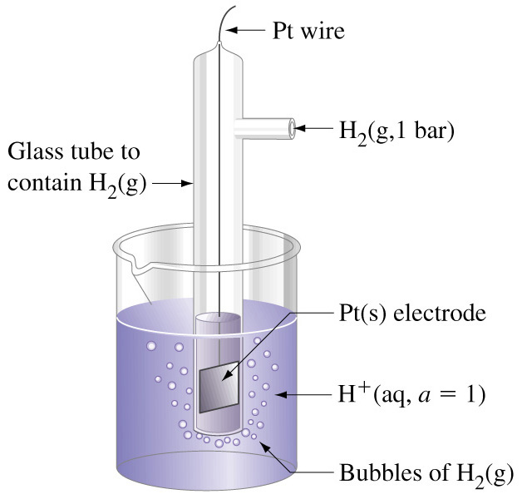
Standard hydrogen electrode
If the oxidation reaction occurs instead in this half-cell as an anode, the overall reaction is
H₂ (g, 1 bar) 
2 H⁺ (aq, 1 mol⋅L⁻¹) + 2 e⁻
Reversing a reaction changes the sign of the potential. For the S.H.E.
E°_{(red),anode} = - E°_{(red),cathode}
= - E°_{H}+_{/H2} = 0 V

Slide 53
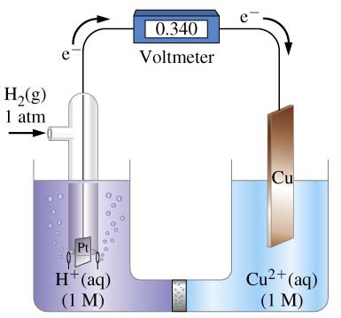
Pt (s) | H₂ (g) | H⁺ (aq) || Cu²⁺ (aq) | Cu (s)
The standard potential for this cell has been measured as 0.340 V at 25 °C, and our anode is the standard hydrogen electrode!

Slide 54
We have defined the standard electrode potential of the reduction of Cu²⁺ ions to solid Cu! This is also known as a
standard reduction potential.
Cu²⁺ (aq) + 2 e⁻  Cu (s)
E°_{(red)} = 0.340 V

Slide 55
If we reverse the half-reaction we’ll get the
standard OXIDATION potential
for the oxidation of solid Cu to Cu²⁺ ions…
Cu (s)  Cu²⁺ (aq) + 2 e⁻
E°_{(ox)} = -0.340 V

Slide 56
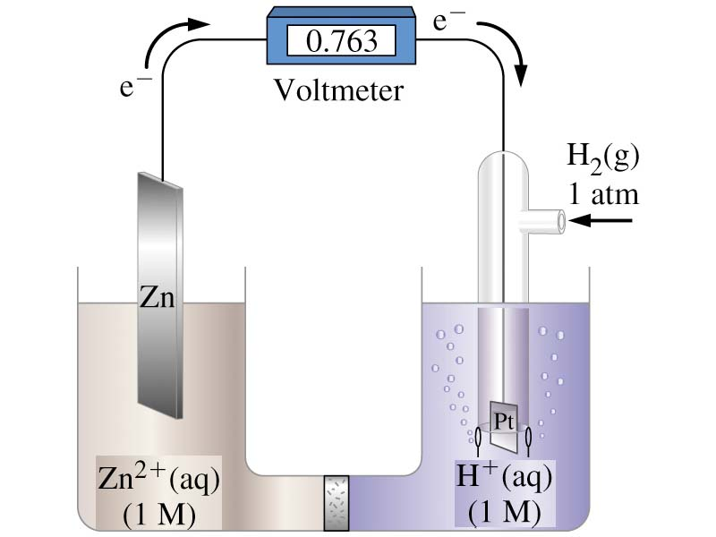
Zn (s) | Zn²⁺ (aq) || H⁺ (aq) | H₂ (g) | Pt (s)
The standard potential for this cell has been measured as 0.763 V at 25 °C, and our anode is the zinc electrode!

Slide 57
We have found the standard potential of the oxidation of solid zinc to zinc ions!
This is a
standard oxidation potential.
Zn (s)  Zn²⁺ (aq) + 2 e⁻
E°_{(ox)} = 0.763 V

Slide 58
If we reverse the half-reaction we’ll get the standard reduction potential for Zn²⁺ ions to solid zinc
Zn²⁺ (aq) + 2 e⁻  Zn (s)
E°_{(red)} = -0.763 V
We report this value as the
standard electrode potential!

Slide 59
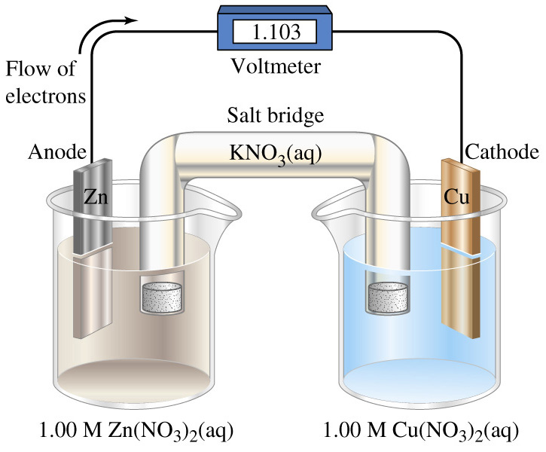
Zn (s) | Zn²⁺ (aq) || Cu²⁺ (aq) | Cu (s)
The standard cell potential for this cell can be calculated if we know the anode is the zinc electrode and the cathode is the copper electrode!

Slide 60
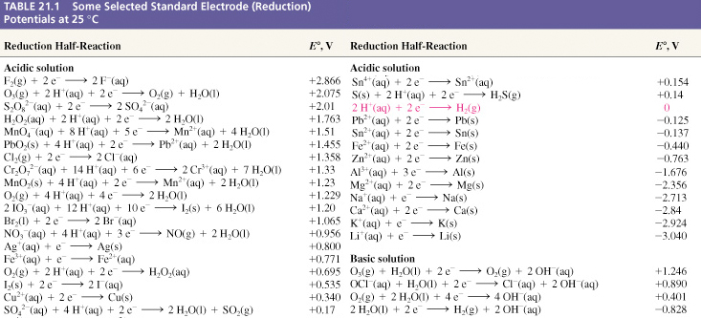
Standard electrode potentials E°_{(red)}

Slide 61
Using standard electrode potentials
Using tabulated standard electrode potential data is accomplished much like a Hess’s Law problem with one very important difference!
Let’s consider
Zn (s) | Zn²⁺ (aq) || Ag⁺ (aq) | Ag (s)
which has the balanced equation
2 Ag⁺ (aq) + Zn (s)  2 Ag (s) + Zn²⁺ (aq)

Slide 62
Using standard electrode potentials
Oxidation Zn (s)  Zn²⁺ (aq) + 2 e⁻
Reduction 2 [Ag⁺ (aq) + 1 e⁻  Ag (s)]
2 Ag⁺ (aq) + Zn (s)  2 Ag (s) + Zn²⁺ (aq)
E°_{cell} = 1.563 V

Slide 63
Like Hess’s Law, we look up the standard electrode potential reactions for both our sets of chemicals and then reverse the half-reaction for the set undergoing oxidation while changing the sign of the electrode potential (- E°_{(red),anode}!) .
However, we DO NOT multiply the potential for either half-reaction.
Why?

Slide 64
Potential
Recall the potential is
like the slope of a hill.
A hill does not change its slope if we have two (or more!) balls rolling downhill instead of one ball.
Therefore the potential of an electrode does not change if we multiply to get the right number of electrons!

Slide 65
Problem
The standard cell potential for the following galvanic cell is 0.78 V
Al (s) | Al³⁺ (aq) || Cr²⁺ (aq) | Cr (s)
The standard electrode potential for the Al electrode is -1.676 V. Calculate the standard electrode potential for the Cr electrode.

Slide 66
Free energy and electrical work
The constant of proportionality k_{elec} must depend on two things. First, it depends on how many electrons we have moved through the wire. Twice as many electrons should mean twice as much work…
We will usually measure numbers of electrons in moles and symbolize it by n.

Slide 67
Problem
When sodium metal is added to seawater, which has [Mg²⁺] = 0.0512 M, no magnesium metal is obtained. According to the data below, should this reaction occur? What reaction does occur?
Na⁺ (aq) + 1 e⁻ → Na (s) E°_{Na}+_{/Na} = -2.713 V
Mg²⁺ (aq) + 2 e⁻ → Mg (s) E°_{Mg}2+_{/Mg} = -2.356 V
2 H₂O (l) + 2 e⁻ → H₂ (g) + 2 OH⁻ (aq) E°_{H2O/H2} = -0.828 V

Slide 68
Problem answer
For the reaction
2 Na (s) + Mg²⁺ (aq) → 2 Na⁺ (aq) + Mg (s)
E°_{cell} = 0.357 V and the reaction should be spontaneous. However, the reaction of sodium with water is
2 Na (s) + 2 H₂O (l) → 2 Na⁺ (aq) + H₂ (g) + 2 OH⁻ (aq)
and has E°_{cell} = 1.885 V and this reaction should also be spontaneous.
Since this reaction is “more spontaneous” (higher E°_{cell}) sodium preferentially reacts with water and not magnesium ions!

Slide 69
Problem
Without using the data for a detailed calculation, explain why Sn²⁺ solutions must be protected from oxygen. One way to protect them is to add metallic (solid) tin.
Sn⁴⁺ (aq) + 2 e⁻ → Sn²⁺ (aq) E°_{Sn}4+_{/ Sn}2+ = 0.154 V
Sn²⁺ (aq) + 2 e⁻ → Sn (s) E°_{Sn}2+_{/ Sn} = -0.137 V
O₂ (g) + 4 H⁺ (aq) + 4 e⁻ → 2 H₂O (l) E°_{O2/H2O} = 1.229 V

Slide 70
Problem answer
For both possible reactions the reduction of oxygen is the cathode half-cell reaction.
Since E°_{cell} = E°_{(red),cathode} - E°_{(red),anode}, then the anode half-cell reaction that is more negative will give the higher (“more spontaneous”) E°_{cell} reaction that will preferentially occur.

Slide 71
Metals and acids
Some metals will react with acidic solutions to form H₂ gas and metal ions in solution while others will not.
We now know that those metals that do react with acid do so because the reaction is spontaneous while those that do not react do not because the reaction is non-spontaneous.

Slide 72
Metals and acids
In MOST cases the reduction reaction of metals in acidic solutions is
2 H⁺ (aq) + 2 e⁻  H₂ (g)
E°_{(red),cathode} = E°_{H}+_{/H2} = 0 V
This is the standard hydrogen electrode half-reaction !

Slide 73
Metals and acids
IF this is the preferred reduction (cathode) reaction, and since a spontaneous process must have a positive potential then for a metal to react with the H⁺ of an acid means
E°_{cell} = E°_{(red),cathode} - E°_{(red),anode} > 0
(0 V) - E°_{(red),anode} > 0
E°_{(red),anode} < 0

Slide 74
Metals and acids
The metals that CAN REACT with H⁺ are the ones with a negative E°_{red} value like
Na (E°_{Na}+_{/Na} = -2.713 V)
or Al (E°_{Al}3+_{/Al} = -1.676 V)
or Pb (E°_{Pb}2+_{/Pb} = -0.125 V)

Slide 75
Metals and acids
The metals that CAN NOT REACT with H⁺ have a positive E°_{red} value like
Ag (E°_{Ag}+_{/Ag} = +0.800 V)
or Au (E°_{Au}3+_{/Au} = +1.52 V)
or Cu (E°_{Cu}2+_{/Cu} = +0.340 V)

Slide 76
Metals and acids
Some acids, like HNO₃ have a different preferred reduction (cathode) reaction. For example
NO₃⁻ (aq) + 4 H⁺ (aq) + 3 e⁻ 
NO (g) + 2 H₂O (l)
E°_{(red),cathode} = E°_{NO3}-_{/NO}
= +0.956 V

Slide 77
Metals and acids
IF this is the preferred reduction (cathode) reaction, and since a spontaneous process must have a positive potential then for a metal to react with the NO₃⁻ of nitric acid means
E°_{cell} = E°_{(red),cathode} - E°_{(red),anode} > 0
(0.956 V) - E°_{(red),anode} > 0
E°_{(red),anode} < 0.956 V

Slide 78
Metals and acids
In nitric acid all the metals that usually react with acids will still react, but now
Ag (E°_{Ag}+_{/Ag} = +0.800 V)
WILL ALSO REACT!

Slide 79
E_{cell} as a function of concentration
Zn (s) | Zn²⁺ (aq, 1M) || Cu²⁺ (aq, 1M) | Cu (s)
We’ve seen that E°_{cell} is 1.103 V for this reaction at standard conditions.
However, what happens to the cell at non-standard conditions?
Zn (s) | Zn²⁺ (aq, 0.10 M) || Cu²⁺ (aq, 2.0 M) | Cu (s)
If we set up this cell and measure the potential, then E_{cell} is 1.142 V.

Slide 80
E_{cell} as a function of concentration
Since the actual reaction is
Zn (s) + Cu²⁺ (aq) → Zn²⁺ (aq) + Cu (s)
then Le Chatalier’s Principle tells us that decreasing [Zn²⁺] from 1 M to 0.10 M should shift the reaction towards products and increasing [Cu²⁺] from 1 M to 2.0 M should shift the reaction towards products as well.

Slide 81
Electrolysis and electrolytic cells
The reverse of every spontaneous chemical reaction is non-spontaneous.
If we apply electric current to a chemical system, it is possible to force non-spontaneous chemical reactions occur in a process called electrolysis, in what we call electrolytic cells.

Slide 82
Electrolysis and electrolytic cells
The potential we apply to the electrolytic cell must be greater than that for the spontaneous reaction, and must be applied in the opposite direction.
E_{battery} > -E_{cell}

Slide 83
Zinc in Cu²⁺ solution is spontaneous
Since we actually see this reaction occurring, this reaction must be spontaneous!
The reverse reaction, where we put copper metal into a Zn²⁺ ion solution is non-spontaneous!

Slide 84
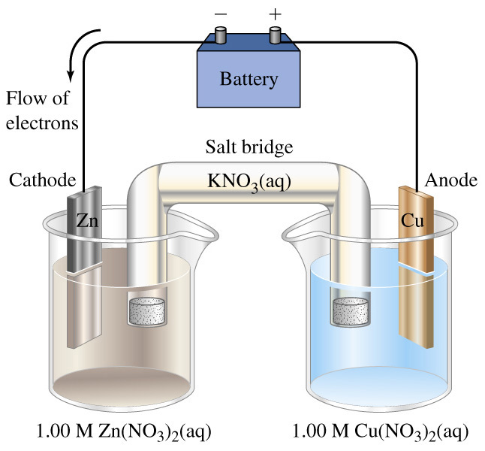
Zinc in Cu²⁺ solution is spontaneous
If we want to get zinc from this cell, we must force the non-spontaneous reaction to occur by applying a potential in the direction opposite that for the spontaneous process!
Reduction ALWAYS occurs at the cathode!
Cathode is –ve!
Anode is +ve!
Reduction!
Oxidation!

Slide 85
Electrodes
Platinum is an inert electrode that only provides a surface for the true reactants to transfer electrons.
An active electrode is an actual reactant in the half-cell reaction.
Using a different electrode on one side of the electrolytic cell might change the half-cell reaction on that side!

Slide 86
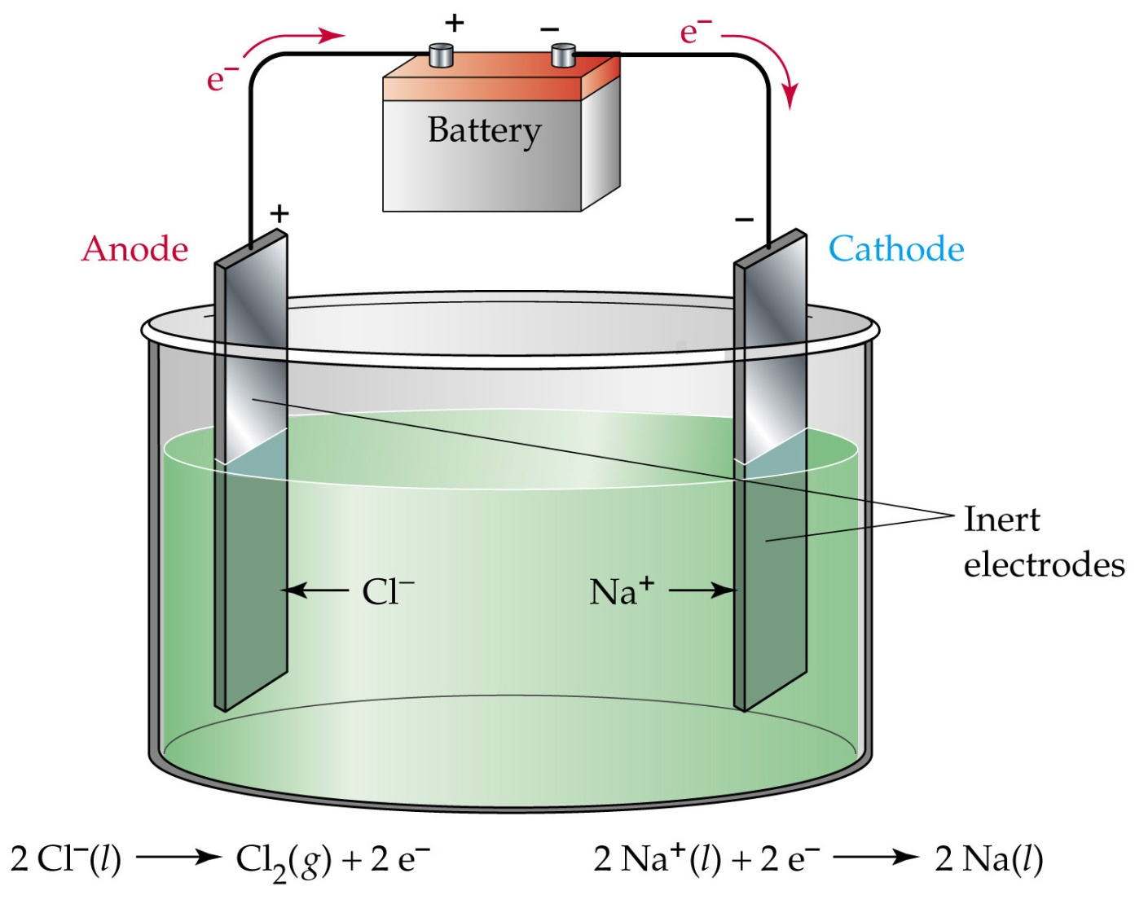
Quantitative aspects of electrolysis

Slide 87
Quantitative aspects of electrolysis
If we pass 1 mole of electrons through the cell, from the balanced equation
Na⁺ (l) + e⁻  Na (s)
we see we will get 1 mole (23.0 g) of solid sodium out. At the other electrode, where
2 Cl⁻ (l)  Cl₂ (g) + 2 e⁻
we see that one mole of electrons is enough to give us one-half a mole (35.5 g) of Cl₂.

Slide 88
Quantitative aspects of electrolysis
How many electrons pass through the cell depends on the current, which is charge per unit time, (the ampere A, which is a C/s) and the time the current was allowed to pass though the cell…
Charge (C) = Current (C/s) x time (s)
Charge (C) = Current (A) x time (s)

Slide 89
Quantitative aspects of electrolysis
We saw earlier that one mole of electrons has a charge equal to one Faraday
1 F = 9.65 x 10⁴ C⋅mol⁻¹
moles of e⁻ = Charge (C) / Faraday
moles of e⁻ = (Current x time)
9.65 x 10⁴ C⋅mol⁻¹

Slide 90
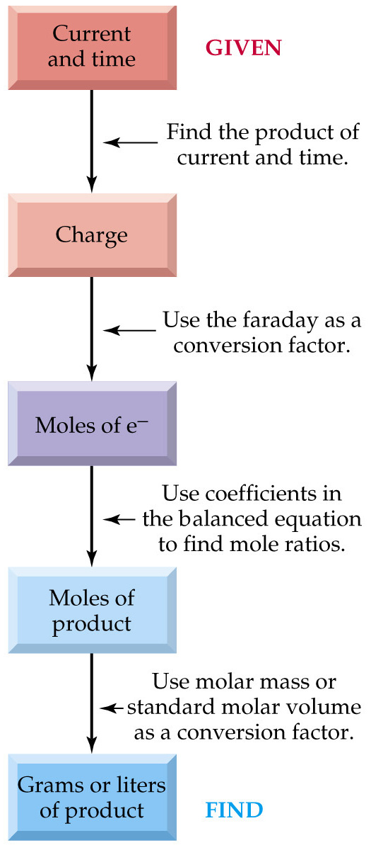
The flowchart shows how to find the amount of substance that comes from electrolysis based on a known current and time.
If we want to know the current or time we used to get a certain amount of substance, we reverse the order of the flowchart.

Slide 91
Problem
How many kilograms of aluminum can be produced in 8.00 h by passing a constant current of 1.00 x 10⁵ A for an electrolytic cell with the following half reaction at the cathode?
Al³⁺ + 3 e⁻  Al
Molar mass of Al is 26.9815 g⋅mol⁻¹
Answer: 268 kg

Slide 92
Problem
A layer of silver is electroplated (an electrolytic process) on a coffee server using a constant current of 0.100 A. How much time is required to deposit 3.00 g of silver?
Molar mass of silver is 107.868 g⋅mol⁻¹
Answer: 7.45 hours

