Slide 1
DETERGENTS
Synthetic detergents
Soaps have problems in use for hard water.
Hard water has calcium and magnesium, which does
not create lather. Synthetic detergents overcome this
problem. Synthetic detergents do not have sodium salts
of fatty acids. In spite of this the detergents have all the
properties of soap. Synthetic detergents have long chain
molecules such as sodium n-dodecyl benzene sulphonate and
sodium n- dodecyl sulphate.

Slide 2
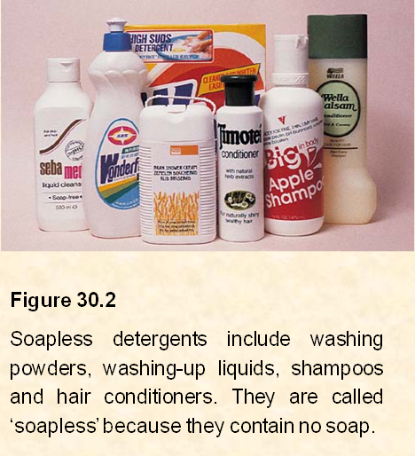

Slide 3
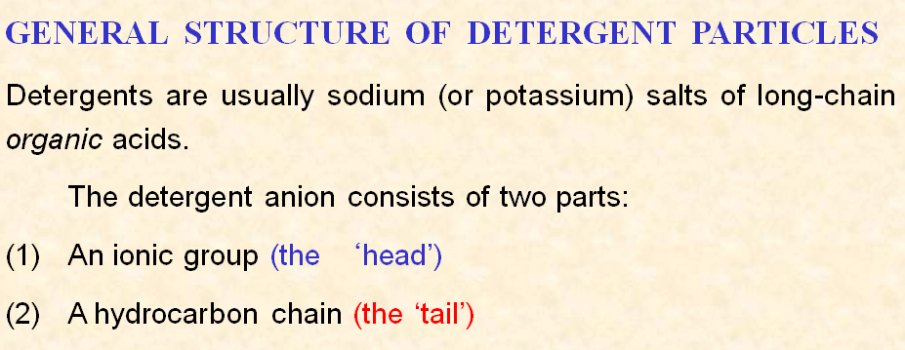

Slide 4
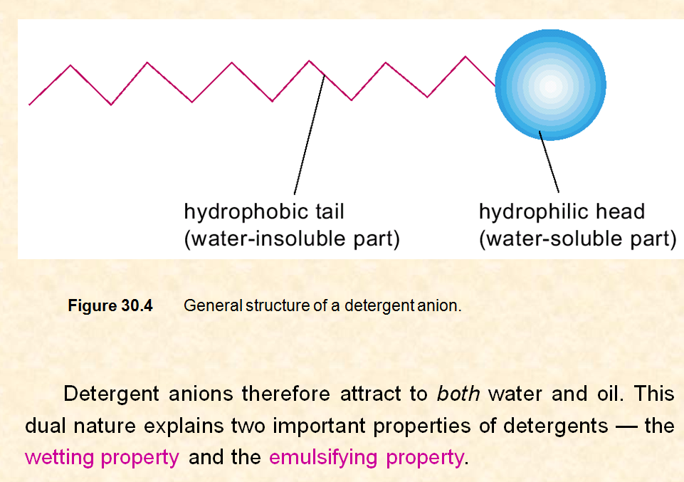

Slide 5
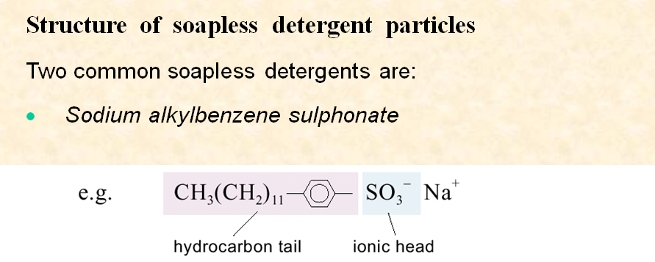
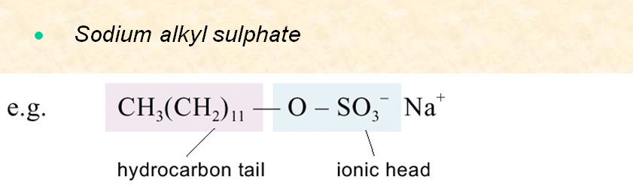

Slide 6
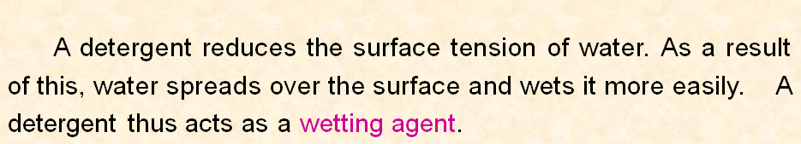
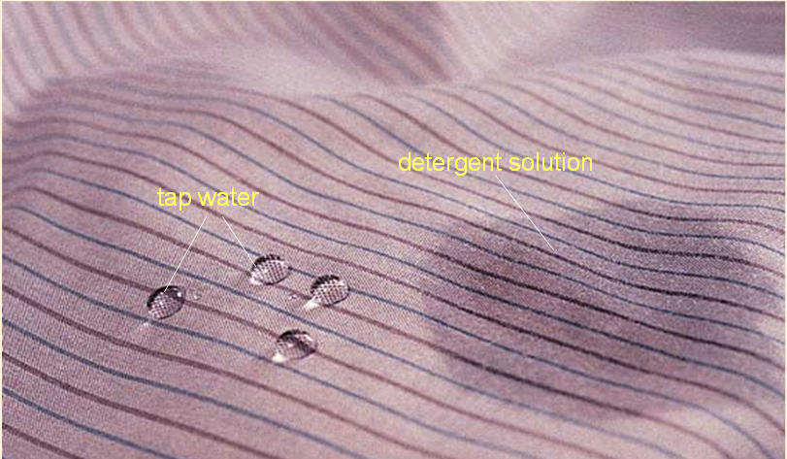

Slide 7
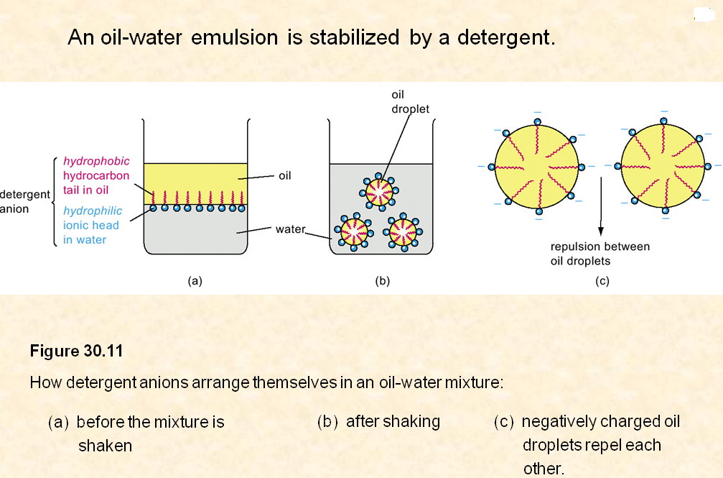

Slide 8
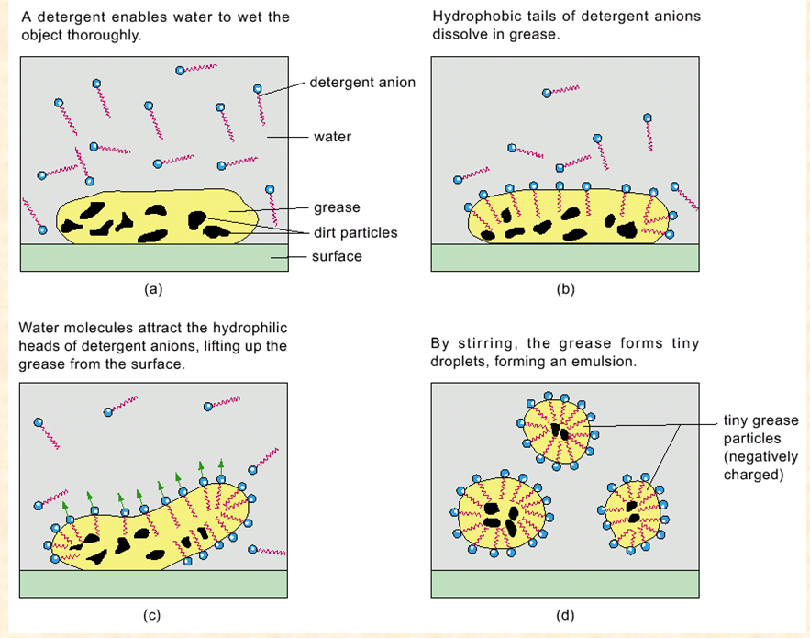

Slide 9
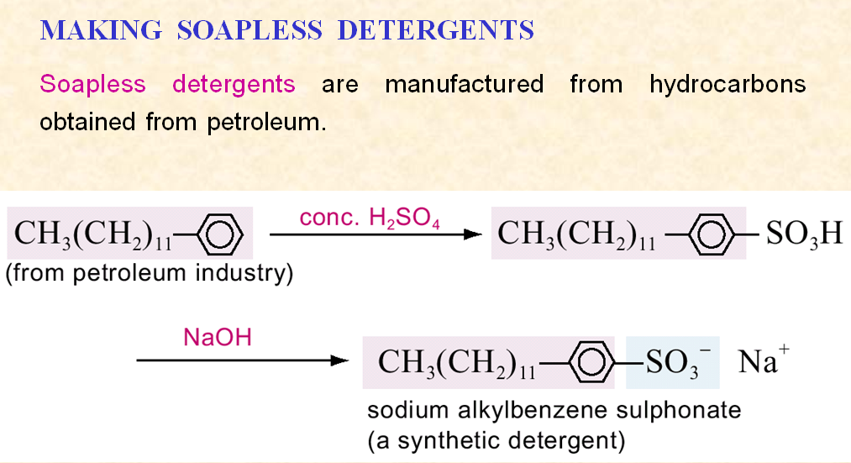

Slide 10
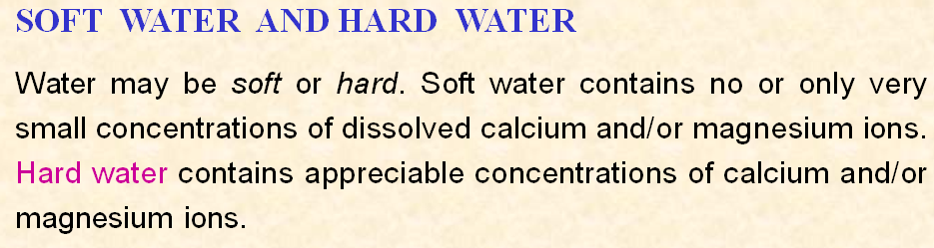
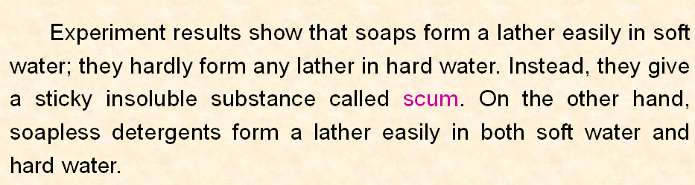

Slide 11
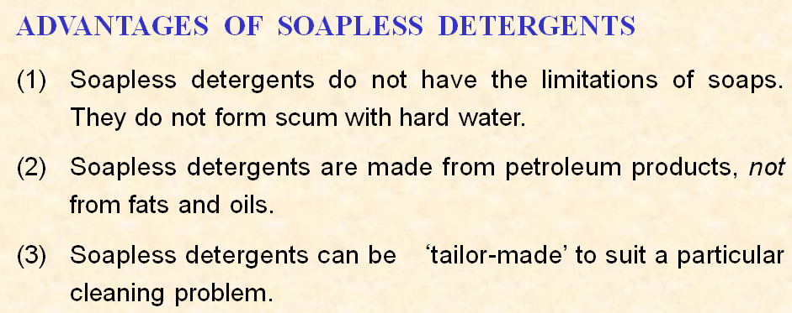

Slide 12
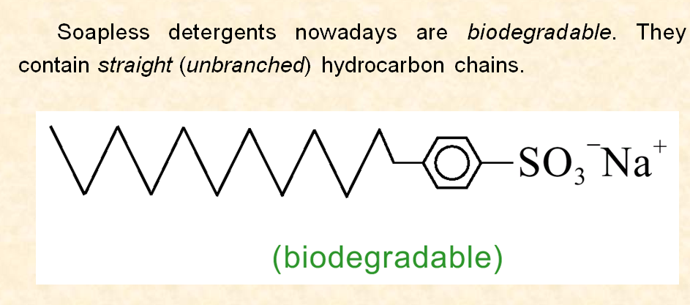

Slide 13
