Slide 1
POLYMERS

Slide 2

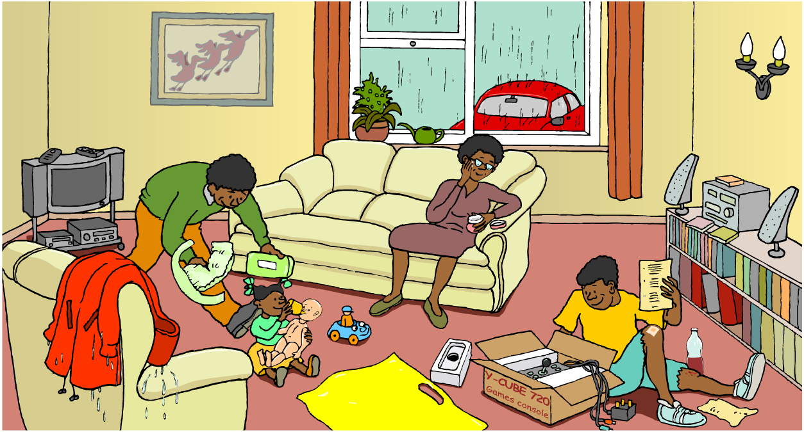
A world of plastic
How many different uses of plastic can you spot?
Notes:
Teacher Notes
Among the many different types of plastic in the picture, specific examples are:
children's toys and plant pot (polypropene)
plastic bag (low-density polyethene – LDPE)
electrical insulation (PVC)
packaging (polystyrene)
plaster (hydrogel wound dressings)
moisturiser jar (as new types of packaging)
jacket (as waterproof and breathable linings for clothes)
drinks bottles (polyethene terephthalate – PET)
speaker/TV/video/remote control casing (acrylonitrile butadiene styrene – ABS)
CDs and transparent cases (polycarbonate)
double glazing (uplasticized polyvinyl chloride – uPVC)
watering can (high-density polyethene – HDPE)
nappy (sodium polyacrylate)
See the ‘Designer Materials’ presentation for further uses of polymers.

Slide 3
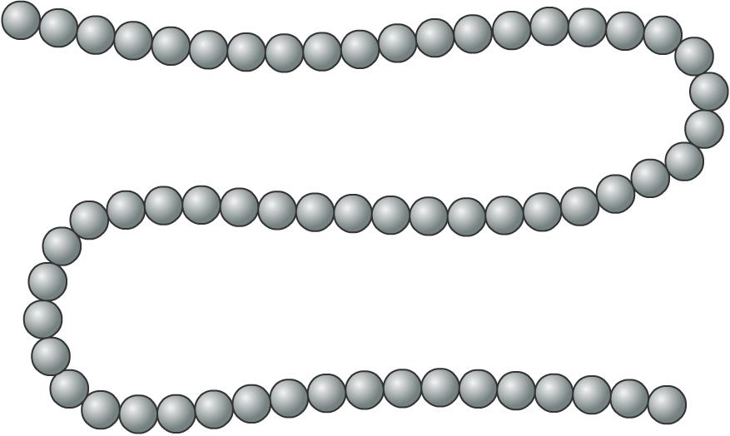
What are polymers?
Polymers are very large molecules made when hundreds of monomers join together to form long chains.
The word ‘polymer’ comes from the Greek words poly (meaning ‘many’) and meros (meaning ‘parts’).
Plastics are synthetic polymers that can be shaped by heat or pressure.

Slide 4
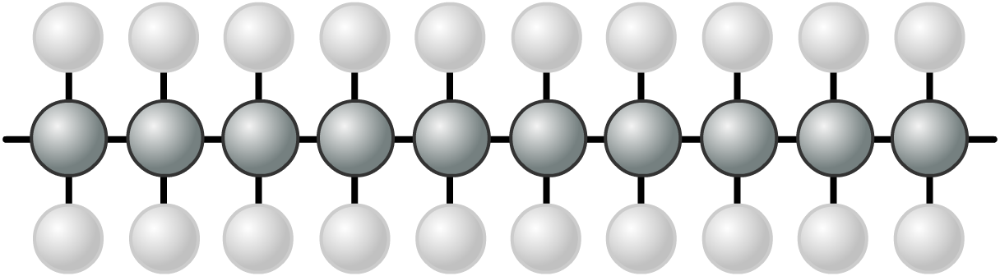
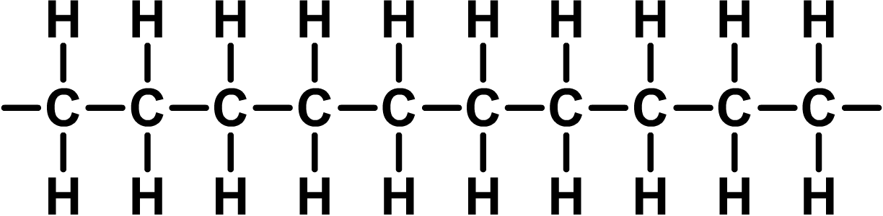
What keeps the chain together?
The monomers in a polymer are joined together by covalent bonds between atoms.
In a covalent bond, each atom shares one or more electrons with another atom. The bonds are sometimes shown as sticks.
covalent bond

Slide 5
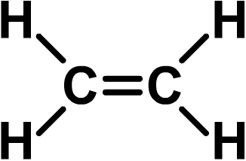
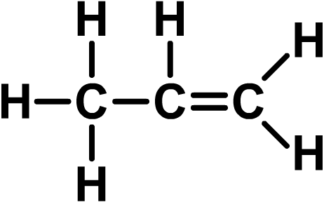
What are polymers made from?
Many polymers are formed from alkenes, which are a family of hydrocarbon molecules with the general formula C_{n}H_{2n}.
Alkenes contain at least one double covalent bond between carbon atoms. The double bond makes them very reactive.
The simplest alkene is ethene (C₂H₄).
double covalent
bond
The second simplest alkene is propene (C₃H₆).

Slide 6
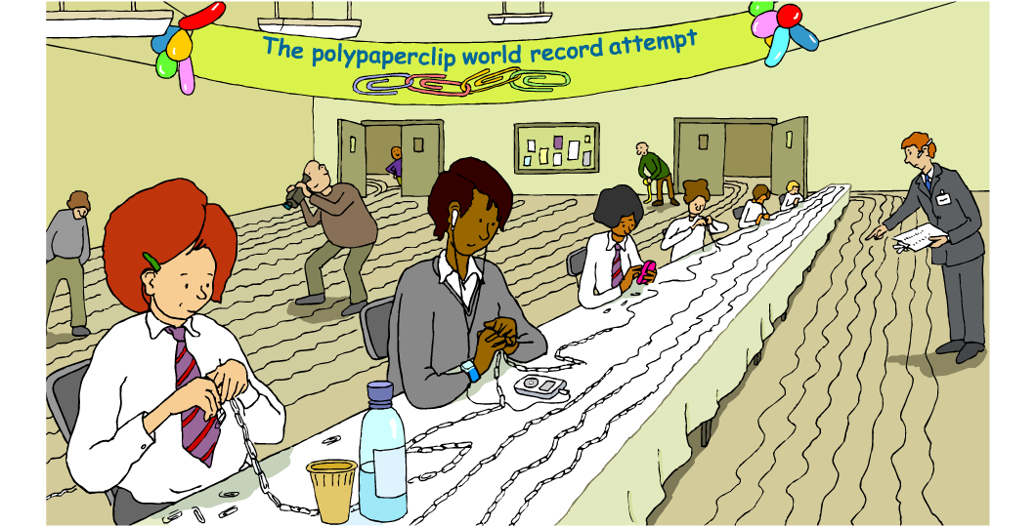
Making polymers
How are monomers turned into polymers?
Notes:
Teacher notes
An additional exercise would be to ask student to identify objects in the scene that are made of or contain plastics.

Slide 7
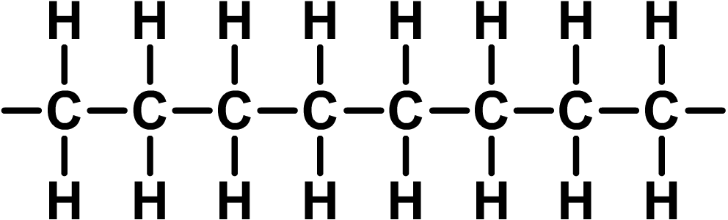
Addition polymerization
Polyethene (sometimes called polythene) is a polymer made from ethene.
The process by which polyethene and other polymers is made is called addition polymerization. This is because many monomers (ethene molecules) are added together.
monomers
➔
addition polymerization
polymer

Slide 8
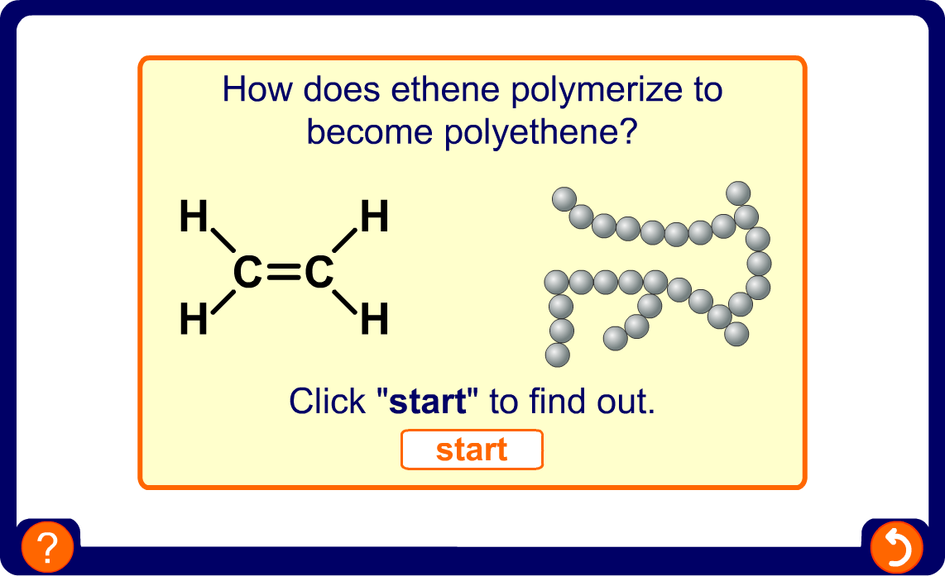
How is polyethene made?
Notes:
Teacher notes
This interactive animation illustrates the formation of low-density polyethene as an example of addition polymerization.

Slide 9
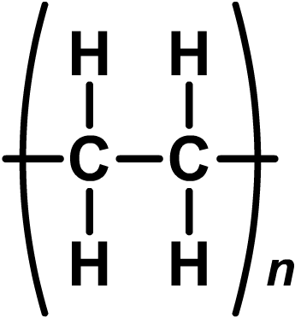
Drawing polymers – shorthand formulae
Polymers contain thousands of molecules, so how can their structures be easily drawn?
Part of the polymer molecule can be drawn:
A better way is to show a shorthand formula:
The ‘n’ means that the polymer contains a very large number of the repeating unit shown in the brackets.

Slide 10
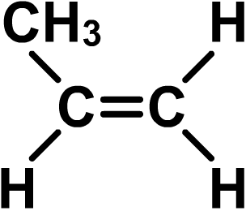
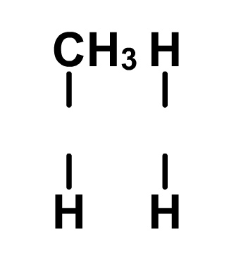
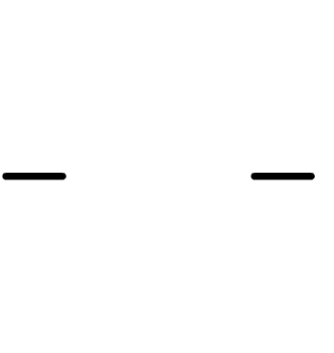
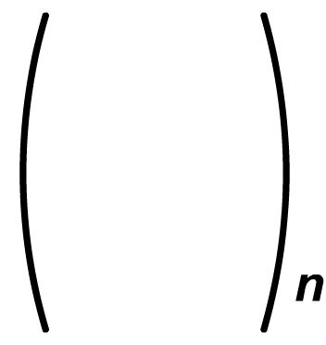
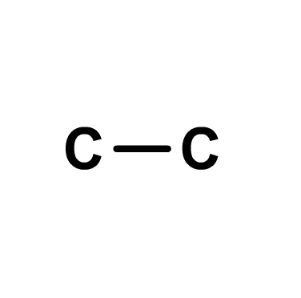
What’s the polymer?
What is the shorthand formula for polypropene?
The monomer is propene (C₃H₆):
which can
be drawn as:
1. Draw two C atoms that were in the double bond with a single covalent bond.
2. Draw the brackets and the ‘n’.
3. Add the links outside the brackets.
4. Add the atoms that were attached to each C atom of the double bond.
polypropene

Slide 11
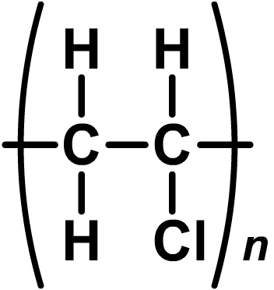
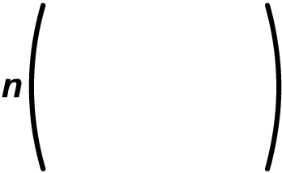
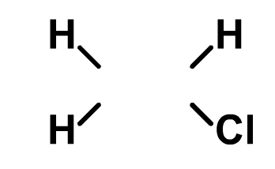
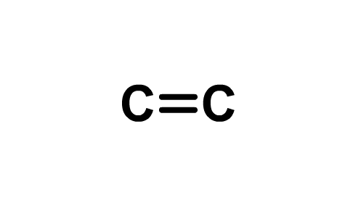
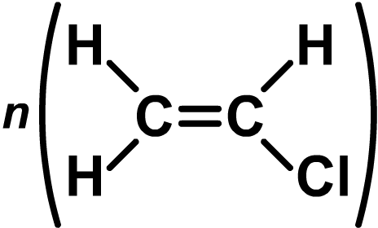
What’s the monomer?
What is the monomer of polyvinylchloride (PVC)?
1. Draw two C atoms joined with a double covalent bond.
2. Add the atoms attached to each C atom.
3. Draw the brackets and ‘n’.
The equation for the reaction can be drawn as:
➔

Slide 12
What are the properties of plastics?
Plastics are all different, but they show a few general properties:
they do not conduct electricity and are poor conductors of heat
they are unreactive – most are not affected by water or air, and many are not affected by chemicals.
Why is the unreactivity of plastics both useful and problematic?
Their unreactivity makes plastics durable and able to safely contain and protect many substances. However, it also means that they persist in the environment for a long time.

Slide 13
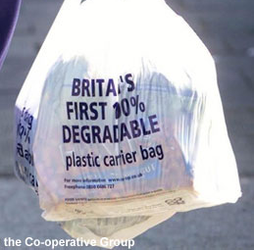
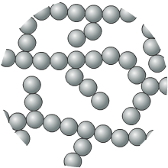
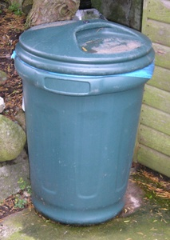
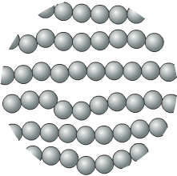
What makes plastics different?
The properties of a plastics depend greatly on how the polymer chains are arranged:
branching chains make plastics light, soft and easy to melt
(e.g. low-density polyethene)
lined-up chains make plastics dense, rigid and harder to melt
(e.g. high-density polyethene).

Slide 14
Changing the properties of plastics
What factors might determine the properties of a plastics?
Factor
Effect
reaction conditions
Temperature, pressure and catalysts affect the length and branching of the polymer chain.
monomer
The type of monomer used affects the type of forces between polymer chains.
additives
Additives can ‘lubricate’ polymer chains, join them together with cross-links, or preserve them from decay.

Slide 15
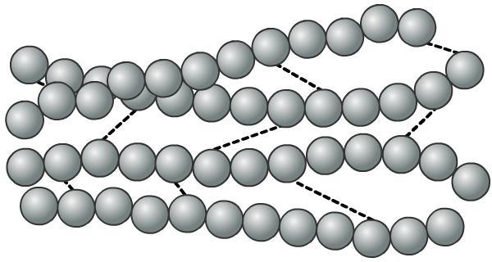
What are thermosoftening plastics?
What do polymer chains and spaghetti have in common?
Cooked spaghetti is solid when cold, but soft when warm. The strands can slide past each other. It is the same with many polymers.
weak intermolecular forces –
these let the chains slide past each other
Plastics made of these polymers are stretchy and have a
low melting point. They are called thermosoftening plastics.

Slide 16
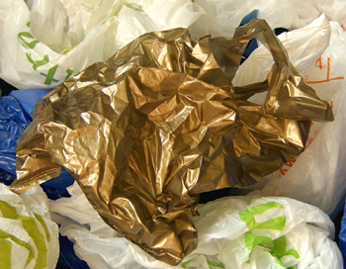
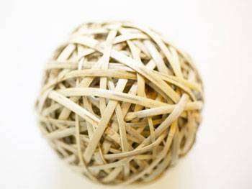
Uses of thermosoftening plastics
Thermosoftening plastics (also called ‘thermoplastics’) do not contain cross-links.
This means they are flexible, stretchy and have a low melting point. It also means they can be moulded and shaped after they have been made, many times.
What are some examples of thermoplastics?
polyethene
natural rubber

Slide 17
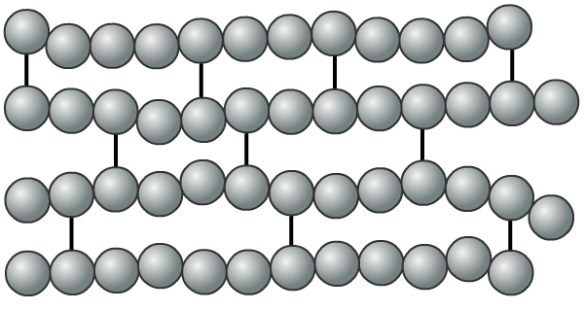
What are thermosetting plastics?
Some polymer chains cannot slide past each other.
strong intermolecular forces
(cross-links) –
these hold the chains firmly in place
Plastics made of these polymers cannot be stretched, are rigid and have a high melting point. They are called thermosetting plastics (or ‘thermosets’).

Slide 18
Uses of thermosetting plastics
Thermosetting plastics contain cross-links. This means that they:
are rigid
will break when bent
have a high melting point (they char rather than melt)
must be moulded into shape when they are being made,
What type of objects might you make from thermosetting plastics?

Slide 19
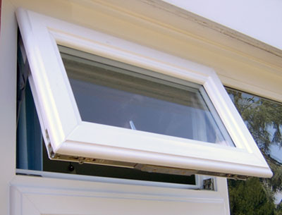
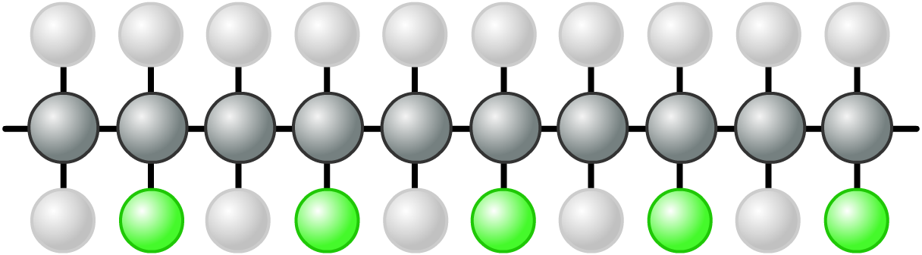
uPVC chains
uPVC is perfect for window frames as it is strong, light and durable.
The ‘u’ stands for unplasticized, and means the polymer is rigid.
chains packed tightly together

Slide 20

Oiling the chains?
Adding a plasticizer lets the chains slide.
plasticizer
How will the plasticizer change the polymer’s properties?
The polymer will be flexible, not rigid.

Slide 21
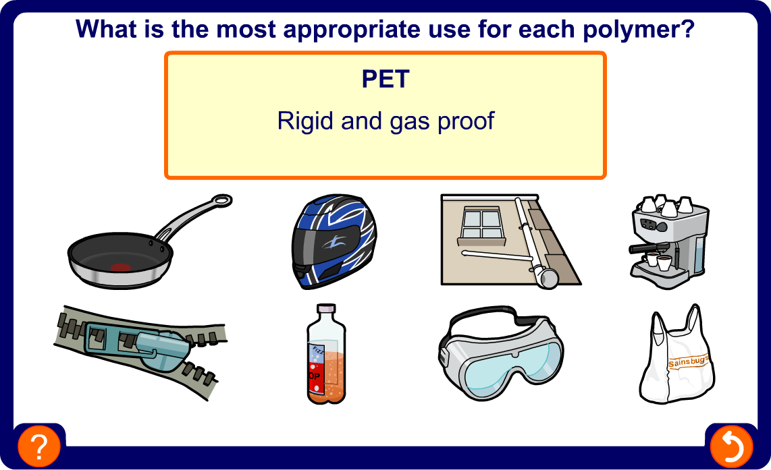
Matching polymers to their uses

Slide 22
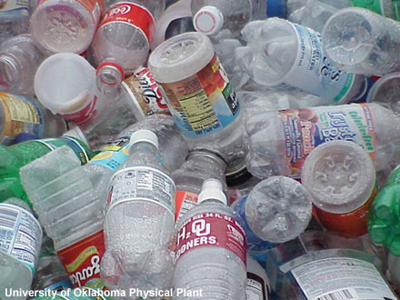
How much waste plastic?
In the UK, 3.5 million tonnes of plastic packaging is thrown away each year!
There are three ways to dispose of waste plastics:
landfill
incineration (burning)
recycling
Each method of disposal has its own advantages and disadvantages.
Why has the issue of dealing with waste plastic in a cheap and environmentally-friendly way become more important?
Notes:
Photo credit: University of Oklahoma Physical Plant

Slide 23
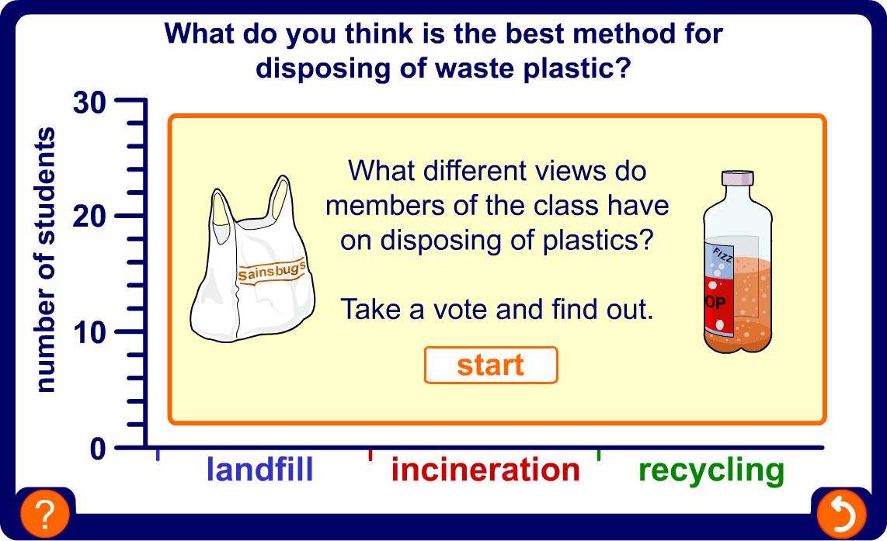
Disposing of plastics
Notes:
Teacher notes
This activity can be used to gauge students’ opinions on how best to dispose of waste plastic. The activity could be undertaken at the start of the lesson, and then repeated at the end when the science underpinning the concept has been explored, to see if the students’ opinions have changed.
There are no correct answers for this activity.

Slide 24
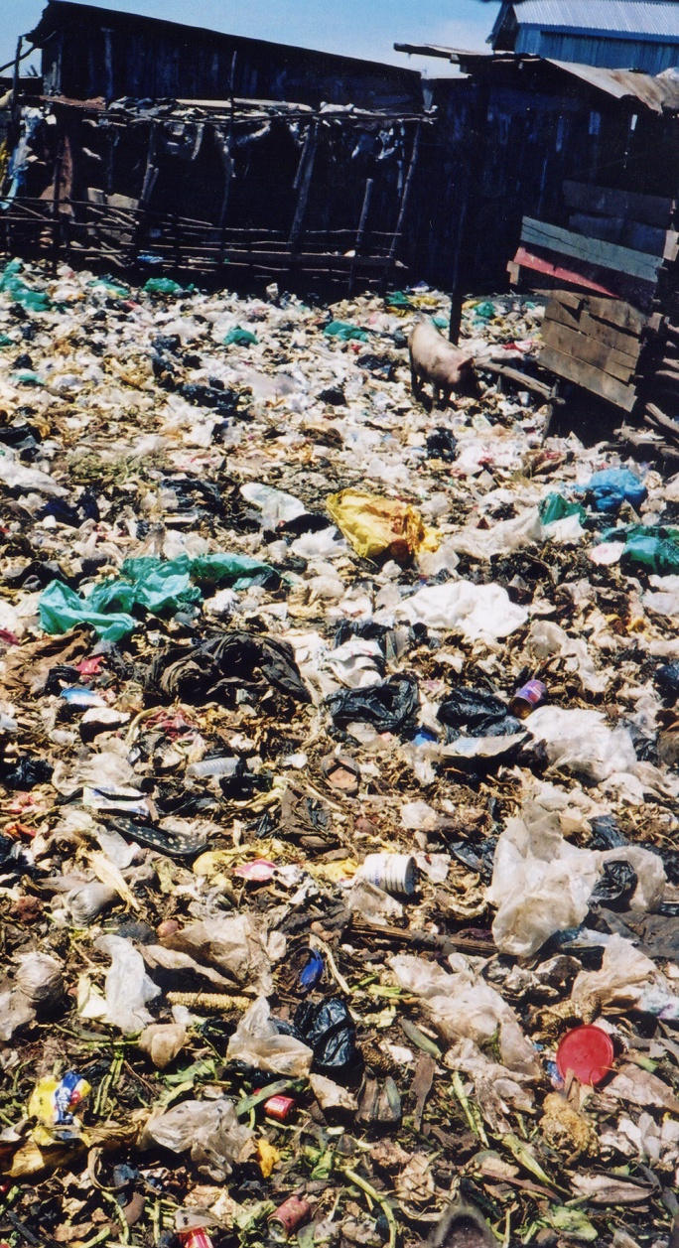
What happens to plastics in landfill sites?
Plastic bags are a major source of waste at landfill. British shoppers use over 8 billion of them a year!
The UK has 4,000 landfill sites and it is predicted that the largest of these will become full in less than 5 years.
Landfill is a convenient method of waste disposal but it is only designed to bury rubbish, not to break it down.
Most plastics are made up of tightly bonded molecules that cannot be decomposed by micro-organisms. These will remain buried at landfill sites for thousands of years without rotting.

Slide 25
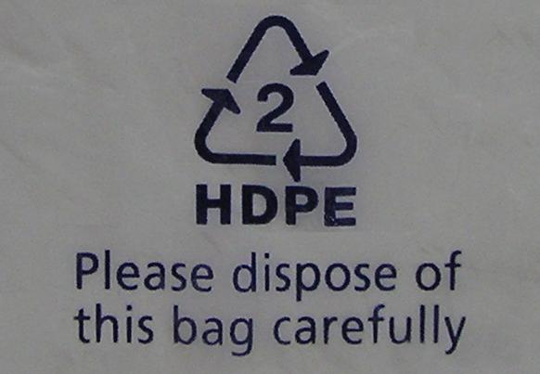
How are plastics identified for recycling?
Most plastic products carry a symbol that shows which type of polymer they are made from.
Usually, the only types of plastic to be recycled are PET, PVC and HDPE.
Many plastic items look and/or feel similar to each other but they are actually made from different materials, e.g. margarine tubs (polystyrene) and plant pots (polypropene).
If different polymers are mixed together during recycling, it can reduce the quality and value of the final recycled plastic.

Slide 26
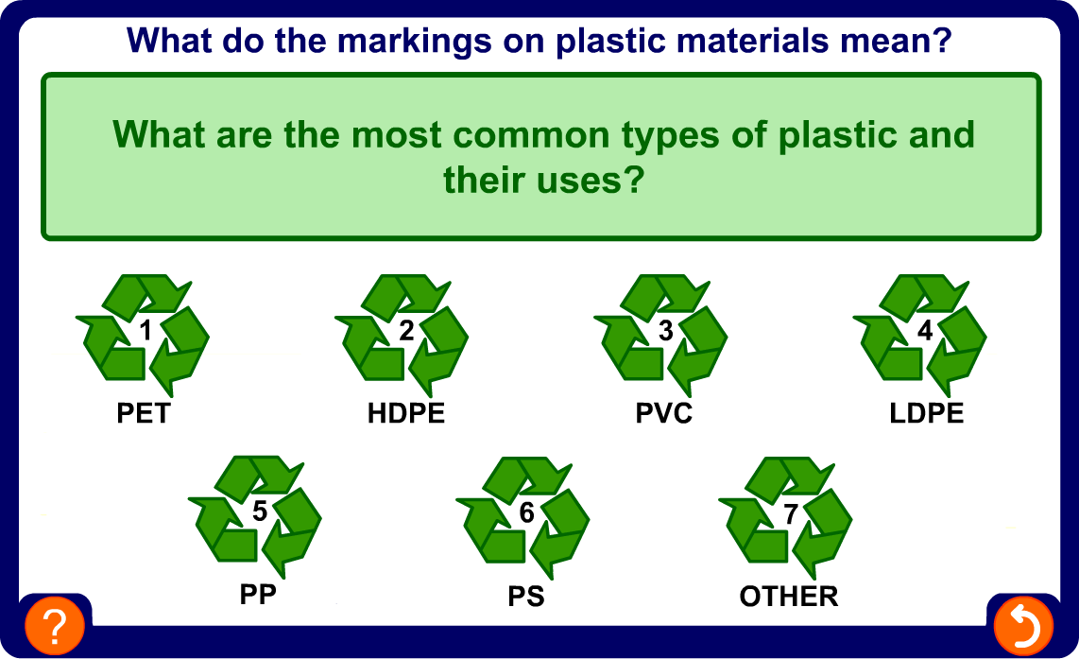
Recycling symbols for plastics

Slide 27

What is the effect of recycling plastics?
Recycling plastic uses less water and energy resources than in producing new plastics, and produces fewer greenhouse gases.
One problem with recycling, however, is that is reduces the strength and versatility of the plastic over time.
This is because the polymer chains become damaged or contaminated with food or other types of plastic.
Notes:
Photo credit: Fabienne Winkworth
A section of recycled children’s Wellington boots.

Slide 28
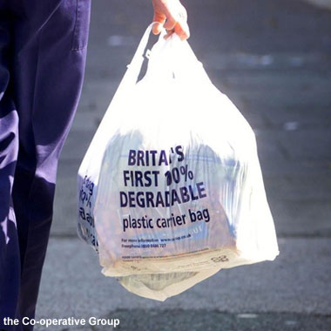
What are biodegradable plastics?
One of the problems with traditional plastics is that they do not break down when thrown away.
Biodegradable plastics are plastics that can be broken down. They are converted into carbon dioxide, water and minerals by micro-organisms.
Biodegradable plastics are increasingly being used in carrier bags, bin bags and food packaging.
Biodegradable plastics, such as polylactide, are plant-based polymers. They are often made from starch that has been
modified to become more stable.
Notes:
Photo credit: the Co-operative Group
In 2002, the Co-op became the first grocery store to introduce (bio)degradable carrier bags.

Slide 29
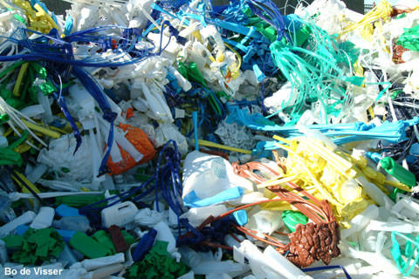
Dealing with waste
Dealing with waste is important, but there are many issues involved:
what can businesses and individuals do to reduce the amount of waste they produce?
how many products could be made from biodegradable plastic?
if more products are made of biodegradable plastics, how will the management of landfill sites change?
what will happen to closed landfill sites in future?
Notes:
Photo credit: Bo de Visser © 2006

Slide 30
Glossary
biodegradable – A substance that can be naturally broken down by micro-organisms.
cross-link – A chemical bond that joins one polymer chain to another.
monomer – A molecule that is the building block of a polymer.
polymer – A long chain molecule formed from many monomers joined together.
polymerization – The reaction used to convert monomers into a polymer.
thermosetting – A type of plastic that is hard, rigid and has a high melting point.
thermosoftening – A type of plastic that is flexible, stretchy and has a low melting point.

