Slide 1
CIRCULAR MOTION

Slide 2
Specification
Lessons | Topics
 | Circular motion Motion in a circular path at constant speed implies there is an acceleration and requires a centripetal force. Angular speed ω = v / r = 2π f Centripetal acceleration a = v² / r = ω² r Centripetal force F = mv² / r = mω² r The derivation of a = v²/ r will not be examined.

Slide 3
Uniform Circular Motion
Consider an object moving around a circular path of radius, r with a constant linear speed , v
The circumference of this circle is 2π r.
The time taken to complete one circle, the period, is T.
Therefore:
v = 2π r / T
But frequency, f = 1 / T and so also:
v = 2π r f
v
v
v
v
r
v
r
r
v
v
r
v
r
r
r
r
Note: The arrows represent the velocity of the object. As the direction is continually changing, so is the velocity.
Notes:
3

Slide 4
Question
The tyre of a car, radius 40cm, rotates with a frequency of 20 Hz. Calculate (a) the period of rotation and (b) the linear speed at the tyres edge.
Notes:
4

Slide 5
Question
The tyre of a car, radius 40cm, rotates with a frequency of 20 Hz. Calculate (a) the period of rotation and (b) the linear speed at the tyres edge.
(a) T = 1 / f
= 1 / 20 Hz
period of rotation = 0.050 s
(b) v = 2π r f
= 2 π x 0.40 m x 20 Hz
linear speed = 50 ms⁻¹
Notes:
5

Slide 6
Angular displacement, θ
Angular displacement, θ is equal to the angle swept out at the centre of the circular path.
An object completing a complete circle will therefore undergo an angular displacement of 360°.
½ circle = 180°.
¼ circle = 90°.
θ

Slide 7
Angles in radians
The radian (rad) is defined as the angle swept out at the centre of a circle when the arc length, s is equal to the radius, r of the circle.
If s = r
then θ = 1 radian
The circumference of a circle = 2πr
Therefore 1 radian = 360° / 2π = 57.3°
And so:
360° = 2π radian (6.28 rad)
180° = π radian (3.14 rad)
90° = π / 2 radian (1.57 rad)
s
θ
r
r
Also: s = r θ
Notes:
7

Slide 8
Angular speed (ω)
angular speed = angular displacement
time
ω = Δθ / Δt
units:
angular displacement (θ ) in radians (rad)
time (t ) in seconds (s)
angular speed (ω) in radians per second (rad s⁻¹)
Notes:
8

Slide 9
Angular speed can also be measured in revolutions per second (rev s⁻¹) or revolutions per minute (r.p.m.)
Question:
Calculate the angular speed in rad s⁻¹ of an old vinyl record player set at 78 r.p.m.
78 r.p.m.
= 78 / 60 revolutions per second
= 1.3 rev s⁻¹
= 1.3 x 2π rad s⁻¹
78 r.p.m. = 8.2 rad s⁻¹
Notes:
9

Slide 10
Angular frequency (ω)
Angular frequency is the same as angular speed.
For an object taking time, T to complete one circle of angular displacement 2π:
ω = 2π / T
but T = 1 / f
therefore: ω = 2π f
that is: angular frequency = 2π x frequency
Notes:
10

Slide 11
Relationship between angular and linear speed
For an object taking time period, T to complete a circle radius r:
ω = 2π / T
rearranging: T = 2π / ω
but: v = 2π r / T
= 2π r / (2π / ω)
Therefore:
v = r ω
and:
ω = v / r
Notes:
11

Slide 12
Question
A hard disc drive, radius 50.0 mm, spins at 7200 r.p.m. Calculate (a) its angular speed in rad s⁻¹; (b) its outer edge linear speed.
Notes:
12

Slide 13
Question
A hard disc drive, radius 50.0 mm, spins at 7200 r.p.m. Calculate (a) its angular speed in rad s⁻¹; (b) its outer edge linear speed.
(a) 7200 r.p.m. = [(7200 x 2 x π) / 60] rad s⁻¹
angular speed = 754 rad s⁻¹
(b) v = r ω
= 0.0500 m x 754 rad s⁻¹
linear speed = 37.7 ms⁻¹
Notes:
13

Slide 14
Complete
Complete
angular speed | linear speed | radius
 | 6 ms⁻¹ | 0.20 m
40 rad s⁻¹ |  | 0.50 m
6 rad s⁻¹ | 18 ms⁻¹
 | 48 cms⁻¹ | 4.0 m
45 r.p.m. |  | 8.7 cm

Slide 15
Complete
Answers
angular speed | linear speed | radius
 | 6 ms⁻¹ | 0.20 m
40 rad s⁻¹ |  | 0.50 m
6 rad s⁻¹ | 18 ms⁻¹
 | 48 cms⁻¹ | 4.0 m
45 r.p.m. |  | 8.7 cm
30 rad s⁻¹
20 ms⁻¹
3 m
0.12 rad s⁻¹
0.42 ms⁻¹

Slide 16
Centripetal acceleration (a)
An object moving along a circular path is continually changing in direction. This means that even if it is travelling at a constant speed, v it is also continually changing its velocity. It is therefore undergoing an acceleration, a.
This acceleration is directed towards the centre (centripetal) of the circular path and is given by:
v
v
a
a
r
v
r
a
r
a = v²
r
Notes:
16

Slide 17
but: v = r ω
combining this with: a = v² / r
gives:
a = r ω²
and also:
a = v ω
Notes:
17

Slide 18
Complete
Complete
angular speed | linear speed | radius | centripetal acceleration
 | 8.0 ms⁻¹ | 2.0 m
2.0 rad s⁻¹ |  | 0.50 m
9.0 rad s⁻¹ | 27 ms⁻¹
 | 6.0 ms⁻¹ |  | 9.0 ms⁻²
33⅓ r.p.m. |  |  | 1.8 ms⁻²

Slide 19
Complete
Answers
angular speed | linear speed | radius | centripetal acceleration
 | 8.0 ms⁻¹ | 2.0 m
2.0 rad s⁻¹ |  | 0.50 m
9.0 rad s⁻¹ | 27 ms⁻¹
 | 6.0 ms⁻¹ |  | 9.0 ms⁻²
33⅓ r.p.m. |  |  | 1.8 ms⁻²
4.0 rad s⁻¹
32 ms⁻²
1.0 ms⁻¹
2.0 ms⁻²
3.0 m
243 ms⁻²
1.5 rad s⁻¹
4.0 m
0.52 ms⁻¹
0.15 m

Slide 20
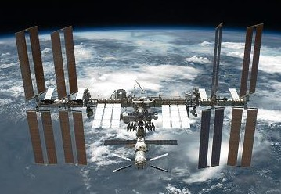
ISS Question
For the International Space Station in orbit about the Earth (ISS) Calculate:
(a) the centripetal acceleration and
(b) linear speed
Data:
orbital period = 90 minutes
orbital height = 400km
Earth radius = 6400km
Notes:
20

Slide 21
(a) ω = 2π / T
= 2 π / (90 x 60 seconds)
= 1.164 x 10⁻³ rads⁻¹
a = r ω²
= (400km + 6400km) x (1.164 x 10⁻³ rads⁻¹)²
= (6.8 x 10⁶ m) x (1.164 x 10⁻³ rads⁻¹)²
centripetal acceleration = 9.21 ms⁻¹
(b) v = r ω
= (6.8 x 10⁶ m) x (1.164 x 10⁻³ rads⁻¹)
linear speed = 7.91 x 10³ ms⁻¹
(7.91 kms⁻¹)
Notes:
21

Slide 22
Proof of: a = v² / r
NOTE: This is not required for A2 AQA Physics
Consider an object moving at constant speed, v from point A to point B along a circular path of radius r.
Over a short time period, δt it covers arc length, δs and sweeps out angle, δθ.
As v = δs / δt then δs = v δt.
The velocity of the object changes in direction by angle δθ as it moves from A to B.
v_{A}
A
B
v_{B}
δθ
C
Notes:
22

Slide 23
The change in velocity, δv
= v_{B} - v_{A}
Which is equivalent to:
δv = v_{B} + (- v_{A})
A
B
δs
v_{B}
r
r
δθ
v_{B}
C
δv
δθ
If δθ is very small then δs can be considered to be a straight line and the shape ABC to be a triangle.
-v_{A}
Triangle ABC will have the same shape as the vector diagram above.
Therefore δv / v_{A (or B)} = δs / r
Notes:
23

Slide 24
but δs = v δt
and so:
δv / v = v δt / r
δv / δt = v² / r
As δt approaches zero, δv / δt will become equal to the instantaneous acceleration, a.
Hence: a = v² / r
In the same direction as δv, towards the centre of the circle.
v_{B}
δv
δθ
-v_{A}
Notes:
24

Slide 25
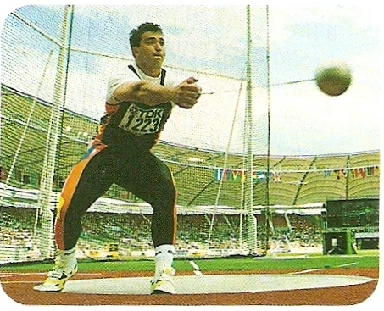
Centripetal Force
Newton’s first law:
If a body is accelerating it must be subject to a resultant force.
Newton’s second law:
The direction of the resultant force and the acceleration must be the same.
Therefore centripetal acceleration requires a resultant force directed towards the centre of the circular path – this is CENTRIPETAL FORCE.
Tension provides the CENTRIPETAL FORCE required by the hammer thrower.

Slide 26
What happens when centripetal force is removed
When the centripetal force is removed the object will move along a straight line tangentially to the circular path.

Slide 27
Other examples of centripetal forces
Situation | Centripetal force
Earth orbiting the Sun | GRAVITY of the Sun
Car going around a bend. | FRICTION on the car’s tyres
Airplane banking (turning) | PUSH of air on the airplane’s wings
Electron orbiting a nucleus | ELECTROSTATIC attraction due to opposite charges

Slide 28
Equations for centripetal force
From Newton’s 2nd law of motion:
ΣF = ma
If a = centripetal acceleration
then ΣF = centripetal force
and so:
ΣF = m v² / r
and ΣF = m r ω²
and ΣF = m v ω
Notes:
28

Slide 29
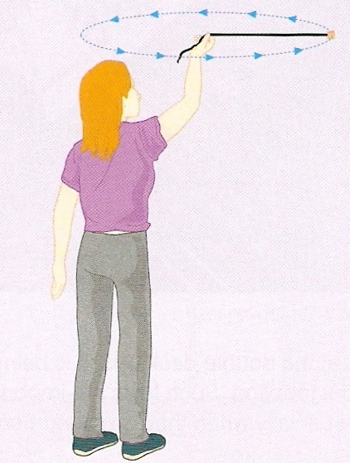
Question 1
Calculate the centripetal tension force in a string used to whirl a mass of 200g around a horizontal circle of radius 70cm at 4.0ms⁻¹.

Slide 30
Question 1
Calculate the centripetal tension force in a string used to whirl a mass of 200g around a horizontal circle of radius 70cm at 4.0ms⁻¹.
ΣF = m v² / r
= (0.200kg) x (4.0ms⁻¹)² / (0.70m)
tension = 4.6 N

Slide 31
Question 2
Calculate the maximum speed that a car of mass 800kg can go around a curve of radius 40m if the maximum frictional force available is 8kN.

Slide 32
Question 2
Calculate the maximum speed that a car of mass 800kg can go around a curve of radius 40m if the maximum frictional force available is 8kN.
The car will skid if the centripetal force required is greater than 8kN
ΣF = m v² / r
becomes: v² = (ΣF x r ) / m
= (8000N x 40m) / (800kg)
v² = 400
maximum speed = 20ms⁻¹

Slide 33
Question 3
A mass of 300g is whirled around a vertical circle using a piece of string of length 20cm at 3.0 revolutions per second.
Calculate the tension in the string at positions:
(a) A – top
(b) B – bottom and
(c) C – string horizontal
The angular speed, ω = 3.0 rev s⁻¹
= 6 π rad s⁻¹
A
C
B

Slide 34
(a) A – top
Both the weight of the mass and the tension in the string are pulling the mass towards the centre of the circle.
Therefore: ΣF = mg + T
and so: m r ω² = mg + T
giving: T = m r ω² – mg
= [0.300kg x 0.20m x (6π rads⁻¹)²]
– [0.300kg x 9.8 Nkg⁻¹]
= [21.32N] – [2.94N]
tension at A = 18.4N
mg
T

Slide 35
(b) B – bottom
The weight is now acting away from the centre of the circle.
Therefore: ΣF = T – mg
and so: m r ω² = T – mg
giving: T = m r ω² + mg
= [0.300kg x 0.20m x (6π rads⁻¹)²]
+ [0.300kg x 9.8 Nkg⁻¹]
= [21.32N] + [2.94N]
tension at B = 24.3N
T
mg

Slide 36
(c) C – horizontal string
The weight is acting perpendicular to the direction of the centre of the circle. It therefore has no affect on the centripetal force.
Therefore: ΣF = T
and so: m r ω² = T
giving: T = m r ω²
= [0.300kg x 0.20m x (6π rads⁻¹)²]
tension at C = 21.3N
T
mg

Slide 37



Question 4
meow!
Calculate the maximum speed that Pat can drive over the bridge for Jess to stay in contact with the van’s roof if the distance that Jess is from the centre of curvature is 8.0m.

Slide 38
Forces on Jess
Jess will remain in contact with the van’s roof as long as the reaction force, R is greater than zero.
The resultant force, ΣF downwards on Jess, while the van passes over the bridge, is centripetal and is given by:
ΣF = mg - R
and so: m v² / r = mg - R
The maximum speed is when R = 0
and so: m v² / r = mg
v² / r = g
v² = g r
maximum speed, v = √ (g r)
= √ (9.8 x 8.0)
= √ (78.4)
maximum speed = 8.9 ms⁻¹
R
mg

