Slide 1
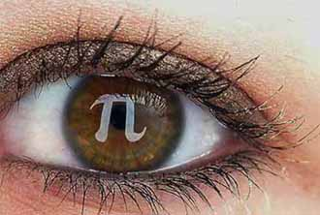
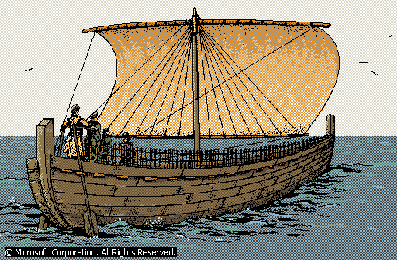
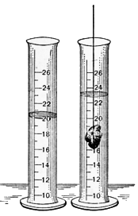
3.5….ARCHIMEDES’ PRINCIPLE

Slide 2
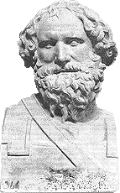
Who is Archimedes?
Archimedes (287-212 BC), pre-eminent Greek mathematician and inventor, who wrote important works on plane and solid geometry, arithmetic, and mechanics.
"Archimedes",Microsoft« Encarta« Encyclopedia 2001. ⌐ 1993-2000 Microsoft Corporation. All rights reserved.

Slide 3
The law
Archimedes' Principle, law of physics that states that when an object is totally or partially immersed in a fluid, it experiences an upthrust equal to the weight of the fluid displaced.
The principle is most frequently applied to the behaviour of objects in water, and helps to explain floating and sinking, and why objects seem lighter in water. It also applies to balloons in the air.

Slide 4
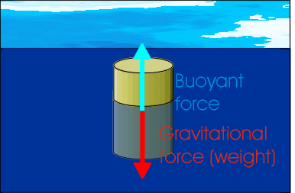
UPTHRUST AND BUOYANT FORCE
The key word in the principle is “upthrust” (or buoyant force), which refers to the force acting upward to reduce the actual weight of the object when it is under water.
for example, a metal block with a volume of 100 cm³ is dipped in water, it displaces an equal volume of water, which has a weight of approximately 1 N. The block therefore seems to weigh about 1 N less.

Slide 5
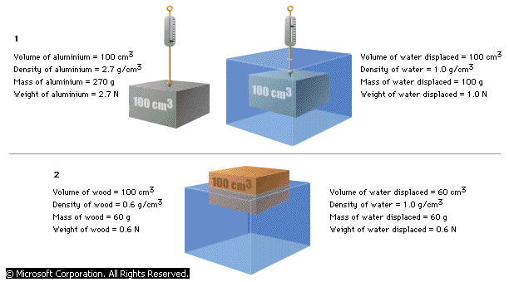
SINKING AND FLOATING OBJECTS
The reading of
spring balance is 2.7 N
The reading of
spring balance is 1.7 N

Slide 6
What is the reading of spring balance
if the wood is attached to it ?
ZERO

Slide 7
Density and Buoyancy
From Archimedes’s Principle :
Buoyant Force = Weight of fluid displaced
= mg (note : F = ma)
= ρVg (note : ρ = m )
V
Thus F_{B} = ρ V g
Where ……
F_{B} = Buoyant Force or Upthrust
ρ = Density of fluid
V = Volume of fluid displaced or
the volume of the object that immersed in the fluid.

Slide 8
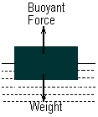
Buoyant Force and Floatation
Buoyant force = weight ⇒ the object floats and stationary
Buoyant force > weight ⇒ the object moves up
Buoyant force < weight ⇒ the object moves down

Slide 9
The Law of Floatation
A floating object displaces its own weight of fluid in which it floats.

Slide 10
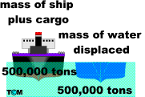

Slide 11
THINK!!!!!
warm fresh water | cold fresh water | warm sea water | cold sea water
1. Why the depth of ship immersed in the water different?

Slide 12
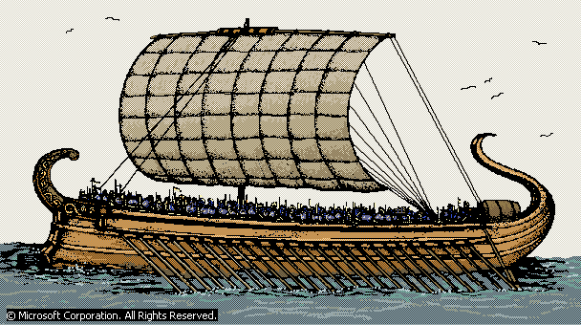
Fresh water less dense than sea water and warm water less dense than coldwater so warm fresh water need to be displaced more to keep the uptrust force equal with weight of the boat so it still can float.

Slide 13
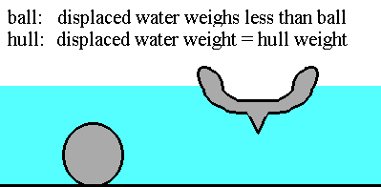
2. If the plasticine is formed into a ball, it will sink.
But when it is formed into a hull it will float. Why?
-

Slide 14
BECAUSE…..

Slide 15
APPLICATIONS
Hot air balloon
1. rises upwards
(Upthrust > Weight of hot air (helium gas) + weight of airship fabric + weight of gondola + weight of passengers.)( balloon expand)
2..descends
(Upthrust < Weight of hot air (helium gas) + weight of airship fabric + weight of gondola + weight of passengers.)(balloon shrinks)
3. stationary
(Upthrust = Weight of hot air (helium gas) + weight of airship fabric + weight of gondola + weight of passengers.)( balloon size uncanged)

Slide 16
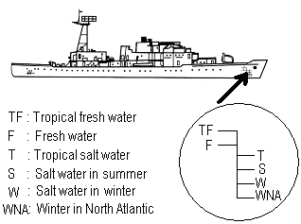
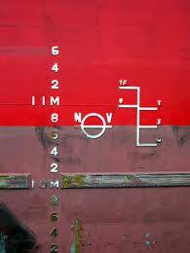
PLIMSOLL LINE OF THE SHIP
The density of sea water varies with location and season. To ensure that a ship is loaded within safe limits , the Plimsoll line marked on the body of the ship acts as a guide.

Slide 17
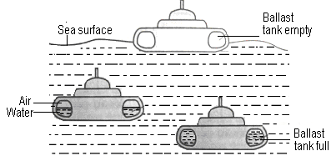
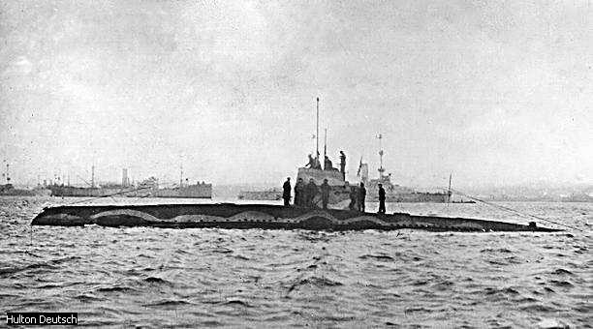
If ballast tanks empty ⇒Upthrust > weight ⇒ submarine rises to surface
If ballast tanks full ⇒ Upthrust < weight ⇒ submarine sinks to bottom
SUBMARINE

Slide 18
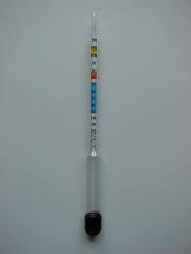
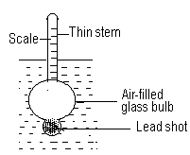
Hydrometer
An hydrometer is an instrument used to measure the density of a liquid.
lead shot to make it float upright
In a liquid of lesser density , the hydrometer is more submerged.
The hydrometer floats higher in a liquid of higher density.

Slide 19
Example
1. The weight of the rock in air is 0.85N. When it is completely submerged in water, its weight is 0.45N. What is the buoyant force acting on the rock when it is completely submerged in the water ?
Solution :
Buoyant force = Actual weight – Apparent weight
= 0.85 – 0.45
= 0.4N

Slide 20
2. A concrete slab weight 180N. When it is fully submerged under the sea its apparent weight is 105N.
Calculate the density of the sea water if the volume of the sea water displaced by the concrete slab is 4800 cm³. [ g = 9.8 Nkg⁻¹ ]
Solution :
Buoyant force = actual weight – apparent weight
= 180 – 102
= 72N

Slide 21
According to Archimedes’s principle
Buoyant force = weight of sea water
displaced
Therefore,
F = pVg
so…. p = F / Vg
= 72 / (4800 x 10⁻⁶ x 9.8 )
= 1530.61 kg m⁻³

Slide 22
THE END
PHYSICS IS SIMPLY FUN

