Slide 1
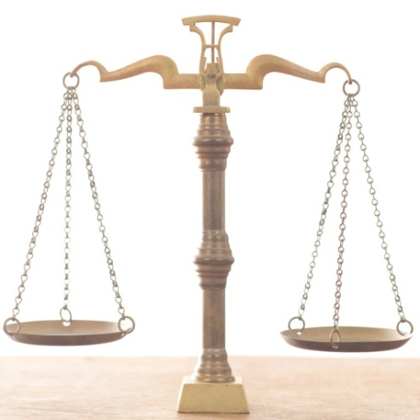
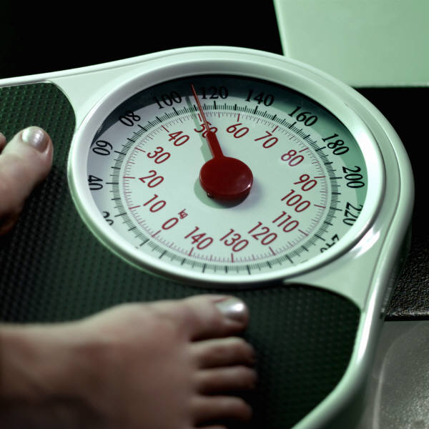
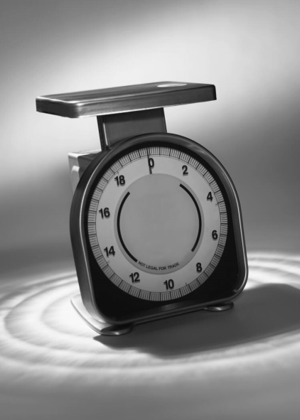
Measurement Mass & Density

Slide 2
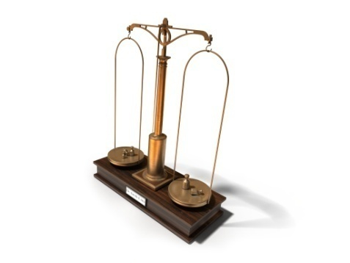
Mass and Weight
The mass of an object is the amount of matter in that object.
Mass is sometimes confused with weight, which is the force that gravity places on an object.
The higher the mass of an object is, the greater the force of gravity upon it and therefore, the greater its weight.
If you were to weigh yourself on the moon, your weight would be much less because the force of gravity on the moon is much less than the force of gravity on Earth.
Your mass, however, would not change.

Slide 3
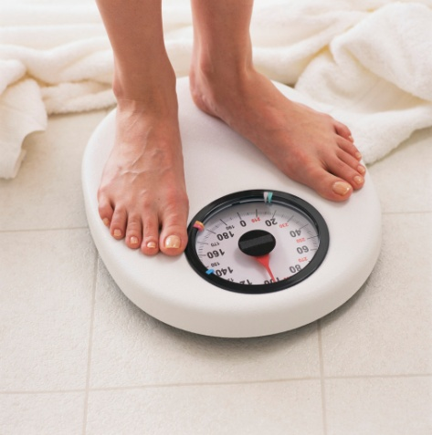
Units
Mass is normally measured in the Metric units of grams (g), milligrams (mg), or kilograms (kg). The English unit of mass is the slug.
Weight is usually in the English unit of pounds (lb) or the Metric unit of Newtons (N).
Although these are the technically correct units to use when referring to mass and weight, the metric units for mass are often used for weight, and the English unit for weight is often used for mass.

Slide 4
Mass
In a scientific laboratory, mass is usually determined instead of weight.
The Metric units are always used.
There are different types of scales used to measure mass, but the type you will be using in this course is a digital scale.
To determine the mass of the item or substance, you simply place it on the pan.
The mass will then appear on the screen.

Slide 5
Scales
If you are measuring the mass of a powdery substance, you should first place a piece of tissue paper or something similar on the scale.
The tissue paper itself weighs a little bit, so you will need to tare the scales.
Taring the scales sets the measurement back to zero.
Then when you add the powder to the tissue, only the mass of the powder will be measured and not the mass of the paper.

Slide 6
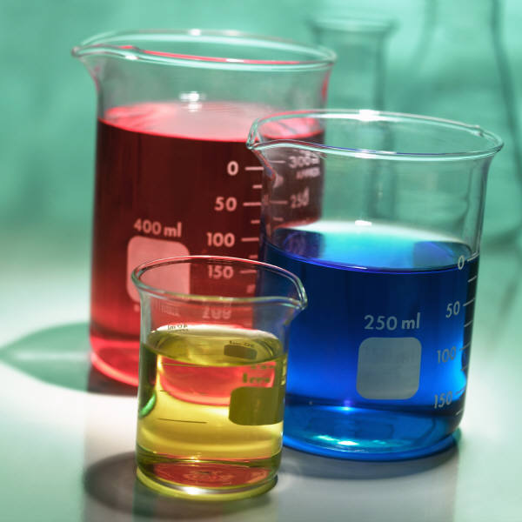
Density
Density is the amount of mass per unit volume.
Unlike length, volume, and mass, an object’s density is generally not measured directly. Instead density is generally calculated.
An object’s density is calculated by dividing its mass by its volume.

Slide 7
B-RELATIVE DENSITY
RELATIVE DENSITY:
DEFFINED AS THE RATIO BETWEEN THE DENSITY OF ANY LIQUID TO THE DENSITY OF FRESH WATER.
R.D = DENSITY OF ANY LIQUID
DENSITY OF FRESH WATER
DENSITY OF FRESH WATER = 1000 KG/M3 OR 1.000 T/M3
DENSITY OF SALT WATER = 1025 KG/M3 OR 1.025 T/M3

Slide 8
Relative Density Measurement
Relative density can easily be determine if at least one of the substances being compared is in liquid or gas form.
Substances with higher densities will float on substances of lower density if the second substance is in liquid or gas form.
This concept is known as buoyancy.

