Slide 1
ELECTROMAGNETIC INDUCTION

Slide 2
Specification
Electromagnetic induction
understand that a voltage is induced in a conductor or a coil when it moves through a magnetic field or when a magnetic field changes through it; and describe the factors which affect the size of the induced voltage
describe the generation of electricity by the rotation of a magnet within a coil of wire and of a coil of wire within a magnetic field; also describe the factors which affect the size of the induced voltage
describe the structure of a transformer, and understand that a transformer changes the size of an alternating voltage by having different numbers of turns on the input and output sides
explain the use of step-up and step-down transformers in the large-scale generation and transmission of electrical energy
know and use the relationship:
input (primary) voltage / output (secondary) voltage = primary turns / secondary turns
V_{p} / V_{s} = n_{p} / n_{s}
recall and use the relationship: input power = output power
V_{P} I_{P} = V_{s} I_{s} for 100% efficiency

Slide 3
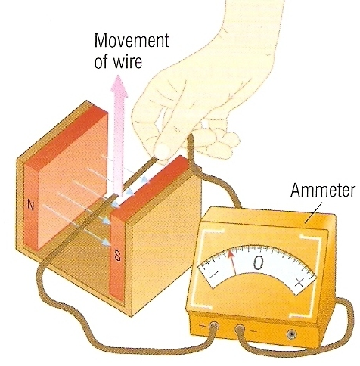
Electromagnetic induction
If an electrical conductor cuts through magnetic field lines, a voltage is induced across the ends of the conductor.
If the wire is part of a complete circuit, a current is induced in the wire.
This is called electromagnetic induction and is sometimes called the generator effect.

Slide 4
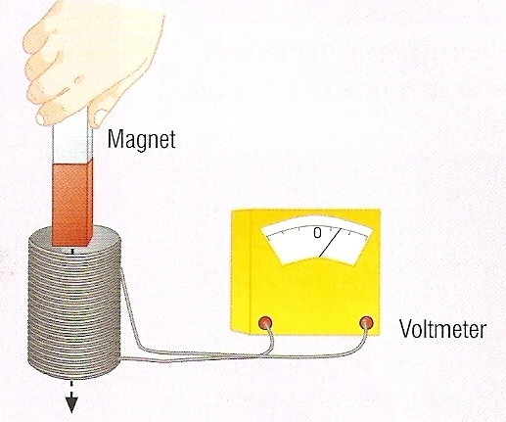
If a magnet is moved into a coil of wire, a voltage is induced across the ends of the coil.
If the direction of motion, or the polarity of the magnet, is reversed, then the direction of the induced voltage and the induced current are also reversed.
Electromagnetic induction also occurs if the magnetic field is stationary and the coil is moved.

Slide 5
The size of the induced voltage increases when:
– the speed of the movement increases
– the strength of the magnetic field increases
– the number of turns on the coil increases
– the area of the coil is greater.

Slide 6
Alternating Current Generators
Most electricity is produced using the ‘generator effect’.
The simplest generators and the types used in power stations produce alternating current (A.C.)

Slide 7
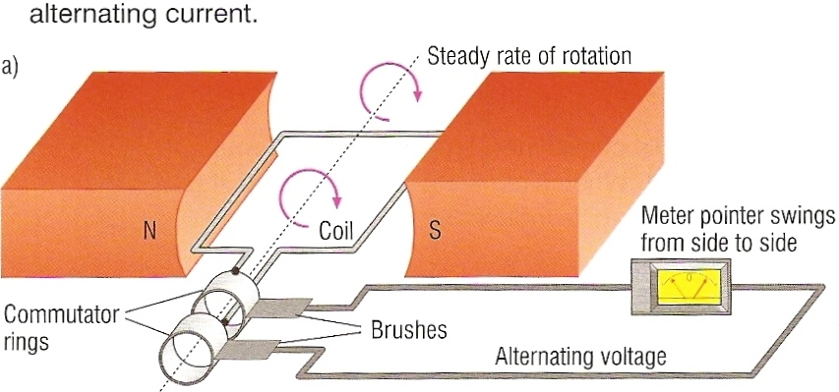
Moving Coil A.C. Generator

Slide 8
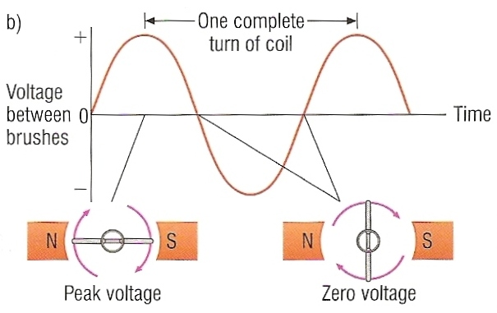

Slide 9
This like an electric motor in reverse.
As the coil is rotated electromagnetic induction occurs.
An alternating voltage is induced in the coil.
An alternating current is drawn off through two slip rings.
The faster the coil is rotated:
- the greater is the amplitude of the voltage and current
- the higher is the frequency of the a.c.

Slide 10
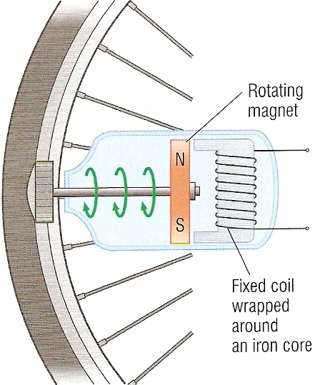
Bicycle generator
When the wheel turns the magnet is made to rotate next to the fixed coil of wire.
Electromagnetic induction occurs and a alternating voltage is induced in the coil.
This causes an alternating current to flow to the light bulb of the bicycle.

Slide 11
Question 1
The graph opposite shows how the voltage of a generator varies in time. Using the same set of axes show how the voltage would vary if the rotational speed of the generator was doubled.
V
time
The new voltage will have TWICE the amplitude AND frequency of the original.

Slide 12
Question 2
Choose appropriate words to fill in the gaps below:
The _________ effect occurs when a conductor is moved relative to a ____________ field. This is also known as electromagnetic ___________.
The greater the relative __________ of the conductor and magnetic field the _______ is the voltage ________.
If the conductor is part of a ________ circuit an electric current will flow.
___________ current is produced if the direction of movement is continually _________.
WORD SELECTION:
magnetic
complete
alternating
generator
reversed
induction
induced
greater
movement

Slide 13
Question 2
Choose appropriate words to fill in the gaps below:
The _________ effect occurs when a conductor is moved relative to a ____________ field. This is also known as electromagnetic ___________.
The greater the relative __________ of the conductor and magnetic field the _______ is the voltage ________.
If the conductor is part of a ________ circuit an electric current will flow.
___________ current is produced if the direction of movement is continually _________.
generator
magnetic
induction
movement
greater
induced
complete
alternating
reversed
WORD SELECTION:
magnetic
complete
alternating
generator
reversed
induction
induced
greater
movement

Slide 14
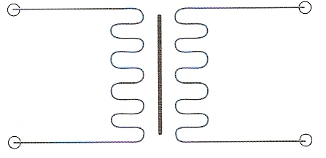
The transformer
A transformer is a device that is used to change one alternating voltage level to another.
circuit symbol

Slide 15
Structure of a transformer
A transformer consists of at least two coils of wire wrapped around a laminated iron core.
PRIMARY COIL of N_{p} turns
SECONDARY COIL of N_{s} turns
PRIMARY VOLTAGE V_{p}
SECONDARY VOLTAGE V_{s}
laminated iron core

Slide 16
How a transformer works
When an alternating voltage, V_{p} is applied to the primary coil of N_{p} turns it causes an alternating to flow in this coil.
This current causes a changing magnetic field in the laminated iron core which cuts across the secondary coil of N_{s} turns.
Electromagnetic induction occurs in this coil which produces an alternating voltage, V_{s}.

Slide 17
Question
Why can a transformer not change the level of the voltage output of a battery?

Slide 18
Question
Why can a transformer not change the level of the voltage output of a battery?
A battery produces a steady (DC) voltage.
This voltage would cause a constant direct current in the primary coil of a transformer.
This current would produce an unchanging magnetic field in the iron core.
This unchanging magnetic field would NOT cause electromagnetic induction in the secondary coil.
There would therefore be no secondary voltage.

Slide 19
The transformer equation
The voltages or potential differences across the primary and secondary coils of a transformer are related by the equation:
primary voltage = primary turns
secondary voltage secondary turns
V_{p} = N_{p}
V_{s} N_{s}
Transformer - eChalk

Slide 20
Question 1
Calculate the secondary voltage of a transformer that has a primary coil of 1200 turns and a secondary of 150 turns if the primary is supplied with 230V.

Slide 21
Question 1
Calculate the secondary voltage of a transformer that has a primary coil of 1200 turns and a secondary of 150 turns if the primary is supplied with 230V.
Vp = Np
Vs Ns
230 / V_{s} = 1200 / 150
230 / V_{s} = 8
230 = 8 x V_{s}
230 / 8 = V_{s}
Secondary voltage = 28.8 V

Slide 22
Question 2
Calculate the number of turns required for the primary coil of a transformer if secondary has 400 turns and the primary voltage is stepped up from 12V to a secondary voltage of 48V.

Slide 23
Question 2
Calculate the number of turns required for the primary coil of a transformer if secondary has 400 turns and the primary voltage is stepped up from 12V to a secondary voltage of 48V.
Vp = Np
Vs Ns
12 / 48 = N_{p} / 400
0.25 = N_{p} / 400
0.25 x 400 = N_{p}
Primary has 100 turns

Slide 24
Transformer power transfer equation
If a transformer is 100% efficient then the power input to the primary coil is equalled by the power output from the secondary coil.
as power = current x voltage
then:
I_{p} x V_{p} = I_{s} x V_{s}

Slide 25
Question 1
Calculate the primary current if when a transformer is supplied with 230V the secondary provides 4A at a voltage of 13V. Assume that the transformer is 100% efficient.

Slide 26
Question 1
Calculate the primary current if when a transformer is supplied with 230V the secondary provides 4A at a voltage of 13V. Assume that the transformer is 100% efficient.
I_{p} x V_{p} = I_{s} x V_{s}
I_{p} x 230V = 4A x 13V
I_{p} = 52 / 230
Primary current = 0.226 A

Slide 27
Question 2
Calculate the secondary current from a transformer supplying a secondary voltage of 6V if the primary is supplied with a current of 0.20A at 230V. Assume that the transformer is 100% efficient.

Slide 28
Question 2
Calculate the secondary current from a transformer supplying a secondary voltage of 6V if the primary is supplied with a current of 0.20A at 230V. Assume that the transformer is 100% efficient.
I_{p} x V_{p} = I_{s} x V_{s}
0.2A x 230V = I_{s} x 6V
I_{s} = 46 / 6
Secondary current = 7.67 A

Slide 29
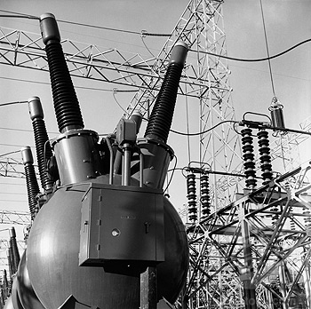
Step-up transformers
In a step-up transformer the voltage across the secondary coil is greater than the voltage across the primary coil.
The secondary turns must be greater than the primary turns.
Use: To increase the voltage output from a power station from 25 kV (25 000 V) to up to 400 kV.

Slide 30
Step-down transformers
In a step-down transformer the voltage across the secondary coil is smaller than the voltage across the primary coil.
The secondary turns must be smaller than the primary turns.
Use: To decrease the voltage output from the mains supply from 230V to 18V to power and recharge a lap-top computer.

Slide 31
Transformers and the National Grid
The National Grid is the system of cables used to deliver electrical power from power stations to consumers.
The higher the voltage used, the greater is the efficiency of energy transmission.
Lower voltages result in higher electric currents and greater energy loss to heat due to the resistance of the cables.

Slide 32
At power stations the output voltage of the generators is stepped up by transformers from 25kV to 132kV.
The voltage may be further increased to up to 400 kV for transmission over long distance pylon lines.

Slide 33
The voltage is reduced in stages by step-down transformers to different levels for different types of consumer.
The lowest level is 230V for domestic use. The final step-down transformer will be at sub station within a few hundred metres of each group of houses.

Slide 34
Question 1
Why is electrical energy transmitted over the National Grid in the form of alternating current?

Slide 35
Question 1
Why is electrical energy transmitted over the National Grid in the form of alternating current?
To maximise efficiency high voltages must be used.
Voltage therefore needs to be changed in level.
Transformers are needed to change voltage levels.
Transformers only work with alternating current.

Slide 36
Question 2
Choose appropriate words to fill in the gaps below:
Transformers are used to change one ___________ voltage level to another. They do not work with ____________current.
Step-up transformers _________ the voltage because their ___________ coil has more turns than the primary.
Transformers are used in the __________ Grid. The _______ output of a power station is increased to up to _______. A high voltage reduces the ________ lost to heat due to the _________ of the power lines.
WORD SELECTION:
energy
direct
National
secondary
resistance
increase
400 kV
alternating
25 kV

Slide 37
Question 2
Choose appropriate words to fill in the gaps below:
Transformers are used to change one ___________ voltage level to another. They do not work with ____________current.
Step-up transformers _________ the voltage because their ___________ coil has more turns than the primary.
Transformers are used in the __________ Grid. The _______ output of a power station is increased to up to _______. A high voltage reduces the ________ lost to heat due to the _________ of the power lines.
alternating
direct
increase
secondary
National
25 kV
400 kV
energy
resistance
WORD SELECTION:
energy
direct
National
secondary
resistance
increase
400 kV
alternating
25 kV

