Slide 1
X-RAYS

Slide 2
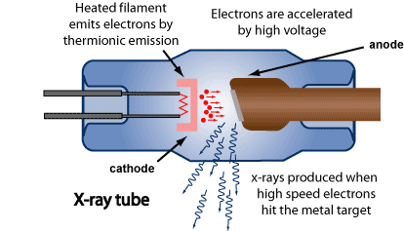
X-RAY TUBE

Slide 3

X-rays are commonly produced by accelerating electrons
through a potential difference (a voltage drop) and
directing them onto a target material.
(The metal tungsten is a typical example).
The incoming electrons release X-rays as they slow down
in the target. The x-ray photons produced in this manner
range in energy from near zero up to the energy of the
electrons.

Slide 4
Increasing the tube voltage (EHT)
Increasing the high p.d. that is used to accelerate the
electrons will give the average electron more energy
when it hits the target. The quality or penetrating power
increases

Slide 5
Increasing the tube current
Increases the rate of thermionic emission - more
electrons of same energy hit the target - more X-rays
produced. The intensity increases.

Slide 6
EFFICIENCY
Most of the kinetic energy is converted into heat.
Generally, more than 99% of the kinetic energy of
projectile electrons is converted to thermal energy,
leaving less than 1% available for the production of
X-radiation. In this sense, the X-ray machine is a very
inefficient apparatus.

Slide 7
X-Rays are:
High frequency, high energy electromagnetic rays.
Undetectable by the human senses
Very penetrating
Cause low localized ionization.
Generated when high energy electrons strike a metal target

Slide 8
Quality of X-Rays
The penetrating power of an X-ray beam
X-rays with high penetrability are termed high-quality
or hard X-rays, and those with low penetrability are of low quality
and are called soft X-rays.
As the energy of an X-ray beam is increased, the penetrability or
quality of the X-ray beam is also increased.
Hard x-rays - highly penetrating x-rays
Soft x-rays - low penetrating x-rays

Slide 9
Properties of X-Rays
X-rays can pass easily through flesh but not through bone.
X-ray photographs are used to show the image of bones against a black background.
These photographs can show if bones are broken or damaged.

Slide 10
How do X-rays cause Harm?
Low intensity X-rays can damage living cells and
cause cancer. People who work with X-rays
take measures to protect themselves from exposure.
They wear a film badge and stand behind
special screens when the X-ray machine is switched on.
High intensity X-rays will kill living cells.

Slide 11
Uses of X-Rays:
Imaging for detection of broken bones or tumours: simple X-ray,
CT scanning, barium meal scanning.
High energy ones for treatment of cancer (destroying cells)

