Slide 1
PHOTO ELECTRIC EFFECT

Slide 2
At the end of the century, many physicists felt that
all the significant laws of physics had been discovered.
Hertz even stated, “The wave theory of light is, from
the point of view of human beings, a certainty.”
That view was soon to change.
Around 1900,
the photoelectric effect was observed.
“the emission of electrons by a substance
when illuminated by e/m radiation”
Careful study of the photoelectric effect
was performed by many scientists.

Slide 3
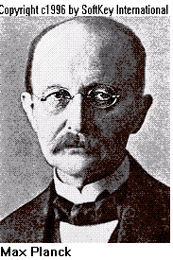
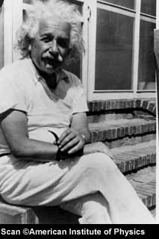
The wave theory could not totally explain the
photoelectric effect, but a variation of the
old particle theory could!
Max Planck and
Albert Einstein
subsequently proposed the
QUANTUM THEORY.
The Quantum Theory
The transfer of energy between
light radiation and matter occurs in
discrete units called quanta, the magnitude
of which depends on the frequency of radiation.

Slide 4
Although we still commonly characterize
light as a wave, it is actually neither a
wave nor a particle. It seems to have
characteristics of both.
The modern view of the nature of
light recognizes the dual character:
Light is radiant energy transported
in photons that are guided along
their path by a wave field.

Slide 5
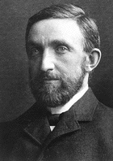
Photo electric emission
In 1902 it was discovered that electrons could be ejected from metals by electromagnetic radiation.
Any metal will emit electrons if it is given enough energy.Heated coils in electron guns give of large amounts of electrons.This is called thermionic emission.
Philipp Lenard
Philipp Lenard

Slide 6
A definition
Photoelectric emission is the emission of electrons from the surface of a metal when it is exposed to electromagnetic radiation of sufficient high frequency.
Learn this definition

Slide 7
When red light is incident on a clean metal surface:
Clean metal surface
e
e
e
e
e
e
no electrons are released,
however long light is shone onto it,
however intense the light source is.

Slide 8
When UV light is incident on a clean metal surface:
UV light
Clean metal surface
e
e
e
e
e
e
e
electrons are released instantaneously,
however weak the light source.

Slide 9
Classically this cannot be explained because:
If red light is shone onto the metal surface
for long enough some electrons should
gain sufficient energy to enable them to escape.

Slide 10
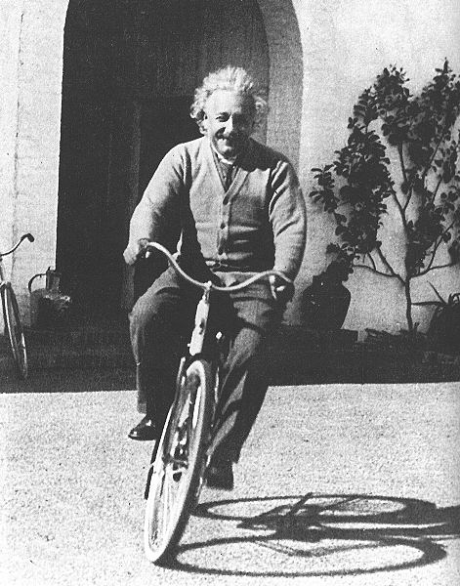
Einstein put forward a theory:
Light energy is quantised.
Light consists of a stream of particles
called photons.
The energy of each photon (E) depends
on the frequency (f ) of the light.
E = h f

Slide 11
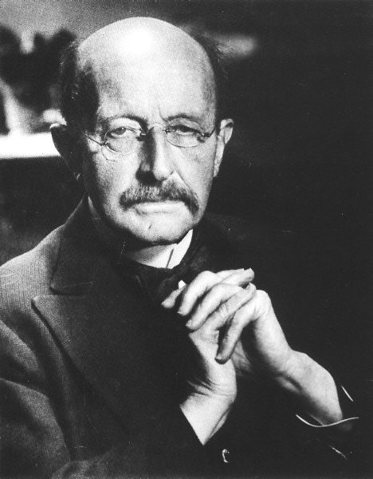
What is h?
h is called Planck´s constant.
h = 6.6 x 10⁻³⁴ Js
Max Planck

Slide 12

h
is planck's constant
red light has a smaller
frequency
Frequency increasing
than violet light

Slide 13
Calculating Frequencies
Red light has a wavelength of 640 nm
Ultra violet has a wavelength of 2.6 x 10⁻⁷m
For each of these calculate the frequency.

Slide 14
E = h x f
Photon energy
Red light photons therefore
have less energy
than violet light photons
and even less than UV photons

Slide 15
Simple questions
1) Blue light has a frequency of
7.7 x 10¹⁴ Hz while red light has a frequency of 4.3 x 10¹⁴Hz.Calculate the energy of a photon of each.

Slide 16
ONE
PHOTON
GIVES ALL ITS ENERGY
e
TO ONE ELECTRON

Slide 17
A photon of red light gives an electron insufficient energy to
enable it to escape from the surface of the metal.
Red light photon
Clean metal surface
e
e
e
e
e
e
e
surface electrons
No electrons are released from the metal surface

Slide 18
A photon of UV light gives an electron sufficient energy to
enable it to escape from the surface of the metal.
UV photon
Clean metal surface
e
e
e
e
e
e
e
surface electrons
Electrons are released instantaneously. Each photon releases an electron This is called photoemission.

Slide 19
Laws of Photoelectric emission
Observations based on the measurement made of the charge,mass and energy of the emitted electrons lead to the following laws of Photoelectric emission:-

Slide 20
) The number of electrons emitted per second from any given metal is directly proportional to the INTENSITY of the radiation falling on it(Intensity is a measure Of the energy per unit area.In the case of light, it is equivalent to the brightness of the light)

Slide 21
Ii) The photoelectrons are emitted from a given metal with a range of Kinetic energies.from zero up to a maximum.The maximum energy increases with the frequency of the radiation and is independent of the intensity of the radiation.(Shining brighter light of the same colour produces more electrons per second but does not increase their kinetic energies)

Slide 22
For each metal, there is a minimum frequency required to produce emission.This is called the threshold frequency.Radiation below this frequency cannot produce emission, no matter how intense the radiation.

Slide 23
So why is all of this so important?
Wave theory of electromagnetic radiation predicts that emission of photoelectrons should happen at all frequencies.Electrons in the metal would absorb energy continuously from radiation of any frequency, and be emitted when they had absorbed enough energy.This process would take longer at lower frequencies but should still happen.
Also there should be no maximum kinetic energy of the emitted electrons.

Slide 24
According to wave theory
For a particular frequency of light,the energy carried is proportional to the intensity of the beam.
The energy carried by the light would be spread evenly over the wavefront.
Each free electron on the surface of the metal would gain a bit of energy from each incoming wave.
Gradually each electron would gain enough energy to leave the metal

Slide 25
So
If the light had a lower frequency(i.e it was carrying less energy) it would take longer for the electrons to gain enough energy
but
it would eventually happen

Slide 26
The higher the intensity of the wave the more energy it should transfer to each electron so the kinetic energy should increase with the intensity.There is no explanation for the kinetic energy depending only on the frequency.

Slide 27
Photon Model
According to the photon model:-
When light hits its the metal is bombarded by photons.
If one of these photons collides with a free electron the electron will gain energy equal to hf

Slide 28
Why Electron Leaves
Before an electron can leave the surface of the metal it needs enough energy to break the bonds holding it there.This energy is called the work function energy and its value depends on the metal.

Slide 29
Threshold frequency
If the energy gained from the photon is greater than the work function the electron is emitted.
If it isnt the electron will just shake about a bit,then release the energy as another photon.The metal will heat up but no electrons will be emitted.

Slide 30
Maximum kinetic energy
The energy transferred to an electron is hf
The ke it will be carrying when it leaves the metal is hf minus any energy its lost on the way out(thats why there is a range of ke)
The minimum amount of energy it can lose is the work function energy so the maximum kinetic energy is given by the equation
hf-work function

Slide 31
Photoelectric equation
Energy of incident photon hf
Work function Φ
KE of freed electron

Slide 32
Photoelectric Effect
e
e

Slide 33
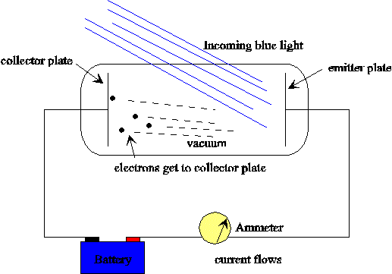
Photoelectric Effect

Slide 34
Graphical representation
Stopping potential
Frequency

Slide 35
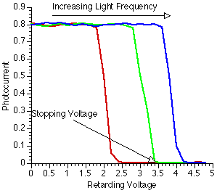
Photoelectric Effect

Slide 36
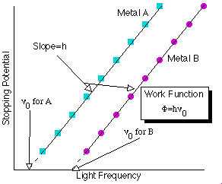
Photoelectric Effect

Slide 37
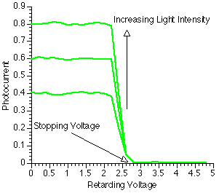
Photoelectric Effect

Slide 38
Summary
Light and all forms of electromagnetic radiation is emitted in brief bursts or packets of energy ie it is quantised.
The packets of energy which are called PHOTONS travel in one direction only in a straight line.
When an atom emits a photon its energy changes by an amount equal to the photon energy
The amount of energy contained in each quantum is directly proportional to the frequency f of the radiation.

Slide 39
Negative electroscope
White light does not discharge an electroscope
UV light does cause discharge
-
-
-
-
-
-
-
-
-
-
-

Slide 40
Positive Electroscope
Any electrons emitted by a positively charged electroscope just get attracted back on to it
+
-
+ + + + +
+
+
+
+
+
+

Slide 41
Work function
Emission takes place if hf ≥ W₀
A photon of white light does not contain enough energy to get an electron out of the surface.
UV light does have enough energy to get the electron out of the surface
If the energy of the photon is greater than W₀ then an electron can be emitted.
W₀

Slide 42
A brighter Light
Using a brighter light gives more photons
Each photon still has less energy than the work function.
The electron can absorb many separate photons but none of them have enough energy to release it
W₀

Slide 43
Light comes in lumps
Light comes in tiny lumps called photons.
The energy in one photon depends on the frequency
E = hf
UV has a higher frequency than white light so one photon contains more energy

Slide 44
Einstein’s Photoelectric Equation
½ mv² = hf – W_{o}
If the photon has 8 units of energy, and the work function is 6 then how much energy does the electron have when it gets out.
KE = energy given – energy used to escape
KE = 8 -6 =2
Einstein got a Noble prize for this (8 - 6 = 2)
½ mv²
hf
W₀

Slide 45
Milikan’s Photoelectric Experiment
h is the height that stops the ball
How can you measure the KE of an electron if you don’t know its speed.
Keep increasing the height of the ramp until the ball can’t reach the top
PE at top = KE at bottom
mgh = ½ mv²
h

Slide 46
Milikan’s Photoelectric Experiment
A slope can stop a ball but what will stop an electron?
We use a negative voltage to try and stop the electrons
Increase the voltage until it is just enough to stop the electrons (this is called the stopping voltage, V_{s})
-
- - -
-
-
-
-
-
-
-
- - -
-
This is a very sensitive ammeter that can detect the flow of electrons
Variable voltage supply

Slide 47
Photoelectric equation

Slide 48
Stopping Voltage
V_{s}
Energy = charge x voltage
½ mv² =eV_{s}
hf = W₀ + ½ mv²
hf = W₀ + eV_{s}
eV_{s} = hf – W₀
V_{s} = (h/e) f – W₀/e
Y = mX + C
Gradient = h/e
f
Threshold frequency (f₀)
Negative intercept = W₀/e
Photo effect applet try this!!!

Slide 49
Chapter 18
1 Photoelectric emission: emission of electrons from a surface when illuminated with electromagnetic
radiation of sufficient frequency
See experiment on page 38
2 Threshold frequency: minimum frequency that will cause photoelectric emission from a material
c = fλ
λ = c/f = 3.0 × 108 m s–1/(0.88 × 1015 Hz) = 3.4 × 10–7 m = 340 nm

Slide 50
3 The larger the wavelength, the lower the photons’ energy
No emission occurs when photon energy is less than the work function
Electrons gain energy from an increase in temperature so less energy then required to remove them
from the surface (smaller work function)
Less energy corresponds to a longer wavelength
Visible photon energy is smaller than zinc’s work function so no electrons are released
It’s the individual photon energy that matters, not how many there are

Slide 51
4 Photon: a small packet of electromagnetic energy; the smallest amount of light you can get at a
given frequency
(a) Both produce photons with identical energy but the bright source produces more photons each
second than the dim source
(b) Visible source produces lower energy photons than the ultra-violet source, although it produces
them at a greater rate to achieve the same intensity
5 Work function: minimum amount of energy needed to release an electron from the surface of a metal
Ultra-violet photon energy is greater than zinc’s work function so electrons are released

Slide 52
Chapter 19
1 Kinetic energy of freed electron = photon energy – energy required to remove electron
Surface electrons are the easiest to remove so have greatest kinetic energy and move the fastest
2 See experiment on page 40
Measure the voltage VS needed just to stop their emission
Energy = eVS where e = 1.6 × 10–19 C
3 Photon energy = hf = hc/λ
so hc/λ = φ + maximum kinetic energy
and maximum kinetic energy = hc/λ – φ
Maximum kinetic energy/10–19 J 3.26 2.56 1.92 1.25 0.58
Incident wavelength/10–7 m 3.00 3.33 3.75 4.29 5.00
(1/incident wavelength)/106 m–1 3.33 3.00 2.67 2.33 2.00

Slide 54
4 Maximum kinetic energy = (hc/λ) – φ = [6.6 × 10–34 J s × 3 × 108 m s–1/(319 × 10–9 m)] –
3.78 × 10–19 J = 6.21 × 10–19 J – 3.78 × 10–19 J = 2.43 × 10–19 J
eVS = 2.43 × 10–19 J
VS = 2.43 × 10–19 J/(1.6 × 10–19 C) = 1.52 V
5 Maximum kinetic energy = (hc/λ) – φ
Situation 1:
2.4 × 10–19 J = [6.6 × 10–34 J s × 3 × 108 m s–1/(500 × 10–9 m)] – φ
φ = 3.96 × 10–19 J – 2.4 × 10–19 J = 1.56 × 10–19 J
Situation 2:
9.0 × 10–19 J = (6.6 × 10–34 J s × 3 × 108 m s–1/λ) – 1.56 × 10–19 J
6.6 × 10–34 J s × 3 × 108 m s–1/λ = 9.0 × 10–19 J + 1.56 × 10–19 J = 1.056 × 10–18 J
λ = 6.6 × 10–34 J s × 3 × 108 m s–1/(1.056 × 10–18 J) = 1.88 × 10–7 m = 188 nm

Slide 55
Chapter 20
1 Electronvolt: the energy transferred to an electron when it moves through a potential difference
of 1 V;
1 eV is equivalent to 1.6 × 10–19 J
E = hc/λ = 6.6 × 10–34 J s × 3 × 108 m s–1/(253 × 10–9 m) = 7.83 × 10–19 J
= 7.83 × 10–19 J/(1.6 × 10–19 J eV–1) = 4.89 eV
2 φ = 1.4 eV = 1.4 eV × 1.6 × 10–19 J eV–1 = 2.24 × 10–19 J
hc/λο = 2.24 × 10–19 J
λο = 6.6 × 10–34 J s × 3 × 108 m s–1/(2.24 × 10–19 J) = 8.84 × 10–7 m = 884 nm

Slide 56
3 For caesium, φ = 3.11 × 10–19 J
Maximum kinetic energy = (hc/λ) – φ = [6.6 × 10–34 J s × 3 × 108 m s–1/(0.4 × 10–6 m)] –
3.11 × 10–19 J = 4.95 × 10–19 J – 3.11 × 10–19 J = 1.84 × 10–19 J
1–2 mvmax
2 = 1.84 × 10–19 J
vmax
2 = 2 × 1.84 × 10–19 J/(9.1 × 10–31 kg) = 4.04 × 1011 m2 s–2
vmax = √(4.04 × 1011 m2 s–2) = 6.36 × 105 m s–1
4 (a) The intensity
(b) The photon frequency and the material’s work function

Slide 57
5 Photon energy increases with frequency (E = hf )
Maximum kinetic energy increases with photon energy (maximum kinetic energy = hf – f )
A greater potential difference is needed to stop these more energetic electrons
ΔE = hc/Δλ = 6.6 × 10–34 J s × 3 × 108 m s–1/(1.24 × 10–6 m) = 1.6 × 10–19 J = 1 eV
So a reduction of 1.24 μm in λ increases E by 1 eV
requiring an increase of 1 V in the stopping voltage

Slide 58
1. (a) The following equation describes the release of electrons from a metal surface illuminated by electromagnetic radiation.
hf = k.e.max + φ
Explain briefly what you understand by each of the terms in the equation.
Hf (1)
k.e.max (1)
Φ... (1)
(3 marks)

Slide 59
1. (a) The following equation describes the release of electrons from a metal surface illuminated by electromagnetic radiation.
hf = k.e.max + φ
Explain briefly what you understand by each of the terms in the equation.
hf Energy of a photon (1)
k.e.max Kinetic energy of emitted electron/equivalent (1)
φ Energy to release electron from surface / equivalent (1)
(3 marks)

Slide 60
2. Experiments on the photoelectric effect show that
• the kinetic energy of photoelectrons released depends upon the frequency of the incident light and not on its intensity,
light below a certain threshold frequency cannot release photoelectrons.
How do these conclusions support a particle theory but not a wave theory of light?
Particle theory: E = hf implied packets/photons (1)
One photon releases one electron giving it k.e. (1)
Increase f ⇒ greater k.e. electrons (1)
Lower f; finally ke = O ie no electrons released Waves (1)
Energy depends on intensity / (amplitude)2 (1)
More intense light should give greater k.e–NOT SEEN (1)
More intense light gives more electrons but no change in maximum kinetic energy (1)
Waves continuous ∴ when enough are absorbed electrons should be released–NOT SEEN (1)

Slide 61
Calculate the threshold wavelength for a metal surface which has a work function of 6.2 eV.
6.2eV × 1.6 × 10–19 C (1)
Use of (1)
Threshold wavelength = 2.0 × 10–7 m (1)
To which part of the electromagnetic spectrum does this wavelength belong?
UV ecf their λ (1)
(4 marks)
[Total 10 marks]

Slide 62
3. Explanation:
Photons/quanta
Photon releases / used electron
Energy/frequency of red < energy/frequency of ultra violet
Red insufficient energy to release electrons so foil stays 4
Ultraviolet of greater intensity: foil/leaf collapses quicker/faster
Red light of greater intensity: no change/nothing 2
Observations if zinc plate and electroscope were positively charged:
Foil rises or Foil stays same/nothing
as electrons released it becomes more Released electrons attracted back by
positive positive plate/more difficult to
release electrons 2

