Slide 1
NUCLEAR FISSION AND FUSION

Slide 2
Specification
Radioactivity and particles
Particles
describe the results of Geiger and Marsden’s experiments with gold foil and alpha particles
describe Rutherford’s nuclear model of the atom and how it accounts for the results of Geiger and Marsden’s experiment and understand the factors (charge and speed) which affect the deflection of alpha particles by a nucleus
understand that a nucleus of U-235 can be split (the process of fission) by collision with a neutron, and that this process releases energy in the form of kinetic energy of the fission products
understand that the fission of U-235 produces two daughter nuclei and a small number of neutrons
understand that a chain reaction can be set up if the neutrons produced by one fission strike other U-235 nuclei
understand the role played by the control rods and moderator when the fission process is used as an energy source to generate electricity.

Slide 3
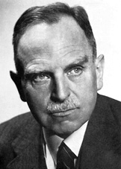
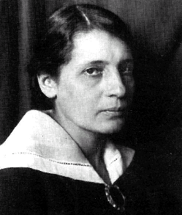
Nuclear fission
Nuclear fission is the splitting of an atomic nucleus.
The process of nuclear fission was discovered in 1938 by Lise Meitner, Otto Hahn and Fritz Strassmann.
Lise Meitner 1878-1968
Otto Hahn 1879-1968
Notes:
3

Slide 4
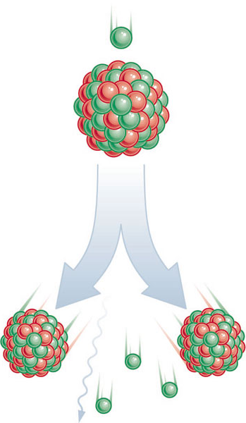
Fissile materials
A fissile material easily undergoes fission.
The mostly commonly used fissile material is uranium-235.
When this undergoes fission two daughter nuclei are produced that are called fission fragments.
The process also produces neutrons, gamma radiation and a considerable amount of kinetic energy.
Notes:
4

Slide 5
The fission of uranium-235
The fission of a nucleus uranium-235 can be initiated by its absorption of a slow-moving neutron.
235
1
236
+
n
U
U
92
0
92
Uranium-236 is very unstable and splits apart.
236
144
89
1
0
U
Ba
+
Kr
+
3
n
+
γ
92
56
36
0
0
fission fragments
barium-144 and krypton-89
Notes:
5

Slide 6
Other fission examples
Other fission products can be produced. Their masses usually have a roughly 3:2 ratio.
236
134
90
1
0
U
Xe
+
Sr
+
2
n
+
γ
92
54
38
0
0
fission products = xenon-134 and strontium-90
Plutonium-239 is also fissile.
239
137
89
1
0
Pu
Cs
+
Y
+
3
n
+
γ
94
55
39
0
0
fission products = caesium-137 and yttrium-89
Notes:
6

Slide 7
Fission equation questions
Complete the equations below:
236
143
91
1
0
U
Cs
+
Rb
+
2
n
+
γ
A
37
B
Rubidium
239
145
92
1
0
C
γ
Pu
Ba
+
Sr
+
2
n
+
38
D
235
131
91
1
0
E
U
I
+
Y
+
3
n
+
γ
53
F
Iodine
This last example combines the uranium-235 neutron absorption with the fission of uranium-236
Notes:
7

Slide 8
Fission equation questions
Complete the equations below:
236
143
91
1
0
U
Cs
+
Rb
+
2
n
+
γ
A
92
55
37
0
0
B
Rubidium
239
145
92
1
0
C
γ
Pu
Ba
+
Sr
+
2
n
+
94
56
38
0
0
D
235
131
91
1
0
E
U
I
+
Y
+
3
n
+
γ
92
53
39
0
0
F
Iodine
This last example combines the uranium-235 neutron absorption with the fission of uranium-236
Notes:
8

Slide 9
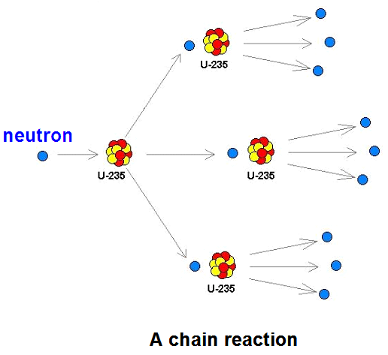
Chain reaction
The fission of a nucleus of Uranium-235 can be initiated by a slow-moving neutron.
When this nucleus splits further neutrons are produced.
These neutrons in turn can cause more nuclei to split.
An avalanche effect, called a ‘chain reaction’ can then occur.
Notes:
9

Slide 10
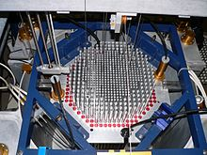
Nuclear fission reactors
A nuclear reactor is used to produce substantial and controllable energy from nuclear fission.
The thermal energy produced is used to convert water to high pressure steam.
This steam is used to drive turbines which rotate generators to produce electricity.
top view of a nuclear reactor
Notes:
10

Slide 11
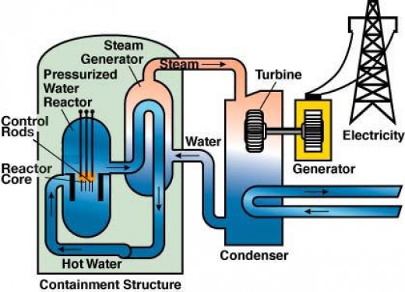
Nuclear power plant
Notes:
11

Slide 12
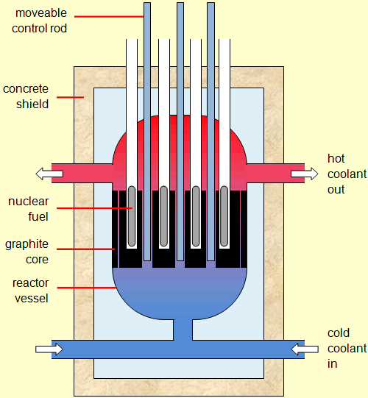
Structure of a reactor
Notes:
12

Slide 13
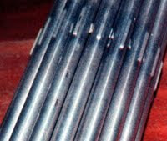
What each part does
1. Uranium fuel rods
These contain enriched uranium. This consists of uranium-238 with a higher proportion of uranium-235 than is found in natural reserves of uranium. The fuel rods become very hot and dangerously radioactive due to nuclear fission.
2. Removable control rods
Made of boron or cadmium, when placed in-between the fuel rods these absorb neutrons and so reduce the rate of fission. Their depth is adjusted to maintain a constant rate of fission.
3. Moderator (graphite core)
Made of graphite. This surrounds the fuel rods and slows the neutrons down to make absorption of neutrons by uranium-235 more likely.
uranium fuel rods
Notes:
13

Slide 14
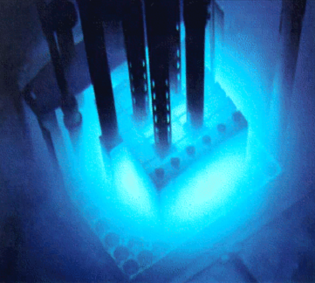
4. Coolant
This can be water, carbon dioxide gas or liquid sodium. This transfers the thermal energy of the fuel rods to the heat exchanger.
5. Heat exchanger
Here water is converted into high pressure steam using the heat energy of the coolant.
6. Concrete shield
This absorbs the radiation coming from the nuclear reactor.
reactor underneath water coolant
Notes:
14

Slide 15
Choose appropriate words to fill in the gaps below:
Nuclear fission is the _________ up of the nucleus of an atom into two smaller nuclei. Energy, neutrons and _________ radiation are also emitted.
Nuclear ________ use Uranium _____ or Plutonium _____to produce energy by nuclear ________. A controlled chain reaction is maintained by the use of _______ rods which absorb some of the _________ produced.
An _______ bomb is the consequence of an uncontrolled chain reaction.
WORD SELECTION:
reactors
gamma
239
atomic
splitting
neutrons
235
fission
control
Notes:
15

Slide 16
Choose appropriate words to fill in the gaps below:
Nuclear fission is the _________ up of the nucleus of an atom into two smaller nuclei. Energy, neutrons and _________ radiation are also emitted.
Nuclear ________ use Uranium _____ or Plutonium _____to produce energy by nuclear ________. A controlled chain reaction is maintained by the use of _______ rods which absorb some of the _________ produced.
An _______ bomb is the consequence of an uncontrolled chain reaction.
splitting
gamma
reactors
235
239
fission
control
neutrons
atomic
WORD SELECTION:
reactors
gamma
239
atomic
splitting
neutrons
235
fission
control
Notes:
16

Slide 17
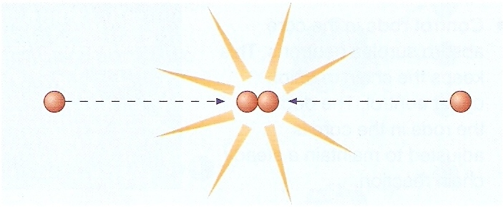
Nuclear fusion
Nuclear fusion is the joining of two atomic nuclei to form a larger one.
Hydrogen nuclei undergo fusion in stars to make helium nuclei
Notes:
17

Slide 18
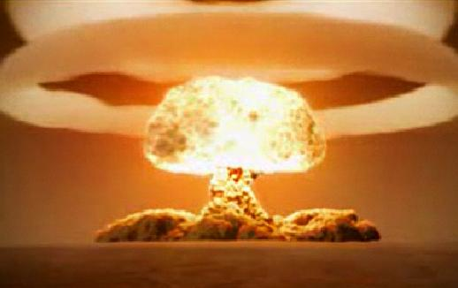

Energy from fusion
Nuclear fusion is the process by which energy is released in the Sun and other stars.
It is also the energy source of the hydrogen bomb.
Notes:
18

Slide 19
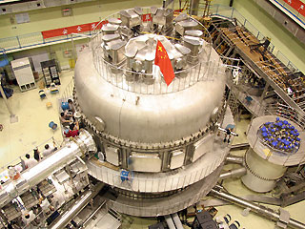
Nuclear fusion reactors
Scientists are currently working to make nuclear fusion reactors.
The fuel for fusion reactors is the isotope hydrogen 2 (deuterium) which is found in sea water.
An experimental fusion reactor in Seatle USA
Notes:
19

