Slide 1
RADIATION AND HALF-LIFE

Slide 2

Specification
Radioactivity and particles
Radioactivity
understand that ionising radiations can be detected using a photographic film or a Geiger-Muller detector
explain the sources of background radiation
understand that the activity of a radioactive source decreases over a period of time and is measured in becquerels
understand the term ‘half-life’ and understand that it is different for different radioactive isotopes
use the concept of half-life to carry out simple calculations on activity

Slide 3
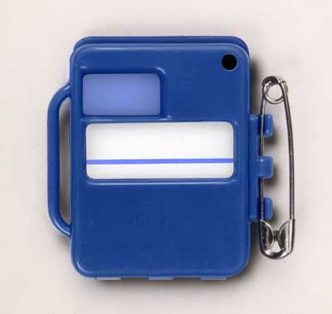
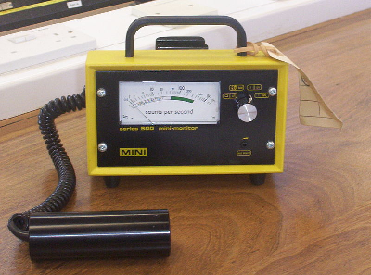
Detecting radioactivity
Radioactivity can be detected using
photographic film
or a Geiger counter.
Radiation badge containing photographic film
Geiger tube and counter
Notes:
3

Slide 4
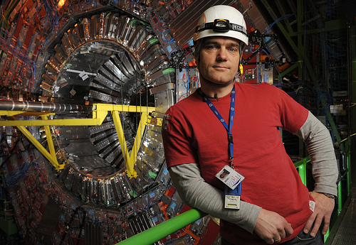
Radiation badges
Photographic film darkens on exposure to radiation and light.
Light cannot penetrate the badge but ionising radiation can.
Darkening of the film indicates that a person has been exposed to too much radiation.
Engineer at CERN wearing a radiation badge
Notes:
4

Slide 5
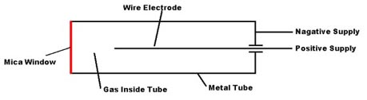
The Geiger tube
Radiation produces ions in a low pressure gas between a central positively charged electrode and the outer negatively charged tube. A pulse of current then flows that is registered by the counter.
The thin mica window allows the least penetrating radiation (alpha) to enter the tube. Gamma radiation and most beta can enter through the sides of the metal tube.
Notes:
5

Slide 6
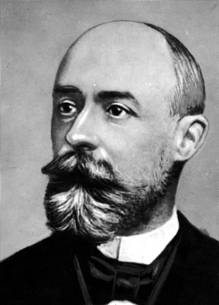
Activity
The activity of a radioactive source is equal to the number of decays per second.
Activity is measured
in bequerels (Bq)
1 becquerel
= 1 decay per second
Henri Becquerel discovered radioactivity in 1896
Notes:
6

Slide 7
Question 1
A radioactive source undergoes 72 000 decays over a ten minute period.
What is its average activity in becquerels?
Notes:
7

Slide 8
Question 1
A radioactive source undergoes 72 000 decays over a ten minute period.
What is its average activity in becquerels?
Activity in becquerels equals decays per second.
72 000 per 10 minutes
= 72 000 / 10 per minute
= 72 000 / (10 x 60) per second
= 72 000 / 600
= 120 per second
Activity = 120 becquerel
Notes:
8

Slide 9
Question 2
A radioactive source has an activity of 25 Bq.
How many decays would be expected over a 3 hour period?
Notes:
9

Slide 10
Question 2
A radioactive source has an activity of 25 Bq.
How many decays would be expected over a 3 hour period?
Activity is 25 Bq
= 25 decays per second
= (25 x 60) = 1500 decays in one minute
= (1500 x 60) = 90 000 decays in one hour
= (90 000 x 3) decays in 3 hours
Number of decays in 3 hours = 270 000
Notes:
10

Slide 11
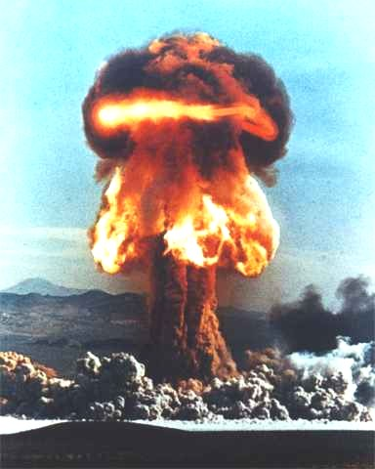
Background radiation
Background radiation is low-level ionising radiation that is produced all of the time.
Most of this radiation occurs naturally but a small amount is due to man-made sources such as nuclear weapon testing.
Notes:
11

Slide 12
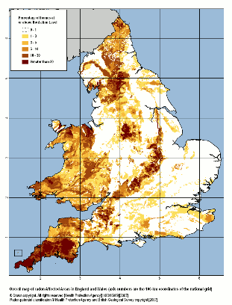
Radon gas
Radon gas accounts for about 50% of natural background radiation.
Two isotopes of radon, radon 222 and radon 220 (also known as thoron) are produced by the radioactive decay of uranium and thorium in the Earth’s crust
.
This gas seeps into the atmosphere sometimes building up first inside the basements and foundations of buildings.
Areas containing granite and other igneous rocks, for example Cornwall, have a higher than average amount of background radiation due to radon gas.
Background radiation map of England and Wales
Notes:
12

Slide 13

Cosmic rays
Cosmic rays are a form of natural background radiation produced by the nuclear reactions occurring in stars and exploding stars called supernovae.
These produce high energy particles which continually bombard the Earth.
Our atmosphere gives us good protection from cosmic radiation.
Cosmic radiation is an issue that must be considered in proposed manned space exploration to Mars.
Exposure to cosmic radiation is increased during jet travel
Notes:
13

Slide 14

Internal radiation
Internal radiation is background radiation due to radioactive sources present inside our bodies.
Some of these are from naturally occurring events. An example is carbon 14 that is formed in the atmosphere by the Sun’s radiation. This behaves chemically and biologically in the same way as non-radioactive carbon 12.
Others such as strontium 90 are from man-made events such as nuclear weapons testing and accidents. Strontium behaves like calcium in our bodies.
We are all sources of background radiation!
Notes:
14

Slide 15
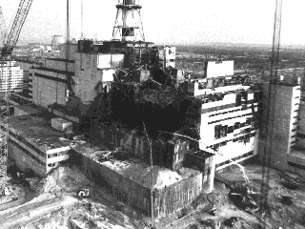
Artificial radiation
Artificial radiation is background radiation due to man-made events or procedures
Some is to due leakage and accidents associated with the generation of electricity using nuclear energy. Some is due to fall-out from nuclear weapon testing.
Radioactive tracers are used in industry and medicine and radioisotopes are used to treat cancer.
Overall artificial radiation normally accounts for only a small percentage of background radiation.
The explosion of the Chernobyl power plant in the Ukraine in 19986 placed significant radioactive isotope into the atmosphere.
Notes:
15

Slide 16
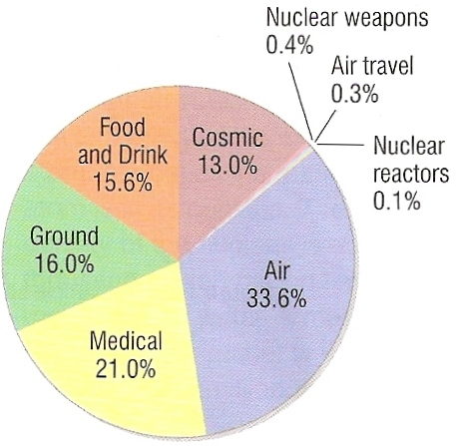
Background radiation pie-chart
Notes:
16

Slide 17
Choose appropriate words to fill in the gaps below:
Radioactivity was first discovered by Henri ___________ in 1896 when he noticed that the radiation emitted by an ore of ___________ caused the exposure of a _____________ plate.
Radioactivity can also be detected using a _________ tube connected to an electronic _________ or rate meter.
Background radiation is mainly due to natural sources of _________ radiation such as from ________ gas that seeps out from rocks in the ground.
WORD SELECTION:
counter
radon
Geiger
photographic
ionising
Becquerel
uranium
Notes:
17

Slide 18
Choose appropriate words to fill in the gaps below:
Radioactivity was first discovered by Henri ___________ in 1896 when he noticed that the radiation emitted by an ore of ___________ caused the exposure of a _____________ plate.
Radioactivity can also be detected using a _________ tube connected to an electronic _________ or rate meter.
Background radiation is mainly due to natural sources of _________ radiation such as from ________ gas that seeps out from rocks in the ground.
Becquerel
uranium
photographic
Geiger
counter
ionising
radon
WORD SELECTION:
counter
radon
Geiger
photographic
ionising
Becquerel
uranium
Notes:
18

Slide 19
Half-life
The activity of a radioactive sample decreases over time.
The half-life of a radioactive sample is the average time taken for half of the original mass of the sample to decay.
Notes:
19

Slide 20
Half-lives of some radioactive isotopes
Uranium 238 = 4500 million years
Uranium 235 = 704 million years
Plutonium 239 = 24 100 years
Carbon 14 = 5600 years
Strontium 90 = 29 years
Hydrogen 3 (Tritium) = 12 years
Cobalt 60 = 5.2 years
Technetium 99m = 6 hours
Radon 224 = 60 seconds
Helium 5 = 1 x 10⁻²⁰ seconds
Notes:
20

Slide 21
Example 1 - The decay of a sample of strontium 90
Strontium 90 has a half-life of 29 years.
In 2012 a sample contains 18.2g of strontium 90
The mass of strontium 90 in the sample halves every 29 years.
Year | Mass of strontium 90 (g)
2012
2041
2070
2099
2128
2157
18.2
9.60
4.80
2.40
1.20
0.60
When will the mass have fall to 0.15 g?
2215
Notes:
21

Slide 22
Question 1
At 10am in the morning a radioactive sample contains 80g of a radioactive isotope. If the isotope has a half-life of 20 minutes calculate the mass of the isotope remaining at 11am.
10am to 11am = 60 minutes
= 3 x 20 minutes
= 3 half-lives
mass of isotope = ½ x ½ x ½ x 80g
mass at 11 am = 10g
Notes:
22

Slide 23
Question 2
Calculate the half-life of the radioactive isotope in a source if its mass decreases from 24g to 6g over a period of 60 days.
Notes:
23

Slide 24
Question 2
Calculate the half-life of the radioactive isotope in a source if its mass decreases from 24g to 6g over a period of 60 days.
24g x ½ = 12g
12g x ½ = 6g
therefore TWO half-lives occur in 60 days
half-life = 30 days
Notes:
24

Slide 25
Other ways of defining half-life
In terms of activity of a source:
The half-life of a radioactive source is the average time taken for the activity of the source to decrease to half of its initial value.
In terms of the number of nuclei:
The half-life of a radioactive isotope is the average time it takes for half of the nuclei of the isotope to decay into some other isotope.
Notes:
25

Slide 26
Example 2 – The decay of source Z
Source Z decays with a half-life of three hours.
At 9 am the source has an activity of 16000 Bq
The activity halves every three hours.
Time | Activity (Bq)
9 am
12 noon
3 pm
6 pm
9 pm
midnight
16000
8000
4000
2000
1000
500
When will the activity have fallen to 125 Bq?
6 am
Notes:
26

Slide 27
Example 3 – The decay of isotope X
Isotope X decays to Isotope Y with a half-life of 2 hours.
At 2 pm there are 6400 nuclei of isotope X.
Time | Nuclei of X | Nuclei of Y
2 pm
4 pm
6 pm
8 pm
10 pm
midnight
6400
0
3200
3200
1600
4800
800
5600
400
6000
200
6200
When will the nuclei of isotope X fallen to 25?
6 am
Notes:
27

Slide 28
Question 3
A radioactive source has a half-life of 3 hours.
At 8 am it has an activity of 600 Bq.
What will be its activity at 2 pm?
at 8 am activity = 600 Bq
2 pm is 6 hours later
this is 2 half-lives later
therefore the activity will halve twice
that is: 600 ⇒ 300 ⇒ 150
activity at 2 pm = 150 Bq
Notes:
28

Slide 29
Question 1 – The decay of substance P
Substance P decays to substance Q with a half-life of 15 minutes. At 9 am there are 1280 nuclei of substance P.
Complete the table.
Time | Nuclei of X | Nuclei of Y
9 am
9:15
9:30
9:45
10 am
10:15
1280
0
640
640
320
960
160
1120
80
1200
40
1240
How many nuclei of substance X will be left at 11 am?
5
Notes:
29

Slide 30
Question 4
A sample contains 8 billion nuclei of hydrogen 3 atoms. Hydrogen 3 has a half-life of 12 years. How many nuclei should remain after a period 48 years?
Notes:
30

Slide 31
Question 4
A sample contains 8 billion nuclei of hydrogen 3 atoms. Hydrogen 3 has a half-life of 12 years. How many nuclei should remain after a period 48 years?
48 years = 4 x 12 years
= FOUR half-lives
nuclei left = ½ x ½ x ½ x ½ x 8 billion
nuclei left = 500 million
Notes:
31

Slide 32
Finding half-life from a graph
The half-life in this example is about 30 seconds.
A more accurate value can be obtained be repeating this method for a other initial nuclei numbers and then taking an average.
half-life
Notes:
32

Slide 33
Question 1
Estimate the half-life of the substance whose decay graph is shown opposite.
The half-life is approximately 20 seconds
half-life
Notes:
33

Slide 34
Question 2
The mass of a radioactive substance over a 8 hour period is shown in the table below.
Draw a graph of mass against time and use it to determine the half-life of the substance.
Time (hours) | 0 | 1 | 2 | 3 | 4 | 5 | 6 | 7 | 8
Mass (g) | 650 | 493 | 373 | 283 | 214 | 163 | 123 | 93 | 71
The half-life should be about 2 hours:
Notes:
34

Slide 35
Choose appropriate words or numbers to fill in the gaps below:
The ________ of a radioactive substance is the average time taken for half of the _______of the substance to decay. It is also equal to the average time taken for the ________ of the substance to halve.
The half-life of carbon 14 is about _______ years. If today a sample of carbon 14 has an activity of 3400 Bq then in 5600 years time this should have fallen to ______ Bq. 11200 years later the activity should have fallen to ____ Bq.
The number of carbon 14 nuclei would have also decreased by ______ times.
WORD & NUMBER SELECTION:
5600
nuclei
eight
half-life
425
1700
activity
Notes:
35

Slide 36
Choose appropriate words or numbers to fill in the gaps below:
The ________ of a radioactive substance is the average time taken for half of the _______of the substance to decay. It is also equal to the average time taken for the ________ of the substance to halve.
The half-life of carbon 14 is about _______ years. If today a sample of carbon 14 has an activity of 3400 Bq then in 5600 years time this should have fallen to ______ Bq. 11200 years later the activity should have fallen to ____ Bq.
The number of carbon 14 nuclei would have also decreased by ______ times.
half-life
nuclei
activity
5600
1700
425
eight
Notes:
36

