Slide 1
P-N JUNCTION DIODE
Electronics

Slide 2
OBJECTIVE
1. describe the electrical properties of semiconductors and distinguish between p-type and n-type material;
2. explain the formation of a depletion layer at a p-n junction;
3. discuss the flow of current when the p-n junction diode is forward-biased or reverse-biased;
4. discuss the I-V characteristic of the p-n junction diode.
5. use the diode for half-wave rectification;
6. use the bridge rectifier (4 diodes) for full-wave rectification;
7. represent half-wave and full-wave rectification graphically;
8. discuss the use of a capacitor for smoothing a rectified ac wave;
9. answer questions and solve problems regarding the topics mentioned above.

Slide 3
INTRODUCTION
In the modern world no other technology permeates every nook and cranny of our existence as does electronics. The p-n junction is at the heart of this technology. Most electronics is silicon based, that is, the devices are made of silicon. Silicon wafers are subjected to special procedures which result in what is called p-type silicon material and n-type silicon material. Where these two types of materials meet we have a p-n junction. The physical characteristics of this junction are responsible for all the electronic wizardry we have become accustomed to. Televisions, radios, stereo equipment, computers, scanners, electronic control systems (in cars for example), all these have silicon based technology as there foundation.

Slide 4
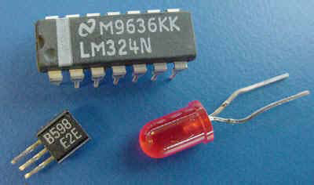
INTRODUCTION

Slide 5
SEMICONDUCTORS AND ELECTRONICS
Semiconductors are materials whose electrical conductivities are higher than those of insulators but lower that those of conductors.
Silicon, Germanium, Gallium, Arsenide, Indium, Antimonide and cadmium sulphide are some commonly used semiconductors.
Semiconductors have negative temperature coefficients of resistance, i.e. as temperature increases resistivity deceases.

Slide 6
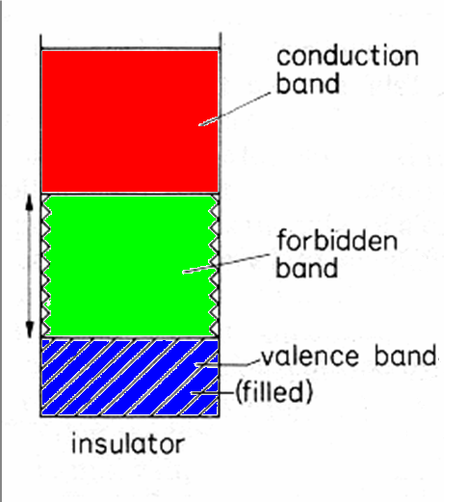
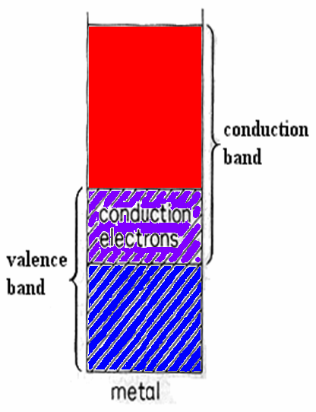
ENERGY BANDS IN INSULATORS & CONDUCTORS

Slide 7
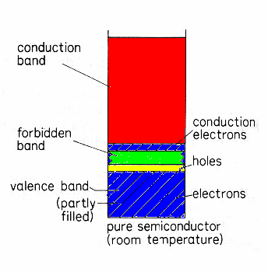
ENERGY BANDS IN SEMICONDUCTORS
Forbidden band small for semiconductors.
Less energy required for electron to move from valence to conduction band.
A vacancy (hole) remains when an electron leaves the valence band.
Hole acts as a positive charge carrier.

Slide 8
INTRINSIC SEMICONDUCTOR
Both silicon and germanium are tetravalent, i.e. each has four electrons (valence electrons) in their outermost shell.
Both elements crystallize with a diamond-like structure, i.e. in such a way that each atom in the crystal is inside a tetrahedron formed by the four atoms which are closest to it.
Each atom shares its four valence electrons with its four immediate neighbours, so that each atom is involved in four covalent bonds.

Slide 9
INTRINSIC SEMICONDUCTOR
At zero Kelvin all of the four valence electrons of each atom in the silicon crystal form part of the covalent bond with the four neighboring atoms.
The valence band is completely full and the conduction band completely empty.
The semiconductor behaves as a
perfect insulator because there are
no conducting electrons present.

Slide 10
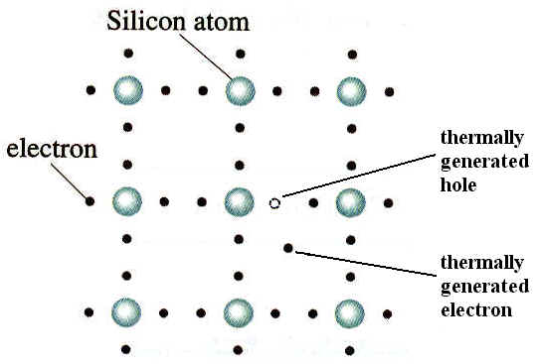
INTRINSIC SEMICONDUCTOR
At temperatures above zero Kelvin some of the valence electrons are able to break free from their bonds to become free conduction electrons.
The vacancy that is left behind is referred to as a hole. This hole is treated as a positive carrier of charge.
Conduction due solely to thermally
generated electron-hole pairs is
referred to as intrinsic conduction.

Slide 11
POSITIVE CHARGE CARRIER
An electron leaves its bond in position 7 (see i) and occupies the vacancy in position 6 (see ii). Hence the hole effectively moves from position 6 to position 7.

Slide 12
EXTRINSIC CONDUCTION
A pure or intrinsic conductor has thermally generated holes and electrons. However these are relatively few in number. An enormous increase in the number of charge carriers can by achieved by introducing impurities into the semiconductor in a controlled manner. The result is the formation of an extrinsic semiconductor. This process is referred to as doping. There are basically two types of impurities: donor impurities and acceptor impurities. Donor impurities are made up of atoms (arsenic for example) which have five valence electrons. Acceptor impurities are made up of atoms (gallium for example) which have three valence electrons.

Slide 13
N-TYPE EXTRINSIC SEMICONDUCTOR
Arsenic has 5 valence electrons, however, only 4 of them form part of covalent bonds. The 5th electron is then free to take part in conduction.
The electrons are said to be the majority carriers and the holes are said to be the minority carriers.

Slide 14
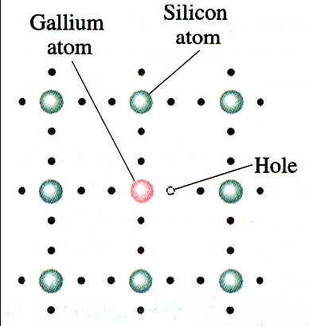
P-TYPE EXTRINSIC SEMICONDUCTOR
Gallium has 3 valence electrons, however, there are 4 covalent bonds to fill. The 4th bond therefore remains vacant producing a hole.
The holes are said to be the majority carriers and the electrons are said to be the minority carriers.

Slide 15
P-N JUNCTION DIODE
On its own a p-type or n-type semiconductor is not very useful. However when combined very useful devices can be made.
The p-n junction can be formed by allowing a p-type material to diffuse into a n-type region at high temperatures.
The p-n junction has led to many inventions like the diode, transistors and integrated circuits.

Slide 16
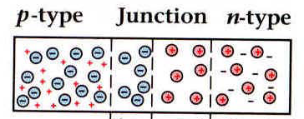
P-N JUNCTION DIODE
Free electrons on the n-side and free holes on the p-side can initially diffuse across the junction. Uncovered charges are left in the neighbourhood of the junction.
This region is depleted of mobile carriers and is called the DEPLETION REGION (thickness 0.5 – 1.0 µm).

Slide 17
P-N JUNCTION DIODE
The diffusion of electrons and holes stop due to the barrier p.d (p.d across the junction) reaching some critical value.
The barrier p.d (or the contact potential) depends on the type of semiconductor, temperature and doping densities.
At room temperature, typical values of barrier p.d. are:
Ge ~ 0.2 – 0.4 V
Si ~ 0.6 – 0.8 V

Slide 18
FORWARD BIAS P-N JUNCTION
When an external voltage is applied to the P-N junction making the P side positive with respect to the N side the diode is said to be forward biased (F.B).
The barrier p.d. is decreased by the external applied voltage. The depletion band narrows which urges majority carriers to flow across the junction.
A F.B. diode has a very low resistance.

Slide 19
REVERSE BIAS P-N JUNCTION
When an external voltage is applied to the PN junction making the P side negative with respect to the N side the diode is said to be Reverse Biased (R.B.).
The barrier p.d. increases. The depletion band widens preventing the movement of majority carriers across the junction.
A R.B. diode has a very high resistance.

Slide 20
REVERSE BIAS P-N JUNCTION
Only thermally generated minority carriers are urged across the p-n junction. Therefore the magnitude of the reverse saturation current (or reverse leakage current) depends on the temperature of the semiconductor.
When the PN junction is reversed biased the width of the depletion layer increases, however if the reverse voltage gets too large a phenomenon known as diode breakdown occurs.

Slide 21
I-V CHARACTERISTICS

Slide 22
I-V CHARACTERISTICS
When the diode is F.B., the current increases exponentially with voltage except for a small range close to the origin.
When the diode is R.B., the reverse current is constant and independent of the applied reverse bias.
Turn-on or cut-in (threshold) voltage Vγ: for a F.B. diode it is the voltage when the current increases appreciably from zero.
It is roughly equal to the barrier p.d.:
For Ge, V γ ~ 0.2 – 0.4 V (at room temp.)
For Si, Vγ ~ 0.6 – 0.8 V (at room temp.)

Slide 23
DIODE DESTRUCTION
Diode breakdown occurs when either end of the depletion region approaches its electrical contact, the applied voltage has become high enough to generate an electrical arc straight through the crystal. This will destroy the diode.
It is also possible to allow too much current to flow through the diode in the forward direction. The crystal is not a perfect conductor; it does exhibit some resistance. Heavy current flow will generate some heat within that resistance. If the resulting temperature gets too high, the semiconductor crystal will actually melt, destroying its usefulness.

Slide 24
RECTIFICATION
Rectification is the process whereby a sinusoidal alternating current is converted into direct current.
There are two types of rectification:
  Half-Wave Rectification
  Full-Wave Rectification

Slide 25
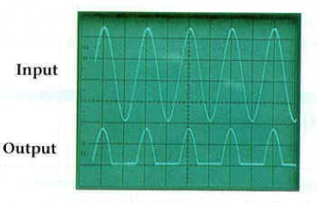
HALF-WAVE RECTIFICATION
A single diode can be used to achieve half-wave rectification.
The disadvantage of this . method is that only half of the signal is used. The output voltage is direct (there is no change in polarity) however it is not very smooth.

Slide 26
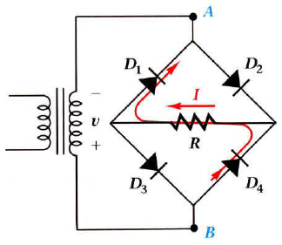
FULL-WAVE RECTIFICATION
During the half-cycle in which A is at the higher potential diodes D2 and D3 conduct. During the subsequent half-cycle diodes D4 and D1 conduct. Note that in both cycles the current flows in the same direction through resistor R.

Slide 27
FULL-WAVE RECTIFICATION
The output voltage is smoother than the output for half-wave rectification but still not smooth enough for many applications.

Slide 28
SMOOTHING
A capacitor can be used to filter (remove the voltage variation) the output voltage.
As the voltage grows the capacitor charges up, and as the voltage falls the capacitor discharges through the resistor.
If the capacitance is large enough the voltage will not fall a lot before the capacitor is charged up once more. In this way the output voltage is smoothened.

Slide 29
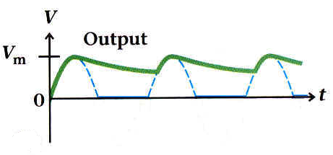
SMOOTHING
Note that a small ripple is left. This ripple is reduced by increasing the capacitance of the capacitor.
It should be noted however that increasing the capacitance increases the current which surges through the diode as the capacitor is charged up once every cycle.
This surge could possibly destroy the diode.

