Slide 1





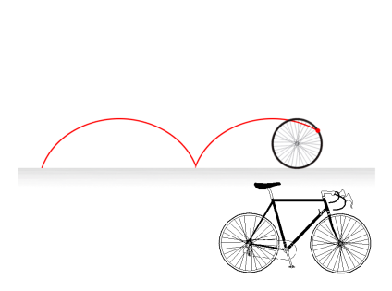

Whiteboardmaths.com
7
2
1
5
© 2004 All rights reserved

Slide 2


Cumulative Frequency Curves
Remember:
When data is grouped we don’t know the actual value of either the mean, median, mode or range.
We can get an estimate for the mean by using mid-points from the frequency table.
minutes late
frequency
midpoint(x)
mp x f
0 - 10
27
10 - 20
10
20 - 30
7
30 - 40
5
40 - 50
4
50 - 60
2
The measure of spread used with the median is the inter- quartile range. This is a better measure of spread as it only uses the middle half of the data that is grouped around the median. This means that unlike the range it is not subject to extreme values.
We can also use the grouped data to obtain an estimate of the median and a measure of spread called the inter-quartile range. We do this by plotting a cumulative frequency curve (Ogive).
Remember:
The measure of spread used with the mean is the range.
The range is not a good measure of spread as it is subject to extreme values.

Slide 3
Cumulative Frequency Curves
Remember:
When data is grouped we don’t know the actual value of either the mean, median, mode or range.
We can get an estimate for the mean by using mid-points from the frequency table.
minutes late
frequency
midpoint(x)
mp x f
0 - 10
27
10 - 20
10
20 - 30
7
30 - 40
5
40 - 50
4
50 - 60
2
Discuss the calculations below
Battery Life: The life of 12 batteries recorded in hours is:
2, 5, 6, 6, 7, 8, 8, 8, 9, 9, 10, 15
Mean = 93/12 = 7.75 hours and the range = 15 – 2 = 13 hours.
2, 5, 6, 6, 7, 8, 8, 8, 9, 9, 10, 15
Median = 8 hours and the inter-quartile range = 9 – 6 = 3 hours.

Slide 4
Cumulative Frequency Curves
Cumulative frequency diagrams are used to obtain an estimate of the median, and quartiles. from a set of grouped data. Constructing a cumulative frequency table is first step.
Example 1. During a 4 hour period at a busy airport the number of late-arriving aircraft was recorded.
Cumulative frequency table
Minutes
Late
Frequency
Upper Limit
Cumulative Frequency
0 - 10
5
< 10
5
10 - 20
8
< 20
13
20 - 30
22
< 30
35
30 - 40
12
< 40
47
40 - 50
8
< 50
55
50 - 60
5
< 60
60
Cumulative frequency just means running total.

Slide 5
Plotting the curve
70
Cumulative frequency table
60
Mins
Late
f
Upper Limit
CF
50
¾
0 - 10
5
< 10
5
10 - 20
8
< 20
13
40
Cumulative Frequency
20 - 30
22
< 30
35
½
30
IQR = 38 – 21 = 17 mins
30 - 40
12
< 40
47
40 - 50
8
< 50
55
20
¼
50 - 60
5
< 60
60
10
Median = 27
LQ = 21
UQ = 38
Plot the end point of each interval against cumulative frequency, then join the points to make the curve.
0
10
20
30
40
50
60
70
Minutes Late
Get an estimate for the median.
Find the lower quartile.
Find the Upper Quartile.
Find the Inter Quartile Range.(IQR = UQ - LQ)

Slide 6
Cumulative Frequency Curves
Cumulative frequency diagrams are used to obtain an estimate of the median and quartiles from a set of grouped data. Constructing a cumulative frequency table is first step.
Cumulative frequency table
Example 2. A P.E teacher records the distance jumped by each of 70 pupils.
Distance (cm)
Nº of pupils
Upper
Limit
Cumulative Frequency
180 < d < 190
2
d < 190
2
190 < d < 200
6
d < 200
8
200 < d < 210
9
d < 210
17
210 < d < 220
7
d < 220
24
220 < d < 230
15
d < 230
39
230 < d < 240
18
d < 240
57
240 < d < 250
8
d < 250
65
250 < d < 260
5
d < 260
70
Cumulative frequency just means running total.

Slide 7
Plotting The Curve
70
Cumulative Frequency Table
60
¾
Distance jumped (cm)
Number of pupils
Cumulative Frequency
50
180 < d < 190
2
2
190 < d < 200
6
8
200 < d < 210
9
17
40
½
210 < d < 220
7
24
Cumulative Frequency
220 < d < 230
15
39
30
IQR = 237 – 212 = 25 cm
230 < d < 240
18
57
240 < d < 250
8
65
¼
250 < d < 260
5
70
20
Median = 227
Plot the end point of each interval against cumulative frequency, then join the points to make the curve.
10
LQ= 212
UQ = 237
0
180
190
200
210
220
230
240
250
260
Distance jumped (cm)
Get an estimate for the median.
Find the Lower Quartile.
Find the Upper Quartile.
Find the Inter Quartile Range.(IQR = UQ - LQ)

Slide 8
Interpreting Cumulative Frequency Curves
70
The cumulative frequency curve gives information on aircraft arriving late at an airport. Use the curve to find estimates to
(a) The median
(b) The inter-quartile range
(c) The number of aircraft arriving less than 45 minutes late.
(d) The number of aircraft arriving more than 25 minutes late.
60
50
¾
40
Cumulative Frequency
½
30
IQR = 38 – 21 = 17 mins
20
¼
10
Median = 27
LQ = 21
UQ =38
0
10
20
30
40
50
60
70
Minutes Late

Slide 9
Interpreting Cumulative Frequency Curves
70
The cumulative frequency curve gives information on aircraft arriving late at an airport. Use the curve to find estimates to:
(a) The median
(b) The inter-quartile range
(c) The number of aircraft arriving less than 45 minutes late.
(d) The number of aircraft arriving more than 25 minutes late.
60
52
50
40
Cumulative Frequency
30
60 – 24 =36
20
10
0
10
20
30
40
50
60
70
Minutes Late

Slide 10

Interpreting Cumulative Frequency Curves
70
The graph shows the cumulative frequency curve of the marks for students in an examination. Use the graph to find:
(a) The median mark.
(b) The number of students who got less than 55 marks.
(c) The pass mark if ¾ of the students passed the test.
58
60
50
40
Cumulative Frequency
30
20
Median = 27
10
0
10
20
30
40
50
60
21
Marks
¾ of the students passing the test implies that ¼ failed. (15 students)

Slide 11
Interpreting Cumulative Frequency Curves
140
The lifetime of 120 projector bulbs was measured in a laboratory. The graph shows the cumulative frequency curve for the results. Use the graph to find:
(a) The median lifetime of a bulb.
(b) The number of bulbs that had a lifetime of between 200 and 400 hours?
(c) After how many hours were 80% of the bulbs dead?.
(d) What was the shortest lifetime of a bulb?
120
100
80
Cumulative Frequency
60
40
20
0
100
200
300
400
500
600
Lifetime of bulbs in hours
(a) 330 hours
(b) 86 - 12 = 74
(c) 440 hours
(d) 100 hours

Slide 12
Box Plot from Cumulative Frequency Curve
70
60
50
¾
40
Cumulative Frequency
½
30
IQR = 38 – 21 = 17 mins
20
¼
10
Median = 27
LQ = 21
UQ = 38
0
10
20
30
40
50
60
70
Minutes Late
0
10
20
30
40
50
60

Slide 13
Example 1
70
60
50
Mins
Late
f
Upper Limit
CF
40
0 - 10
5
< 10
Cumulative Frequency
10 - 20
8
< 20
30
20 - 30
22
< 30
20
30 - 40
12
< 40
40 - 50
8
< 50
10
50 - 60
5
< 60
0
10
20
30
40
50
60
70
Minutes Late

Slide 14
Example 2
70
60
Distance jumped (cm)
Number of pupils
Cumulative Frequency
50
180 < d < 190
2
190 < d < 200
6
40
200 < d < 210
9
Cumulative Frequency
210 < d < 220
7
30
220 < d < 230
15
230 < d < 240
18
20
240 < d < 250
8
250 < d < 260
5
10
0
180
190
200
210
220
230
240
250
260
Distance jumped (cm)

Slide 15
Interpreting Cumulative Frequency Curves
70
The cumulative frequency curve gives information on aircraft arriving late at an airport. Use the curve to find estimates to
(a) The median
(b) The inter-quartile range
(c) The number of aircraft arriving less than 45 minutes late.
(d) The number of aircraft arriving more than 25 minutes late.
60
50
40
Cumulative Frequency
30
20
10
0
10
20
30
40
50
60
70
Minutes Late

Slide 16
Interpreting Cumulative Frequency Curves
70
The graph shows the cumulative frequency curve of the marks for students in an examination. Use the graph to find:
(a) The median mark.
(b) The number of students who got less than 55 marks.
(c) The pass mark if ¾ of the students passed the test.
60
50
40
Cumulative Frequency
30
20
10
0
10
20
30
40
50
60
Marks

Slide 17
Interpreting Cumulative Frequency Curves
140
The lifetime of 120 projector bulbs was measured in a laboratory. The graph shows the cumulative frequency curve for the results. Use the graph to find:
(a) The median lifetime of a bulb.
(b) The number of bulbs that had a lifetime of between 200 and 400 hours?
(c) After how many hours were 80% of the bulbs dead?.
(d) What was the shortest lifetime of a bulb?
120
100
80
Cumulative Frequency
60
40
20
0
100
200
300
400
500
600
Lifetime of bulbs in hours

Slide 18
Cumulative Frequency Curves
Cumulative Frequency = a running total of the data
Median = Half way up the Cumulative Frequency
Lower Quartile (LQ) = ¼ way up Cum Freq
Upper Quartile (UQ) = ¾ way up Cum Freq
Inter Quartile Range = UQ - LQ

Slide 19
Big Worked Example
The table below shows the number of minutes students were late for their fun algebra lesson.
(a) Draw a Cumulative Frequency Diagram of the data
(b) Use it to find the Median, Lower Quartile, Upper Quartile, and Inter Quartile Range
(c) Draw a Box-Plot assuming a minimum time of o minutes and a maximum of 25 minutes
Time t (mins) | Number of Students | Cumulative Frequency
0 < t ≤ 5 | 10
5 < t ≤ 10 | 16
10 < t ≤ 15 | 30
15 < t ≤ 20 | 22
20 < t ≤ 25 | 2

Slide 20
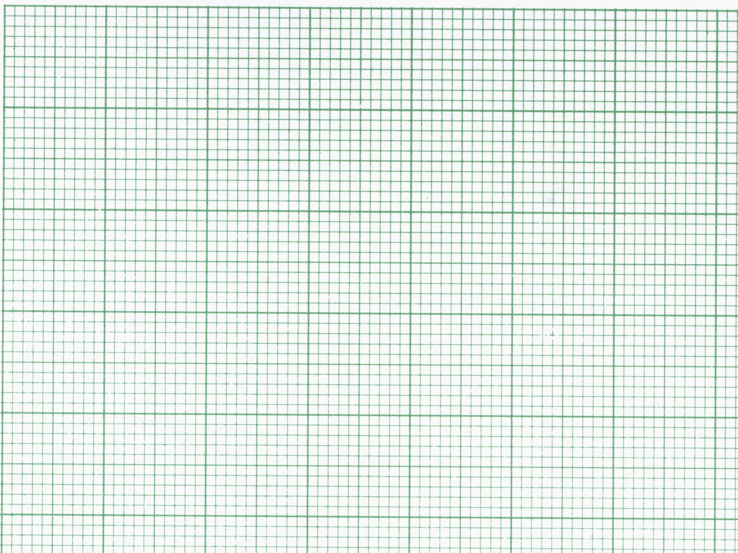
80
x
x
Cum freq
60
x
Median = Middle Value
40
QUARTILES
Lower Quartile = ¼ way
Upper Quartile = ¾ way
x
20
x
8½
12½
15½
5
10
15
20
25
t mins
Interquartile Range
= 15½ - 8½ = 7 mins

