Slide 1
Contents
S9 Construction and loci
S9.1 Constructing triangles
S9.2 Geometrical constructions
S9.3 Imagining paths and regions

Slide 2
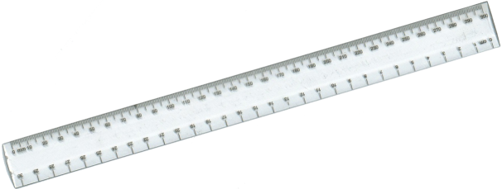
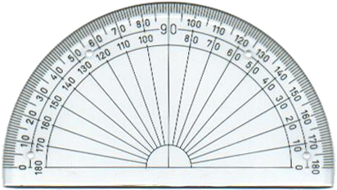
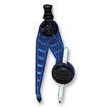
Equipment needed for constructions
Before you begin make sure you have the following equipment:
A ruler marked in cm and mm
A protractor
A sharp pencil
A pair of compasses
Notes:
Constructions should be drawn in pencil and construction lines should not be rubbed out.

Slide 3
Constructing triangles
To accurately construct a triangle you need to know:
The length of two sides and the included angle (SAS)
The size of two angles and a side (ASA)
The lengths of three of the sides (SSS)
Or
A right angle, the length of the hypotenuse and the length of one other side (RHS)

Slide 4
Constructing a triangle given SAS
How could we construct a triangle given the lengths of two of its sides and the angle between them?
side
angle
side
The angle between the two sides is often called the included angle.
We use the abbreviation SAS to stand for Side, Angle and Side.
Notes:
Discuss how this could be constructed using a ruler and a protractor.

Slide 5
Constructing a triangle given SAS

Slide 6
Constructing a triangle given ASA
How could we construct a triangle given two angles and the length of the side between them?
angle
angle
side
The side between the two angles is often called the included side.
We use the abbreviation ASA to stand for Angle, Side and Angle.
Notes:
Point out that if we are given two angles in a triangle we can work out the size of the third angle using the fact that the angles in a triangle add up to 180°. If the side we are given is not the included side then we can work out the third angle.
Discuss how this triangle could be constructed using a ruler and a protractor.

Slide 7
Constructing a triangle given ASA
Notes:
Ask pupils how we could check that this triangle has been constructed correctly.
Establish that we could measure angle C to verify that it measures 30°.
Remind pupils that construction lines should not be rubbed out.

Slide 8
Constructing a triangle given SSS
How could we construct a triangle given the lengths of three sides?
side
side
side
Hint: We would need to use a compass.
We use the abbreviation SSS to stand for Side, Side, Side.
Notes:
Discuss how this triangle could be constructed using a ruler and a compass.

Slide 9
Constructing a triangle given SSS

Slide 10
Constructing a triangle given RHS
Remember, the longest side in a right-angled triangle is called the hypotenuse.
How could we construct a right-angled triangle given the right angle, the length of the hypotenuse and the length of one other side?
hypotenuse
right angle
side
We use the abbreviation RHS to stand for Right angle, Hypotenuse and Side.

Slide 11
Constructing a triangle given RHS
Notes:
Ask pupils how we know that if angle B is the right-angle side AC must be the hypotenuse.
Stress that the hypotenuse, the longest side in a right-angled triangle, must always be the side opposite the right angle.
Review the construction of a perpendicular from a point on a line on slide 24.

Slide 12
Contents
S9 Construction and loci
S9.1 Constructing triangles
S9.2 Geometrical constructions
S9.3 Imagining paths and regions
S9.4 Loci
S9.5 Combining loci

Slide 13
Bisecting lines
Two lines bisect each other if each line divides the other into two equal parts.
For example, line CD bisects line AB at right angles.
C
A
B
D
We indicate equal lengths using dashes on the lines.
When two lines bisect each other at right angles we can join the end points together to form a rhombus.
Notes:
State that lines AB and CD are perpendicular.

Slide 14
Bisecting angles
A line bisects an angle if it divides it into two equal angles.
For example, in this diagram line BD bisects ABC.
A
D
B
C

Slide 15
The perpendicular bisector of a line
Notes:
Ask pupils how we could add lines to this diagram to make a rhombus.
The orange line, the perpendicular bisector, forms the set of points, or locus, of the points that are equidistant from points A and B.
Remind pupils that construction lines should not be rubbed out.

Slide 16
The bisector of an angle
Notes:
When the diagram is complete ask pupils to name the two equal angles. These are angle ABR and angle RBC.

Slide 17
The perpendicular from a point to a line

Slide 18
The perpendicular from a point on a line

