Slide 1
“Teach A Level Maths” Vol. 1: AS Core Modules
20: The Mid-Ordinate Rule
© Christine Crisp

Slide 2
Module C3
AQA
"Certain images and/or photos on this presentation are the copyrighted property of JupiterImages and are being used with permission under license. These images and/or photos may not be copied or downloaded without permission from JupiterImages"

Slide 3
To find an area bounded by a curve, we need to evaluate a definite integral.
If the integral cannot be evaluated, we can use an approximate method.
You have already met the Trapezium rule for doing this. This presentation uses another method, the mid-ordinate rule.

Slide 4
As before, the area under the curve is divided into a number of strips of equal width. However, this time, the top edge of each strip
. . .
is replaced by a straight line so the strips become rectangles.

Slide 5
As before, the area under the curve is divided into a number of strips of equal width. However, this time, the top edge of each strip
. . .
is replaced by a straight line so the strips become rectangles.
The top of the rectangle is drawn at the point on the curve whose x-value is at the middle of the strip.
The total area of the rectangles gives an approximation to the area under the curve.

Slide 6
To find the area of a strip we need
The width is h ( as in the Trapezium rule )
The height is y (the value of the function at the mid-point of the base)
The total area is

Slide 7
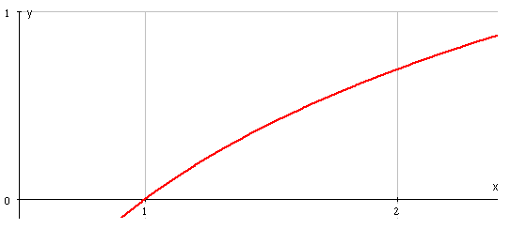
e.g.1 Use 4 strips with the mid-ordinate rule to estimate the value of
Give the answer to 4 d.p.
Solution:
Notice that the number of x-values is the same as the number of strips.

Slide 8
N.B.
a
b
1
2
So,

Slide 9
SUMMARY
The mid-ordinate rule for estimating an area is
where n is the number of strips.
The width, h, of each strip is given by
( but should be checked on a sketch )
The 1st x-value is at the mid-point of the width of the 1st rectangle:
The number of ordinates is the same as the number of strips.
The accuracy can be improved by increasing n.

Slide 10
Exercises
1. Estimate
using the mid-ordinate
rule with 4 strips, giving your answer to 3 d.p. How can your answer be improved?
2. Estimate
using the mid-ordinate
rule with 3 strips. Give your answer to 3 s.f.
N.B. Radians !

Slide 11
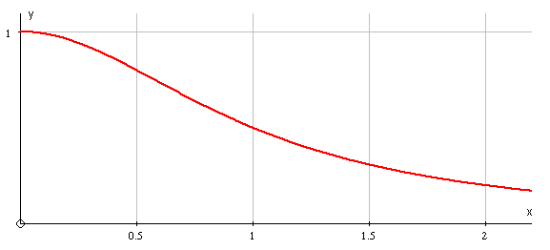
Solutions
1.
The answer can be improved by using more strips.

Slide 12
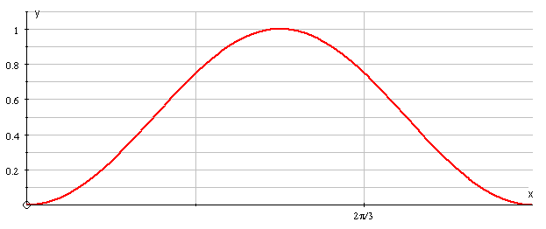
Solutions

Slide 13
The following sketches show sample rectangles where the mid-ordinate rule under- and over-estimates the area.
Under-estimates
( concave upwards )
Over-estimates
( concave downwards )
The blue shaded areas are not under the curve but are included in the rectangle.
The red shaded areas should be included but are not.

Slide 14
The following slides contain repeats of information on earlier slides, shown without colour, so that they can be printed and photocopied.
For most purposes the slides can be printed as “Handouts” with up to 6 slides per sheet.

Slide 15
SUMMARY
The mid-ordinate law for estimating an area is
where n is the number of strips.
The width, h, of each strip is given by
( but should be checked on a sketch )
The 1st x-value is at the mid-point of the width of the 1st rectangle:
The number of ordinates is the same as the number of strips.
The accuracy can be improved by increasing n.

Slide 16
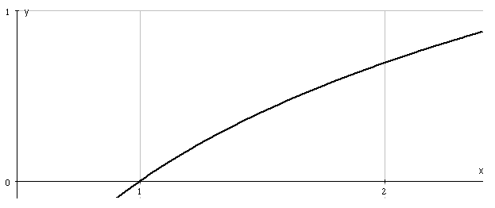
e.g.1 Use 4 strips with the mid-ordinate rule to estimate the value of
Give the answer to 4 d.p.
Solution:
We need 4 y-values so we set out the calculation in a table as for the Trapezium rule.

Slide 17
N.B.
a
b
1
2
So,

Slide 18
The following sketches show sample rectangles where the mid-ordinate rule under- and over estimates the area.
Underestimates
( concave upwards )
Overestimates
( concave downwards )

