Slide 1
“Teach A Level Maths”
Vol. 1: AS Core Modules
51: The Trapezium Rule
© Christine Crisp

Slide 2
Module C2
"Certain images and/or photos on this presentation are the copyrighted property of JupiterImages and are being used with permission under license. These images and/or photos may not be copied or downloaded without permission from JupiterImages"

Slide 3
To find an area bounded by a curve, we need to evaluate a definite integral.
If the integral cannot be evaluated, we can use an approximate method.
This presentation uses the approximate method called the Trapezium Rule.

Slide 4
The area under the curve is divided into a number of strips of equal width. The top edge of each strip . . .
. . . is replaced by a straight line so the strips become trapezia.

Slide 5
The area under the curve is divided into a number of strips of equal width. The top edge of each strip . . .
. . . is replaced by a straight line so the strips become trapezia.
The total area of the trapezia gives an approximation to the area under the curve.
The formula for the area of a trapezium is:
the average of the parallel sides
the distance apart
h seems a strange letter to use for width but it is always used in the trapezium rule

Slide 6
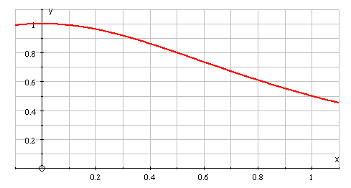
e.g.1
Suppose we have 5 strips.

Slide 7
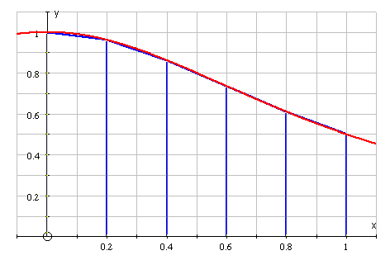
e.g.1
Suppose we have 5 strips.
The parallel sides of the trapezia are the y-values of the function.
The area of the 1st trapezium

Slide 8
e.g.1
Suppose we have 5 strips.
The parallel sides of the trapezia are the y-values of the function.
The area of the 1st trapezium
The area of the 2nd trapezium
etc.

Slide 9
e.g.1
Suppose we have 5 strips.
Adding the areas of the trapezia, we get
( removing common factors ).
Since is the side of 2 trapezia, it occurs twice in the formula. The same is true for to .
So,

Slide 10
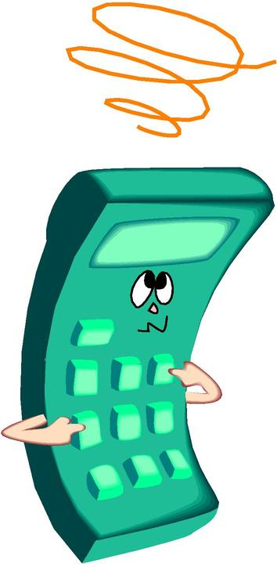
e.g.1
For each value of x, we calculate the y-values, using the function, and writing the values in a table.
So,

Slide 11
The general formula for the trapezium rule is
where n is the number of strips.
The y-values are called ordinates.
There is always 1 more ordinate than the number of strips.
The width, h, of each strip is given by
To improve the accuracy we just need to use more strips.

Slide 12
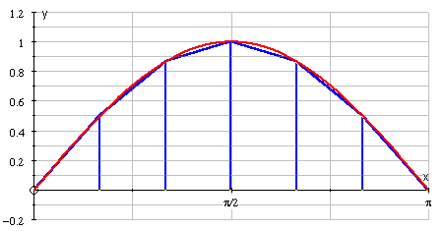
e.g.2 Find the approximate value of
using 6 strips and giving the answer to 2 d. p.
Solution:
Always draw a sketch showing the correct number of strips, even if the shape is wrong, as it makes it easy to find h and avoids errors.
The top edge of every trapezium in this example lies below the curve, so the rule will underestimate the answer.
( It doesn’t matter that the 1st and last “trapezia” are triangles )

Slide 13
Radians!
To make sure that we have the required accuracy we must use at least 1 more d. p. than the answer requires. It is better still to store the values in the calculator’s memories.

Slide 14

The exact value of is 2.
The percentage error in our answer is found as follows:
Percentage error =
error
exact value
( where, error = exact value − the approximate value ).
%

Slide 15
SUMMARY
The trapezium law for estimating an area is
where n is the number of strips.
The width, h, of each strip is given by
( but should be checked on a sketch )
The number of ordinates is 1 more than the number of strips.
The trapezium law underestimates the area if the tops of the trapezia lie under the curve and overestimates it if the tops lie above the curve.
The accuracy can be improved by increasing n.

Slide 16

Exercises
Use the trapezium rule to estimate the areas given by the integrals, giving the answers to 3 s. f.
1.
using 4 strips
How can your answer be improved?
2.
using 4 ordinates
Find the approximate percentage error in your answer, given that the exact value is 1.

Slide 17
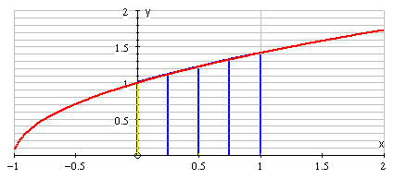
Solutions
1.
using 4 strips
The answer can be improved by using more strips.

Slide 18
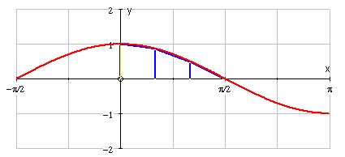
Solutions
2.
using 4 ordinates
The exact value is 1, so the percentage error
%

Slide 19


Slide 20
The following slides contain repeats of information on earlier slides, shown without colour, so that they can be printed and photocopied.
For most purposes the slides can be printed as “Handouts” with up to 6 slides per sheet.

Slide 21
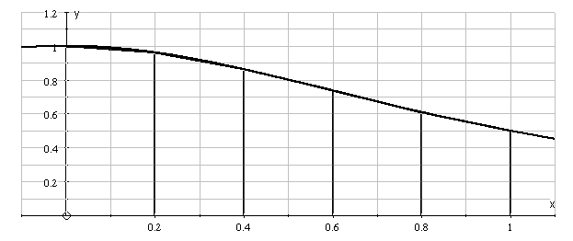
e.g.1
Suppose we have 5 strips.
Adding the areas of the trapezia, we get
( removing common factors ).
Since is the side of 2 trapezia, it occurs twice in the formula. The same is true for to .
So,

Slide 22
e.g.1 cont.
For each value of x, we calculate the y-values, using the function, and writing the values in a table.
So,

Slide 23
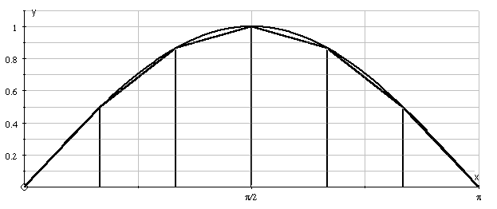
e.g.2 Find the approximate value of
using 6 strips and giving the answer to 2 d. p.
Solution:
Always draw a sketch showing the correct number of strips, even if the shape is wrong, as it makes it easy to find h and avoids errors.

Slide 24
The top edge of every trapezium in this example lies below the curve, so the rule will underestimate the answer.
( It doesn’t matter that the 1st and last “trapezia” are triangles )

Slide 25
Radians!
To make sure that we have the required accuracy we must use at least 1 more d. p. than the answer requires. It is better still to store the values in the calculator’s memories.

Slide 26
SUMMARY
The trapezium law for estimating an area is
where n is the number of strips.
The width, h, of each strip is given by
( but should be checked on a sketch )
The number of ordinates is 1 more than the number of strips.
The trapezium law underestimates the area if the tops of the trapezia lie under the curve and overestimates it if the tops lie above the curve.
The accuracy can be improved by increasing n.

