Slide 1
Bearings
Learning Intention
Success Criteria
1. Interpret information in a problem to create a suitable scale drawing.
  1. To solve real-life problems using scale drawings.
2. Use a scale drawing to solve a given problem.

Slide 2
Scale Drawings & Bearings
Problem
The sketch shows a flag-pole YT supported by
a wire. The distance from X to Y is 6m and
angle TXY = 55º.
T
Make a scale drawing and work
Out the real height of the pole.
Use a scale of 1cm = 2m
X
55º
Y
6m

Slide 3

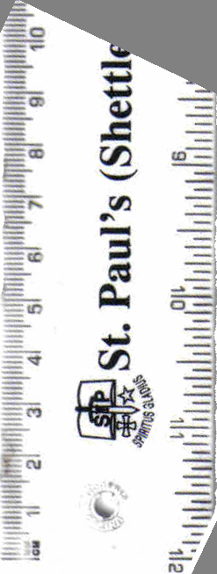
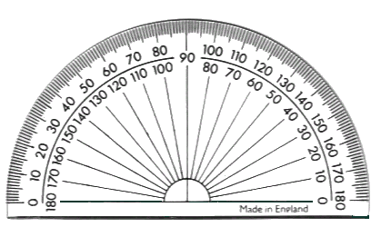
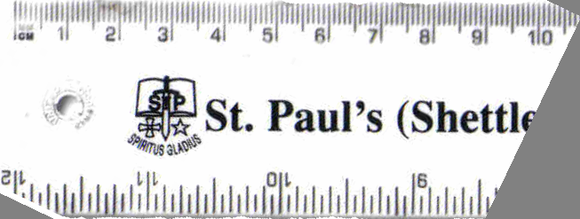
T
Scale Drawings & Bearings
X
55º
Y
6m
Solution
Using a scale of 1cm = 2m
T
Step 1: Draw line XY=3cm
Step 2: Draw a line straight up from Y.
Step 3: Measure angle 55º from X.
Step 4: Draw line from X to vertical line
and mark T at crossover point.
Step 5: Measure length YT.
4.3cm
Step 6: Multiply length YT.
by scale factor.
4.3 x 2 = 8.6m
X
Y
Flag pole is 8.6m high

Slide 4
Directions & Scale Drawings
Learning Intention
Success Criteria
1. Be able to make sense of a map.
  To show how to write down directions using a map.
  2. To explain how to construct a scale drawing using bearings.
Write down accurate directions from a map.
3. Construct and interpret an accurate scale drawing.

Slide 5
Compass Points
360/000º
Half way between North and West
N
Half way between North and East
NW
NE
270º
W
E
090º
SW
SE
Half way between South and West
Half way between South and East
S
180º

Slide 6
If Gary walks to John then to Barry and then back to where he started. Write down all the directions he took.
If Anne walks to Julie then to Amy and then back to where she started. Write down all the directions she took.
If Daniel is facing North and turns clockwise to face Anne. How many degrees is this.
If Daniel is facing Frances and turns clockwise to face Amy. How many degrees is this.
If Amy is facing Paul and turns anti-clockwise to face Daniel. How many degrees is this.
Who is North of Daniel
Who is East of John
Who is South West
of Barry
Who is North East
of Gary
Compass Points
John
Frances
Barry
N
Julie
Daniel
Anne
Gary
Amy
Paul

Slide 7
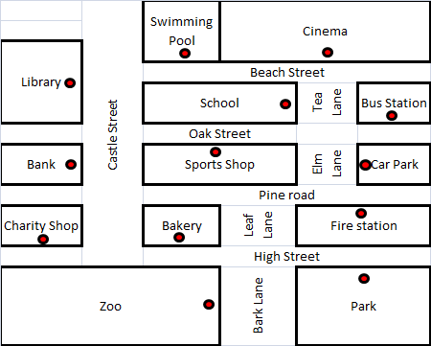
I leave the zoo to go back to my car which is in the town car park. Write down the directions I should take.
After going to the park I want to go to the cinema.
Tea Lane is closed.
Write down the directions
I should take.
There’s a fire at the library. Right down the directions the fire engine should take.
I come out of the swimming pool and turn right then left. I go into the building second on my the right.
Name the building.
I come out of the charity shop and need to catch a bus. Write down the directions to the bus station.
I come out of school and go to the Park.
Write down the directions I must take.
Map Directions
N

Slide 8
Scale Drawings & Bearings
Learning Intention
Success Criteria
1. Work out a bearing.
  1. To understand how to work out a bearing. Practical uses for bearings.
2. Give a bearing in the correct format (three figure reference).

Slide 9
Bearings
360/000º
N
1. Measured from North.
060º
2. In a clockwise direction.
60º
270º
W
E
090º
3. Written as 3 figures.
S
180º
N
N
N
315º
W
145º
E
W
E
W
E
230º
315º
145º
230º
S
S
S

Slide 10
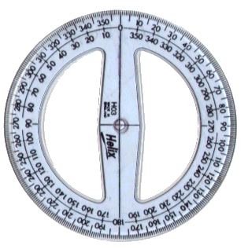
A 360º protractor is used to measure bearings.
Bearings
Use your protractor to measure the bearing of each point from the centre of the circle. (Worksheet 1)
360/000º
350º
N
020º
315º
045º
NW
NE
290º
080º
270º
W
E
090º
250º
110º
SW
SE
225º
210º
135º
S
160º
180º
Worksheet 1

Slide 11

N
360/000º
030º
330º
Estimate the bearing of each aircraft from the centre of the radar screen.
315º
045º
290º
075º
W
270º
090º
E
110º
Air Traffic Controller
Control Tower
250º
135º
225º
170º
200º
180º
S

Slide 12
N
360/000º
010º
325º
7
040º
Estimate the bearing of each aircraft from the centre of the radar screen.
310º
8
1
ACE
Controller
contest
060º
11
12
4
280º
2
W
270º
090º
E
3
5
Air Traffic Controller
Control Tower
250º
10
9
120º
235º
6
195º
155º
180º
Worksheet 2
S

Slide 13
Bearings
Measuring the bearing of one point from another.
To Find the bearing of Q from P.
N
P
118º
1. Draw a straight line between both points.
Q
2. Draw a North line at P.
3. Measure angle between.
Worksheet 3

Slide 14
Bearings
Measuring the bearing of one point from another.
To Find the bearing of P from Q.
N
298º
P
1. Draw a straight line between both points.
Q
2. Draw a North line at Q.
3. Measure angle between.
Worksheet 3

Slide 15
Bearings: Fixing Position
Trainee pilots have to to learn to be cope when the unexpected happens. If their navigation equipment fails they can quickly find their position by calling controllers at two different airfields for a bearing. The two bearings will tell the pilot where he is. The initial call on the controllers radio frequency will trigger a line on the radar screen showing the bearing of the calling aircraft.
Airfield (A)
283.2 MHZ UHF
170º
255º
Airfield (B)
306.7 MHZ UHF
Thankyou

Slide 16
Bearings
000/360º
N
270º
W
E
090º
S
180º
Worksheet 1

Slide 17
Bearings
360/000º
N
1. Measured from North.
060º
2. In a clockwise direction.
60º
270º
W
E
090º
3. Written as 3 figures.
S
180º
N
N
N
315º
W
145º
E
W
E
W
E
230º
315º
145º
230º
S
S
S

Slide 18
Scales & Drawing
Bearings
Example
The bearing from A to B is 70º.
What is the bearing from B to A.
North
North
Bearing
from B to A is :
70º
70º
+ 180º
B
70º
= 250º
A

Slide 19
Scales & Drawing
Bearings
Example
The bearing from X to Y is 30º.
What is the bearing from Y to X.
North
North
30º
Bearing
from Y to X is :
Y
30º
+ 180º
30º
= 210º
X

