Slide 1
Physical principles related to operation
Basic parts of the engine assembly
Four stroke operating theory

Slide 2
Physical Principles related to Engine Operation
Energy conversion
Atmospheric pressure
Vacuum
Pressure
The relationship between temperature, pressure and volume.
The three states of matter.

Slide 3
Energy Conversion
Engines take heat energy and convert it into mechanical energy.
Motors take electrical energy and convert it into mechanical energy.

Slide 4
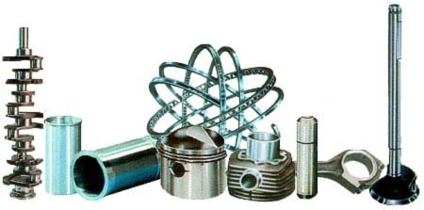
Basic Parts of the Gasoline Engine
Cylinder block
Piston
Piston rings
Piston pin
Connecting rod
Crankshaft
Cylinder head
Intake valve
Exhaust valve
Camshaft
Timing gears
Spark plug

Slide 5
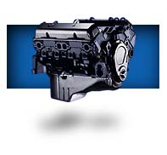
Cylinder Block
Basic frame of gasoline engine.
Contains the cylinder.

Slide 6
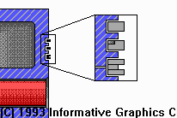
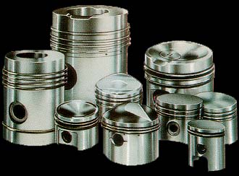
Piston
A sliding plug that harnesses the force of the burning gases in the cylinder.

Slide 7
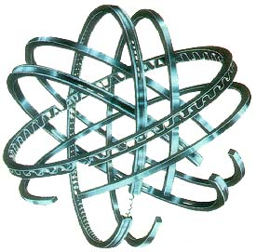
Piston Rings
The rings seal the compression gases above the piston keep the oil below the piston rings.

Slide 8
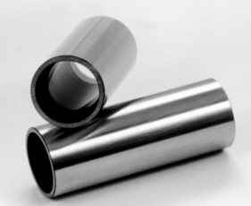
Piston Pins
Also known as the wrist pin, it connects the piston to the small end of the connecting rod.
It transfers the force and allows the rod to swing back and forth.

Slide 9
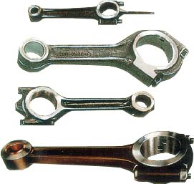
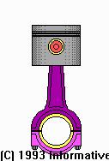
Connecting Rod
Connects the piston and piston pin to the crankshaft.

Slide 10
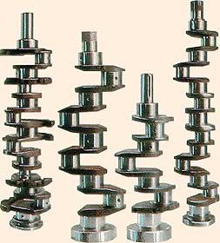
Crankshaft
Along the the piston pin and connecting rod it converts the up and down motion (reciprocating) of the engine to spinning (rotary) motion.

Slide 11
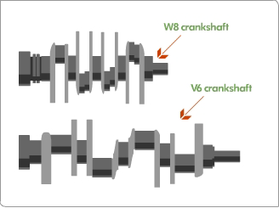
V Crank VS W Crank

Slide 12
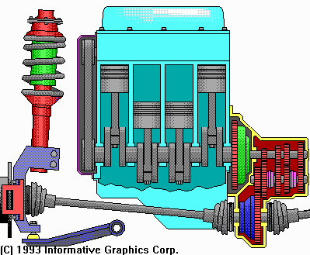

Flywheel
Carries the inertia when there is no power stroke.

Slide 13
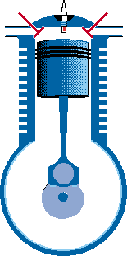
Lower End Action

Slide 14
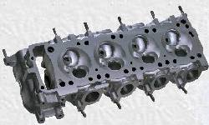
Cylinder Head
Forms the top of the combustion chamber.
Contains the valves, the passageways for the fuel mixture to move in and out of the engine.

Slide 15
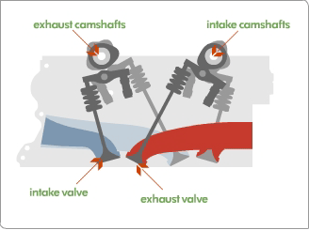
W Head

Slide 16
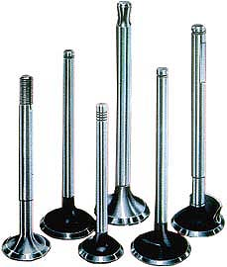
Intake and Exhaust Valves
Doorway that lets the gases in and out of the engine.

Slide 17
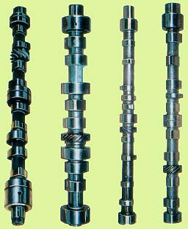
Camshaft
Through the use of an eccentric the cam lobes push the valves open.
The valve springs close them.

Slide 18

Timing Gears
These gears drive the camshaft from the crankshaft.

Slide 19

Spark Plug
Electric match used to begin the combustion process of burning air and gasoline to create heat.

Slide 20
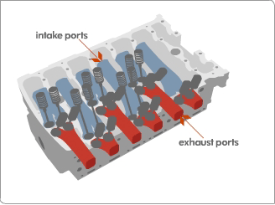
Engine Related Terms
TDC (top dead center)
BDC (bottom dead center)
Stroke
Bore
Revolution
Compression Ratio
Displacement
Cycle

Slide 21
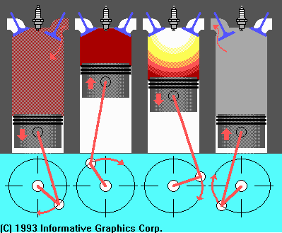
Four Stroke Cycle
Intake
Compression
Power
Exhaust

Slide 22
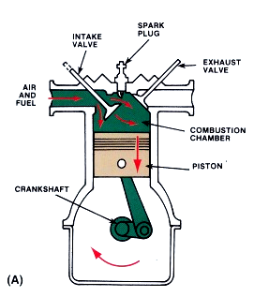
Intake Stroke
Intake valve opens.
Piston moves down, ½ turn of crankshaft.
A vacuum is created in the cylinder.
Atmospheric pressure pushes the air/fuel mixture into the cylinder.

Slide 23
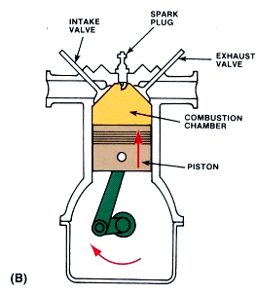
Compression Stroke
Valves close.
Piston moves up, ½ turn of crankshaft.
Air/fuel mixture is compressed.
Fuel starts to vaporize and heat begins to build.

Slide 24
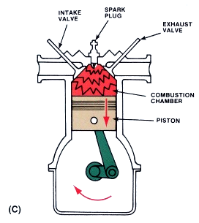
Power Stroke
Valves remain closed.
Spark plug fires igniting fuel mixture.
Piston moves down, ½ turn of crankshaft.
Heat is converted to mechanical energy.

Slide 25
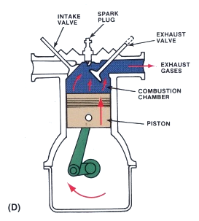
Exhaust Stroke
Exhaust valve opens.
Piston move up, crankshaft makes ½ turn.
Exhaust gases are pushed out polluting the atmosphere.

Slide 26
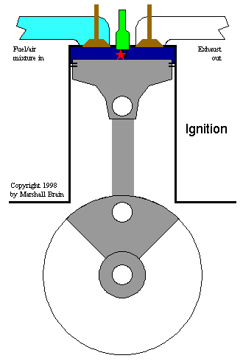
Four Stroke Cycle Animation

Slide 27
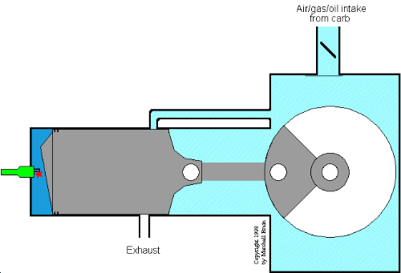
Two Stroke Animation

Slide 28
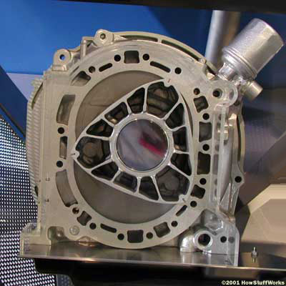
Rotary Engine

Slide 29
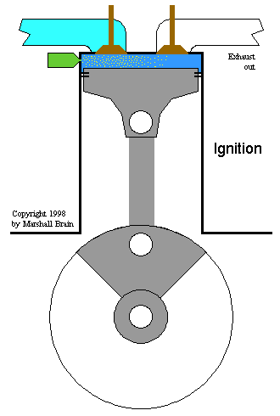
Diesel Animation

Slide 30
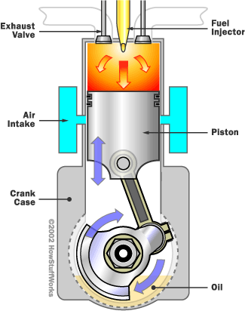
Diesel 2 stroke

Slide 31
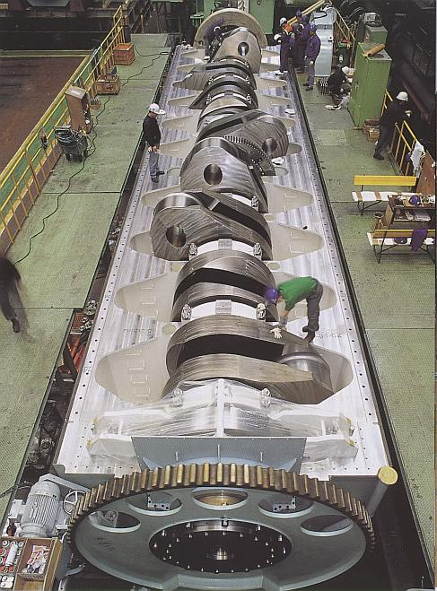
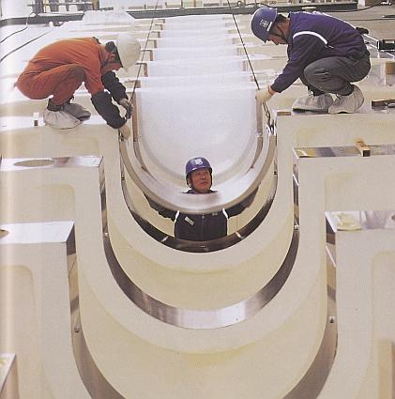
Diesel

Slide 32
Why not diesel?
Diesel engines, because they have much higher compression ratios (20:1 for a typical diesel vs. 8:1 for a typical gasoline engine), tend to be heavier than an equivalent gasoline engine.
Diesel engines also tend to be more expensive.

Slide 33
Why not diesel?
3. Diesel engines, because of the weight and compression ratio, tend to have lower maximum RPM ranges than gasoline engines (see Question 381 for details). This makes diesel engines high torque rather than high horsepower, and that tends to make diesel cars slow in terms of acceleration.
4. Diesel engines must be fuel injected, and in the past fuel injection was expensive and less reliable

Slide 34
Why not diesel?
5. Diesel engines tend to produce more smoke and "smell funny".
6. Diesel engines are harder to start in cold weather, and if they contain glow plugs, diesel engines can require you to wait before starting the engine so the glow plugs can heat up.
7. Diesel engines are much noisier and tend to vibrate.
8. Diesel fuel is less readily available than gasoline

Slide 35
Why not diesel?
One or two of these disadvantages would be OK, but a group of disadvantages this large is a big deterrent for lots of people.

Slide 36
Advantages
The two things working in favor of diesel engines are better fuel economy and longer engine life. Both of these advantages mean that, over the life of the engine, you will tend to save money with a diesel. However, you also have to take the initial high cost of the engine into account. You have to own and operate a diesel engine for a fairly long time before the fuel economy overcomes the increased purchase price of the engine. The equation works great in a big diesel tractor-trailer rig that is running 400 miles every day, but it is not nearly so beneficial in a passenger car.

Slide 37
The Cycle
How many revolutions of the crankshaft does it take to complete the four strokes?
If an engine idles at 500 rpm, how many power strokes occur per minute?
How many power strokes per second?
How about at 5000 rpm or 10,000 rpm?

