Slide 1
Australia
Your task over the next two Geography sessions is to design your own project about Australia.
Your project must be informative but interesting. You must include pictures. These can be found on the internet and printed off.
The project must be on paper form and be around two sides of A4 paper or equivalent.
The best projects will have drawn from information from this PowerPoint and your own knowledge.
The questions in orange act as useful prompts.
Be careful not to overload your projects with information. Take out the “best bits”. Remember that you only have 2 sides of A4 paper.

Slide 2
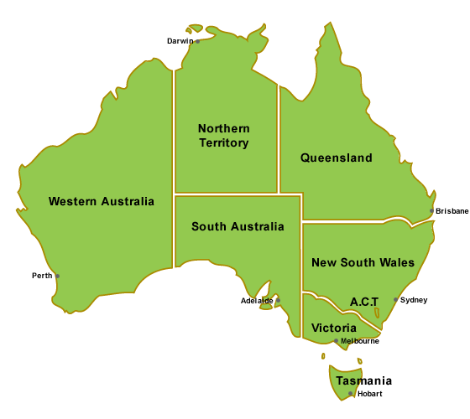
Australia
Location
Landmarks
Facts
&
Figures
Australian
Life
Leisure
Web Pages
Culture

Slide 3
Leisure
Due to Australia’s sunny climate, leisure activities often involve outdoor pursuits. These include outdoor sports, swimming, surfing and sailing.
How does this compare to how to spend your leisure time?
Can you find out which sports Australians particularly enjoy? Are they the same as those that British people enjoy?
HOME

Slide 4
Facts & Figures
Population: 20,406,800
Currency: Dollar (AUD)
Official Language Spoken: English
Weather: The northern third of Australia lies in the tropics and so is warm or hot the year around. The rest of the country lies south of the tropics and has warm summers and mild or cool winters.
Capital city: Canberra
Can you look on the internet and/or in books and find any other interesting facts and figures to present in your project?
HOME

Slide 5
Location
Australia makes up part of Australasia.
Can you find out what other countries make up Australasia?
Sydney is approximately 17,000 km away from London
How would you get there? How long would it take? How much would it cost?
HOME

Slide 6
Australian Life
Over 80% of Australia’s population lives in cities and towns along the coast.
What is the name of Australia’s largest city?
The vast area in the middle of Australia is known as the outback. With farms and tows being extremely far apart, people can lead quite isolated lives.
Can you find out about how the sick are cared for in the outback?
Can you find out about schooling in the outback?
HOME

Slide 7
Culture
The variety of animals associated with Australia will always be a key aspect of their culture. These include Kangaroos and Koalas.
Can you find any more animals associated with Australia and find out more about them?
The didgeridoo is another aspect of Australian culture.
What is a didgeridoo? How is it used?
Can you find out about Australian Slang? What is pidgin English?
Who were the Aborigines?
HOME

Slide 8
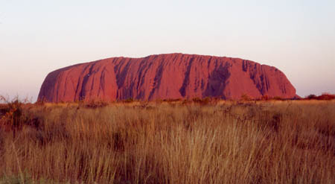
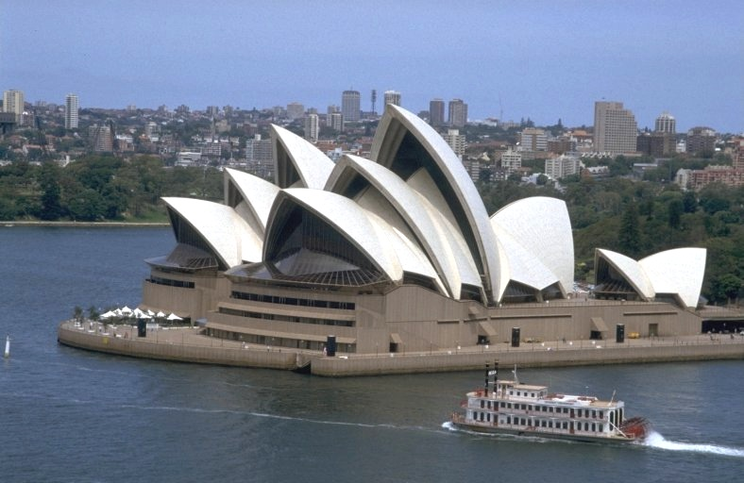
Landmarks
Australia has some of the worlds most beautiful landmarks. Ayers Rock and the Sydney opera house are just two of them.
Can you find out anything about these places or any other famous landmarks in Australia?
HOME

Slide 9
Web Pages
You can try these websites for more information, or use a search engine to find your own.
http://www.csu.edu.au/australia/
http://www.auswildlife.com/
http://www.bbc.co.uk/schools/barnabybear/stories/downunder.shtml
http://www.travelonline.com.au/
HOME

