Slide 1
Session 1

Slide 2
Learning Objectives Today I am Learning…
That animals have babies
and they grow into new adults
Success Criteria
I need to…
Ask questions about the
differences

Slide 3
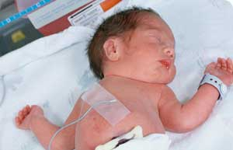
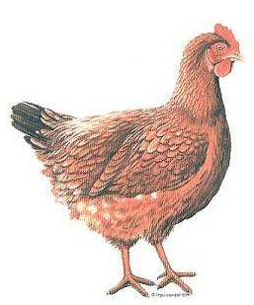
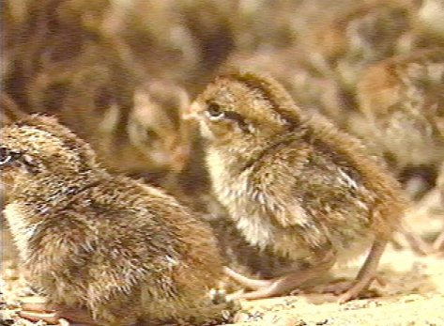
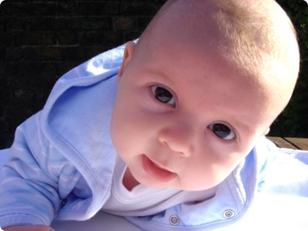
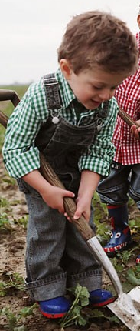
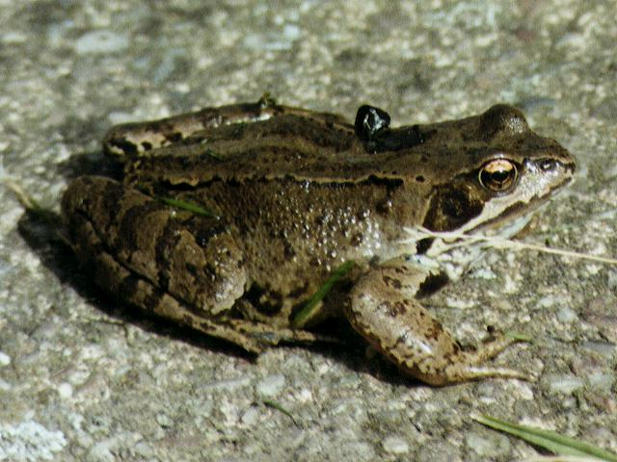
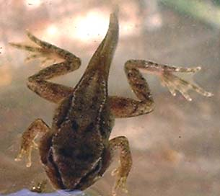
Changing from babies to adults
Animals change from babies to adults.
?
?

Slide 4
Activity
Fold a circle of paper into quarters.
Choose which life cycle you want to
show.
Draw each stage of the
life cycle.
Remember to add the
arrows to show which
direction the life cycle goes.

Slide 5
Session 2

Slide 6
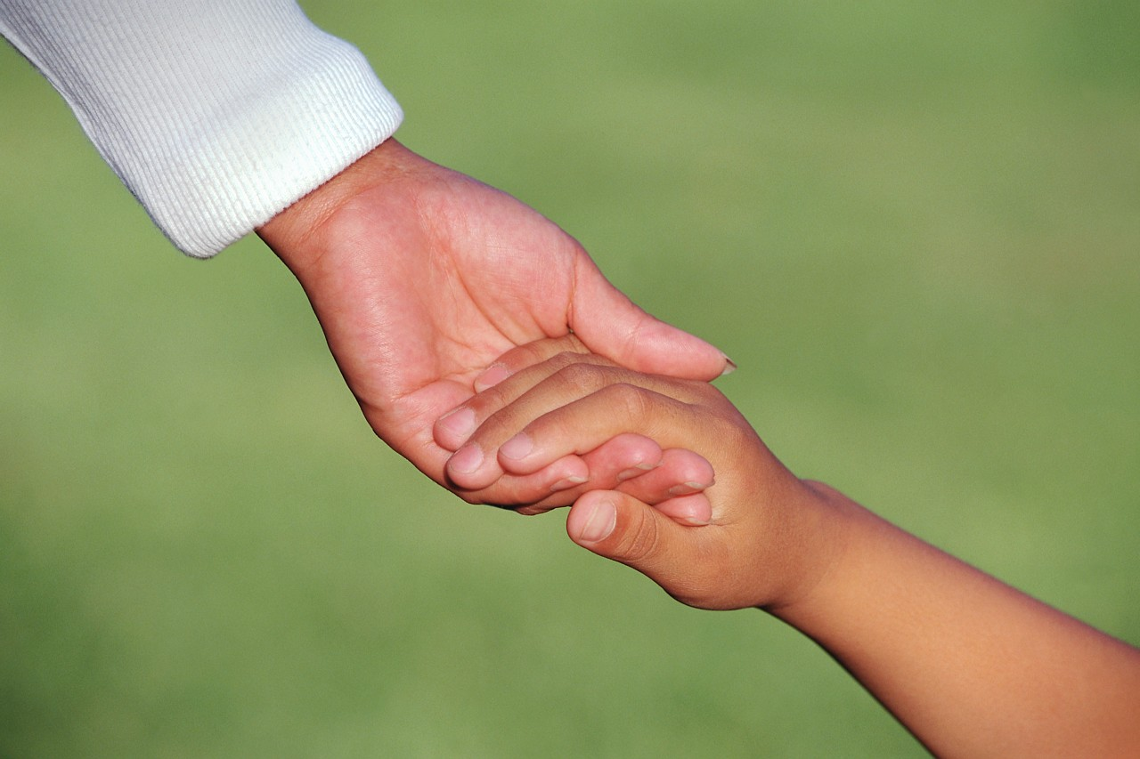
Learning Objectives Today I am Learning…
That babies and children need to be looked after while
they are growing
That we can ask questions to help us compare babies and
toddlers

Slide 7
Success Criteria I need to…
Record in different ways how a baby and toddler need
to be looked after
Ask questions about the differences between the baby
And the toddler

Slide 8
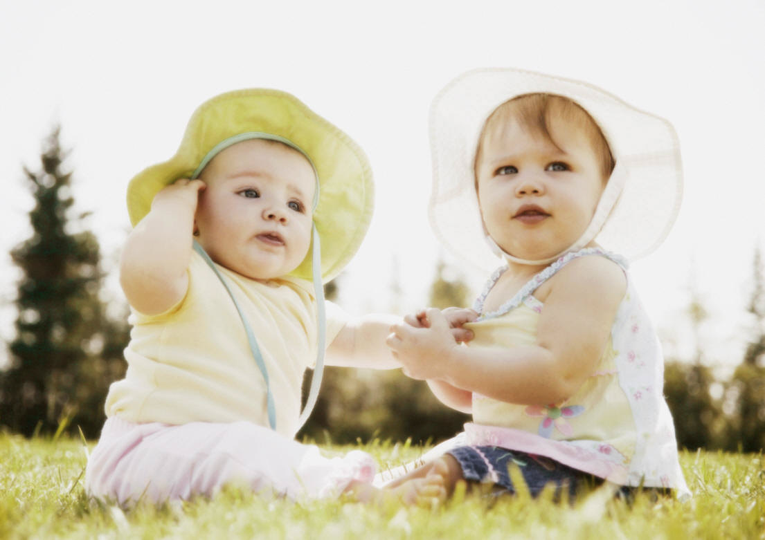
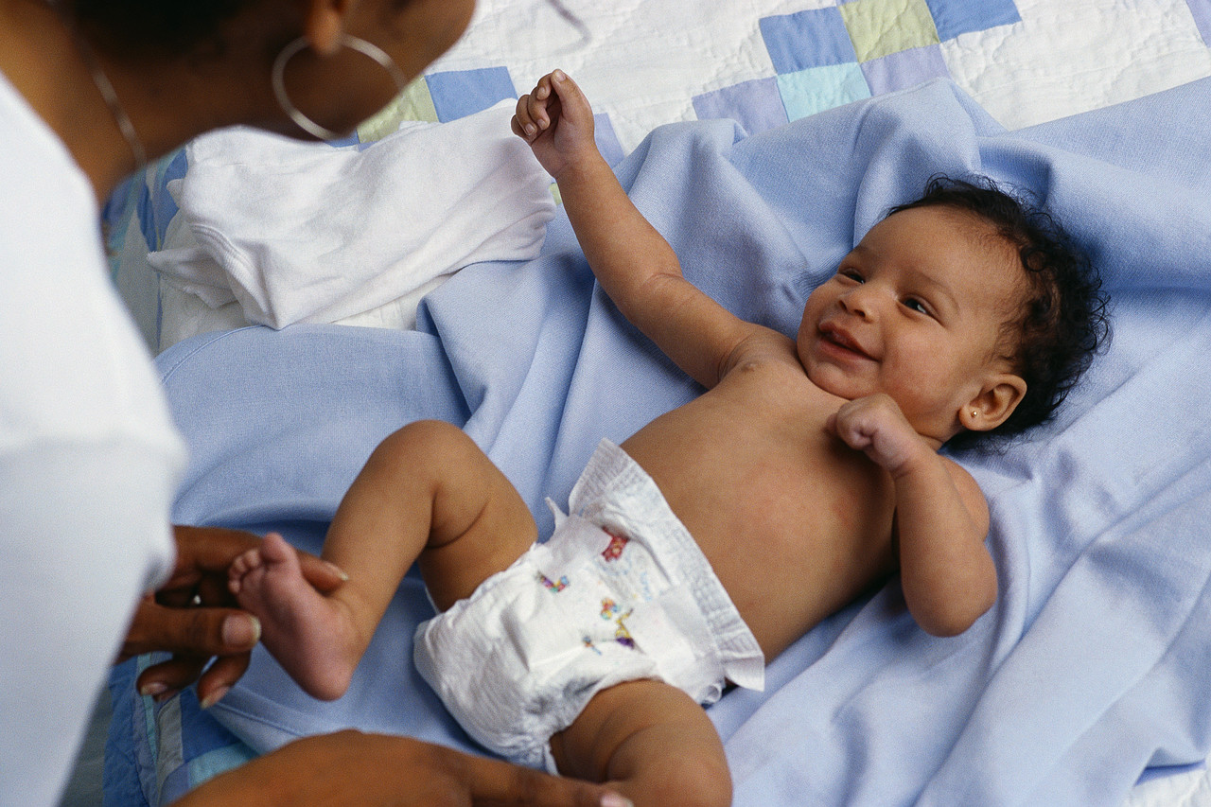
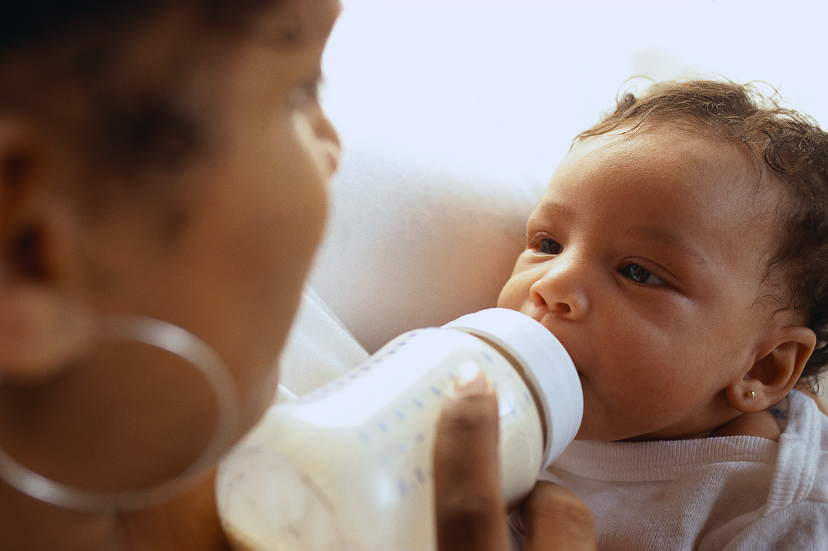
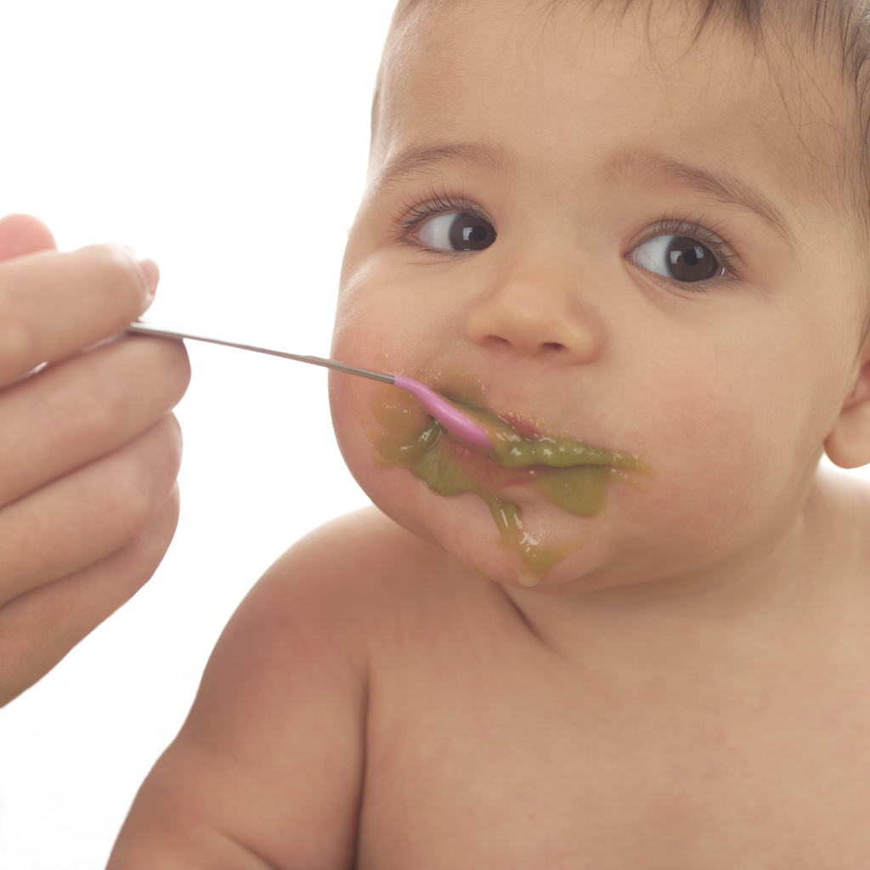
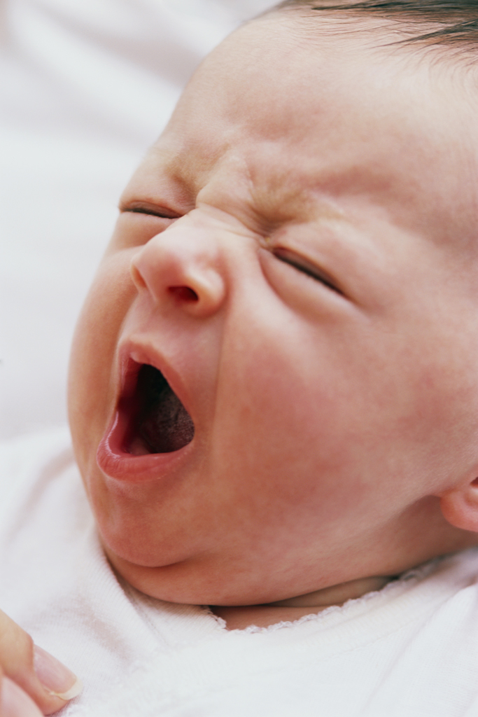
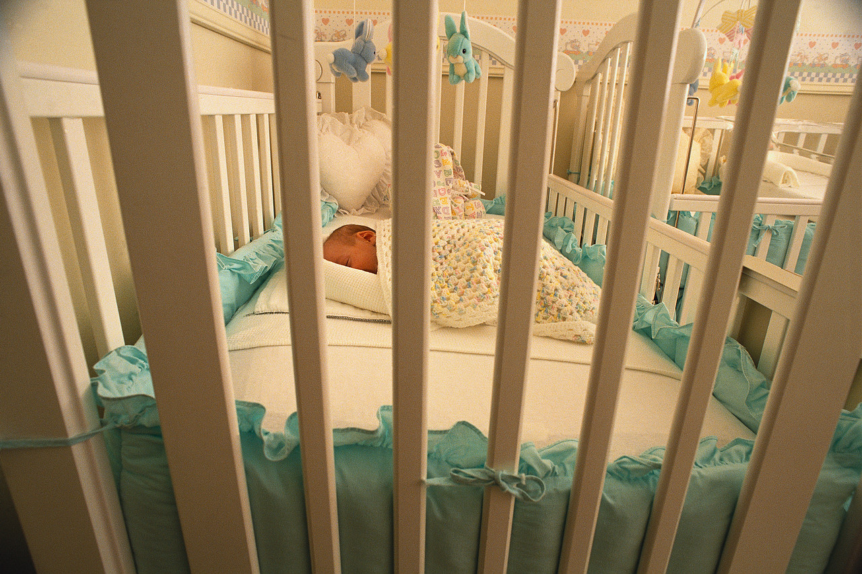
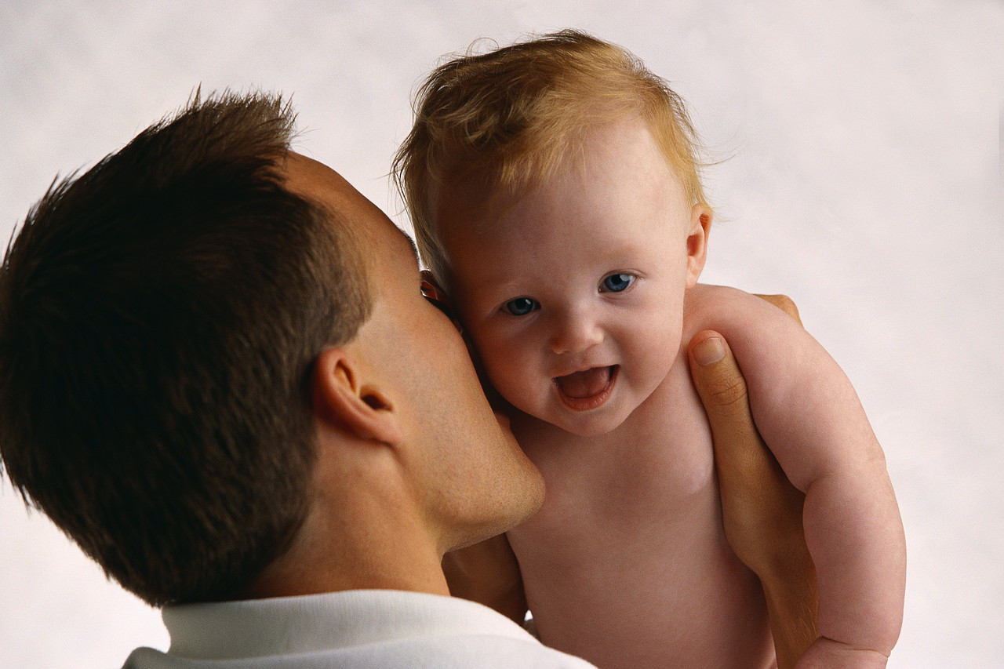
What can a baby do?
How does a baby feed?
How does a baby get dressed?
How does a baby go to bed?
How does a baby tell you it’s hungry?
How does a baby move about?

Slide 9
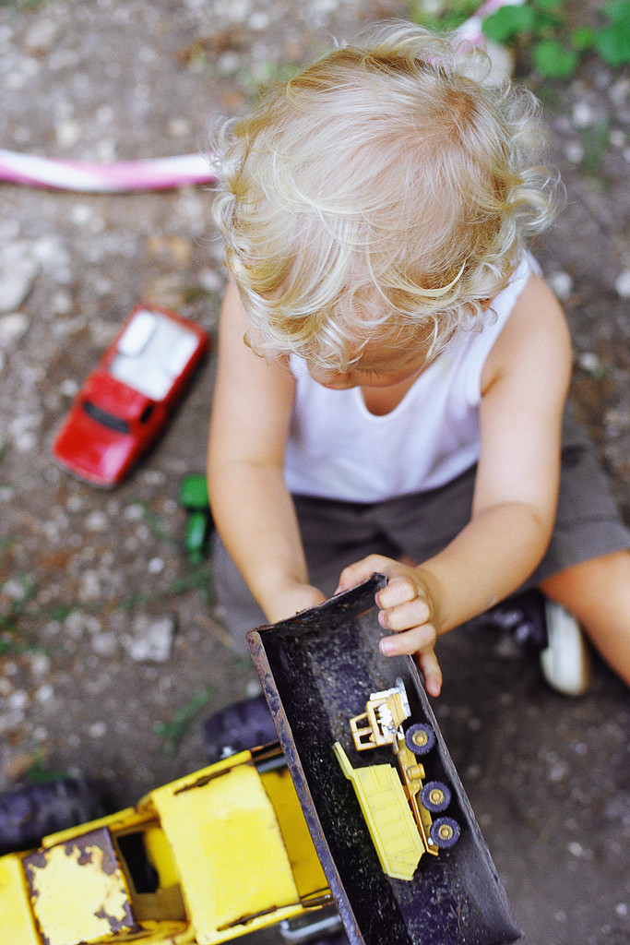
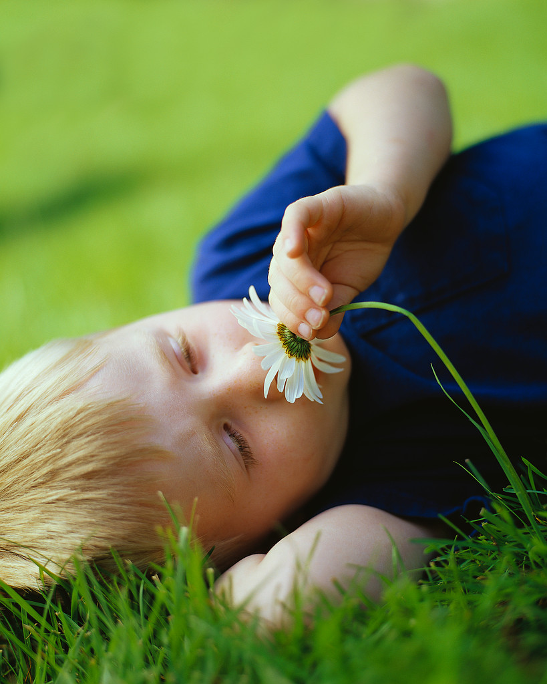
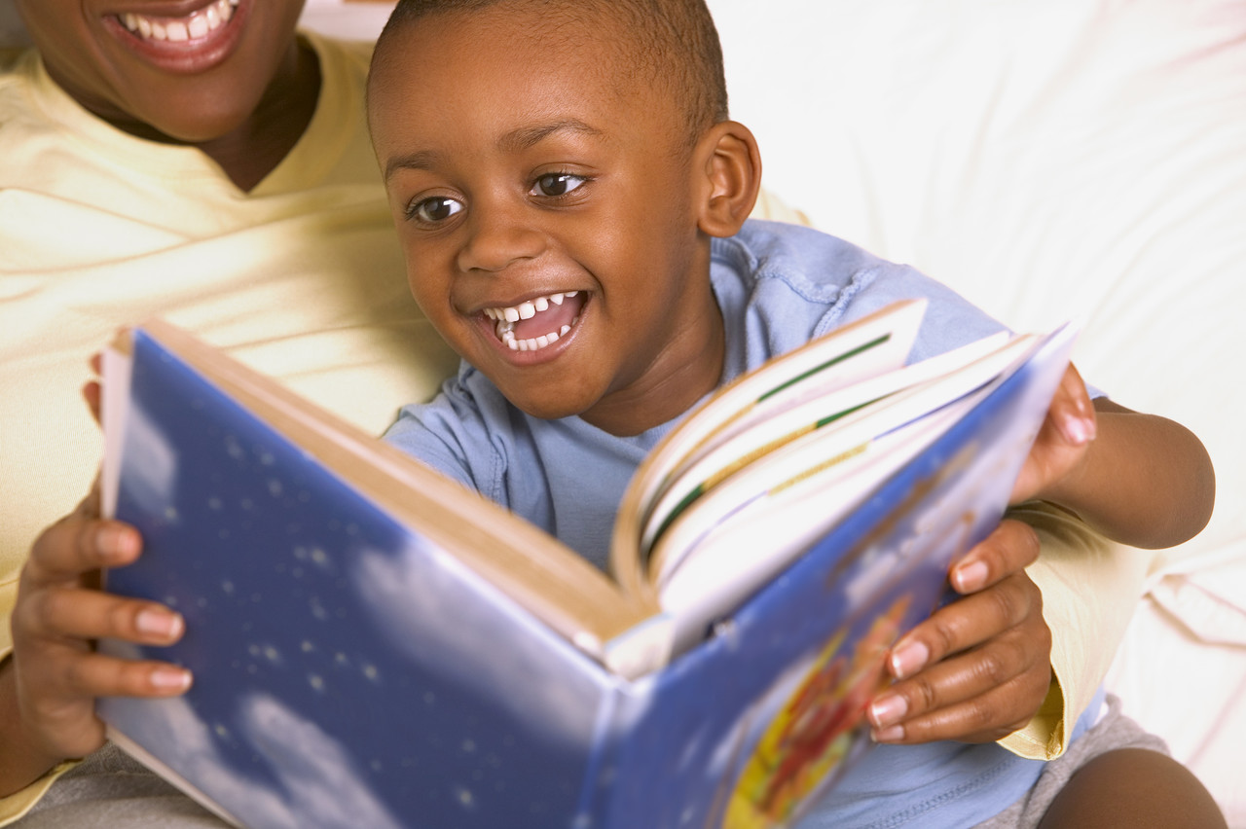
What can a toddler do?
How does a toddler feed?
How does a toddler get dressed?
How does a toddler go to bed?
How does a toddler tell you it’s hungry?
How does a toddler move about?

