Slide 1
Habitats

Slide 2
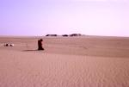

Who would live here?

Slide 3
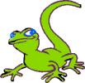



Did you get all of these?
gecko
coyote

Slide 4
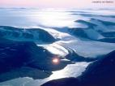

Who would live here?

Slide 5


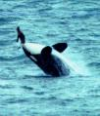

Did you get all of these?

Slide 6
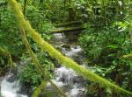
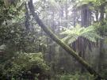
Who would live here?

Slide 7
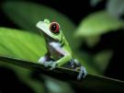



Did you get all of these?
orang-utan

Slide 8


Who would live here?

Slide 9




Did you get all of these?
salmon
otter

Slide 10
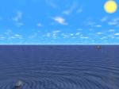
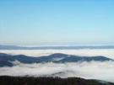
Who would live here?

Slide 11

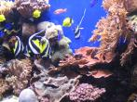


Did you get all of these?
Whale shark

