Slide 1


Covers part of Science Unit 5a:
Keeping Healthy
Healthy Eating
by Mrs. Chapman, 2005
Greet School, Birmingham

Slide 2
Introduction
A Healthy Diet and Our Body
Healthy Eating Pyramid
The Main Food Groups
Fruit and Vegetables
Grains and Pulses
Dairy Products
Starches, Sugars and Fats
Vitamins and Minerals
Reading the Labels on Foods
Healthy Eating Myths
Links for further study

Slide 3
A Healthy Diet and Our Body
If our bodies are human machines food is our fuel. How well we eat, affects how well our bodies work, and how long we live.
It is especially important that we eat heathily as children, as we are still growing and developing; a young plant not given proper nutrients grows up to be a poor specimen ☹.
A healthy diet is sometimes called a balanced diet as it needs to consist of different types of foods.
Eating properly and regularly is really important; what we eat and drink now, affects our health in the future.
Foodie fact
Children that eat breakfast get better scores in tests than children that don’t!
Back to Introduction

Slide 4
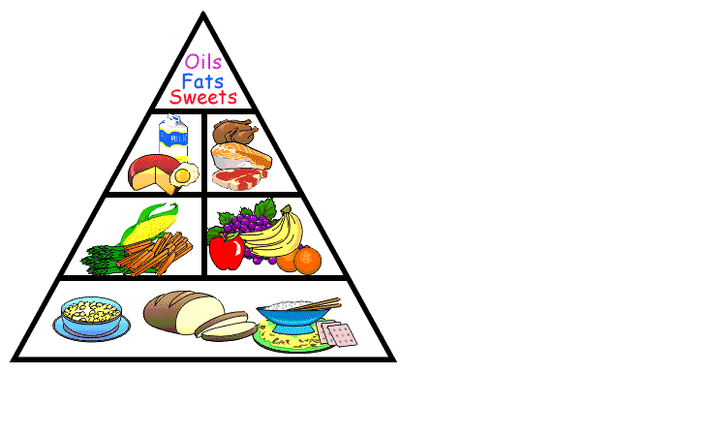
Healthy Eating Pyramid
Carbohydrates: take most food from this group (rice, pasta, bread, potatoes)

Slide 5
Healthy Eating Pyramid
Fruit and vegetables: take 5 portions a day from this group
Carbohydrates: take most food from this group (rice, pasta, bread, potatoes)

Slide 6
Healthy Eating Pyramid
Meat, fish and dairy: take something from this group
Fruit and vegetables: take 5 portions a day from this group
Carbohydrates: take most food from this group (rice, pasta, bread, potatoes)

Slide 7
Healthy Eating Pyramid
Foods high in fats and sugars: take only small amounts from this group
Meat, fish and dairy: take something from this group
Fruit and vegetables: take 5 portions a day from this group
Carbohydrates: take most food from this group (rice, pasta, bread, potatoes)

Slide 8





The Main Food Groups
Back to Introduction

Slide 9
Fruit and Vegetables
Fruits and vegetables grow on plants: underground, on the ground or in trees.
Every day we should eat at least 5 portions of fruit and vegetables. (A portion is about a handful.)
Fruit and vegetables give us fibre and vitamins and minerals.
Take
5 a day
everyday!
Back to Main Food Groups

Slide 10
Grains and Pulses
This food group includes wheat, corn, barley, rice, lentils, beans etc.
These are all from plants and form a staple part of the diet for people all over the world.
Grains and pulses give us carbohydrates and proteins.
Nuts are another source of protein.
What is..?
Rice is the staple food in China and much of the East. What is it in the West (UK, USA)?
Back to Main Food Groups

Slide 11
Grains and Pulses
This food group includes wheat, corn, barley, rice, lentils, beans etc.
These are all from plants and form a staple part of the diet for people all over the world.
Grains and pulses give us carbohydrates and proteins.
Nuts are another source of protein.
Answer
Wheat. We eat it in bread, pasta, cereals, cakes, biscuits and it’s added to all sorts of foods.
Back to Main Food Groups

Slide 12
Dairy Products
Dairy foods are made from milk (usually cow’s milk, but can be from other animals like goats or sheep). Dairy foods give us proteins and fats. They are also a good source of calcium which is good for bones and teeth.
These foods include:
Cheese (hard, soft, cottage);
Yogurt;
Food high in milk or milk products.
Weird fact
Our brains are 80% fat.
Back to Main Food Groups

Slide 13
Meat, Fish and Eggs
The main nutrients derived from meat are proteins, but it also gives us fats and some minerals.
The meat and fish group includes:
Chicken and all poultry;
Fish and shellfish;
Beef, pork and lamb.
Eggs are included in this group too.
Athletes eat lots of protein; they help to build muscles.
Foodie fact
Sushi (raw fish) is now Marks and Spencer’s best-selling lunchtime snack.
Back to Main Food Groups

Slide 14
Starches, Sugars and Fats
Sometimes foods are classified into starches, sugars and fats. Starches includes foods like potatoes and provide mainly carbohydrates. Carbohydrates give us the energy to carry on with our day-to-day lives.
Foods high in sugars include those naturally occurring as in fruit, and those containing refined/processed sugars such as sweets, chocolates, cakes etc. We need to limit our intake of refined sugars – these are empty calories which give an immediate ‘boost’.
A small amount of fat is important for health, but eating too much fat is unhealthy. It leads to clogged arteries (restricted blood supply), high cholesterol and becoming overweight.
Back to Introduction

Slide 15
Vitamins and Minerals
Our bodies need all sorts of chemicals (vitamins and minerals) to be healthy. The most common are:
Vitamin A | Helps maintain eyesight | Sweet potatoes, carrots
Vitamin B | Help body make protein | Green leafy vegetables
Vitamin C | Healing skin, preventing colds | Citrus fruit, tomatoes
Vitamin D | Strengthen bones | Milk Sunlight
Vitamin E | Helps strengthen cells | Vegetable oils, nuts
Iron | Healthy blood | Green leafy vegetables
Back to Introduction

Slide 16
Reading the Labels on Foods
Food labelling is confusing. The front of packaging often tells a different story to the back.
Products that claim to be Low in fat on the front, may be loaded with sugar, and sometimes, products saying things like ‘Less than 5% fat’ have more fat tha similar products!
Look at example food labels.
Food label
You cannot trust the front of the pack –
you need to read the back!
Back to Introduction

Slide 17
Healthy Eating Myths
It doesn’t matter what I eat as long as I do lots of exercise.
Back to Introduction

Slide 18
Healthy Eating Myths
It doesn’t matter what I eat as long as I do lots of exercise.
Wrong! Exercise is good for you, but it still matters what you eat. Eating the right foods means we can learn better and exercise better too!
Back to Introduction

Slide 19
Healthy Eating Myths
Chocolate is bad for you!
Back to Introduction

Slide 20
Healthy Eating Myths
Chocolate is bad for you!
It’s true that chocolate isn’t the healthiest snack – but it isn’t innately bad either! So, some chocolate can be part of a balanced diet. Plain (dark) chocolate is better for you thank milk; it is higher in iron.
Back to Introduction

Slide 21
Healthy Eating Myths
Chewing and digesting a stick of celery uses up more energy than you get from the food.
Back to Introduction

Slide 22
Healthy Eating Myths
Chewing and digesting a stick of celery uses up more energy than you get from the food.
This sounds good, but unfortunately it isn’t true!
Back to Introduction

Slide 23
Links for further study
http://www.bbc.co.uk/northernireland/schools/4_11/uptoyou/
http://www.lifebytes.gov.uk/teachers/lb_teachers-eat.htm
Healthy eating and wired for health sites by the government – links to appropriate ages:
http://www.wiredforhealth.gov.uk/cat.php?catid=886&docid=7219
Food Standards Agency, 5 a day the Bash Street Way aimed at 7-11:
http://www.food.gov.uk/interactivetools/educational/bashstreetdiet/
http://www.eatwell.gov.uk/foodlabels/
http://kidshealth.org/kid/stay_healthy/food/vitamin.html
http://www.dole5aday.com/MusicAndPlay/M_Games.jsp?topmenu=6
Flash game ‘identify the fruit’, interactive, suitable whiteboard, aimed at year 2:
http://www.elllo.org/yeartwo/jan17th/vivian/fruit.htm
Back to Introduction

