Slide 1
Heating and Cooling Materials

Slide 2
Learning objectives
that heating some materials can cause them to change
that cooling some materials can cause them to change

Slide 3
Remember……
Heating something is causing its temperature to rise. It is not setting it alight.

Slide 4
Look at each picture.
Predict what will happen to the material when it is heated.

Slide 5
Decide whether these changes are reversible or irreversible.

Slide 6
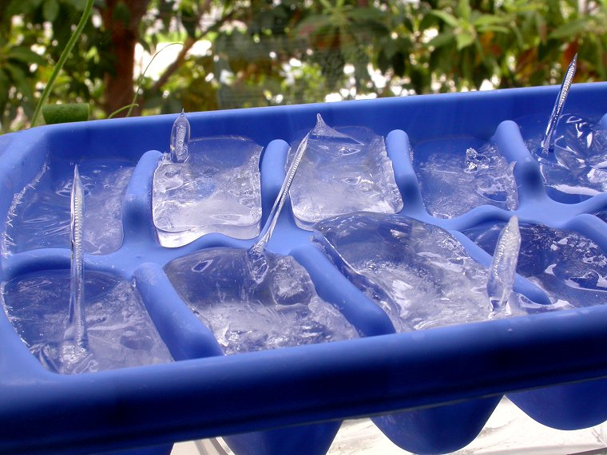

Slide 7
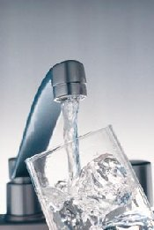
This is a reversible change

Slide 8
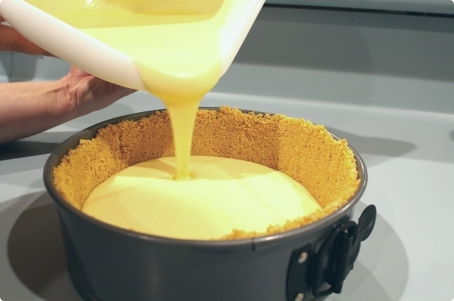

Slide 9
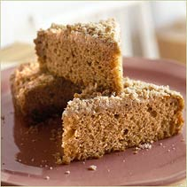
This is an irreversible change

Slide 10
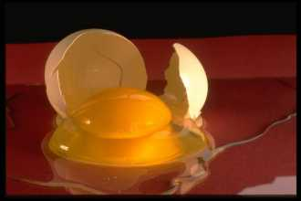

Slide 11
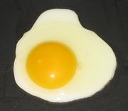
This is an irreversible change

Slide 12
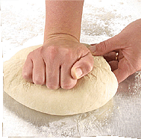

Slide 13
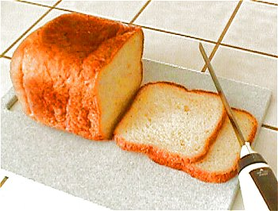
This is an irreversible change

Slide 15
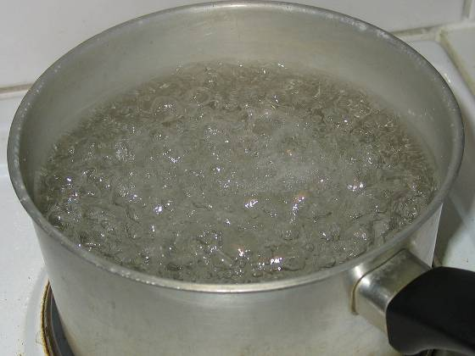
This is a reversible change

Slide 16
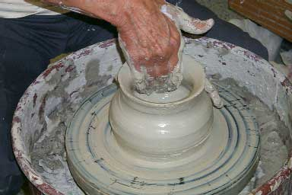

Slide 17
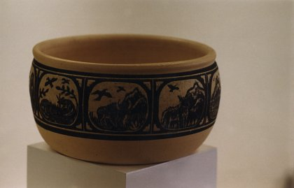
This is an irreversible change

Slide 18
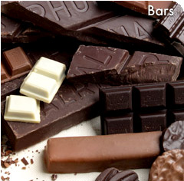

Slide 19
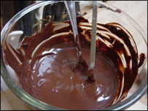
This is a reversible change

Slide 20
Now suggest materials that are changed by cooling and decide whether these changes are reversible or irreversible.

