Slide 1
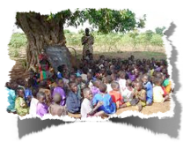
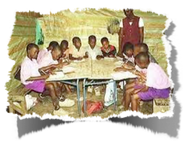
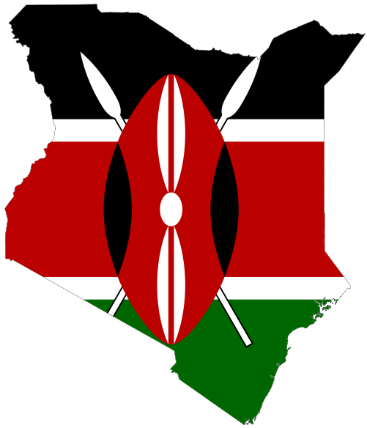
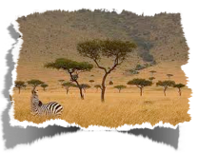
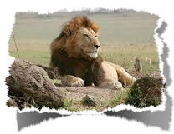
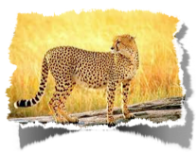
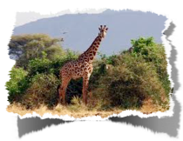
HISTORY OF KENYA
Institut collegial Vincent Massey Collegiate
February 2013

Slide 2
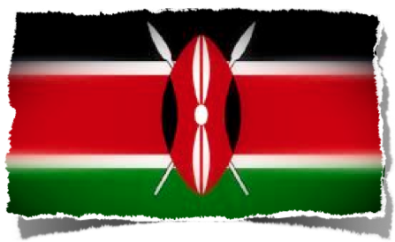
TIMELINE
Prehistoric Time
Traders and Invaders
British Colony
Independence
Modern Kenya
Sources
The Kenyan flag is based on that of Kenyan African National Union.
The colour black symbolises black majority, red for the blood shed during the struggle for freedom, and green for Land; the white fimbriation was added later and symbolizes peace and honesty.
The black, red, and white traditional Maasai shield and two spears symbolize the defense of all the things mentioned.

Slide 3
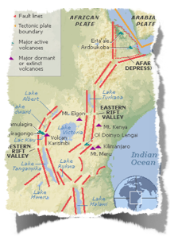
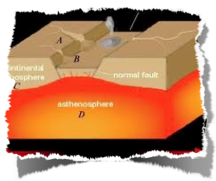
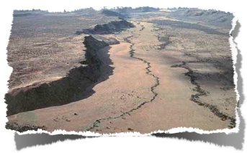
PREHISTORIC TIME 6 million - 500 BC
Kenya is where humanity first evolved. Scientists have found over 230 skeletons of early human beings near Lake Rudolf in northern Kenya.
This is why Kenya, and particularly a great five-thousand-mile slash in the Earth’s crust called the “Rift Valley”, is sometimes called “the cradle of humanity”.
As ages passed, human beings migrated out of Africa into Asia and Europe, and then, about 15,000 years ago, into the Americas.

Slide 4
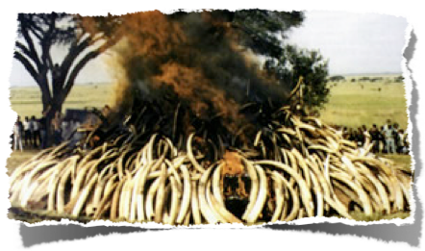
TRADERS AND INVADERS 500 BC to 1000 AD
Bantu-speaking people settled in the region. Bantu is modern Kenya’s largest language group.
During the first millennium A.D., Arab traders settled on the coast. African people, like the Luo and Kikuyu peoples, migrated to the inland areas, trading ivory, gold and slaves with Arabs, Persia and India.
The Swahili language, with Arabic and African roots, grew up as a way for them all to talk to one another.
There are now over 70 ethnic groups in Kenya, and they still use Swahili and sometimes English.
This photo was taken from a protest demonstration in Kenya against the trade of ivory. (January 2010)

Slide 5
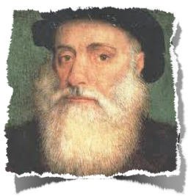
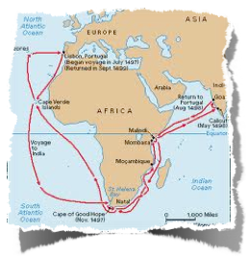
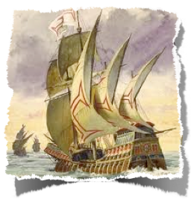
TRADERS AND INVADERS 1498 to late 1600s
Portuguese explorer Vasco da Gama reached Kenya. Portuguese settlers later tried to take control of the coastal region. They were finally driven off by Swahili states and Omani Arabs.

Slide 6
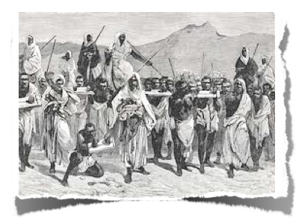
SLAVE TRADE
The slave trade flourished during the period of 1830 to late 1880s.

Slide 7
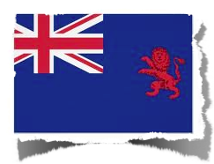
BRITISH COLONY
The British conquered Kenya in the 1895. It became commonly known as British East Africa.
In the early 1900s, white settlers moved into highlands and a railway was built from Mombassa to Lake Victoria.

Slide 8
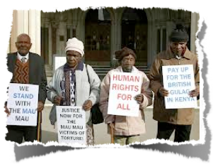
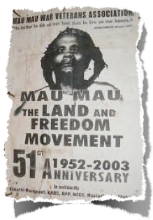
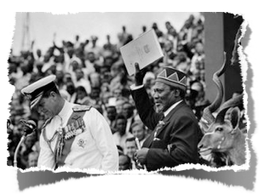
INDEPENDENCE
In the 1940‘s, Kenyan Africans formed groups to fight for independence from Britain. A secret society called the Mau Mau favored violence against white settlers. The Kenyan African Union (KAU) was formed.
In 1953-1956, more than 13,000 people were killed in the Mau Mau rebellion.
On Dec. 12,1963 Kenya won its independence from Britain. The independence movement was led by Jomo Kenyatta, who became the first president of an independent Kenya. His slogan was “Harambee”, Swahili for “All Pull Together”.

Slide 9
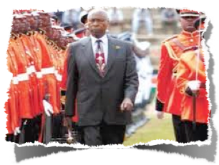
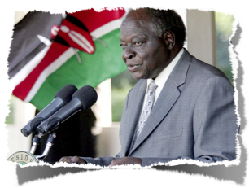
MODERN KENYA
Between 1969 and 1991, only one political party was allowed.
In 1978, Kenyatta dies. Vice President Daniel arap Moi began his long reign as second President.
In 2002, Mwai Kibaki became third President.
Now, there are many political parties in Kenya. As of 2008, President Mwai Kibaki is leader of the National Rainbow Coalition.
In 2010, a new constitution was put into effect. It limits the powers of the President.

Slide 10
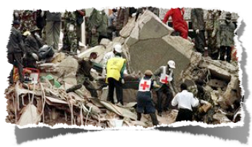
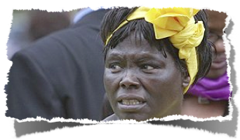
MODERN KENYA
In August 1998, Al-Qaeda operatives bombed the US embassy in Nairobi, killing 224 people and injuring thousands.
In 2004, Wangari Maathai was the first African woman to win the Nobel Peace Prize. She fought to promote conservation, women’s rights and transparent government.
In 2004-2006, drought caused a severe food crisis. In 2009, drought gripped Kenya again.

Slide 11
SOURCES
BBC NEWS AFRICA
Overview: www.bbc.co.uk/news/world-africa-13681341
Facts: www.bbc.co.uk/news/world-africa-13681342
Leaders: www.bbc.co.uk/news/world-africa-13681343
Media: www.bbc.co.uk/news/world-africa-13681344
Detailed Historical Timeline: www.bbc.co.uk/news/world-africa-13682176
Baraza Wildlife Direct Team: http://baraza.wildlifedirect.org/2010/01/06/kenya-and-tanzania-lock-horns-over-ivory-trade/
kids-4-kenya: www.kids-4-kenya.org/learn-about-kenya/history-of-kenya.cfm
TIME for kids: www.timeforkids.com/destination/kenya/history-timeline
Wikipedia: http://en.wikipedia.org/wiki/Flag_of_Kenya

