Slide 1

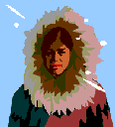
Hot or Cold?

Slide 2
Would you wear these clothes when it is hot or cold?

Slide 3
Cold

Slide 4
Hot

Slide 5
Cold

Slide 6
Cold

Slide 7
Hot

Slide 8
Hot

Slide 9
Cold

Slide 10
Hot

Slide 11
Cold

Slide 12
Cold

Slide 13
Hot

Slide 14
Cold

