Slide 1
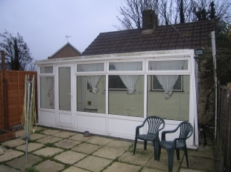
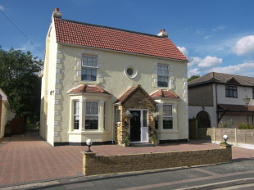
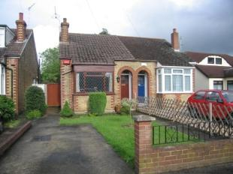
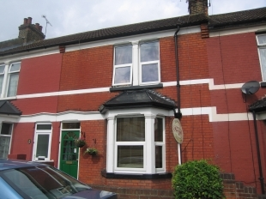
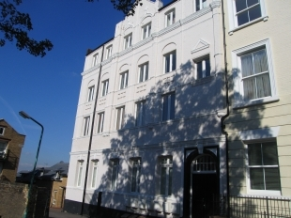
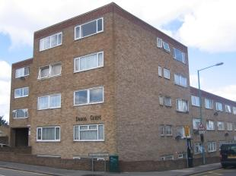
Houses in Gillingham
How many different types of house can we identify?

Slide 2
What type of house is this?

Slide 3

Detached
to another house
Not joined

Slide 4
How about this one?
Terraced
on both sides
Joined to other houses

Slide 5
…and this one??
joined on
the other
Not joined
on one side
This house is semi - detached

Slide 6
O.K. what about this one?
Sandwiched between
other dwellings…
one
on top
of another.
That’s right, it’s a block of Flats

Slide 7
Hey, how do I get upstairs?
You don’t. This type of
house only has a ground
floor.
It’s a bungalow.

Slide 8
What kind of house is this?
It’s tall
It’s wide
It is quite old

Slide 9
What kind of house is this?
This is known as a Townhouse

Slide 10
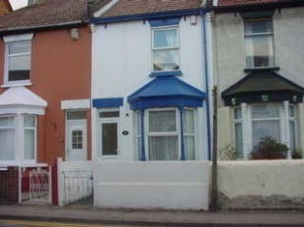
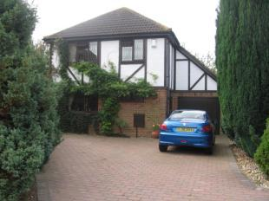
Which house is most like yours?
Talk to your partner and
compare these houses.
What are the similarities and differences?

Slide 11
Which house is most like yours?
Features
Features

