Slide 1
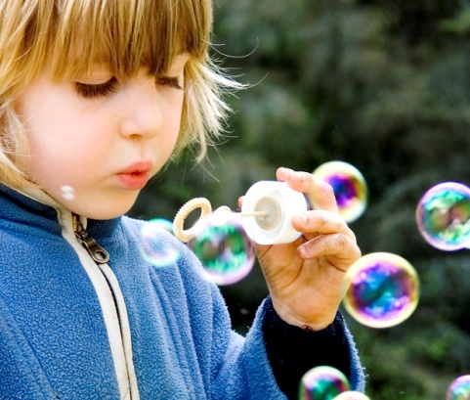
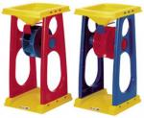
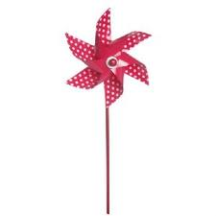
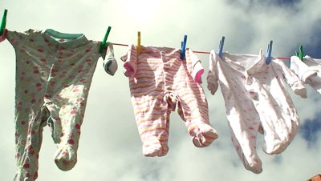
How do they move?

Slide 2
Not everything moves
because we push or pull it.
Some things move
by themselves.
What makes them move?

Slide 3
The water and sand
PUSHED the wheel around

Slide 4
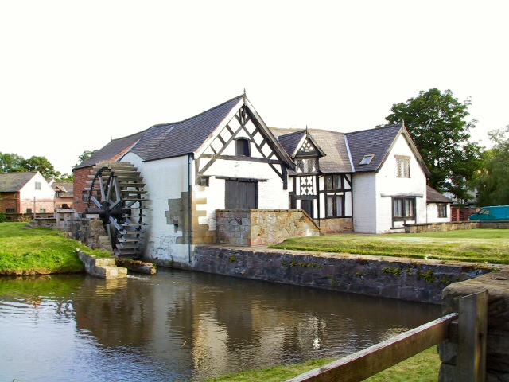
Just like…

Slide 5
The wind PUSHED the
bubbles, the windmill
and the washing.

Slide 6
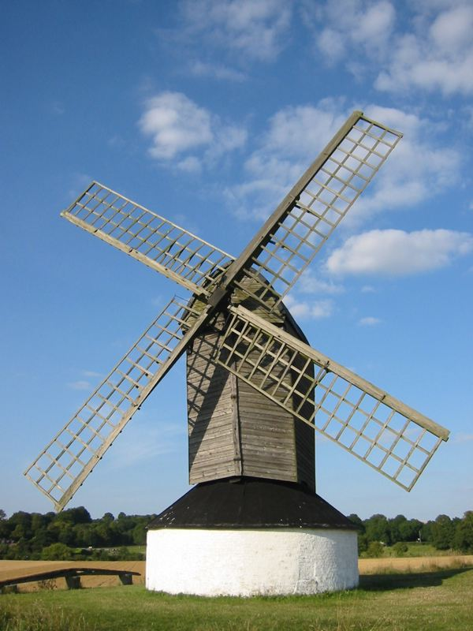
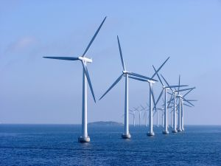
Just like…

