Slide 1
Interdependence
and
Adaptation

Slide 2
Polar Bears

Slide 3
Polar Bears

Slide 4
Polar Bears
Thick warm, white fur coat

Slide 5
Polar Bears
Thick warm, white fur coat
Keeps the bear warm in below
freezing temperatures and allows
him to camouflage in the snow.

Slide 6
Polar Bears
Thick warm, white fur coat
Keeps the bear warm in below
freezing temperatures and allows
him to camouflage in the snow.

Slide 7
Polar Bears
Thick warm, white fur coat
Keeps the bear warm in below
freezing temperatures and allows
him to camouflage in the snow.
Large Paws

Slide 8
Polar Bears
Thick warm, white fur coat
Keeps the bear warm in below
freezing temperatures and allows
him to camouflage in the snow.
Large Paws
Produce an oil that stops his feet freezing
on the snow.

Slide 9
Polar Bears
Thick warm, white fur coat
Keeps the bear warm in below
freezing temperatures and allows
him to camouflage in the snow.
Large Paws
Produce an oil that stops his feet freezing
on the snow.

Slide 10
Polar Bears
Thick warm, white fur coat
Keeps the bear warm in below
freezing temperatures and allows
him to camouflage in the snow.
Large Paws
Produce an oil that stops his feet freezing
on the snow.

Slide 11
Polar Bears
Thick warm, white fur coat
Keeps the bear warm in below
freezing temperatures and allows
him to camouflage in the snow.
Large Paws
Produce an oil that stops his feet freezing
on the snow.
Little eyes

Slide 12
Polar Bears
Thick warm, white fur coat
Keeps the bear warm in below
freezing temperatures and allows
him to camouflage in the snow.
Large Paws
Produce an oil that stops his feet freezing
on the snow.
Little eyes
Keeps cold
and icy snow
blizzards
out of their
eyes.

Slide 13
Camels

Slide 14
Camels
Big, flat feet

Slide 15
Camels
Big, flat feet
Enable camels to walk on the sand
without sinking into it.

Slide 16
Camels
Humps
Big, flat feet
Enable camels to walk on the sand
without sinking into it.

Slide 17
Camels
Humps
Camel can store a
supply of water
so it doesn’t have
to stop to drink
Big, flat feet
Enable camels to walk on the sand
without sinking into it.

Slide 18
Camels
Long eyelashes
Humps
Camel can store a
supply of water
so it doesn’t have
to stop to drink
Big, flat feet
Enable camels to walk on the sand
without sinking into it.

Slide 19
Camels
Long eyelashes
Keeps sand from storms
and glaring sun from
camels eyes.
Humps
Camel can store a
supply of water
so it doesn’t have
to stop to drink
Big, flat feet
Enable camels to walk on the sand
without sinking into it.

Slide 20
Camels
Long eyelashes
Keeps sand from storms
and glaring sun from
camels eyes.
Humps
Camel can store a
supply of water
so it doesn’t have
to stop to drink
Long Legs
Big, flat feet
Enable camels to walk on the sand
without sinking into it.

Slide 21
Camels
Long eyelashes
Keeps sand from storms
and glaring sun from
camels eyes.
Humps
Camel can store a
supply of water
so it doesn’t have
to stop to drink
Long Legs
Help to move across
the dessert quicker
and keeps the sand
off the camels
stomach.
Big, flat feet
Enable camels to walk on the sand
without sinking into it.

Slide 22
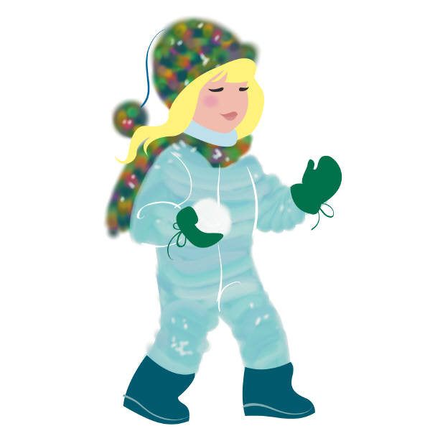
Humans
Humans adapt to suit their climate
and surroundings.

Slide 23
Humans
Humans adapt to suit their climate
and surroundings.
In the summer we wear thin clothes, drink plenty of
water, and keep our selves in the shade.

Slide 24
Humans
Humans adapt to suit their climate
and surroundings.
In the summer we wear thin clothes, drink plenty of
water, and keep our selves in the shade.
In the winter we have to wrap up warm, eat warm
food and drink hot drinks.

Slide 25
Adapting to our
surroundings keeps us
and other living things
alive.

