Slide 1
Interpersonal Skills
The ability to understand self and other people in an organization to work
Co-operatively with them. It includes four components;
Self Awareness,
Self Management
Social Awareness
Social Skills

Slide 2
Self-Awareness/Self-Perception
This is a key aspect of being a leader
The ability to recognize and understand your moods, emotions, and drives, as well as their effect on others
  Self-confidence (but not arrogance)
  Self-assessment
  Self-deprecating - sense of humor (rolling with the punches)
What are my strengths and weaknesses

Slide 3
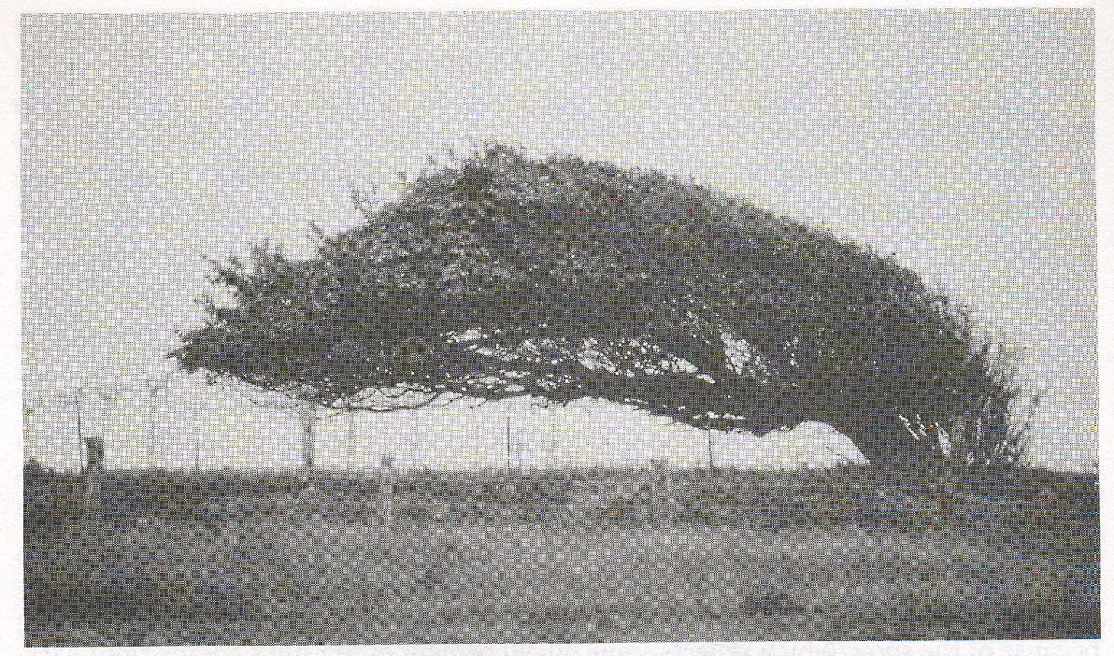
Knowing Yourself
“Good timber does not grow with ease; the stronger the wind, the stronger the trees” - J. Willard Marriott

Slide 4
Knowing Yourself
Being aware of how people respond to you

Slide 5
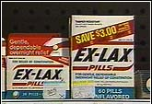
Self-Regulation
This is another key aspect of being a leader
Self-regulation is the ability to manage your emotions and reactions
Others can and should be understanding, but SELF-regulation -- is up to YOU!
Bad scenes stick in people’s minds

Slide 6
Self-Regulation
Creates an environment of trust, safety, and fairness
Discourages those around you from losing control or reacting impulsively
Helps you avoid the temptation of easy or quick fixes
Is characterized by thoughtful reflection and being comfortable with uncertainty

Slide 7
Six ways to make people like you
Become genuinely interested in other people.
Smile.
Remember that a person's name is to that person the sweetest and most important sound in any language.
Be a good listener. Encourage others to talk about themselves.
Talk in terms of the other person's interests.
Make the other person feel important - and do it sincerely.

Slide 8
Fundamental Techniques in Handling People
Don't criticize, condemn or complain.
Give honest and sincere appreciation.
Arouse in the other person an eager want.

Slide 9
TRANSACTIONAL ANALYSIS
“Study of inter and intra individual transactions where there is a stimulus and response”.
Transactional analysis is a method of analyzing human behavior in social transactions.
It is a study of human relations through the study of stimuli and response.
It is an extension of Freudian theory
Id
Ego
Super Ego
TA was developed by Eric Berne and popularized by Harries. Marial James, Dorthy Jongeward and Wagner.

Slide 10
Psycho-Analytical or Psycho-Dynamic Theory
“Sigmund Freud’s STRUCTURAL MODEL OF MENTAL LIFE”
ID Psychic energy
Inherited, Presented at birth, Present in life.
Store of wishes and unconscious.
Strives for immediate pleasure and avoid pain.
Insistent and rash.
Does not tolerate un-comforts-tension.
Immoral, animal drives, Unorganized.
EGO The Gateway of Action
Separates reality from unreality,
Logical, realistic, practical and rational.
Consciously distinguish between the demands of ID & Realities.
Regulate and integrate inner motives and source of Tension release.
SUPER EGO
Sensor agent of – Value, belief and standards of the society.
Ideals & noble thoughts.
Acquired from parents, teachers, friends, religion, etc.,
Describes the right and wrong.
Mediates, filters action.

Slide 11
EGO
A Psychological State of an Individual, which Guide
the Way of Feeling, Thinking and Behavior
EGO Status
Help
---------------
Control
Controlling
Protective
Critical
Nurturing
Instructive
PARENT
(Taught Ego)
ADULT
(Acquired by Maturity)
Rational
Factual
Unemotional
Independent
Problem solver
Free
Dependent Spontaneous
Curious Creative
Rebel Clumsy
Frustrated Pleasure seeking
CHILD
(Felt Ego)
LP
Adp

Slide 12
LIFE POSITIONS
“Assumption about self and others in the Societies”
I am OK - You are not OK
I am not OK - You are OK
I am not OK - You are not OK
I am OK - You are OK
I am OK
You are not OK
I am OK
You are OK
POSITIVE
Attitude Towards Self
I am not OK
You are not OK
I am not OK
You are OK
NEGATIVE
NEGATIVE
POSITIVE

Slide 13
Types of Transactions
OPEN
COMPLIMENTARY
P
P
A
A
P – P – C P= Parent
A – A – C A=Adult
C – C C=Child
BLOCKED
P – A
C - P
C
C
CROSS
P
P
A
A
C
C
ULTERIOR - - Transactions influenced by other than ego status (Hidden Meanings)
GALLOWS TRANSACTIONS - - In appropriate smile or love
GAMES – Repeat, Find it ulterior, Sense at superficial level
INEFFECTIVE STYLES OF GAMES – Perfectionist, Driver, Power game,
and Pleasure game

Slide 14
LIFE SCRIPTS AND STROKES:
A stroke is a unit of recognition may be positive or negative of a condition or both, strokes are required for healthy behavior.
Strokes may be physical, verbal or eye-to-eye contact.
Child hood learning influences the behavior
If a child lives with criticism, he/she learns to fight.
If a child lives with hostility, he/she learns to condemn.
If a child lives with ridicule, he/she learns to be shy.
If a child lives with shame, he/she learns to feel guilty.
If a child lives with tolerance, he/she learns to be patient.
If a child lives with encouragement, he/she learns confidence.
If a child lives with praise, he/she learns to appreciate.
If a child lives with fairness, he/she learns justice.
If a child lives with security, he/she learns to have faith.
If a child lives with approval, he/she learns to like himself.
If a child lives with acceptance and friendship, he/she learns to find love in the world.

Slide 15
JOHARI WINDOW
Feed Back
Known to Self
Unknown to Self
Known to
others
Open Area
Blind Area
Discussion
Unknown to
others
Hidden Area
Unknown Area

Slide 16
Dealing with Difficult People

Slide 17
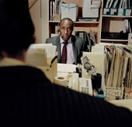
How to deal with Difficult people?
Hostile – Aggressive
Stand up for your self
Give them time to turn down
use self assertive language
avoid direct Confrontation.

Slide 18

Complainers
  Listen attentively
  Acknowledge their feelings
  Avoid complaining with them
  Tell the truth without apology

Slide 19

Clams
Ask open ended questions.
Be patient and wait for response.
If there is no response, tell your opinion.

Slide 20
Super Agreeables
Find out why they will not work
Let them know that you respect them
Ready to act, don’t allow to make unrealistic commitments
Discern the hidden meaning in their humour

Slide 21

Negatives
Don’t get dragged to their despair
Don’t try to Cajole them out of their negativism
Discuss the issue in detail - show the negative side of yours
Ready to act without agreement

Slide 22
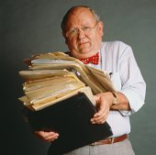
Know it all
Bulldozers
Prepare yourself.
Listen and paraphrase their main points.
Use the Questioning forms to raise problems.

Slide 23

Balloons
State facts as your perspective of reality.
Find a way for them to save face.
Confront them alone, not in public.

Slide 24

Indecisive Stallers
Raise the issue why they are hesitant .
If you are the problem, ask for help.
Keep the action at your own hand.
Remove them from the situation, if possible.

Slide 25
Emotional Intelligence (EI)
The capacity for recognizing our feelings and those of others; for motivating ourselves and others; for managing emotions in ourselves and in our relationships
  Understanding yourself (self-awareness)
  Managing yourself (self-regulation)
  Understanding others (empathy)
  Managing others (motivation, social skills)

Slide 26
Knowing Yourself
Taking criticism – tough medicine to swallow, but usually always valuable

Slide 27
Knowing Yourself
Giving criticism -- kindly?
Leaders have to bring correction, but HOW it’s brought can make or literally break someone

