Slide 1

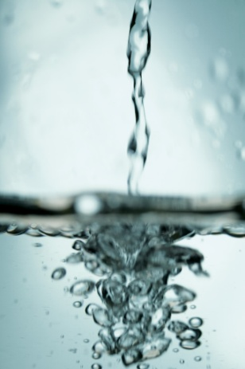
Investigating Viscosity

Slide 2
What are the properties of these liquids?
Runny
Pours easily
Flows slowly
Smooth
Free
Sticky
Slow
Thick
Gloopy
water
milk
cream
cooking oil
washing up liquid
golden syrup

Slide 3
What do we mean by ‘viscosity’?
water
milk
cream
cooking oil
washing up liquid
golden syrup
At what speed can you pour the following liquids?
What affects the speed at which you can pour the different liquids?

Slide 4
What do we mean by ‘viscosity’?
Different liquids have different properties. One of these properties is viscosity, the liquid's resistance to flowing.
Not all liquids are the same. Some are thin and flow easily these have a low viscosity. Others are thick and gooey and have a high viscosity.

Slide 5
Let’s Investigate…
How can we compare the viscosity of a range of different liquids?
What do we want to find out?
How will we find this out? What test will we use?
How will we ensure that we have a fair test?

Slide 6
Tuesday 23rd September
Investigating Viscosity

Slide 7
Investigating Viscosity
lemonade fruit juice
water full fat milk
semi-skimmed milk
cream
cooking oil
vinegar
washing up liquid
golden syrup

Slide 8
Prediction
I predict that the least viscous liquid will be the …………………….. because ………………
I predict that the most viscous liquid will be the …………………….. because ………………

Slide 9
Results

Slide 10
Conclusion
Not all liquids are the same. Some are thin and flow easily such as …………….. and …………………….These liquids have a …………………….. . Others are thick and gooey such as ………………. and …………………. These liquids have a ……………………………….. .

Slide 11
Low viscosity or High viscosity?
lemonade fruit juice
water
semi-skimmed milk
cream
cooking oil
vinegar
washing up liquid
golden syrup
Today we want to sort the liquids into two groups… low viscosity and high viscosity

