Slide 1
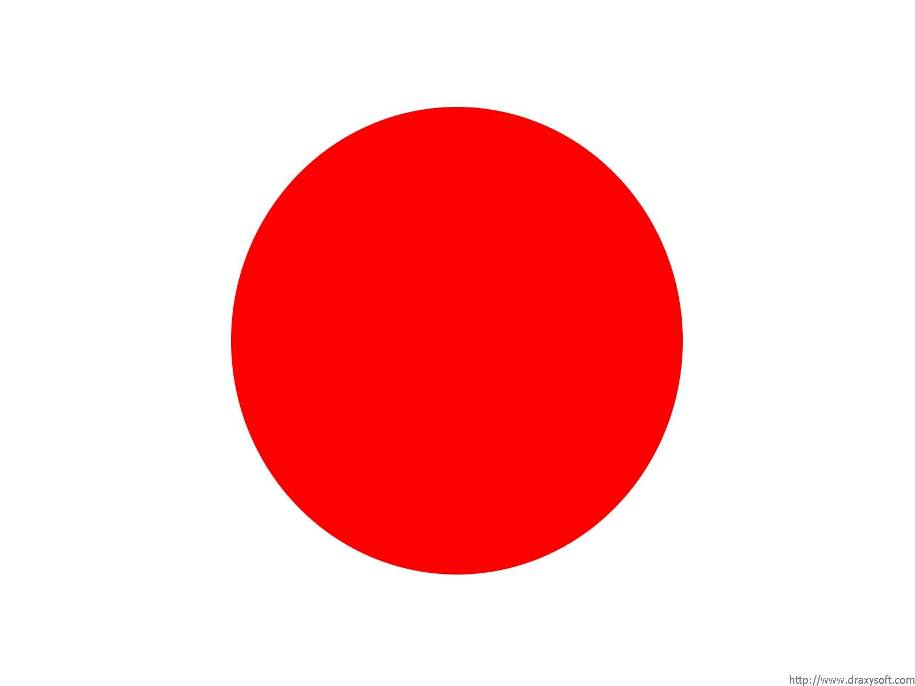
Welcome to Japan.

Slide 2
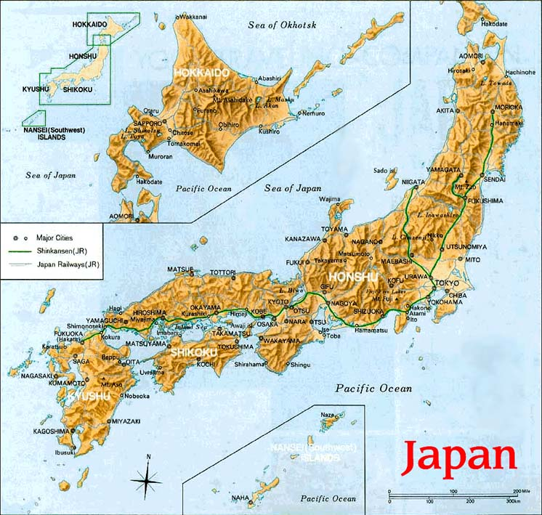

Slide 3
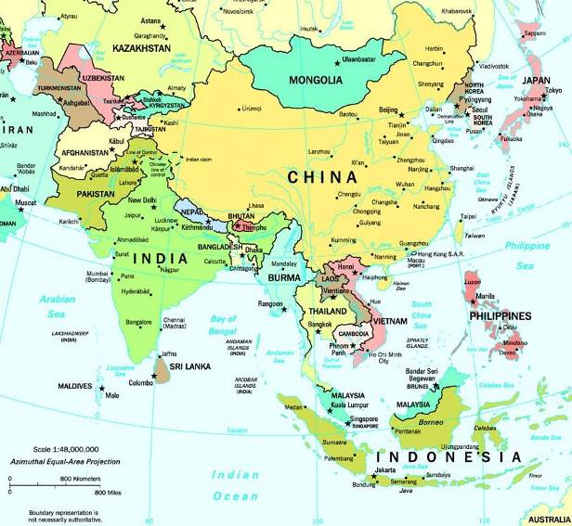
Where in the world is Japan?

Slide 4
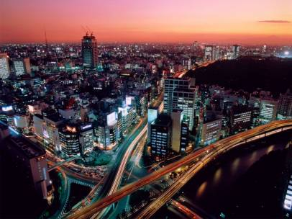
Capital city.
The capital city of Japan is Tokyo. It is on the island of Honshu. It is one of the largest cities in the world.

Slide 5
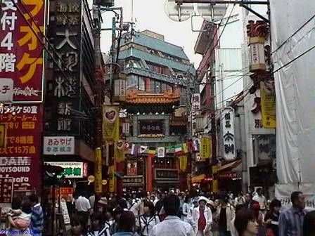
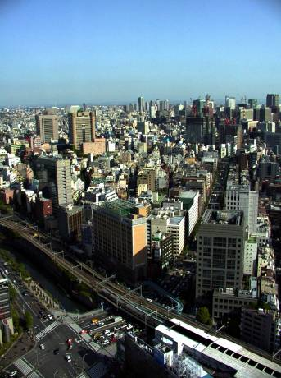
As you can see it is a very modern city. How does it compare to the Isle of Coll?

Slide 6
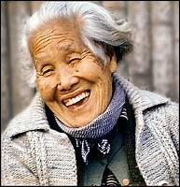
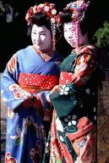
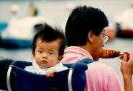
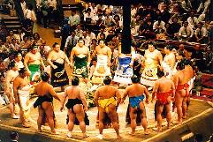
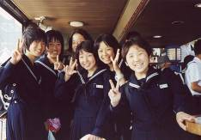
Population
The population of Japan is approximately 125,000,000!
That is 125 million!
In New Zealand the population is just over 4 million. Who has the most space?

Slide 7
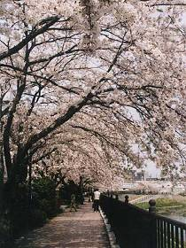
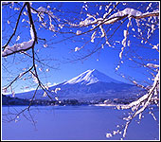
Weather.
There are distinct seasons in Japan. Even though it is in Asia it has a Winter, Spring, Summer and an Autumn.
It is in the Northern Hemisphere so Winter is in December unlike New Zealand.

Slide 8
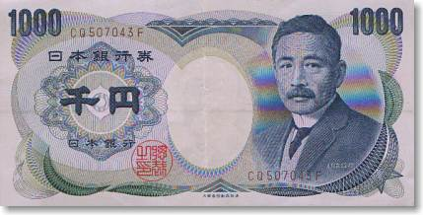
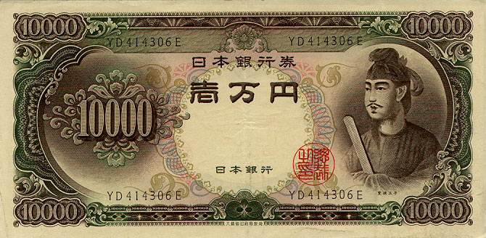
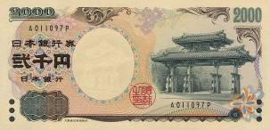
Currency.
The Yen is the unit of currency.
1 Malaysian Ringitt is worth 31 Japanese Yen.
What is 10 Ringitt worth?

Slide 9
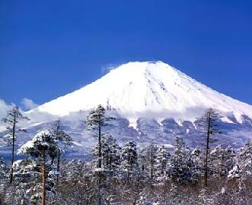
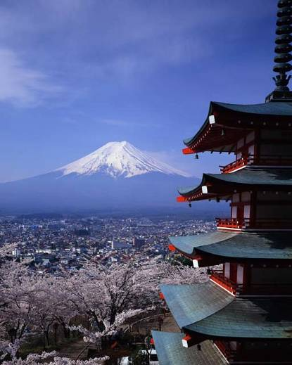
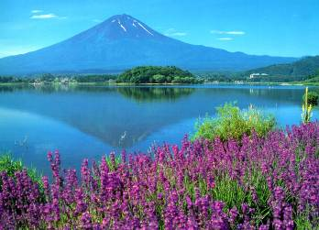
Mount Fuji.
This sacred mountain, the highest in Japan, is a traditional place of pilgrimage.

Slide 10
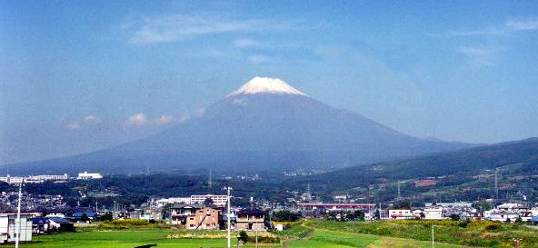
Mount Fuji (Fujisan) is 3776 meters high making it Japan's highest mountain.
Mount Fuji is a dormant volcano, which most recently erupted in 1708.

Slide 11
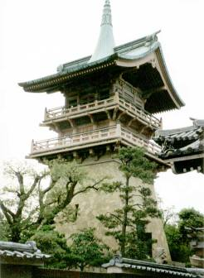
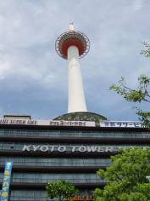
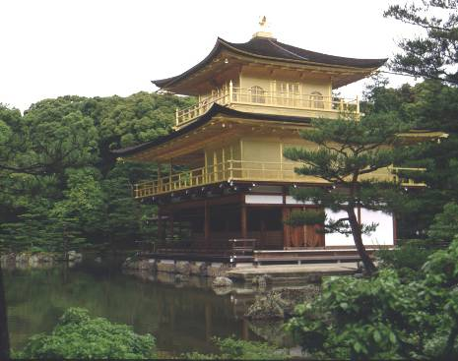
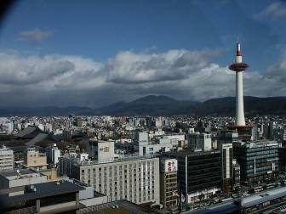
Not all the buildings in Kyoto are ancient there are many modern buildings too.

Slide 12
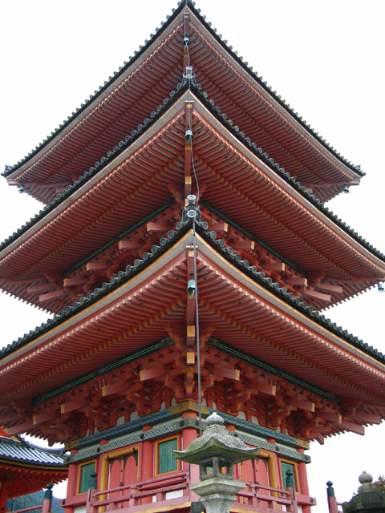
Kyoto
Kyoto is a city in Japan, which has a population close to 1.5 million. Kyoto is located island of Honshu. It was the capital city when the Emperor was in charge. It has many beautiful buildings and temples.

