Slide 1
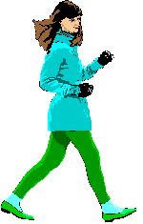
Moving and Growing

Slide 2
In this topic we will find out about….
The human skeleton and its importance….
Skeletons in other animals..
How bones change as we grow..
How we move…
Our muscles…
The effects of exercise on our bodies…

Slide 3
LO – To understand that we have different types of joints in our bodies which help us to move.
VOCABULARY-
Joints, bones, hinge joint, ball and socket joint, gliding joint, movable, fixed, movement.

Slide 4
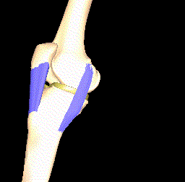
Questions to discuss in partner voices!
Q: What do you think a joint is?
A: A joint is where two bones meet. It can be movable or fixed.
Q: Why do you think we have joints?
A: If we did not have joints we would find simple tasks like eating very difficult. Any movement needing bending would be impossible!!!!

Slide 5
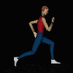
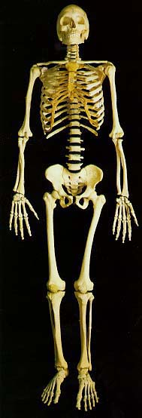
Where in our body do we find movable joints?
Did you locate the joints in our body correctly?

Slide 6
Do you think that these joints all work in the same way?
We actually have three main types of movable joints:
A hinge joint
2) A ball and socket joint
3) A gliding joint

Slide 7
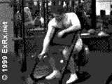
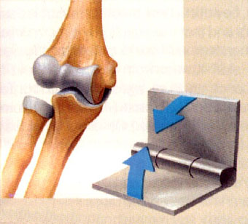
Hinge joint
Your toes use hinge joints (back-and-forth movements like hinges on a door). Elbows, knees and fingers also have these types of joints. Hinge joints are classified as a movable joint.

Slide 8
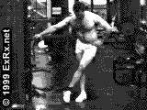
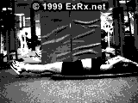
Ball and socket joint
The hips and shoulders contain ball-and-socket joints
In a ball-and-socket joint, one bone has a rounded end that fits into a cuplike cavity on another bone. This provides a wider range of movement. Thus, your hips and shoulders can swing in almost any direction.

Slide 9
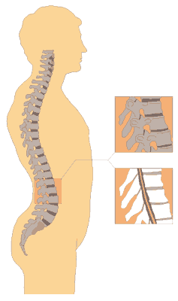
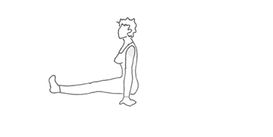
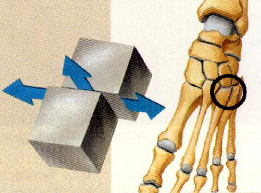
Gliding joint
The joints between the vertebrae are called gliding joints, where one part of a bone slides over another bone.

Slide 10
Types of joints
Hinge joint
elbows,fingers,knee
Ball and socket joint
shoulder, hip
Gliding joint
back bone, finger base

