Slide 1
Hot Stuff & ICE COOL
Key words:
Insulate:
Use a material to stop the transfer of thermal energy
Conductor:
A conductor is a material which transfers (helps move) energy
Thermal Energy:
Heat is thermal energy – it can be kept in, or kept out, using insulation
How can we use what we have learned about Keeping Warm?

Slide 2
Designing our own PRODUCTS

Slide 3
This week, we are going to put learning into practice
You will all be product designers
Use your knowledge of keeping warm and cool to design beautiful, practical products

Slide 4
Have nothing in your house that you do not know to be useful, or believe to be beautiful.
William Morris

Slide 5
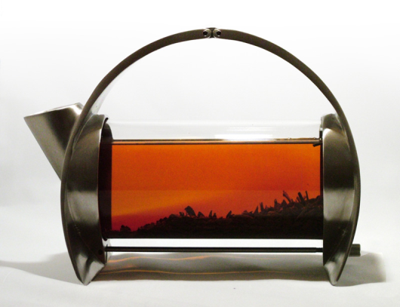
Hot Stuff!
What do we think of this teapot?

Slide 6
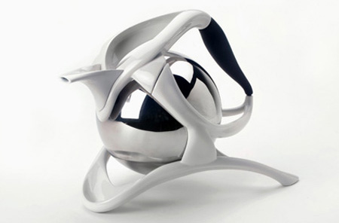
Cool IDEAS
What about this one?

Slide 7
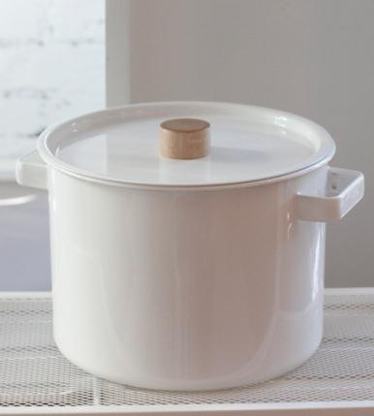
Hot Stuff!
A good design for a pan?

Slide 8
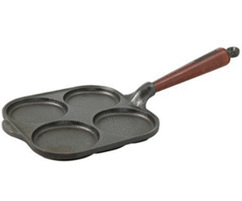
Cool IDEAS
What about this one?

Slide 9
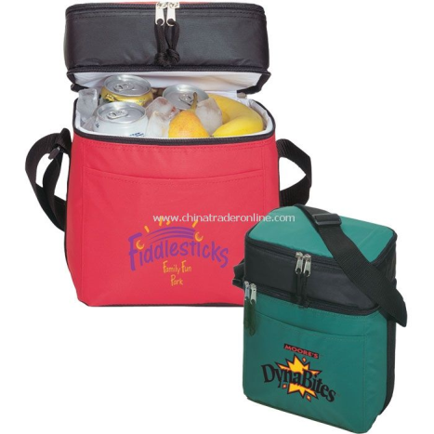
Hot Stuff!
What can we say about these insulated lunchboxes?

Slide 10
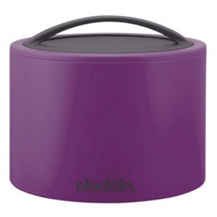
Cool IDEAS
What about this one?

Slide 11
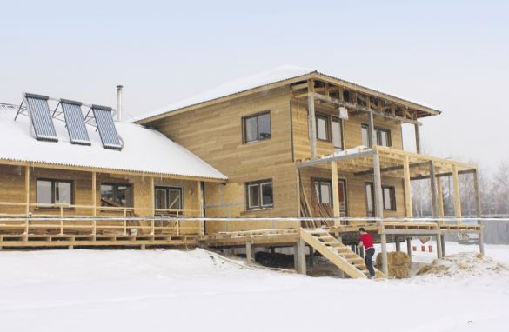
Hot Stuff!
How does heat transfer work in this house?

Slide 12
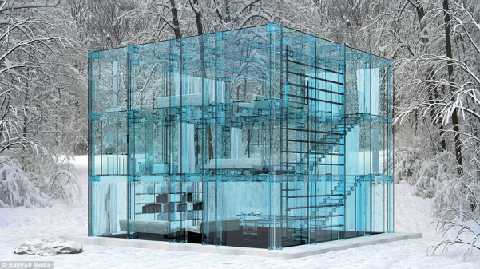
Cool IDEAS
Do you think this house will be cheap or expensive to heat?

Slide 13
Hot Stuff!
You can design:
A teapot
Or
A pan
Or
A lunchbox
Or
A basic house
LO: I CAN DESIGN MY OWN PRODUCT USING INSULATION OR A HEAT CONDUCTIVE MATERIAL TO MAKE IT USEFUL

