Slide 1
Keeping Warm
Year 4
Lesson 1

Slide 2
L.O To know that touch is not an accurate way of judging temperature

Slide 3
Touch
Touch is a method of telling whether things are hot or cold.
Is it accurate? Why, Why not?

Slide 4
Experiment
You have;
A bowl of iced water
Bowl of water at room temperature
Bowl of warm water
Questions
How can you judge the temperatures?
How could it be tested?
Why can’t you tell how hot the water is by looking at it?

Slide 5
Your activity
Touch the items
Draw and write ideas about how hot each is.
What happens when you do this?
Have one hand in the ice, one hand in the warm. Then put both hands in the bowl at room temperature. Do you notice anything different?

Slide 6
Is it always easy to tell by using the sense of touch?
What about if there were slight differences?

Slide 7
Health and Safety
Do not touch ice immediately after it is removed from the freezer.
Water should be warm rather than hot.

Slide 8
How else can temperature be tested?

Slide 9
Keeping Warm
Lesson 2

Slide 10
L.O.

Slide 11
L.O To use a thermometer to make careful measurements of temperature using standard measures.
To know that temperature is a measure of how hot and cold things are.
To know that something will cool and warm until it is the same temperature as its surroundings.

Slide 12
Focus
Use a thermometer correctly
Predict the temperature of water, given the temperature of the room.

Slide 13
Cold-hot scale!

Slide 14
Can you think of….
Three ways to make things hotter? | Three ways to make things colder?

Slide 15
You need to be accurate at recording and taking the temperature of things.
Hold the thermometer
Read the scale at eye level
Do not hold by the bulb
Explore the temperature when it is held in your hand, you blow on it, put it under the tap.

Slide 16
Experiment
You have two bowls of water one warm and one cold.
Take and record the temperatures in a table.

Slide 17
Record your results in the following table.
Time | Bowl 1 (Temp) | Bowl 2 (Temp)

Slide 18
Different objects can have different temperature and that temperature can change.
L.O You now know that something will cool and warm until it is the same temperature as its surroundings.

Slide 19
Keeping Warm
lesson 2B

Slide 20
L.O To collect, store and retrieve temperatures

Slide 21
You have to ….
To decide what evidence to collect
To make a table and record results I it
To draw conclusions for results in terms of scientific knowledge and understanding

Slide 22
Find warm and cold spots in the classroom
Draw a plan of the classroom showing areas you think are hot and cold, make an estimate for the temperature.
Explain your suggestions.

Slide 23
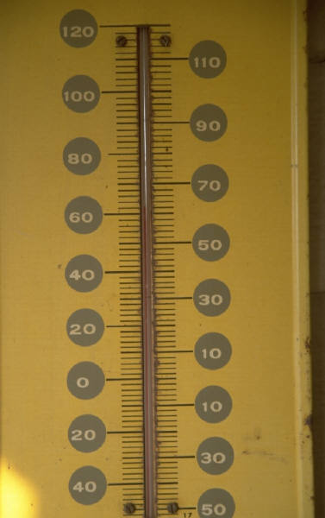
Choose two or three suitable places and record the temperature of the classroom
Monitor over 24hrs
How can we ensure it is a fair test?

Slide 24
Set up a results table
Location 1 | Location 2 | Location 3

Slide 25
Compare the results
Can you suggest reasons for the differences?

Slide 26
Some parts of the classroom are warmer than others, the temperature of the classroom is usually about 20 degrees.

Slide 27
Keeping Warm
Lesson 3 Year 4

Slide 28
Learning Outcomes
You should be able to …..
Turn an idea about how to keep things cold into a form that can be investigated
Decide what evidence to collect
Make a table and record results in it
Draw conclusions from the results

Slide 29
Focus!
Your focus is to stop the surroundings from warming up the ice cubes.

Slide 30
How can you keep things cool?
How could you find out how to keep something cold?

Slide 31
Your Experiment
You have 3 ice cubes per group to test.
You must stop it from melting for as long as possible
What are your ideas?
What materials and equipment will you use?
(You cannot use the freezer!!!!!!!) tee hee!

Slide 32
Think about the following..
I am going to test….
I am using….
I am going to….
To make it fair….
Make a table of your results observing your ice cubes every fifteen minutes.
Sketch and write your results and provide a conclusion.

Slide 33
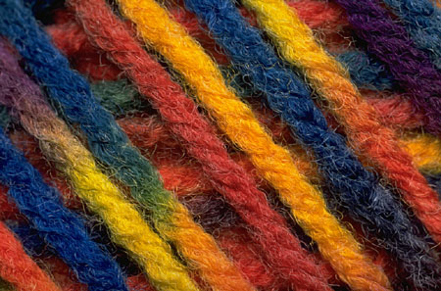
Which materials are effective in preventing the ice cube melting and what are the features of these?

Slide 34
Science Keeping Warm
Lesson 4

Slide 35
Learning Objectives
To turn an idea about how to keep things warm into a form that can be investigated
To plan a fair test deciding what to change, what to keep the same and what to measure
To make careful measurements and use results to draw conclusions
To know that some materials are good thermal insulators.

Slide 36

Focus – To find out which materials make good thermal insulators

Slide 37
What materials keep you warm in winter?

Slide 38
How could we investigate what materials keep things warm?

Slide 39

Your Task
Plan an investigation to find out what materials will keep a container of water warm for the longest time.

Slide 40
How will the test be fair?

Slide 41
How could you record your results?

Slide 42
Choose one material to test in your group, be prepared to feedback to the whole class.

Slide 43
Which material were good thermal insulators?
Good thermals insulators
Poor thermal insulators

