Slide 1

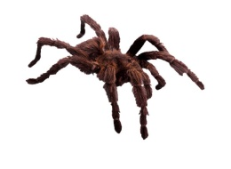
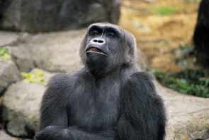
Can it fly?
Yes
No
Does it have feathers?
Does it have legs?
Yes
No
Yes
No
?
?
Does it have fur?
?
Yes
No
?
Does it have 8 legs?
Challenge
Yes
No
?
?

Slide 2

Bird
A bird has feathers and a beak. Most birds can fly. They lay eggs which hatch into their young.

Slide 3
Wasp
A wasp is an insect as it has 6 legs. A wasp can fly and has 2 sets of wings. Wasp string when they feel threatened.

Slide 4

Gorilla
A gorilla is a mammal and a primate. They are closely related to humans. They give birth to live young.

Slide 5

Spider
Spiders have 8 legs and are also known as arachnids. Spiders lay eggs.

Slide 6
Beetle
A beetle is an insect as it has 6 legs. It has 2 antennae which sense the world around them.

Slide 7
Earth worm
Earth worms live in the soil and rarely come to the surface. Unlike the picture worms do not have eyes.

Slide 8
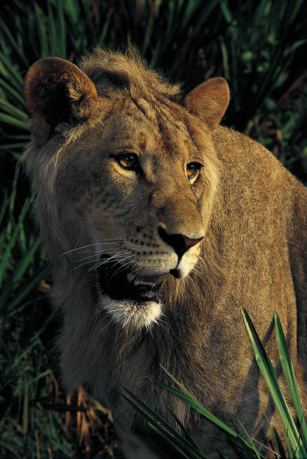
Now try and make your own for these animals.

