Slide 1
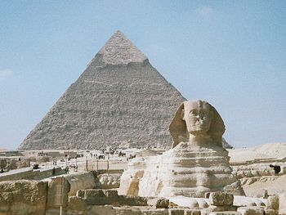
Ancient Africa
Ancient Egypt
Ancient Axum
Ancient Kush

Slide 2
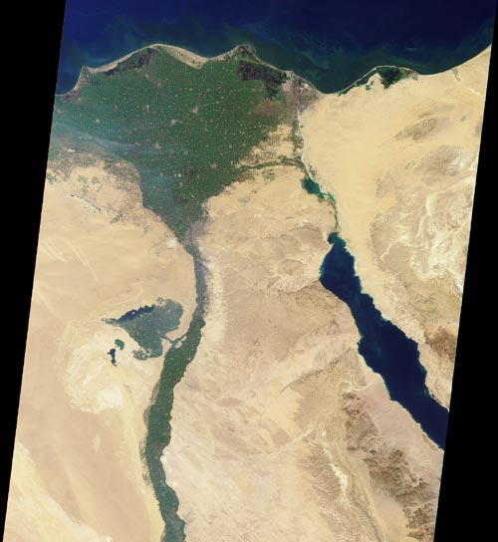
Kingdoms in North Eastern Africa: The Nile River Valley

Slide 3
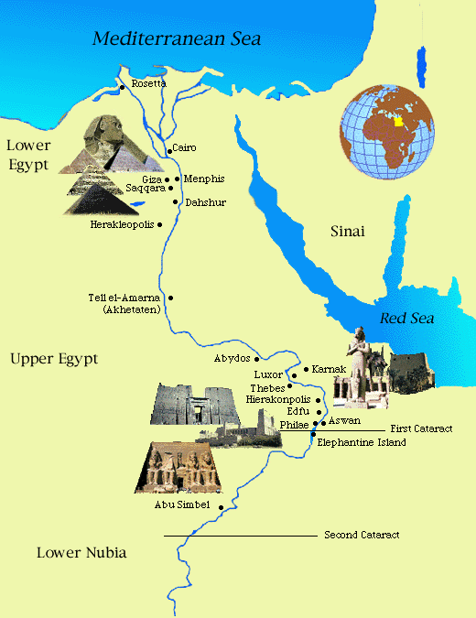
Ancient Egypt

Slide 4
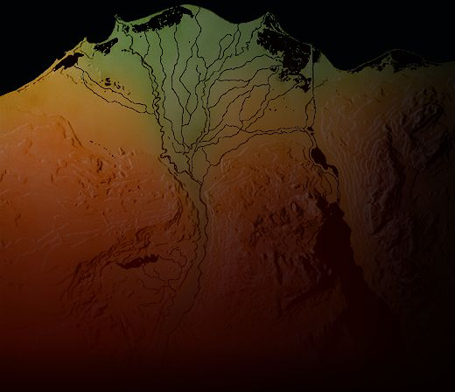
Ancient Egypt

Slide 5
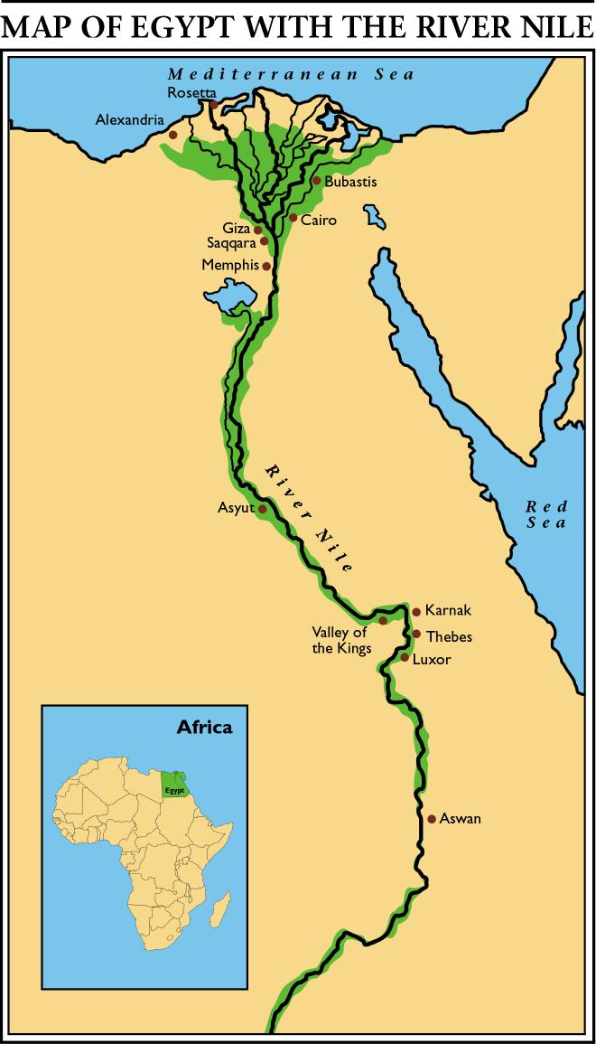
Ancient Egypt
In the Nile River Valley, kingdoms arose because of agricultural growth, urbanization and the creation of large-scale political units. (5000-4000 B.C.E.)
Permanent settlements grew into regional states.
Some of these states united into two states and became known as Upper and Lower Egypt . (3500 B.C.E.)

Slide 6
The Ancient Egyptians thought of Egypt as being divided into two types of land:
The 'black land' was the fertile land on the banks of the Nile. The ancient Egyptians used this land for growing their crops. This was the only land in ancient Egypt that could be farmed because a layer of rich, black silt was deposited there every year after the Nile flooded.

Slide 7
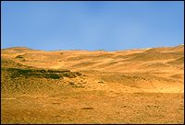
The Ancient Egyptians thought of Egypt as being divided into two types of land:
The 'red land' was the barren desert that protected Egypt on two sides. These deserts separated ancient Egypt from neighbouring countries and invading armies. They also provided the Ancient Egyptians with a source for precious metals and semi-precious stones.

Slide 8
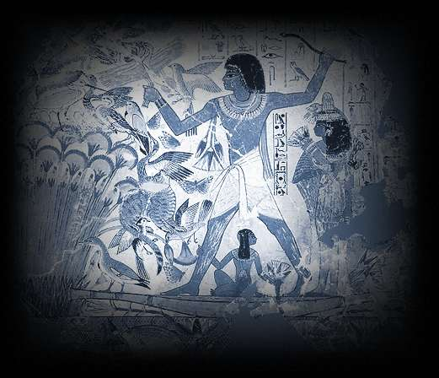
Early Life of Egyptians

Slide 9
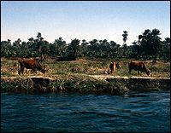
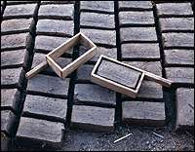
Early Life
Most ancient Egyptians worked as field hands, farmers, craftsmen and scribes. A small group of people were nobles. Together, these different groups of people made up the population of ancient Egypt
The people of ancient Egypt built mudbrick homes in villages and in the country. They grew some of their own food and traded in the villages for the food and goods they could not produce.

Slide 10
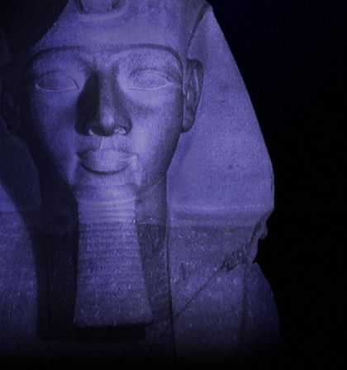
Pharaoh: Lord of the 2 Lands

Slide 11
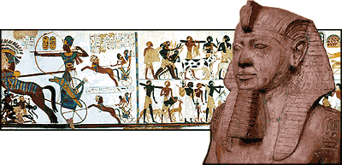
The Pharaoh
The most powerful person in ancient Egypt was the pharaoh (The Great House). The pharaoh was the political and religious leader of the Egyptian people, holding the titles: 'Lord of the Two Lands' and 'High Priest of Every Temple'.

Slide 12
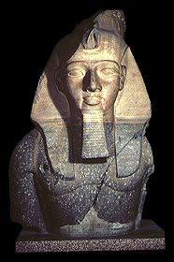
The Pharaoh
As 'Lord of the Two Lands' the pharaoh was the ruler of Upper and Lower Egypt. He owned all of the land, made laws, collected taxes, and defended Egypt against foreigners.
As 'High Priest of Every Temple', the pharaoh represented the gods on Earth. He performed rituals and built temples to honour the gods.

Slide 13
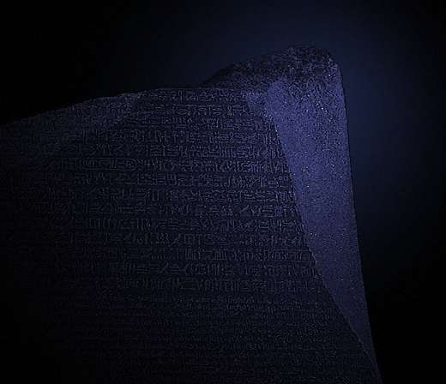
Hieroglyphs

Slide 14
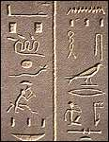
Hieroglyphs
The most famous of all ancient Egyptian scripts is hieroglyphic. However, throughout three thousand years of ancient Egyptian civilization, at least three other scripts were used for different purposes. Using these scripts, scribes were able to preserve the beliefs, history and ideas of ancient Egypt in temple and tomb walls and on papyrus scrolls

Slide 15
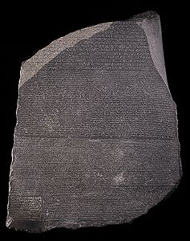
The Rosetta Stone
The Rosetta Stone is a stone with writing on it in two languages (Egyptian and Greek), using three scripts (hieroglyphic, demotic and Greek).

Slide 16
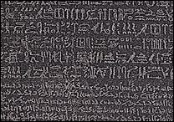
The Rosetta Stone is written in three scripts because when it was written, there were three scripts being used in Egypt.
The first was hieroglyphic which was the script used for important or religious documents.
The second was demotic which was the common script of Egypt.
The third was Greek which was the language of the rulers of Egypt at that time.
The Rosetta Stone was written in all three scripts so that the priests, government officials and rulers of Egypt could read what it said

Slide 17
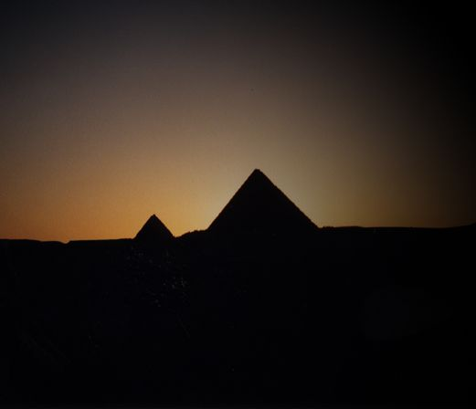
Pyramids

Slide 18
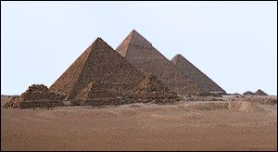
The ancient Egyptians built pyramids as tombs for the pharaohs and their queens. The pharaohs were buried in pyramids of many different shapes and sizes from before the beginning of the Old Kingdom to the end of the Middle Kingdom.
There are about eighty pyramids known today from ancient Egypt. The three largest and best-preserved of these were built at Giza at the beginning of the Old Kingdom. The most well-known of these pyramids was built for the pharaoh Khufu. It is known as the 'Great Pyramid'

Slide 19
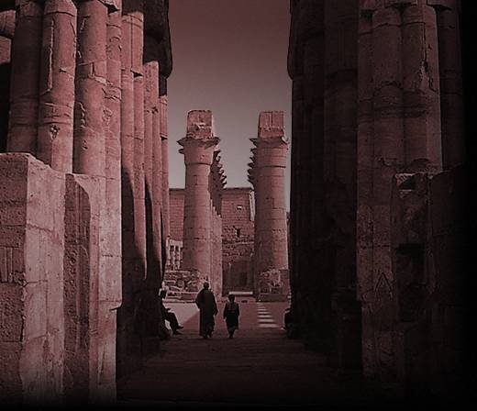
Temples

Slide 20
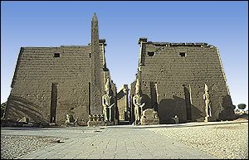
Temples
The ancient Egyptians believed that temples were the homes of the gods and goddesses. Every temple was dedicated to a god or goddess and he or she was worshipped there by the temple priests and the pharaoh.

Slide 21
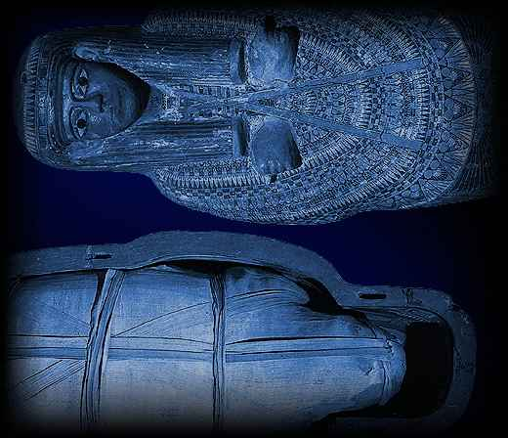
Mummification

Slide 22
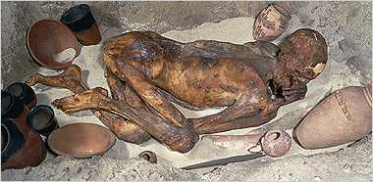
The earliest ancient Egyptians buried their dead in small pits in the desert. The heat and dryness of the sand dehydrated the bodies quickly, creating lifelike and natural 'mummies'.

Slide 23
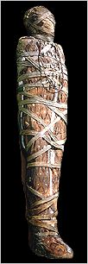
Mummification
Over many centuries, the ancient Egyptians developed a method of preserving bodies so they would remain lifelike. The process included embalming the bodies and wrapping them in strips of linen

Slide 24
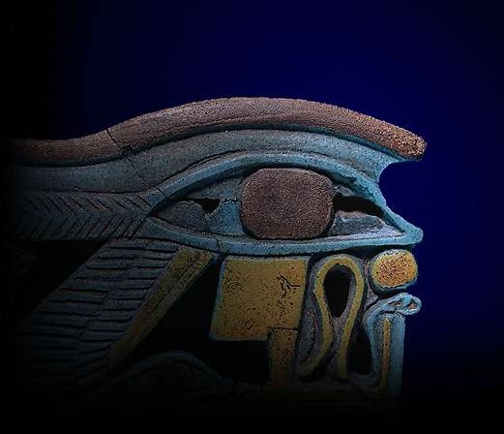
Gods & Goddesses

Slide 25
The ancient Egyptians believed in many different gods and goddesses. Each one with their own role to play in maintaining peace and harmony across the land
Some gods and goddesses took part in creation, some brought the flood every year, some offered protection, and some took care of people after they died. Others were either local gods who represented towns, or minor gods who represented plants or animals.

Slide 26
Old Kingdom (Age of the Pyramids)
2780-2108 B.C.
Pharaohs had all political & religious power
The Pharaoh was a landlord and rented out land to the nobles.
Pyramids were built to protect the dead.
Hieroglyphics told the Pharaoh’s story
Sphinx: Monument that has a body of a lion and head of a man (pharaoh). It represents the pharaoh as Ra, the sun god.
Declined:
Collected taxes, but pyramids were still too costly
Pharaoh began to lose authority to nobles, who gained more authority over nomes (provinces)
Crops failed and people suffered.

Slide 27
Middle Kingdom (Age of the Nobles)
2100-1788 B.C.
A noble named Amenemhet I became pharaoh
He gave power back to the pharaoh
Moved capital to Thebes
Arts and literature flourished
Successful war against Nubia
Trade was successful
Declined:
Weak dynasties
Hyksos warriors destroyed temples, and burned cities.

Slide 28
New Kingdom (Age of the Empire)
1580-1090 B.C.
Egyptian pharaohs drove out Hyksos warriors
The Egyptians created a standing army of charioteers, bowman and foot soldiers
Hatshepsut: Was a powerful female pharaoh, who expanded trade; time of peace; built a pyramid in Valley of the Kings. It is believed that her step-son (Thytmose) murdered her, and he led military campaigns that ended the peace.

Slide 29
Decline
Small invasions
A peace treaty between the Hittites and Ramses II caused Egypt to lose some dominance
Fell under Persia
Alexander the Great occupied Egypt and Cleopatra became the last pharaoh
Defeated in a naval battle against Rome and became part of the Roman Empire

Slide 30
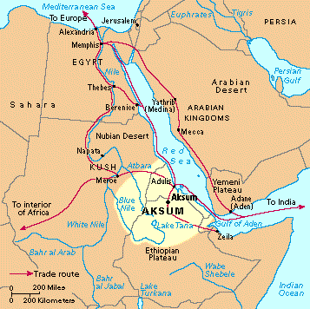
Axum (Aksum)

Slide 31
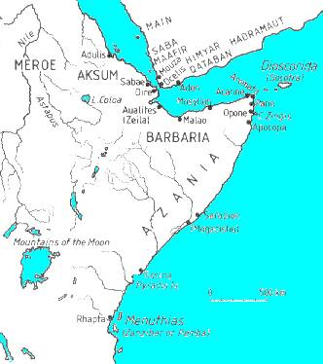

Slide 32
Axum
The Aksumites were a people formed from the mix of Kushitic speaking people in Ethiopia and Semitic speaking people in southern Arabia who settled the territory across the Red Sea around 500 BC.
They lived in the Ethiopian highlands near the Red Sea.

Slide 33
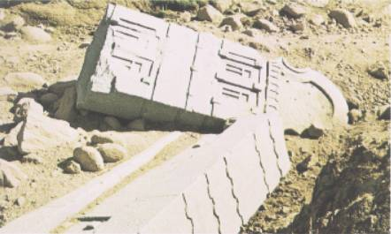
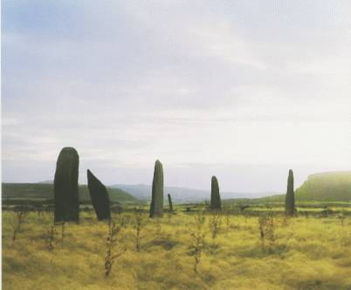
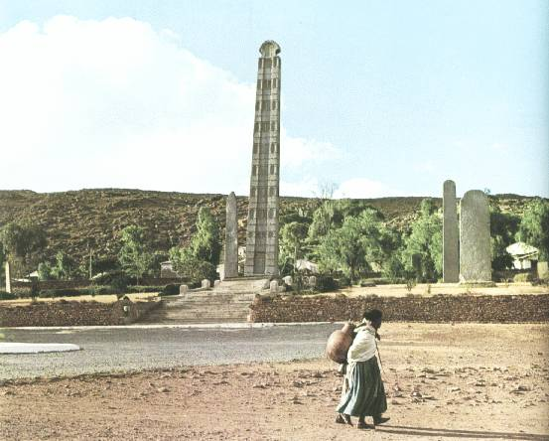
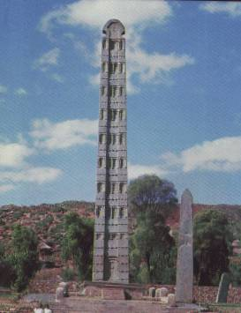

Slide 34
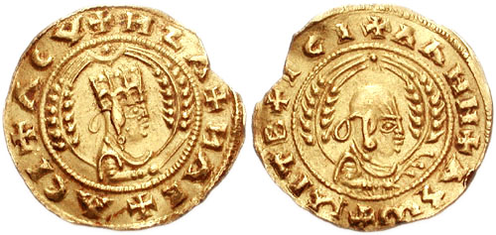
Axum
The Aksumites controlled one of the most important trade routes in the world and occupied one of the most fertile regions in the world.
Adulis was a trade center
Trade in ivory and possibly slaves.

Slide 35
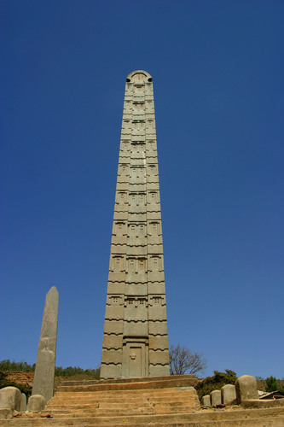
Axum
Ezana, a ruler of Axum, declared Axum to be a Christian state , thus making it the first Christian state in the history of the world, and began actively converting the population to Christianity

Slide 36
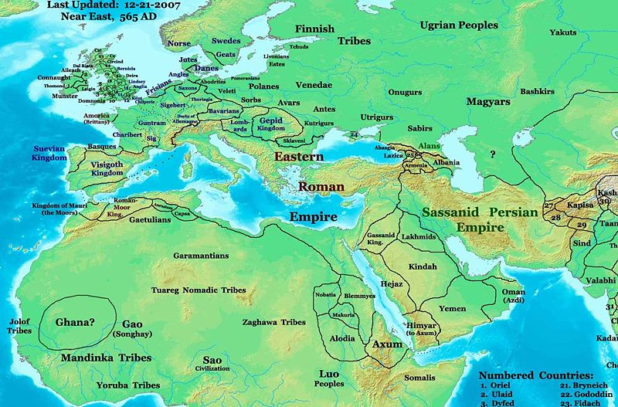
Axum
Axum declined due to the rise of the new and expanding religion Islam.

Slide 37
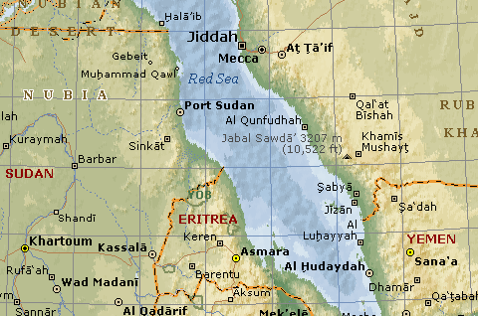
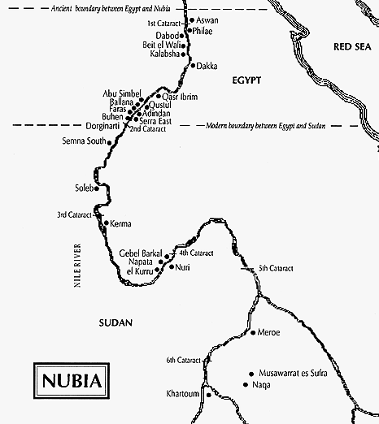
Kush (Nubia)

Slide 38
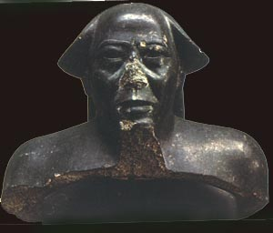
Kush
2000 B.C. to 350 A.D.
Centered in the region Nubia
In the Northern Sudan Region
The people are called Kushites
Alara is said to be the founder. He unified the Napta based kingdom.
The Egyptians enslaved some of them and took them back to Egypt and stole their metals, cattle and ivory.
Its power reached its climax when King Piye conquered all of Egypt. They lost their power in Egypt to the Assyrians, who had iron weapons.
Their culture was similar to that of Egypt. Same beliefs and gods.
They were fishermen & farmers

Slide 39
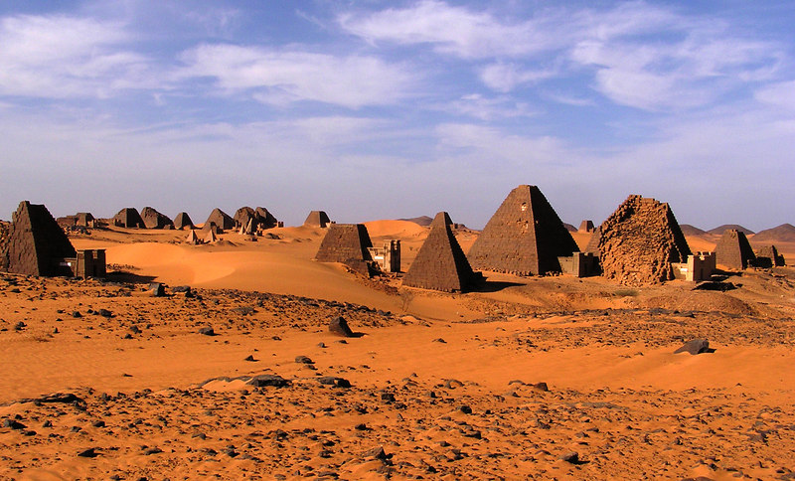

Slide 40
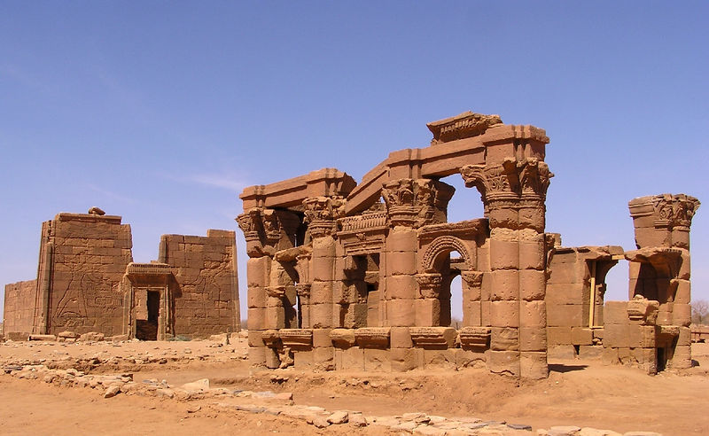

Slide 41
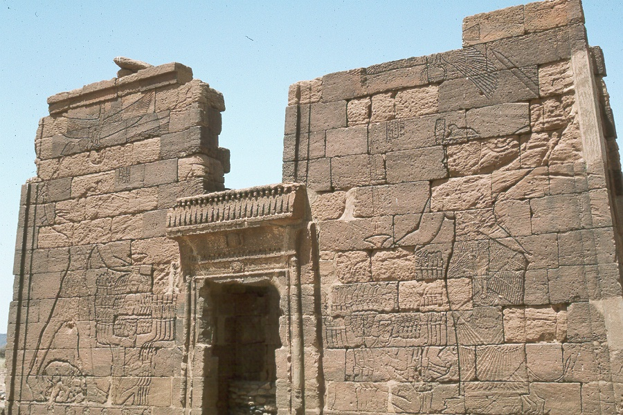

Slide 42
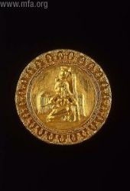
Kush
Alphabet Script = Merotic Language
Men and women held power jointly. A lot of
art work depicts women giving birth to gods.
They traded along the Nile River and eventually with the Greeks.
Resources: Gold, ivory, copper, ebony and also traded pottery
Nubia had more pyramids than Egypt
In 2003, Charles Bonnet discovered 7 large stone statues of Nubian Kings along the 3 rd cataract of the Nile River.
The Sudanese government are building the Merowe Dam, which will flood the terrain where the Nubian Civilization flourished, which will make it impossible to find any new information on this kingdom.

Slide 43
The Black Pharaohs
The Black Pharaohs: Conquerors of Ancient Egypt
1. Piye
Kush’s power reached its climax when King Piye conquered all of Egypt in 730BC
It was a year long battle and when he won, he returned to Nubia with his treasurers.
2. Shabaka
● He came into power when his brother Piye died in 715 B.C.
● He took up residence in Memphis, the capital of Egypt at the time
● He built dykes to seal off Egyptian villages from Nile floods.
● He added buildings and statues in Thebes and the Temple of Luxor
● There is a statue of him wearing the Kushite crown, the double uraeus, that has 2 cobras signifying the legitimacy as the Lord of the 2 lands.

Slide 44
The Black Pharaohs
3. Taharqa
● Ruled in 690 B.C.
● He was the son on Piye
● When he was a prince, he survived an Assyrian attack
● He built monuments, statues and cartouches bearing his image and name throughout
Egypt.
● During his reign, there were great harvests
● He launched a massive building campaign in Thebes and in Napata
● He battled with the Assyrian king Esarhaddon
● After a 15 day-long battle with the Assyrains, the Nubians were pushed back to Memphis and eventually, Taharqa (after being wounded 5 times) escaped and left
● The Assyrians slaughtered the villagers and made piles of their heads
● In 669, he recaptured Memphis, but a new Assyrian king attacked and Taharqa fled to never see Egypt again

Slide 45
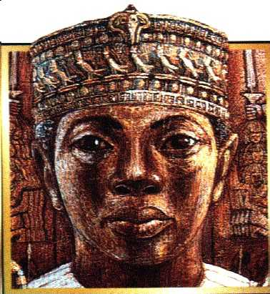
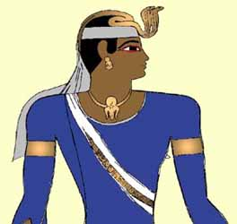
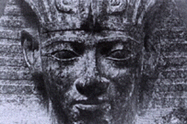
The Black Pharaohs

Slide 46
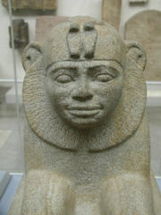
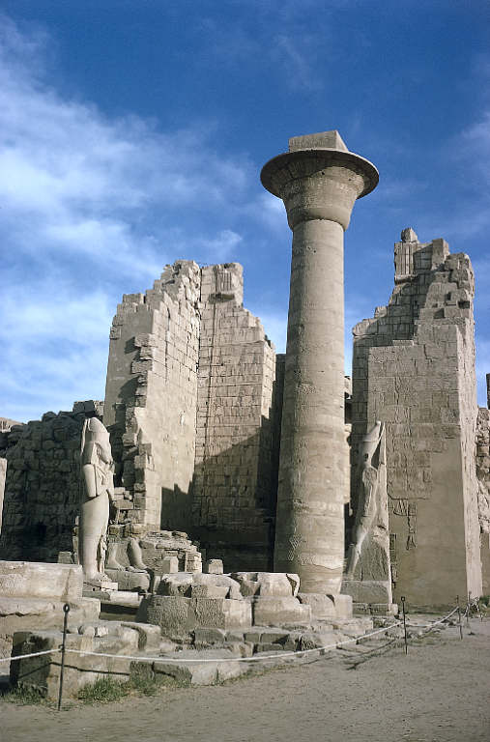
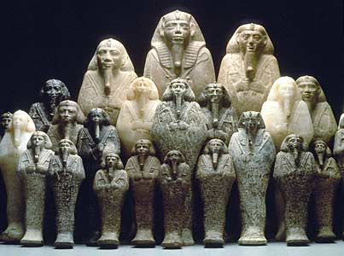

Slide 47
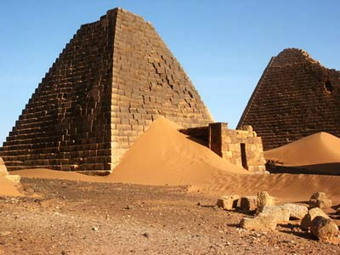
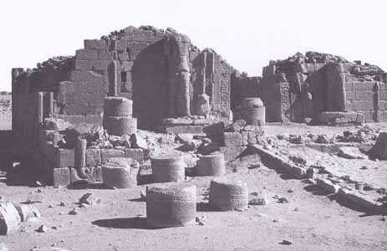
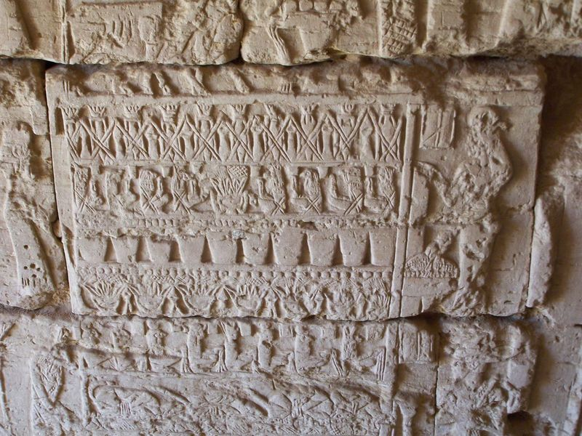
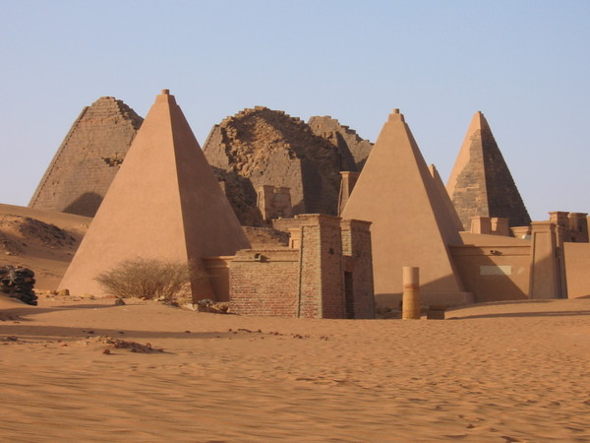
Meroe became a powerful trade & military center.

Slide 48
They trained elephants in warfare and used them for transportation & Trade.

Slide 49
Wrestling was a very popular sport.

Slide 50
Decline
Kush declined in 300 CE due to the growth of the population and industry, which had a devastating impact on the environment. They were defeated by an Axum army.

