Slide 1
My Face

Slide 2
Do you know these parts of your face

Slide 3

eye

Slide 4
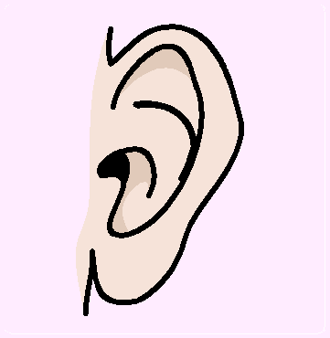
ear

Slide 5
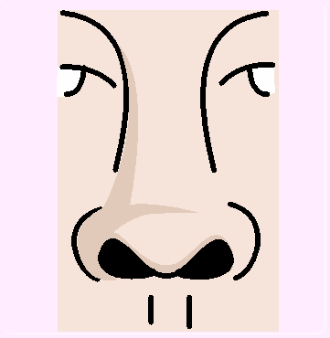
nose

Slide 6

mouth

Slide 7
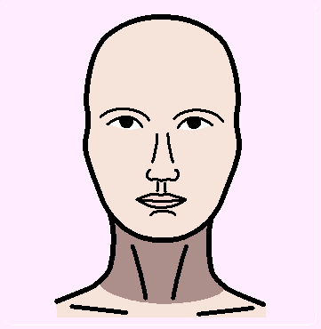
neck

Slide 8
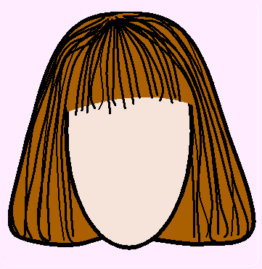
hair

Slide 9
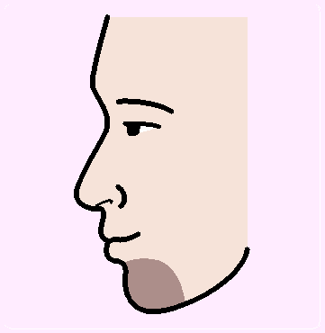
chin

Slide 10
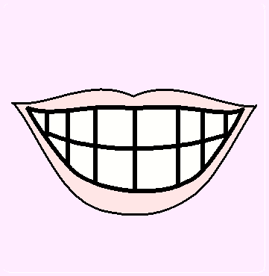
teeth

Slide 11
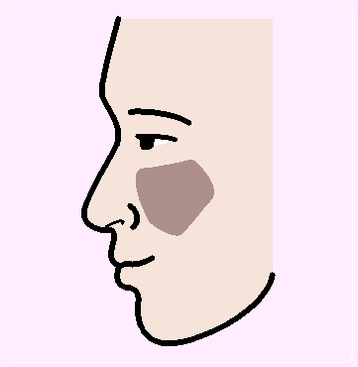
cheek

Slide 12
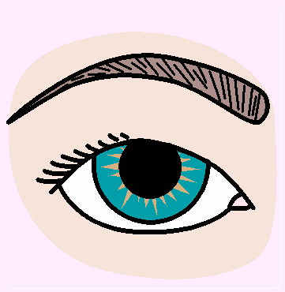
eyebrow

