Slide 1
Labelling Forces
Correctly!

Slide 2
What were the names of the forces you had on your vocabulary cards last week?
Propulsion
This can be any driving force, it may be a push or pull, but it could be an engine which forces an object forward.
Water resistance
This is a force which acts in water, it can slow objects down, reducing the affect of gravity.
Air resistance
This is a force which acts in the air, it can slow objects down when they are moving against it. Or if harnessed could be used to move an object along.

Slide 3
Friction
This force acts on objects when they are in contact with a surface, such as the ground. It can be reduced by ensuring both surfaces are smooth.
Gravity
This force affects every object on Earth. It is a force which pulls everything to the centre of the earth.
Upthrust
This is an upward force which acts in water, it acts on a object against gravity, and is why certain objects float.

Slide 4
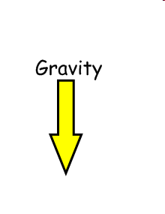
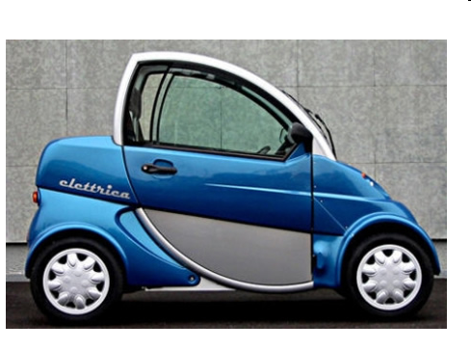
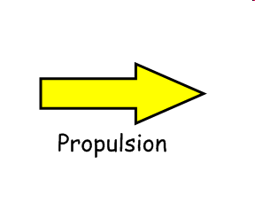
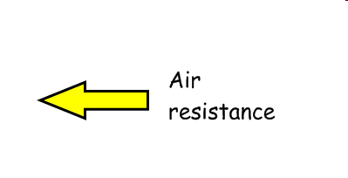
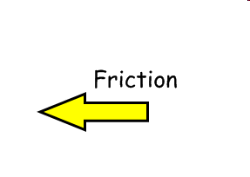
What forces are acting on this car which is driving along?
This force is always present. It goes towards the centre of the earth, so will always be pointing from the top of the object
This acts against the car, as it moves forward and is acting against the propulsion.
This is the most powerful force, this should be your largest arrow, it should be pointing in the direction the car is going …
This force is only present where the car is in contact with the floor, it acts against the propulsion.

Slide 5
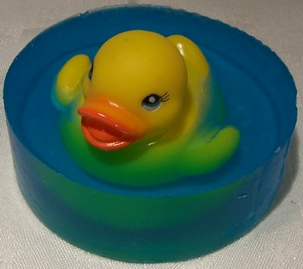
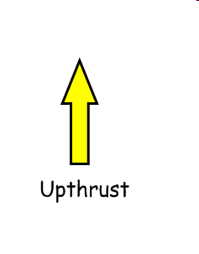
What forces are acting on this duck floating in the water – it’s NOT moving?
They are balanced!
What do you notice about these forces?
This force is always present. It goes towards the centre of the earth, so will always be pointing from the top of the object
This acts against the force of gravity to allow the duck to float.

Slide 6
Now it’s your turn …
You are going to have 6 different objects which you need to label correctly.
These are things I will be looking for:
Choose all the correct forces you think are acting on the object .
Make sure arrows show clearly which force you think is most powerful.
Your arrows should be pointing in the correct direction (the direction of the force) and should be in the correct place on the diagram.

