Slide 1
Some Thoughts on Leadership by
Don C. Bramlett, PE, SMIEEE
IEEE Region 4 Director 2009-2010
Southeastern Michigan Section
DTE Energy – Project Engineer

Slide 2
Workshop Content
Introduction
Definition of Leadership
Interpersonal Effectiveness
Leadership
Attributes of a Leader
Differences between management skills and leadership skills
Being a Leader
Holistic Communications

Slide 3
Workshop Content
Interpersonal Communications
Personal Interactive Skills
Jungian type personality indicators
Self Evaluation
Motivating
Maslow’s Hierarchy of Needs
Team building
Coaching

Slide 4
Workshop Content
Conflict Management
Thomas-Kilmann Conflict Styles
Self Evaluation
Situations to use conflict styles and consequences
Confronting Conflict

Slide 5
Workshop Content
Problem Solving and Decision Making
Formal Techniques, eg. KT, Alamo, Cause Mapping, etc
Brainstorming
Synergistic Decision Making

Slide 6
Definition of Leadership
Leadership, according to Peter DeLisle, is the ability to influence others, with or without authority.
All successful endeavors are the result of human effort; thus, the ability to influence others is a derivation of
Interpersonal Communications
Conflict Management
Problem solving

Slide 7
Interpersonal Effectiveness
Interpersonal effectiveness is the capability of an individual to do this, influence others, competently.
Leadership is a direct function of three elements of interpersonal effectiveness
Awareness
Ability
Commitment

Slide 8
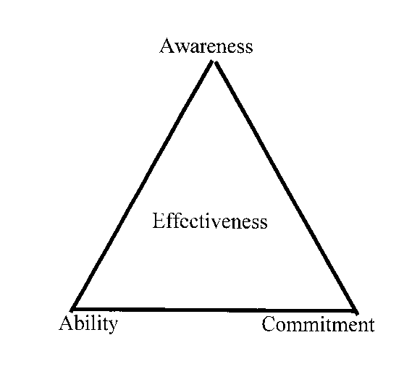
Interpersonal Effectiveness

Slide 9
Awareness
Awareness is a state of consciousness.
It is the ability to recognize yourself, others, events and situations in real time.
It is the ability to assess the impact of actions on situations and others, and be critically self-reflective.
It is a development process that is a function of experience, communication, self discovery and feedback.

Slide 10
Ability
Ability to learn and understand technical issues is the basis of our careers.
Ability to lead is a function of influence:
Ability to communicate
Ability to resolve conflicts
Ability to solve problems and make decisions
As a member of a team, we influence others in a collaborative effort to find better ideas or solve problems.

Slide 11
Commitment
For leaders, the “one thing” that leads to maturity is the fully aware recognition that one’s decisions make a difference, both positively and negatively, in the lives of others, and that any attempt to solve a problem might have a decided negative impact on some, while helping others.
In no-win scenarios, one must still make a hard decision.

Slide 12
Commitment
Movie example – Untouchables
Moment of truth for Elliott Ness
Jimmy O’Neil asks
“What are you prepared to do?”
Ness replies
“Anything I have to do to make this thing right.”
O’Neil says
“Everyone knows where the problems are, but no one is willing to do anything. You said you would do anything you had to, to make it right. Now, I’m willing to help you. You made the commitment.”

Slide 13
Attributes of a Leader
Guiding vision: Effective leaders know what they want to do, and have the strength of character to pursue their objectives in the face of opposition and in spite of failures. The effective leader establishes achievable goals.

Slide 14
Attributes of a Leader
Passion: Effective leaders believe passionately in their goals. They have a positive outlook on who they are, and they love what they do. Their passion for life is a guiding star for others to follow, because they radiate promise!

Slide 15
Attributes of a Leader
Integrity: Because they know who they are, effective leaders are also aware of their weaknesses. They only make promises they can follow through on.
Honesty: Leaders convey an aura of honesty in both their professional and their personal lives.
Trust: Effective leaders earn the trust of their followers and act on behalf of their followers.

Slide 16
Attributes of a Leader
Curiosity: Leaders are learners. They wonder about every aspect of their charge. They find out what they need to know in order to pursue their goals.
Risk: Effective leaders take calculated risks when necessary to achieve their objectives. If a mistake is made, the effective leader will learn from the mistake and use it as an opportunity to explore other avenues.

Slide 17
Attributes of a Leader
Dedication: The effective leader is dedicated to his or her charge, and will work assiduously on behalf of those following. The leader gives himself or herself entirely to the task when it is necessary.

Slide 18
Attributes of a Leader
Charisma: This may be the one attribute that is the most difficult to cultivate. It conveys maturity, respect for your followers, compassion, a fine sense of humor, and a love of humanity. The result is that leaders have the capability to motivate people to excel.
Listening: Leaders Listen! This is the most important attribute of all, listen to your followers.

Slide 19
Leader vs Manager
Leader n, 1. A person who is followed by others.
Manager n, 1. A person controlling or administering a business or a part of a business. 2. A person regarded in
terms of skill in household or financial or other management.

Slide 20
Leadership
Leadership is the ability to develop a vision that motivates others to move with a passion toward a common goal

Slide 21
Management
Management is the ability to organize resources and coordinate the execution of tasks necessary to reach a goal in a timely and cost effective manner

Slide 22
Leadership vs Management
Management seeks stability & predictability
  (order)
Leadership seeks improvement through change
  (disorder)

Slide 23
Leader vs Manager
Leaders:
Do the right thing
Manager:
Do things right

Slide 24
Leadership & Management Skills
Leadership – soft skills
Communications
Motivation
Stress Management
Team Building
Change Management
Management – hard skills
Scheduling
Staffing
Activity Analysis
Project Controls

Slide 25
Managers have the following attributes , they
  Consider alternatives to design
  Estimate costs involved
  Establish risks to the organization
  Develop a schedule for the project
  Include decision steps
  Manage change in an orderly fashion
  Keep the team motivated and informed
  Review responsibilities and goals with each team player
  State clearly the basis for evaluation and where each person fits into the organization

Slide 26
Managers have the following attributes , they
  Monitor progress
  Set directions; set expected achievements for each individual within the next work period. Show the team members where they fit in achieving unit goals.
  Perform administrative tasks
  Report to senior management
  Money and job security play a major role in management effectiveness. They act as deficiency motivators.

Slide 27
Being a Leader
If you want to get ahead, be a leader, you must assume:
  That everything that happens to you results in a situation that is in your control
  That the attitude you convey is what you are judged on
  That what you think and do in your private life is what you will reap in your public or corporate life
  You are what you think and believe
  If you never meet a challenge you will never find out what you are worth

Slide 28
Recipe for being a Leader
Take control of your life
Assume responsibility for who you are
Convey a positive and dynamic attitude in everything you do
Accept blame: learn from your own mistakes as well as those of others. Take blame for everything that happens in your unit
Give credit wherever it is due
Be compassionate when you review your team members' progress or lack thereof

Slide 29
Recipe for Being a Leader
Think great thoughts. Small thinking is why companies go broke
Turn disasters into opportunities. Turn every obstacle into a personal triumph
Determine your "real" goals then strive to achieve them
When you want to tell someone something important, do it personally
Don’t be afraid to get your hands dirty doing what you ask others to do. Make coffee

Slide 30
Recipe for Being a Leader
Listen effectively
Encourage teamwork and participation
Empower team members
Communicate effectively
Emphasize long-term productivity
Make sound and timely decisions
Treat each person as an individual
Know yourself and your team
Protect your team
Have vision, courage and commitment

Slide 31
Holistic Communications
image (noun)
1. Form, semblance; counterpart as regards appearance (That person is the image of an engineer.)
2.simile, metaphor; mental representation; idea, conception; character of thing or person as perceived by the public.
Image includes everything: the way you talk and dress, the way you act, your attitude to others
at work and play.

Slide 32
Holistic Communications
Do you give warm fuzzies? Do you smile a lot? Do you feel dynamic and energized, and show it? Do you feel comfortable in a group?
Or: do you hand out cold pricklies? Do you frown a lot? Do you feel tired and drained of energy, and show it? Do you feel uncomfortable in a group?
When people think about you, do they equate your image with a dynamic, interested, competent person? Are you the sort of a person who makes things happen, at home, at work, or at play?
Or: do people think you are merely occupying a spot in the universe? That you are waiting for the next millennium? Are you the sort of person who waits for someone else to make things happen?

Slide 33
Holistic Communications
What are your personal career objectives?
1. to identify problems and create winning solutions to solve them?
2. to lead effectively, with inspiration; to motivate?
3. to be in control of your world; to make things happen for you?
4. to manage your personal resources effectively?
5. to be president of your own company?
6. to be a millionaire, if you aren't already?

Slide 34
The way you stand or sit
indicates whether you are an open person, easily approachable
says whether you are friendly
tells others whether you could be a good team player
suggests that you are frank and honest
tells others what you really think of them
shows whether you are a part of the team

Slide 35
The way you dress
indicates whether you have conventional ideas or whether you are a radical
shows how neat you are
suggests whether you will fit in with the company's image
makes a statement about whether or not you care enough to find out about the company, its image and its objectives
shows indirectly whether you are confident, whether or not you believe in yourself.

Slide 36
The way you write
Conveys whether you are warm and friendly or appear cool and reserved
Tells whether you are dynamic and energetic or whether you are lethargic and procrastinate
Conveys an image of you as either intuitive in solving problems, or logical, solving problems step by step
Says whether you want to communicate with others or not
Says whether you try to avoid conflict or seek it
Says whether you are materialistic or idealistic

Slide 37
Holistic Communications
Conclusions
Communication is a holistic concept; everything we do conveys something about ourselves
If you want to achieve greatness in your chosen objectives you must communicate holistically. It is not enough to write well or to know a lot of big words. You must be able to project an image that will lead to success
You can change the way you appear to others by changing your behavior pattern
If you want to change your behavior pattern, you must change everything about yourself.

Slide 38
What is the bottom line for you?
You are in control of your environment. You can make every setback an opportunity for success
You can be anything you can be! Whatever you want to be is entirely up to you
You can become the person you want to be. Dress like that person, talk like that person, act like that person, write like that person, and that will be you.

Slide 39
Interpersonal Communications
Carl Jung was a Swiss born psychiatrist, and a colleague of Sigmund Freud, who practiced in the first half of the 20th century.
Jung formulated a classification of personality in terms of types of characteristics, such an introvert and extrovert

Slide 40
Personal Interactive Skills
On the basis of Jung’s classification of personality, Katherine Briggs and her daughter, Isobel Briggs-Myer, developed a procedure for evaluating personality characteristics.
A number of tests exist for giving Myers-Briggs type indicators.
The types are divided into four pairs of preferences.

Slide 41
Personality Indicators
Extraversion: type E, sociable,
about 75%,
expends energy
interacts with others freely
Introversion: type I, territorial,
about 25% conserves energy
reads meditates
solves problems

Slide 42
Personality Indicators
Are you energized around people? Do you like to meet people and seek opportunities to do so? Do you think out loud? Do you talk to plants and discuss problems with animals? This is Extrovert behavior.
Alternatively, do you find you would rather work alone, without interruption. Does meeting too many people tend to tire you out? Would you sooner not answer the phone - let the answering machine do it for you. Would you rather have a problem written down for you than stated verbally? This is typical Introvert behavior.

Slide 43
Personality Indicators
intuitive: type N, creative, about 25% ingenious, future-oriented, fantasizes, imaginative
Sensing: type S, practical, about 75% experience-oriented, utility, sensible
Do you see the world in terms of your senses? Do you like the facts before starting work? Do you like dealing with the details of a project rather than the overall plan? You are likely Sensing.
Or do you think in terms of the big picture, in terms of concepts and ideas, rather than the information involved? Put down intuitive.

Slide 44
Personality Indicators
Thinking: type T, impersonal, 50% (however, 60%M) objective judgments, logical orientation, rules, laws, justice, firmness
Feeling: type F, personal, 50% (however, 60%F) emotional judgments, value-oriented, persuasion, sympathy, devotion
Note: both types can react with the same emotional intensity.
Do you tend to follow the rules regardless of how you feel? Do you hide your feelings and get on with the job? That's Thinking.
Or do you inject a personal note into things you do, even let your emotions take over, sometimes. That's Feeling type behavior.

Slide 45
Personality Indicators
Judging: type J, closure, concluding, 50% settled, decided, work comes first, plan ahead, urgency, deadline, get-it-done.
Perceptive: type P, get more data, 50% pending, flexible, adaptable let-it-happen, open-ended, tentative, wait-and-see.
Note: both types are equally "judging" and "perceptive."
Do you like to set up a schedule to meet deadlines, make lists, make quick decisions in order to get onto the next job? That's Judging behavior.
Or are you really adaptable, you like collecting more information so your decision will be really informed. That's Perceptive.

Slide 46
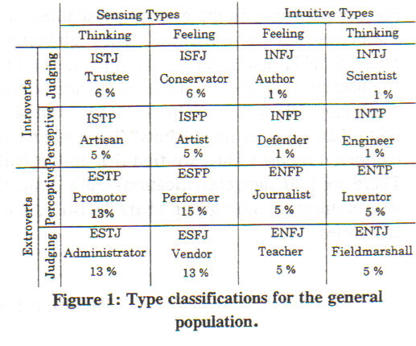
Personality Indicators

Slide 47
Self Evaluation
What is my personality type?
Take the test.
Be as honest as you can, only you will see the results.
List the answers on the chart.
Evaluate the results.
Do you concur?
Do you understand yourself?

Slide 48
Motivating
Abraham Maslow was an American born psychologist, researcher and educator who practiced during the middle third of the 20th century.
Maslow created his now famous hierarchy of needs based on his observations that some needs take precedence over others.

Slide 49
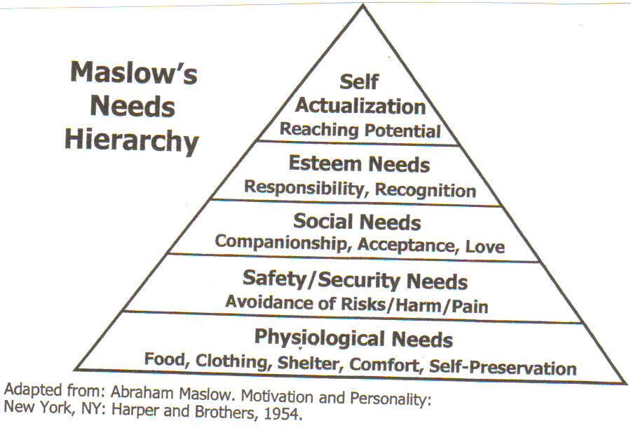
Motivating

Slide 50
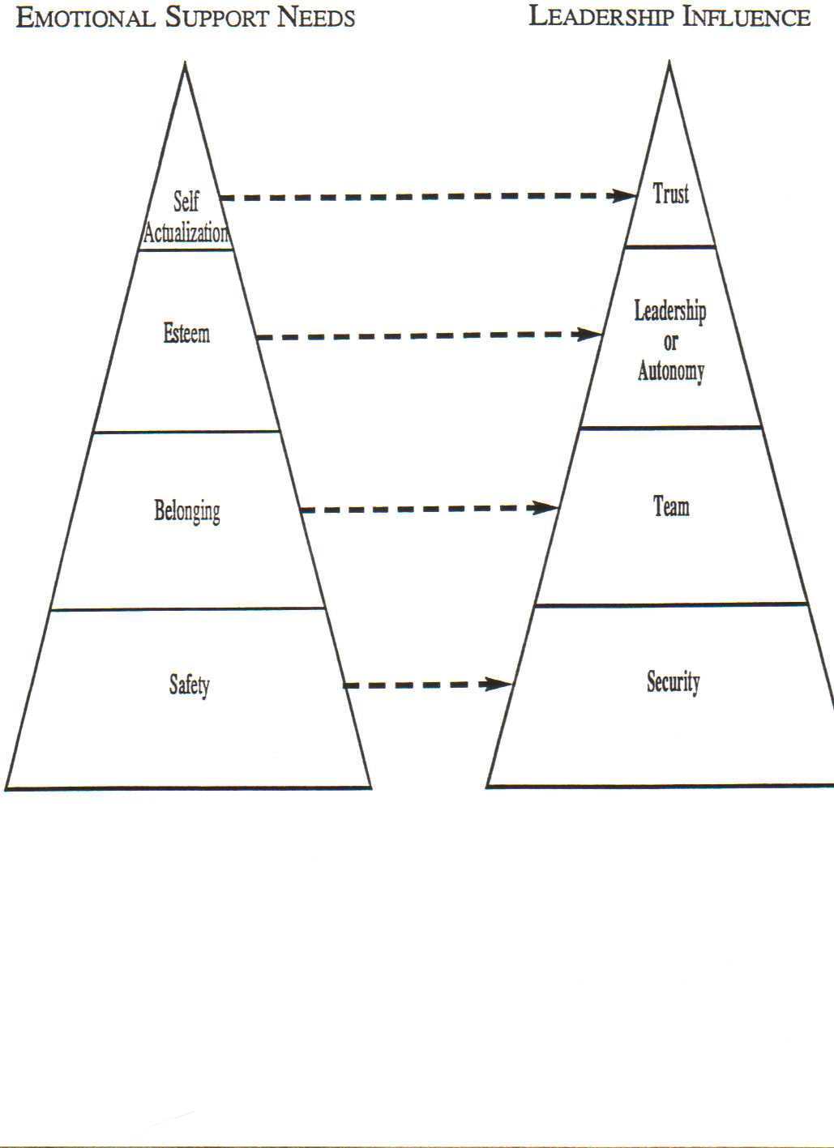
Motivating

Slide 51
Building a Team
Why would someone want to become part of a team?
An effective team helps one feel they are:
Doing something worthwhile for themselves and the organization
Enjoying a more satisfying work life
More in control of their jobs
Making contributions which are well used
Learning new skills
Recognized and respected

Slide 52
Building a Team
When a team is operating well the leader and the members:
Are clear on team goals and are committed to them
Feel ownership for problems rather than blaming them on others
Share ideas
Listen to and show respect for others
Talk more about “we” and less about “I” and “me”

Slide 53
Building a Team
Understand and use each others know-how
Know about each other’s personal lives
Give each other help and support
Show appreciation for help received
Recognize and deal with differences and disagreements
Encourage development of other team members
Are loyal to the group, its members, the leader and the organization

Slide 54
Building a Team
Make decisions based on facts not on emotion or personalities
Play a variety of roles – serve as leader, teacher or coach

Slide 55
Coaching
The goal of coaching is not to provide direction, but to enable team members to work together to help one another find direction.
Coaching is the foundation for continuous improvement.
Coaching is a practical skill anyone can learn.

Slide 56
Coaching
Identify an opportunity to help someone expand on his or her skills, knowledge and abilities
Coaching is a chance to help someone enhance his or her performance and add value to the organization/team. Sometimes, people may ask for coaching, but don’t wait for that to happen. Act on opportunities for coaching at any time.

Slide 57
Coaching
Confirm that the person is ready for coaching.
Before trying to coach, make sure the person is open to it. If a person seems hesitant, try explaining the benefits, but don’t insist on coaching someone who simply isn’t receptive. To ensure a win-win situation, find out if the person is willing before proceeding to coach.

Slide 58
Coaching
Ask questions and offer information to help clarify the situation.
Much of coaching involves helping people clarify situations in their own minds. Often, the best way to do this is by asking open-ended questions that encourage them to think through the situation aloud. Begin questions with words like what, when, where, who and how much.

Slide 59
Coaching
Help the person identify possible actions.
The best coaching enables people to think and act on their own. As you help someone identify immediate actions, you’re also preparing the person to work through similar issues without your help. Offer guidance as he or she develops a plan.

Slide 60
Coaching
Gain agreement on a course of action.
In coaching, you help someone plan how to handle a situation. To be certain that the session results in positive action, you need to gain the person’s commitment to a specific plan of action.

Slide 61
Coaching
Offer your support.
The ultimate goal of coaching is to enable a person to act independently. Most people need assurance and support before they can reach that goal. As a coach, you need to let the person know you’re available to give further assistance – or further coaching- when it is needed. Coaching isn’t a quick fix or a one-time shot, it’s an extended relationship.

Slide 62
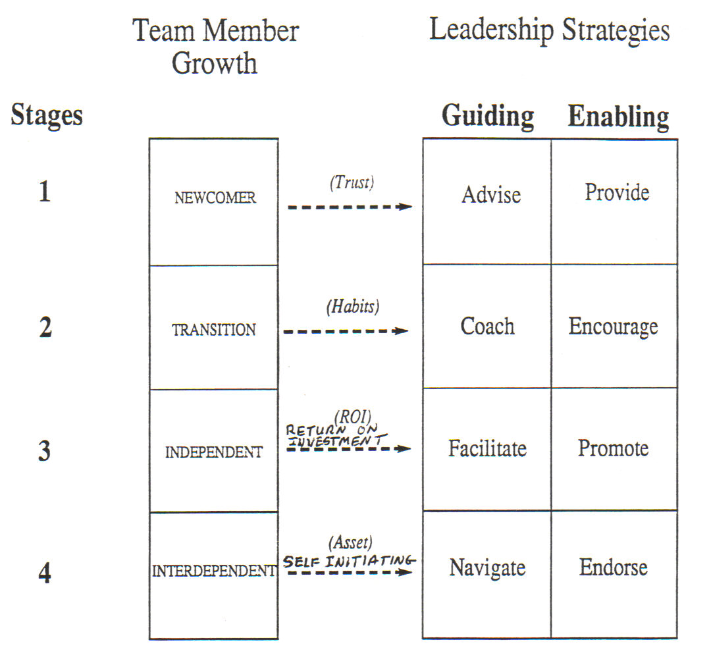
Leadership Strategies

Slide 63
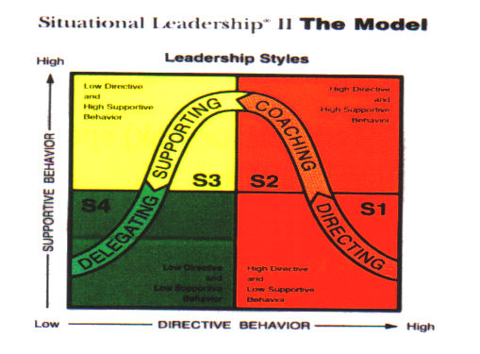
Leadership Styles

Slide 64
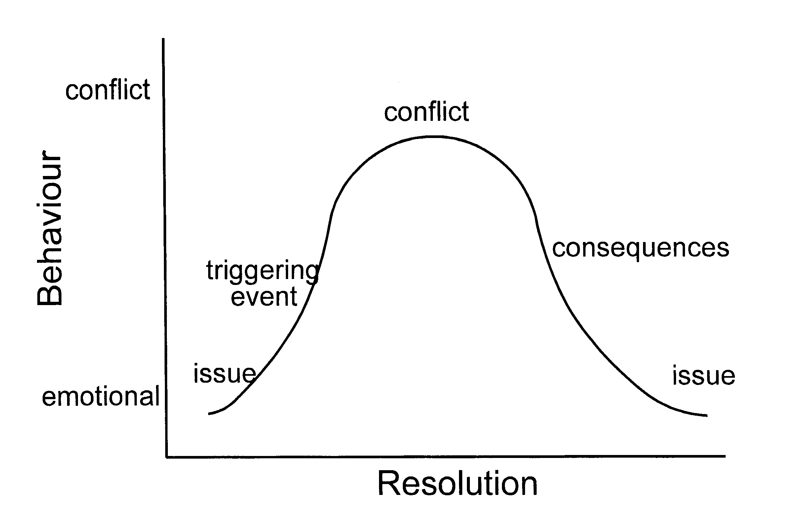
Conflict Cycle

Slide 65
Conflict Management
Kenneth Thomas and Ralph Kilmann developed a model of five (5) conflict handling modes or styles

Slide 66
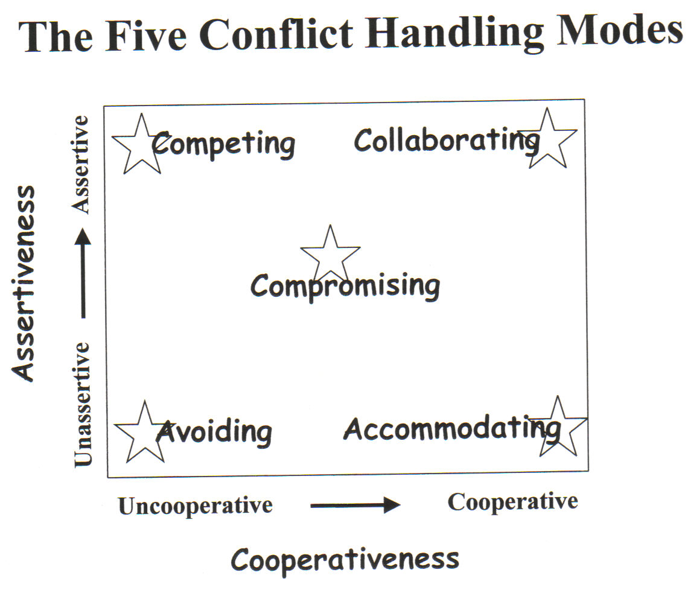
Thomas-Kilmann Conflict Styles

Slide 67
Thomas-Kilmann Conflict Styles
Avoiding (Uncooperative and unassertive) Neglects own concerns as well as those of other parties: does not raise or address conflict issues.
Accommodating (Cooperative and unassertive) Seeks to satisfy other person's concerns at the expense of own.
Competing (Uncooperative and assertive) Opposite of accommodating. Uses whatever seems appropriate to win.

Slide 68
Thomas-Kilmann Conflict Styles
Collaborating (Cooperative and assertive) Opposite of avoiding. Works with other party to find a solution that satisfies both own and other party's concerns.
Compromising (Middle ground) Seeks to find a middle ground to partially satisfy both parties.

Slide 69
When to Avoid
When an issue is trivial.
When there is no chance of getting what you want.
When the potential damage of confrontation is greater than the benefits if resolution.
When you need to gather more information.
When others can resolve the conflict more effectively.
When you need to cool down, reduce tension, and regain perspective or composure.

Slide 70
When to Accommodate
When you realize you are wrong.
When the issue is much more important to the other person than you.
When you need a future favor (credit).
When continuing the competition would damage the cause.
When subordinates need to develop - to learn from our mistakes.

Slide 71
When to Compete
When quick, decisive action is necessary.
On important issues for which unpopular courses of action need implementing.
On issues vital to the group welfare, when you know you are right.
When protection is needed against people who take advantage of noncompetitive behavior.

Slide 72
When to Collaborate
When both sets of concerns are too important to be compromised.
When it is necessary to test your assumptions or better to understand the viewpoint of the other party.
When there is a need to combine ideas from people with different perspectives.
When commitment can be increased by incorporating the concerns of everyone into the proposal.
When there is a history of bad feeling.

Slide 73
When to Compromise
When goals are important but not worth the effort of potential disruption from more aggressive players.
When two opponents with equal power are strongly committed to mutually exclusive goals.
When temporary settlements are needed on complex issues.
When expedient solutions are needed under time pressures.
As back-up when collaboration or competition fail.

Slide 74
Negative Consequences of Competing
Eventually being surrounded by "yes people."
Fear of admitting error, ignorance, or uncertainty.
Reduced communication.
Damaged relationships.
Lack of commitment from others.
More effort during implementation to sell the solution.

Slide 75
Negative Consequences of Collaborating
Too much time spent on insignificant issues.
Ineffective decisions can be made by people with limited knowledge of the situation.
Unfounded assumptions about trust.

Slide 76
Negative Consequences of Compromising
No one is completely satisfied.
Solutions tend to be short-lived.
Cynical climate: perception by both parties that it is a "sellout."
Larger issues, principles, long-term values and the welfare of the company can be lost by focusing on trivia or the practicality of implementation.

Slide 77
Negative Consequences of Avoiding
Decisions made by default.
Unresolved issues.
Self-doubt created through lack of esteem.
Creative input lost.
Lack of credibility.
Anger and hostility generated in subsequent discussions.

Slide 78
Negative Consequences of Accommodating
Decreased influence, respect, or recognition by too much deference.
Laxity in discipline.
Frustration as own needs are not met.
Self-esteem undermined.
Best solution may be lost.

Slide 79
Conflict Control
Use avoidance to ignore the issue.
Use accommodating style to allow the other person to resolve the issue.
Structure the interaction so that a triggering event is unlikely to occur.
Strengthen the barriers that inhibit the expression of conflict.
Avoid dealing with the person with whom you are in conflict.

Slide 80
Steps for Confronting Conflict
Explain the situation as you see it.
Describe how it is affecting your performance or the performance of others.
Ask for the other viewpoint to be explained, and listen to the response.
Agree on the issues independent of personalities.
Explore and discuss the issues, without reference to the problem.

Slide 81
Steps for Confronting Conflict
Agree on what each person will do to resolve the issues.
Try to agree on the problem. If there is no agreement, discuss issues some more.
Explore possible solutions.
Agree on what each person will do to solve the problem.

Slide 82
Problem Solving & Decision Making
A number of formal, structural problem solving and decision making techniques are taught in organizational management courses. Examples:
Kepner-Tregoe (KT) Technique
Alamo Technique
Cause Mapping
etc

Slide 83
Brainstorming Process
Everyone must be involved
Call out ideas to scribe
Build on ideas
No idea is too trivial or silly
There is no criticism nor judgment on any idea
Get as many ideas as possible in the time
Objective: solve problems and enjoy doing it

Slide 84
Objectives of Brainstorming
Identify the issues rapidly
Reach consensus on the most important issues rapidly
Determine possible solutions to issues
Select the most promising action to solve the problem
Agree on who does what
Get a commitment
Sell the process

Slide 85
Synergistic Decision Making
Based on the premise that when people are supportive of one another and follow a rational sequence of activities in dealing with a problem, they can perform beyond the sum of their individual resources.
Synergistic decision making requires participation in effective interpersonal and rational processes.

Slide 86
Synergistic Decision Making
Interpersonal Processes – involves skills we use when working with others.
Listening to others
Supporting their efforts to do well
Differing with others when necessary in a manner that is constructive rather than defensive
Participating equally in group discussions

Slide 87
Synergistic Decision Making
Rational Processes – involves the skills we use in thinking a problem through to a solution.
Analyzing the situation
Identifying objectives (ie., aims or goals)
Considering alternative strategies
Discussing adverse consequences

Slide 88
Synergistic Decision Making
Reaching a consensus is the hallmark of “acceptance” in the effective decision equation:
Effective Decision = Quality X Acceptance
Lack of agreement regarding a decision places acceptance of the decision and its execution in jeopardy.

Slide 89
Synergistic Decision Making
Survival Exercise

Slide 90
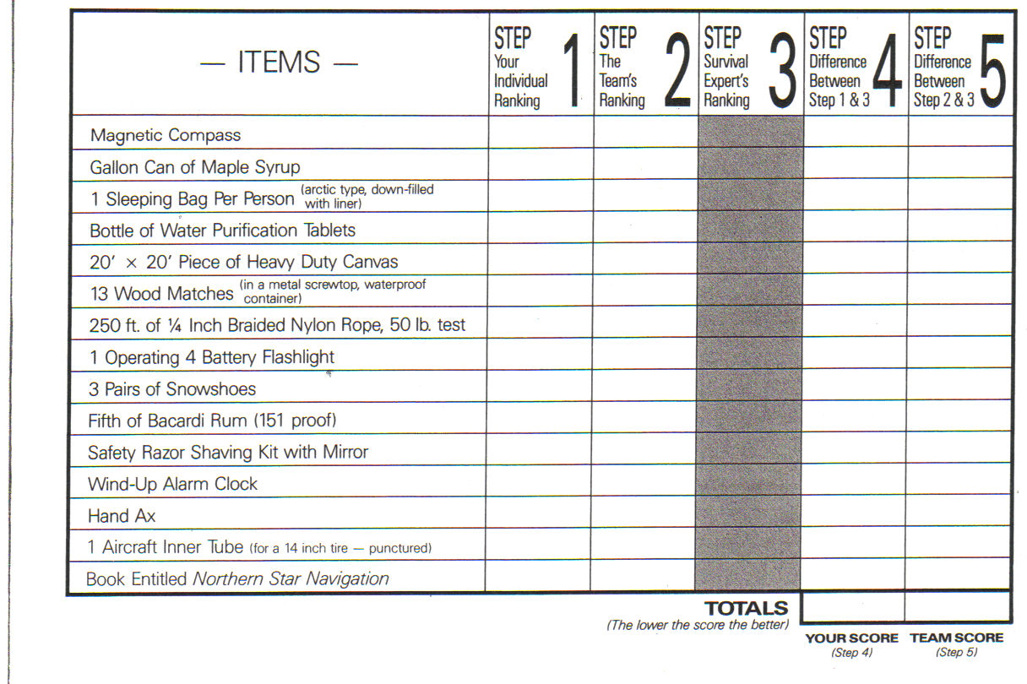
Synergistic Decision Making

Slide 91
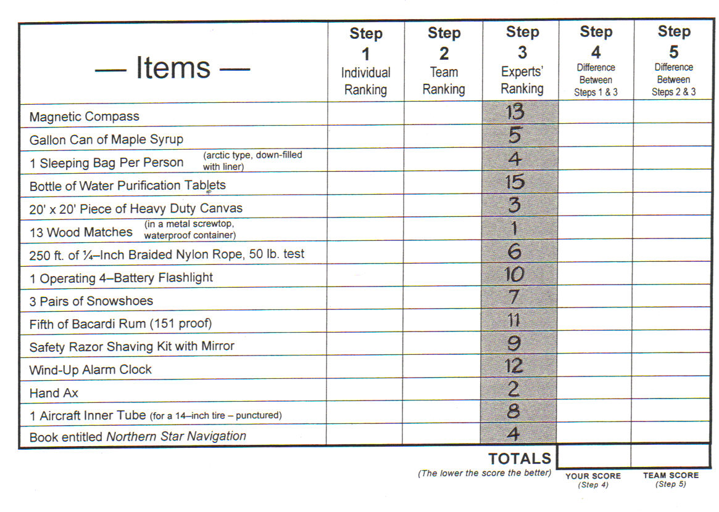
Synergistic Decision Making

Slide 92
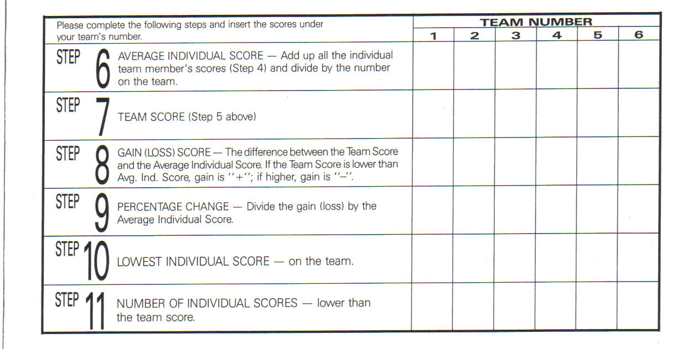
Synergistic Decision Making

Slide 93
Finally
The End

