Slide 1
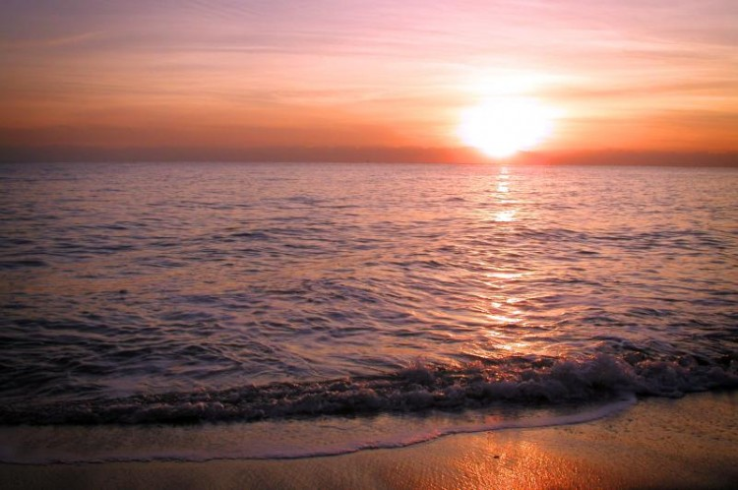
Light

Slide 2
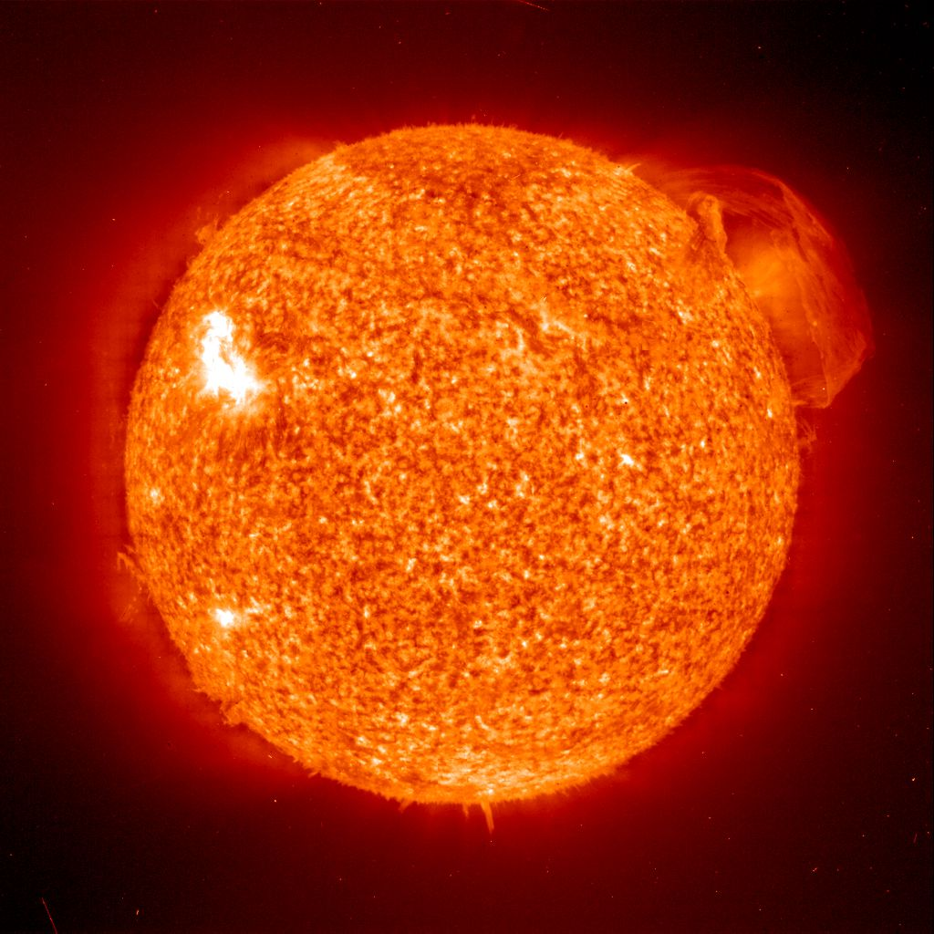
Where does light come from?
Our major light source:
the Sun

Slide 3
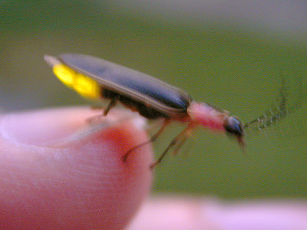
Where else does light come from?

Slide 4
Sorting light sources
Natural vs. Man-made (artificial)

Slide 5
Are these light sources?
moon
mirror
water
These items are not light sources, instead they are reflecting light from other sources.

Slide 6
How does light travel?
light
source
Light rays travel in straight lines from the light source.
When it hits an opaque object, some light is absorbed and the rest reflects off.
If the object is transparent, light rays pass through it easily.
If the object is translucent, some light can pass through, but the rest of the light will be reflected.

Slide 7
How do we see?
Light coming from, (or reflecting off) objects enters the eye through the cornea then the pupil.
It is focused clearly by the lens on to the retina.
The light sensitive cells of the retina gather information about patterns of light and dark, colour and movement and send it through the optic nerve.

Slide 8
How do we see?
Information entering the brain through the optic nerve, is then transmitted through more nerve pathways to the visual cortex.
Here the patterns of light and dark, colour and movement are interpreted.
The brain, based on past experience, can then understand what it ‘sees’.

Slide 9
How do we see colour?
light
source
Light from most light sources looks white, but actually contains all the colours of the spectrum; also known as the rainbow.
If an object looks blue, it is absorbing every colour except blue, which is reflecting off it and entering your eyes.
If an object looks orange, it is absorbing every colour except orange, which, again, is reflecting off and entering your eyes.
If an object looks red... (You get the idea!)

Slide 10
How does light reflect?
on
off
Angle of incidence
Angle of reflection
The ‘angle of reflection’ is always equal to the ‘angel of incidence’.

Slide 11
Light can only be reflected in straight lines.
on
off

Slide 12
How does light form shadows?
light
source
light
source
Light rays travel in straight lines, radiating out from the light source.
If rays are blocked by an opaque object a shadow forms where the light cannot reach.
If the light source is moved closer to the object, more light is blocked and a larger shadow is formed.

Slide 13
How does sunlight cause shadows?
12am
2pm
10am
Looking North, the Sun appears to rise in the East...
The position of the Sun effects the position and length of the shadows created.
9am
3pm
4pm
8am
7pm
6am
Thanks to this natural phenomenon a sundial is able to tell us the time, as long as it is a sunny day!
...and travel across the sky until it sets in the West.

Slide 14
Now explain to your partner:
What is the difference between light from the Sun and light from the moon?
Why does an orange look a different colour to a banana?
Why does the Sun rise in the East and set in the West?
How does a periscope work?
Why can’t we see anything without a light source?

