Slide 1
Materials

Slide 2
We are thinking about two types of materials today…
Solids and liquids

Slide 3
A solid is made up of very tiny particles that hold together very strongly.

Slide 4
They would look like this under a microscope!

Slide 5
The shape of solid material does not change unless it is pushed or pulled into a new shape.

Slide 6
Lets try it out now! The picture gives a clue….

Slide 7
More solid materials..

Slide 8
Many items we use are made from wood.
Is wood a natural or man made material?

Slide 9
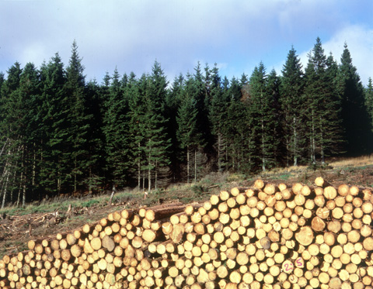
Wood is a natural material
These trees have been felled and cut in to logs.

Slide 10
This boy is playing a wooden piano.
It is made from a very dark wood called ebony.
Can you think of some other types of wood?

Slide 11
The walls of these houses have been made from wood.
What is your house made from?

Slide 12
Can you tell me some of the properties of wood? Look at the words on your desk to help you!

Slide 13
Wood can be processed in to other things.
Can you guess what is being made here?

Slide 14
Paper is a very versatile product

Slide 15
Can you compare the properties of wood and paper? Look at the cards to help you.

Slide 16
Glass is also a solid material which has many different uses.

Slide 17
Glass is a solid material made from limestone and sand.

Slide 18
Some modern buildings are made from glass.
What do you think it would be like on this inside of this building?

Slide 19
Can you tell me some of the properties of glass? Use the cards to help you!

Slide 20
What natural material is being “tapped” from this tree?

Slide 21
Can you guess what this object is? We are looking at it close-up.
Tell me some other things made from rubber.

Slide 22
This ruler is metal.
Is metal a natural or man made material?

Slide 23
Most metals are made from ores which have dug out of the ground. Then they are made into metals .

Slide 24
Can you tell me some of the properties of metals?

Slide 25
What special property do some metals have?

Slide 26
Most solids are hard and strong but some are soft and ……?…….

Slide 27
Plastic is a solid material. Have a look around the class room. Which things are plastic?
Is plastic a man made or natural material?

Slide 28
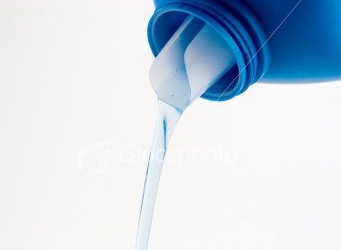
Liquids

Slide 29
Liquids have no strength of their own, and so they take the shape of the container that holds them.

Slide 30
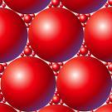
The particles look like this under a microscope. Compare them to the particles in solids.

Slide 31
Although a liquid changes shape, it cannot be squashed. Why?
We are going to investigate the properties of some materials now.

