Slide 1
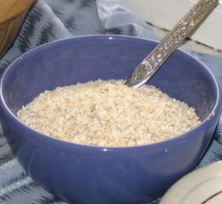
Paragraphs
Little Miss Muffet

Slide 2
Little Miss Muffet
Sat on a tuffet,
Eating her curds and whey.
There came a great spider,
Which sat down beside her,
And frightened Miss Muffet away!

Slide 3
Little Miss Muffet
Sat on a tuffet,
Eating her curds and whey.
There came a great spider,
Which sat down beside her,
And frightened Miss Muffet away!

Slide 4
Describe Miss Muffet.
Setting
Little Miss Muffet
Sat on a tuffet,
Eating her curds and whey.
There came a great spider,
Which sat down beside her,
And frightened Miss Muffet away!
Food
Describe spider.
Movement
Her reaction
Spider’s triumph

