Slide 1
Living Things

Slide 2
How do we know is something is ‘living’?
All living things are characterised as being able to do seven things
These are usually remembered by the mnemonic MRS NERG
M
R
S
N
E
R
G
Can you guess what these letters stand for?

Slide 3
The 7 characteristics of Living Things
Movement – Animals move to find food and keep away from predators, plants move to face the light
Reproduction – the ability to produce offspring to keep the species in existence
Sensitivity – responding and reacting to the environment
Nutrition – Animals need food for respiration, plants need minerals from the soil
Excretion – Getting rid of waste
Respiration – Turning food into energy
Growth – Growing larger and stronger → becoming adult size

Slide 4
Classification of Living Things
Everything that is living can be sorted into these 5 kingdoms
Kingdom Moneran
Protist Kingdom
Fungi Kingdom
Animal Kingdom
Plant Kingdom

Slide 5
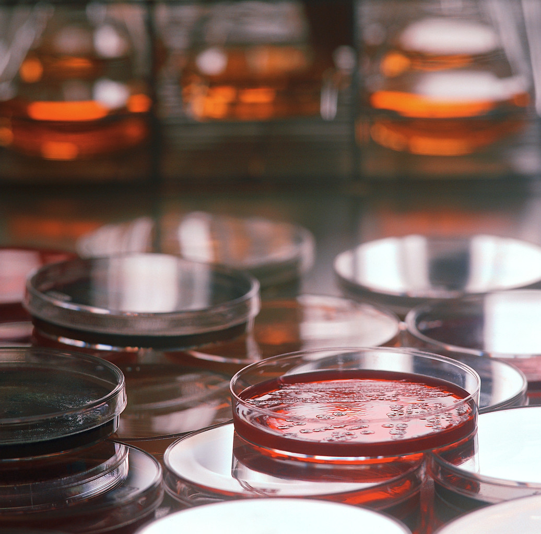
Kingdom Moneran
Tiny, single-celled organisms
Do not have a nucleus
E.g. bacteria

Slide 6
Protist Kingdom
Single-celled organisms with a nucleus
Live in damp places of water
E.g. amoeba

Slide 7
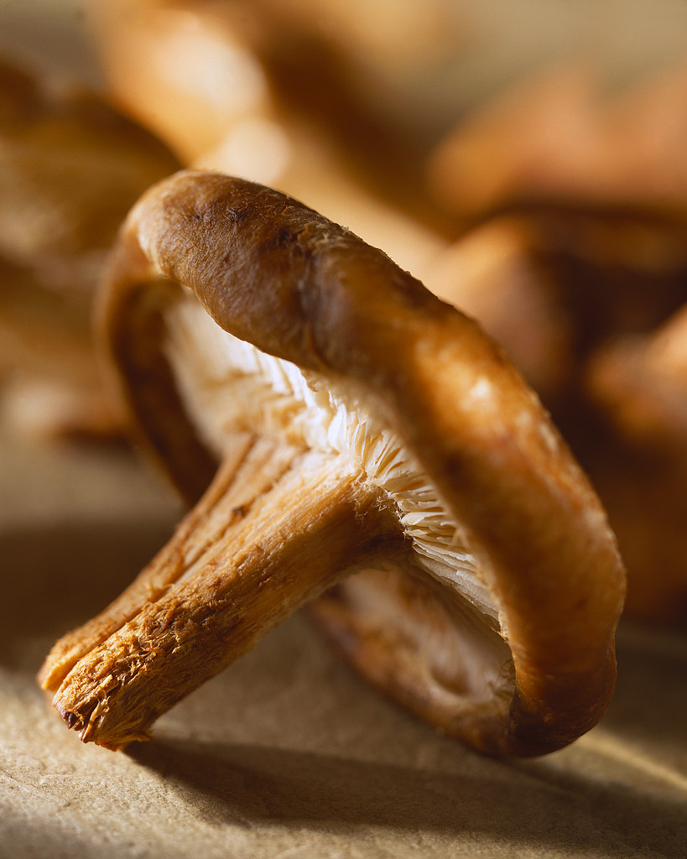
Fungi Kingdom
Body is made up of a network of threads called hyphae
E.g moulds, mushrooms

Slide 8
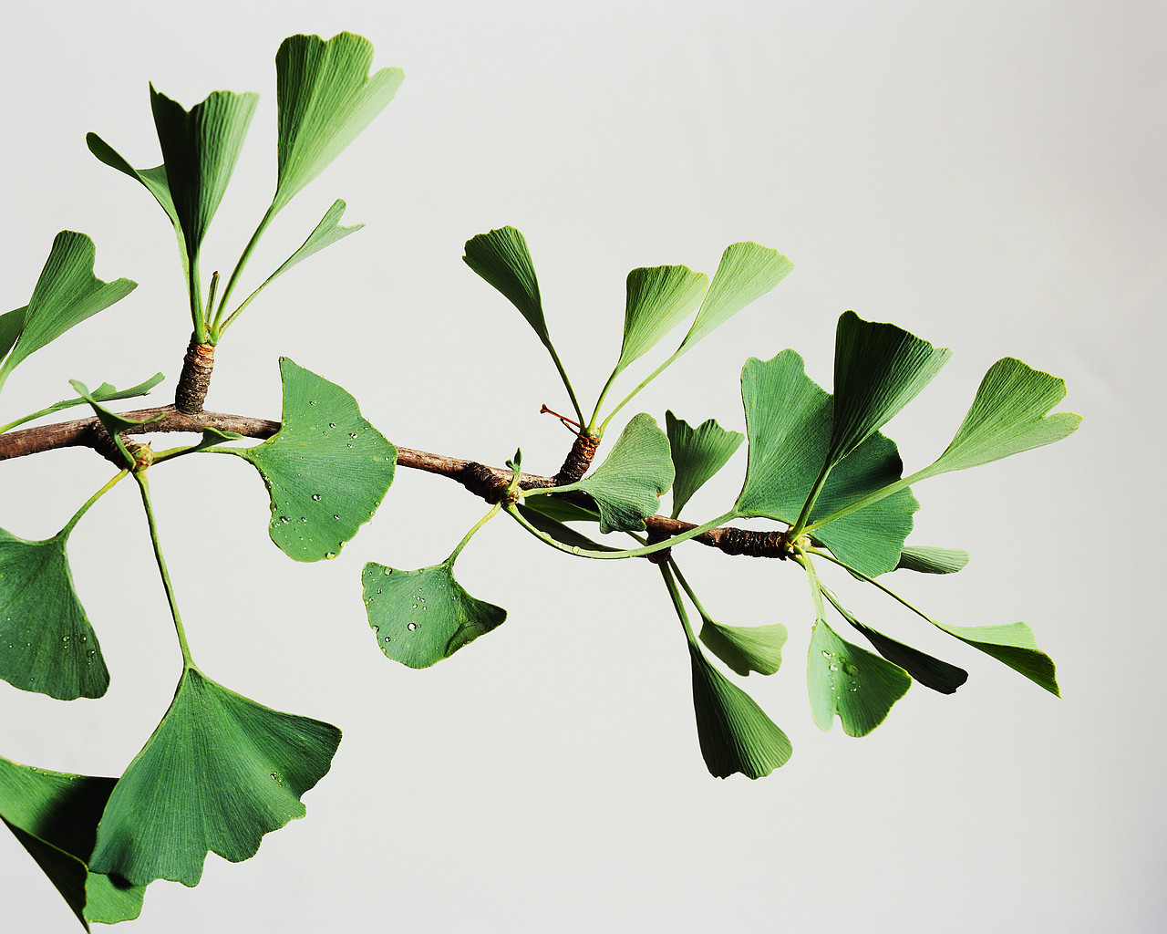
Plant Kingdom
Multicellular – made up of lots of cells
Make their own food by photosynthesis
Lots of examples: flowering plants / non-flowering plants

Slide 9
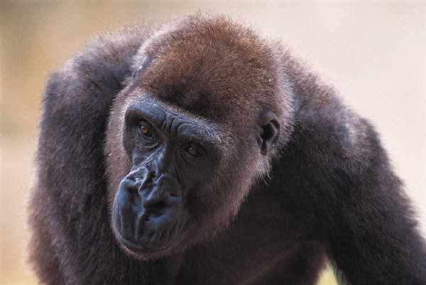
Animal Kingdom
Multicellular – made up of may specialised cells
Cannot make own food
Can be further classified into vertebrates and non-vertebrates then into classes such as amphibians, reptiles, birds, mammals

Slide 10
Task
Everyone
  Make a list of the 7 characteristics of Living Things (MRS NERG)
  Make a list of the 5 Kingdoms of Living Things (try to write an example for each)
Extension
  Research one of the 5 Kingdoms in more detail
  Make a poster / fact page / fact file
If you get stuck use the key word lists and information on your tables

