Slide 1
Location Research Project
_______ Half Term 20__
Name: _______________

Slide 2
Choosing your Locations
You need to choose two locations (places) to focus your project on. One in a rural area (e.g. Hursley) and one in an urban area (e.g. Southampton). You may find it helpful to choose places that you know well, or have visited.
My RURAL location: ________________________
Why I have chosen this location:
_________________________________________
_________________________________________
My URBAN location: ________________________
Why I have chosen this location:
_________________________________________
_________________________________________

Slide 3
Buildings
Sketch and label the different types of buildings you might find in the rural location.
Sketch and label the different types of buildings you might find in the urban location.

Slide 4
Making Comparisons
What do you notice about the buildings you have drawn? Are they the same in your rural location and your urban location?
Answer the questions below to see how they are similar and/or different.
Write the names of the buildings you drew for the rural area but NOT in the urban area:
Write the names of the buildings you drew for the urban area but NOT in the rural area:
In which location was there a larger number of different buildings?

Slide 5
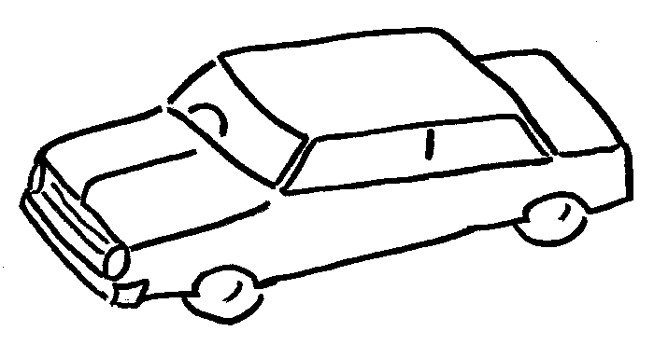
TRANSPORT
Draw or write the names of the different types of transport you might find in the locations that you have chosen.
Rural Location
Urban Location

Slide 6
Facts and Research
What facts and information can you find out about your locations? You may want to think about the types of jobs people can do in the area, what the land looks like (fields, houses etc). It is up to you how you gather this information – internet, books, interviewing people or maybe even visiting places!
RURAL AREA

Slide 7
Facts and Research
URBAN AREA

Slide 8
Reviewing your Project
What did you learn from your project?
_________________________________________
_________________________________________
_________________________________________
What do you think you did well?
_________________________________________
_________________________________________
_________________________________________
What do you think you could improve on next time you do a project like this?
_________________________________________
_________________________________________
_________________________________________

