Slide 1
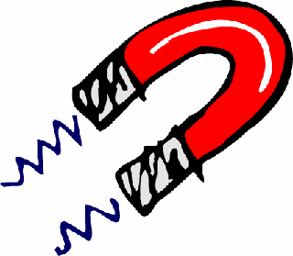
Magnetism

Slide 2
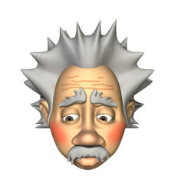
magnets
What do we already know?

Slide 3
What are we going to learn today?
Understand that some materials are attracted to magnets
What the characteristics of magnets are
That magnets can repel and attract each other
How magnets behave
What happens when you put two magnets together

Slide 4
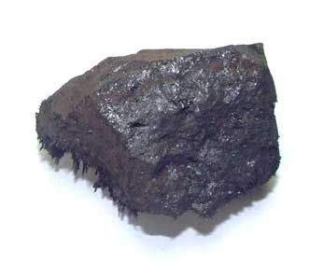
Lodestone
There are many legends that tell us about the discovery of magnets.
One of the most common, is that of an elderly shepherd named Magnets, who was herding his sheep in an area of Northern Greece called Magnesia, about 4,000 years ago.
It is said that both the nails in his shoes and the metal tip of his staff became firmly stuck to the large, black rock on which he was standing. This type of rock was later named magnetite, after either Magnesia or Magnets himself.

Slide 5
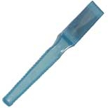
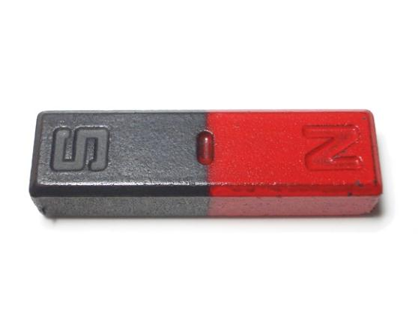
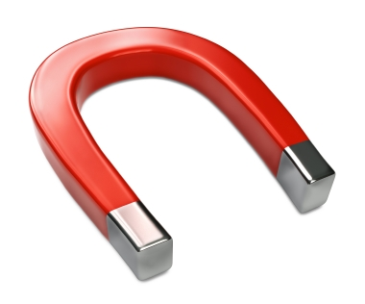
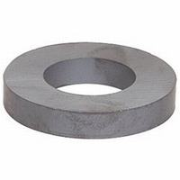
magnets
wand magnet
bar magnet
doughnut magnet
horseshoe magnet

Slide 6
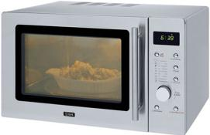
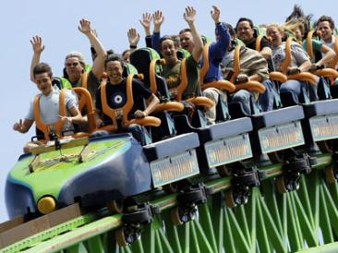
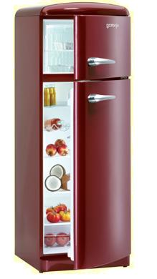
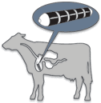
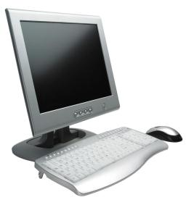
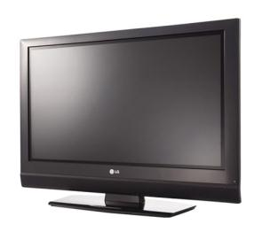
What are some uses for magnets?
Magnets are in most electronic devices, in fact, anything that has a motor uses a magnet.
They are used to slow down roller coasters and subways.
Magnets are used to keep refrigerator doors closed.
Magnets are even placed in the stomachs of cows to catch metals!
Televisions, computers, and microwave ovens all operate with magnets.
More uses of magnets are found every day!

Slide 7
What are the characteristics of magnets?
They are usually made of iron.
They have two ends called magnetic poles.
They can also
repel other
magnets.
They can attract some materials.

Slide 8
What do all these new words actually mean?
Magnet
A stone or a piece of metal that attracts some
other metal.
Attract
To pull towards each other.
Repel
To push away from each other.
Poles
The ends of a magnet.

Slide 9
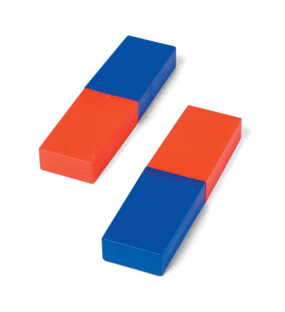
poles
Every magnet has at least one north pole and one south pole.
The blue end of a magnet is usually the south pole.
The red end of a magnet is usually the north pole.

Slide 10
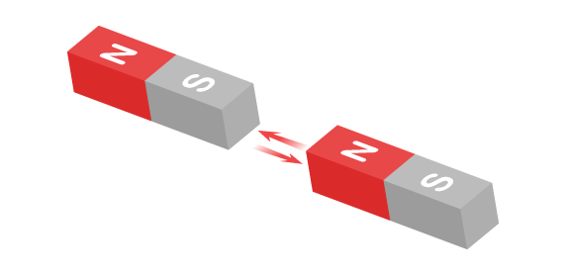
When two magnets are close, they create pushing or pulling forces on one another.
These forces are strongest at the ends of the magnets. The two ends of a magnet are known as the north pole and the south pole.

Slide 11
What did we find out?
So now we know that “like” poles repel each other…
and that “opposite” poles attract each other.
They do this because there is a
FORCE
between them.

Slide 12
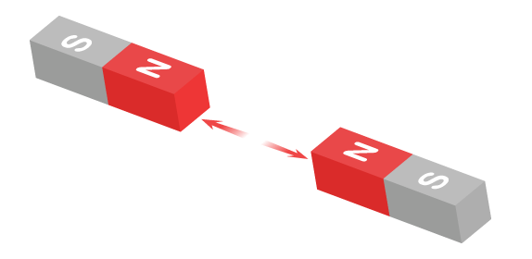
Same poles repel
If you try to put two magnets together with the same poles pointing towards one another, the magnets will push away from each other. We say they repel each other.
In this picture two north poles are pushing away from each other (repelling each other).

Slide 13
Different poles attract
If you put two magnets together with different poles pointing towards one another, the magnets will pull towards each other. We say they attract each other.
In this picture a north and a south pole are pulling towards each other (attracting each other).

Slide 14
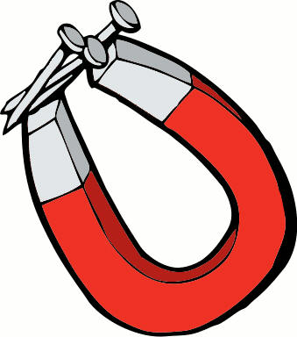
Did you know?
Magnets can attract other magnets but they can also attract magnetic materials.
Magnetic
materials are
always metals
but only a few
metals are
magnetic.

Slide 15
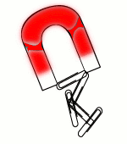
Iron IS magnetic, so any metal with iron in it will be attracted to a magnet. Steel contains iron, so a steel paperclip, for example, will be attracted to a magnet.
Most other metals, for example aluminium, copper and gold, are NOT magnetic. An aluminium drinks can, for example, will not be attracted to a magnet.

Slide 16
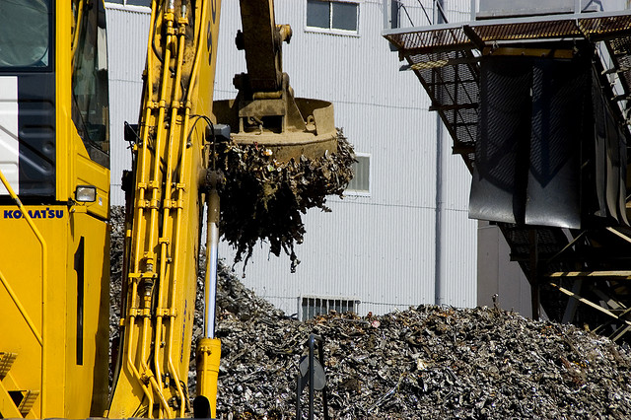
How do magnets help in a scrap yard?
A car is made up of many different materials. When a car is scrapped the different types of metals need to be sorted. A huge rotating magnet is used to sort the magnetic materials from the non-magnetic materials. Separating the materials allows them to be reused.

Slide 17
vocabulary
magnetism | magnet
magnetic | non-magnetic
force | poles
push | pull
repel | attract
north | south

