Slide 1
Herd Health
Beef Cattle

Slide 2
Herd Health
Key factors in establishing a herd health program:
  1. Sound nutritional regime.
  2. Continuous training of personnel.
  3. Known source of livestock.
  4. Sound sanitation management and biosecurity practices.

Slide 3
Key Factors Cont.
  5. Excellent record keeping system accompanied by a sound monitoring and evaluation system.
  6. Functional, well-maintained facilities.
  7. Excellent relationship with a professional herd veterinarian.
  8. A sound preventative vaccination system.

Slide 4
Diseases
Any deviation from the normal state of health.
Accurate disease diagnoses is an essential element in any health management program.

Slide 5
Sources of Infection
Direct or immediate contact with a diseased individual.
-Ex. Brucellosis, ringworm, venereal infections transferred throught sexual contact.
Contact through fomites.
-Fomites are inanimate objects that may serve to carry infections from one animal to another. (feed troughs, trailers).

Slide 6
Sources of Infection
Contact with disease carriers.
Infection from the soil.
-Ex. Blackleg, tetanus, gas gangrene.
Infections from food and water.
-Ex. Leptospirosis, Anthrax, Botulism.
Air-Borne infections
-common cold, influenza, Anthrax, F&M

Slide 7
Sources of Infection
Infections from blood sucking arthropods (fleas, mosquitoes, flies)
-Ex. Malaria, Yellow fever, Texas fever
8. Infections from organisms normally carried (Pasturella, streptococci, pneumococci, tetanus).

Slide 8
Infection & Contagion
A contagious disease is one that may be transmitted from one individual to another by direct or indirect contact. All contagious diseases are also infections but not all infectious diseases are contagious
-Ex. Tetanus, blackleg, gas gangrene

Slide 9
Vaccines
Antigen- is any substance that, when introduced parenterally into animal tissue stimulates the production antibodies.
Antibody- is any substance that makes its appearance in the body fluids of an animal in response to a stimulus provided by the parenteral introduction of an antigen into the tissues, therefore the antibodies give the desired protection.

Slide 10
Most Common diseases vaccinated against in Texas in Cattle
Clostridial Diseases
  Bacillary Hemoglobinuria (Red Water Disease)
  Blackleg caused by Cl. Chauvoei
  Enterotoxemias caused by Cl. Perfringens type C&D
  Infectious necrotic hepatitis caused by Cl. Novi
  Malignant edema caused by Cl. Septicum
  Big head caused by Cl. Sordellii
Brucellosis
Vibrio
Leptospirosis
IBR-IPV
BVD
Parainfluenza 3
BRSV
Pneumonic Pateurellosi s
Haemophilosis
Anthrax

Slide 11
Brucellosis
Symptoms
  Abortion late in term
  Weak or dead calves
  Retained placenta and uterine infection
  Inflamed testicles in bulls
Transmission
  Oral ingestion of aborted material
  Licking of infected cows
  Contaminated feed or water
  Eye, skin, A.I.
  Rarely venereal

Slide 12
Brucellosis
Treatment
  Test and slaughter
  Report reactors to state veterinarian
Prevention
  Calfhood vaccinate at the age of 4 – 12 months

Slide 13
Leptospirosis
Symptoms
  Fever and heavy breathing
  Anemia, bloody urine
  Abortion: late term of pregnancy
Transmission
  Urine of infected animal
  Aborted fetus

Slide 14
Leptospirosis
Treatment
  Dihydrostreptomycin
  Penicillin
Prevention
  Vaccinate annually
  Proper water management
  Rodent control

Slide 15
Vibriosis - Campylobacter
Symptoms
  Infertility, recurring heat
  Embryonic death
  Abortion early in term
Transmission
  Venereal
  A.I.

Slide 16
Vibriosis
Treatment
Prevention
  Vaccination twice first year
  Afterwards 30-60 days before breeding.

Slide 17
PI 3 (parainfluenza)
Symptoms
  Respiratory problems
  Fever
Transmission
  Nasal Droplets
Treatment
  Vaccinate regularly

Slide 18
BVD (bovine viral diarrhea)
Symptoms
  Respiratory
  Digestive tract problems
  Fever and laminitis
  Abortion (early & mid-term)
Transmission
  Ingestion of fecal contamination
  Placenta from dam to fetus

Slide 19
BVD
Treatment
  Symptomatic treatment
  Antibiotics, sulfonamides
Prevention
  Vaccination prior to exposure
  Avoid contact with infected cattle

Slide 20
IBR (Infection Bovine Rhinotracheitis)
Symptoms
  Respiratory and eye ailments
  Scours in baby calves
  Abortion late in the term
  Vaginitis and preputial infections in males
Transmission
  Nasal droplets
  A.I., venereal

Slide 21
IBR
Treatment
  Oxytetracycline
  Penicillin to minimize bacterial infections
Prevention
  Vaccinate cows 40 days prior to breeding
  Vaccinate feeder calves prior to exposure

Slide 22
BRSV (bovine respiratory syncytial virus)
Symptoms
  Labored breathing
  Pneumonia
  Eye problems
  fever
Transmission
  Nasal droplets
    Sneezing
    Nasal fluid contaminating feed and water.

Slide 23
BRSV
Treatment
  Antihistamines
  corticosteroids
Prevention
  Regular vaccination

Slide 24
Tuberculosis
A serious bacterial disease
Affects respiratory system
Three main types:
  Human, cattle, avian
  Avian is restricted to birds
  Bovine can affect many warm blooded vertebrates
  Can be transmitted to hogs and dogs

Slide 25
Tuberculosis
Symptoms
  Usually no signs of ailment
Treatment
  Test and slaughter reactors
  Report to state veterinarian
Prevention
  Periodic testing

Slide 26
Foot & Mouth
Symptoms
  Excessive slobbering
  Going off feed
  Lameness
  Blisters in mouth, on udders, nostrils and feet
  Rapid weight loss
Transmission
  Movement of infected animals
  Fomites
  Airborn from fires
  Carcass of infected animals

Slide 27
Foot & Mouth
Treatment
  No treatment in infected animals, will usually run its course in 2-3 weeks with most animals recovering.
  Can be killed by heat, low humidity and some disinfectants.
Prevention
  Keep animals away from infected areas.

Slide 28
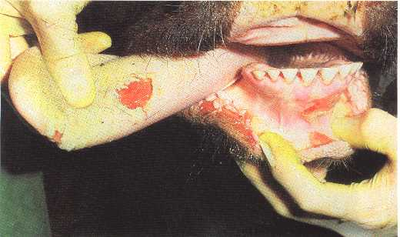
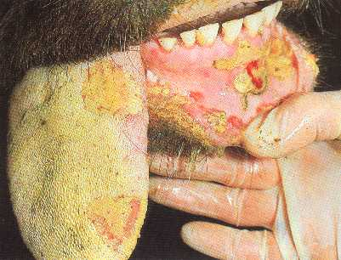
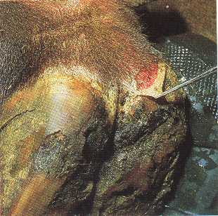
Foot & Mouth
Disease at 3 days
Disease at 7 days

Slide 29
Anthrax
Symptoms
  Sudden death
  Failure of blood to clot
  Delayed rigor mortis
Transmission
  Mostly soil-born ingestion
  Contaminated feed
  Carcass of infected animal

Slide 30
Anthrax
Treatment
  Antibiotics and antiserums
  Do not move or transport carcass
Prevention
  Vaccination
    Recommended only in areas where disease occurs.

Slide 31
Anaplasmosis
Symptoms
  Anemia
  Fever
  Jaundice
  Weakness & emaciation
Transmission
  Direct blood transfer of biting insects
  Infected needles or surgical instruments

Slide 32
Anaplasmosis
Treatment
  In acute cases- blood transfusion
  Chlortetracycline
  oxytetracycline
Prevention
  Control of insects
  Vaccination
  Sterilization of veterinary supplies

Slide 33
Trichomoniasis
Symptoms
  Infertility
  Abortion at 2-4 months
Transmission
  Venereal
  A.I.
Rules
  No longer accept out of state bulls unless have a PCR negative results
  All bulls >12 mos must be PCR neg to exchange ownership

Slide 34
Trichomoniasis
Treatment
  Cull carrier animals
  Report to state veterinarian
Prevention
  Maintain closed herd
  Introduce only virgin/tested animals
  Cull open cows in infected herds

Slide 35
Johne’s (paratuberculosis)
Mycobacterium paratuberculosis
Worldwide /related to TB and Leprosy and in the family of BSE and Scrapie
Symptoms
  Chronic diarrhea, and weight loss
Transmission
  Oral ingestion & Utero transmission to fetus-Years may elapse between infection and symptoms

Slide 36
Johne’s
Treatment
  Consult herd veterinarian
Prevention
  vaccine = must be approved by state veterinarian
  Prevent infection
  Testing of animals

Slide 37
Pinkeye (Moraxella bovis)
Symptoms
  Water eyes
  Swelling
  Corneal opacity
  ulceration
Transmission
  Commonly associated with irritants (dust, stress, sunlight, grass, weeds, pollen, etc.)
  Face flies

Slide 38
Pinkeye
Treatment
  Oxytetracycline
  Patch over infected eye
Prevention
  Control of flies
  Isolate infected animals
  Select breeding animals with eyelid pigmentation

Slide 39
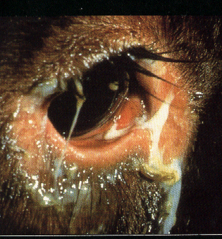
Pinkeye

Slide 40
Clostridial Diseases
Malignant Edema
Blackleg
Tetanus

Slide 41
Blackleg
Symptoms
  Muscular depression
  Gaseous swelling in muscles
  lameness
Transmission
  Wounds
  Ingestion of contaminated feed
  soil

Slide 42
Blackleg
Treatment
  Penicillin
Prevention
  Vaccination of calves at branding
  Vaccinate cow before calving

Slide 43
Malignant Edema
Symptoms
  History of wounds
  Fever and swelling around wounds
  Sudden death
Transmission
  Mostly through wounds
  Ingestion of contaminated soil or feed

Slide 44
Malignant Edema
Treatment
  Penicillin
Prevention
  Vaccination

Slide 45
Tetanus
Symptoms
  Spasms
  Contractions of voluntary muscles
  High mortality rate
Transmission
  Through wounds
  Especially deep puncture wounds
Treatment= antibiotics, tranquilizers, high doses of tetanus anitoxins
Prevention= avoid contamination of open wounds - vaccinate in high risk areas

Slide 46
Tetanus
Anti-toxin
  Give to those animals where the body cavity is opened or a cut with a knife, etc. is made
  Short term protection
Toxoid
  Give to those animals whereby we use an elastrator, callicrate or Calif. Bander
  Provides long term protection
  Needs a booster

Slide 47
Nitrate Poisoning
Nitrate accumulation results from plant stress such as drought
Most nitrates accumulates in the lower leaf and the plant stem
In drought, plants become stressed and the plant cannot convert nitrogen into new growth due to lack of moisture, thus N accumulates

Slide 48
Nitrate Poisoning
  Occurs when more soil nitrogen than needed for maximum growth of the plant
  > 0.9% Nitrate in the plant is lethal to cattle
  Tips
    Don’t turn in hungry cattle into possible affected areas of stressed plants
    Have the hay tested in stressed plant situations

Slide 49
Nitrate Poisoning cont
Toxicity symptoms is a chocolate-brown color to the blood.
Also, nausea, vomiting, bloating, fast heart rate, blue mucous membranes, staggering gait, shortness of breath, then death
Administration of methylene blue can counteract the chemical process if caught early

Slide 50
Nitrate Poisoning cont
Nitrates are converted to nitrites which produce met-hemoglobin, a type of hemoglobin that cannot carry oxygen
Nitrites are more toxic even though the term nitrate is used
Sorghum plants are more susceptible
to nitrate accumulation when mature

Slide 51
Nitrate Poisoning cont
High nitrate feeds can still be fed yet not to breeding animals
When fed at >1% expect abortions and even death
Corn fed 10 days before exposing cattle to stressed forages has shown lowered poisoning
Common causes of high nitrate levels in water include shallow wells and ponds with contaminated surface runoff; (>200 ppm) can be toxic esp. when feed is high too

Slide 52
Prussic Acid/HCN
Also, a cause from stressed plants which produces a cyanide in the rumen
Especially johnsongrass or sorghums such as sudan
Factors associated with Nitrate poisoning such as drought, excessive sunlight, excessive soil nitrogen, young plants increase the HCN potential
Proper curing of hay reduces this risk

Slide 53
HCN cont
Re-growth in sorghums after a cutting of hay, grazing or frost is often dangerous
Contrasted to Nitrate poisoning; HCN is characterized by bright cherry red color
Don’t use over 50 lbs. of nitrogen when fertilizing
Do not graze until sudan type plants until they are 24 to 36 inches

Slide 54
HCN cont.
After a good rain on stressed plants, wait two weeks before grazing
After a frost, wait until the freeze kills the entire plant before grazing (thawed and wilted for a few days)
Allow animals to fill on native grass or hay during the day and then graze sorghum in late afternoon

Slide 55
Grass Tetany
A metabolic non-infectious disease
Also called grass staggers, wheat-pasture poisoning, hypomagnesemia
Normal levels of blood Mg is 2 mg/100 ml; if it drops < 1 mg/100 ml, tetany can occur
If an animal is unable to eat enough forage to provide adequate nutrients

Slide 56
Grass Tetany cont
Importance is dry matter intake of nutrients
Animals affected more often: ruminants, mature animals, lactating animals, animals consuming young tender high moisture plants such as wheat pasture

Slide 57
Grass Tetany cont
Symptoms: discomfort and unusual alertness, muscular twitching, staggering, collapses, and eventually stiffening of muscles and jerking convulsions with the head pulled back
Treatment: magnesium salts injected intravenous; 200-300 ml of 50% solution
Animals surviving for more than 24 hours usually do not show reoccurence

Slide 58
Grass Tetany cont
Prevention: high magnesium mineral and increase dry matter intake
Milk fever is quite similar except animals become paralyzed rather than show violent muscular responses. Serum calcium is low when milk fever is encountered.

Slide 59
Fescue toxicity
Associated with a fungus called an endophyte that lives within the leaves, stems, and seed of tall fescue plants
The fungus causes the grass to produce a toxic compound
This has reduced gains for stockers and reduced conception rates for cows as well as elevated temperature, intolerance to heat, and the failure to shed the winter hair coat
Plant legumes within fescue to assist
One of the worst times to graze is middle of the summer

Slide 60
Sweet Clover poisoning
Coumarin in clover is converted to dicoumarin which prevents the synthesis and metabolism of Vit K
Don’t feed moldy sweet clover
Cause stiffness, lameness and swellings (blood clots) beneath the skin

Slide 61
Foot Rot
Necrotic Pododermatitis, Interdigital Necrobacillosis, fusobacterium necrophorum
Known to live in the soil for > 10 mos.
Causes lameness in cattle
Incubation is about 5 days
Foot tissue or skin has to be broken for introduction of bacteria
Stones, plant stubble, wire, nails, glass, etc. are all culprits of causing cuts or abrasions that lead to infection

Slide 62
Foot Rot
Prevention: Aureomycin/chlortetracycline (CTC)
Dosage 100 mg (not cc) /hd/day
EDDI – Ethylene Diamine Dihydriodide cannot be added to feed to control foot rot but can be used as a nutritional source of iodine at 10 mg/hd/day

Slide 63
Foot Rot
5% CuSO4 or 5% formalin are used as walk-in foot baths at dairies
Also, antibiotics such as Naxcel, Nuflor, LA 200, Sulmet, tetracycline powders are used
If possible, clean and trim the foot of dead tissue and then apply an antiseptic

Slide 64
Grasshopper control
Biological, Chemical, Cultural
  Biological= other insects such as blister beetle, ground beetles, birds, chickens, guineas
  Cultural = tree painting or wraps, Control weeds, soil disturbance (plowing, disc, etc.). All of these difficult during hot dry conditions
  Chemical= used in non crop land and improved pasture areas. Use chemicals such as carbaryl, zeta-cypermethrin, lambda cyhalothrin or Dimilin (used only when grasshoppers are very young or in the nymph stage). Some ranchers use “Sevin” spray

Slide 65
Parasites
Internal- present inside the animal, but their eggs are microscopic in size. The economic loss is great, but a slow continuous process
External- live off of the flesh and/or blood of the cattle. They can mechanically transmit the organisms that cause pinkeye, mastitis, and other infectious diseases to cattle.

Slide 66
Parasites of Beef Cattle
Strategic parasite control programs should be viewed as an investment.
The R.O.I. of the program should be healthier animals. Healthier animals
Utilize feed better for growth & development,
Reach breeding weight and proper body score at optimal time, wean heavier, etc
Notes:
SCRIPT: Therefore strategic parasite control programs that you recommend to your customers should be presented as investments. When you help your customers chose the safest and most economically effective products to be used at the most optimum time of the year to control economically damaging parasites, you are helping to contribute to their Return On Investment in animal health. The minimum your customers should expect from a strategic parasite control program is healthier animals. When evaluating the program as an investment, consider not only the immediate return on total beef production, but also the long-term return. Consider that healthier animals can utilize feed better for growth & development, reach breeding weight & proper body score at optimal time and wean heavier calves. Healthier animals are more likely to achieve their genetic potential.
REFERENCE: IVB-5-1539-FDP

Slide 67
Parasites of Beef Cattle
$2 Billion lost just to Brown Stomach Worm annually ~ or $20 per animal (U.S.D.A. est.). Losses to externals in addition to this.
Subclinical parasitism losses are the greatest
Parasites depress appetite resulting in:
Reduced weight gains & feed conversion
Depressed immunity, higher morbidity/mortality
Decreased milk production, carcass quality & reproductive performance
Notes:
SCRIPT: The economic losses in beef and dairy cattle production attributable just to the brown stomach worm have been estimated by the USDA at $2 billion annually or $20 per animal in the United States. This does not factor in the losses to external parasitism which we will talk about later. Clinically diseased animals represent only a small part of the true impact of parasitism. Cattlemen need to direct their attention to the more important issue of parasitized animals that do not show apparent disease. Subclinical disease can undermine overall herd productivity, thus costing the producer time and resources. This subclinical parasitism is in fact ECONOMIC PARASITISM resulting in the greatest losses. The first noticeable effect of parasitism is DEPRESSION OF APPETITE. More than any other single feature of infection, appetite suppression leads to reduced productivity. This reduction in productivity is evident in reduced weight gains, lower feed conversions, depressed immunity to other diseases, higher morbidity & mortality, decreased milk production, reduced carcass quality and poorer reproductive performance.
REFERENCES: IVB-5-1539-FDP(IVOMEC Benefits Detailer), IVOMEC Eprinex Slide Presentation, USDA/Gasbarre.

Slide 68
Parasites of Beef Cattle
Internal Parasites - Worms:
Gastrointestinal roundworms - Brown Stomach Worm
Other roundworms - Lungworm
Flat worms - Liver Fluke
Segmented worms - Tapeworm
Notes:
SCRIPT: The internal parasites of cattle can be divided into three classes: roundworms (nematodes), flat worms or flukes (trematodes), and segmented worms (tapeworms/cestodes). The roundworms can be further divided into the roundworms of the digestive system, or gastrointestinal roundworms, and roundworms that infect other parts of the body, such as lungworms. The nematodes, or roundworms, are the internal parasite that cause the most severe economic losses in cattle. The liver fluke also can cause heavy losses in cattle. Tapeworms in cattle are of minor importance.
REFERENCE: Parasites of Cattle (MSD AgVet, 1981)

Slide 69
Parasites of Beef Cattle
Most damaging internal parasites are:
Brown Stomach Worm (Ostertagia ostertagi) 80-90% of the U.S. worm problem
Liver Fluke (Fasciola hepatica)
Notes:
SCRIPT: In discussing parasite control programs with your customers help them understand which parasites are the most damaging. By doing this you will better help them to select products that improve their parasite control program R.O.I. By far, the most economically damaging internal parasite of cattle is the brown stomach worm (Ostertagia ostertagi). Brown stomach worm accounts for 80-90% of the worm problem in US. beef and dairy cattle. We have already learned that this one worm is costing the cattle industry more than $2 billion annually in lost production or about $20 per head. Would your customers be interested in picking up an extra $20 per animal? What makes the brown stomach worm so detrimental to your customers’ cattle is the worm’s ability to penetrate the stomach wall and become dormant in order to survive during adverse weather conditions. If the brown stomach worm is not controlled and allowed to emerge from the stomach wall it can severely disrupt the animal’s digestive process. When this happens cattle performance is greatly reduced and may even result in death. Cattle of all ages can be adversely affected by brown stomach worm. Liver fluke (Fasciola hepatica) is the next most important internal parasite of cattle. Losses due to liver fluke are not just to liver condemnations but also to reduced average daily gains, reduced milk production and lower weaning weights. Adult liver flukes irritate the bile ducts of cattle, impairing liver function.
REFERENCE: IVB-8-2072-DEM-C, IVB-8-2072-DEM-A, USDA/Gasbarre

Slide 70
Parasites of Beef Cattle
Adult and L4s
in Cattle
Eggs in Feces
Reinfection
Infective 3rd
Stage Larvae
Contaminated
Pasture
GI parasites are present in the animal (adult and larvae)
and on pasture (eggs, L1, L2, L3)
Notes:
SCRIPT: There is value in reviewing the internal parasite life cycle of the roundworm with your customers as you help them decide what product to use, how many times during the year to treat and which season of the year to treat. You can demonstrate that roundworms are the most common internal parasites and that any animal on grass is exposed to continuous reinfection. Cattle ingest larvae of internal parasites by grazing contaminated pastures. These larvae mature to adults inside the animal and the adult female produces eggs which are passed in the feces of the cattle back onto the pasture. These eggs hatch into infective larvae (or immature worms) in the manure and then migrate onto the pasture and up the blade of grass to start the cycle over again.
REFERENCE: IVOMEC EPRINEX Electronic Detailer script

Slide 71
Strategic Parasite Control
GI Parasite Eggs per Gram - South
60
55
50
45
40
35
30
25
20
15
10
5
GEOMETRIC MEANS
I I I I I I I I I I I I
JAN FEB MAR APR MAY JUN JUL AUG SEP OCT NOV DEC
Low parasite egg counts from cows can mean high
pasture contamination for calves
Notes:
SCRIPT: Here’s another way to look at the problem. Cows have low parasite egg counts but produce large amounts of manure. Once the eggs in the manure hatch, the larvae contaminate the pasture infecting the calves. Stress, such as calving, can result in higher parasite egg production in cows, leading to even greater pasture contamination. And finally, parasite egg counts per gram of manure in calves rise sharply in the spring and summer, peaking in the fall.
REFERENCE: IVOMEC EPRINEX Slide Presentation script

Slide 72
Strategic Parasite Control
Conceptual Patterns of Brown Stomach Worm Inhibition
NORTHERN - Autumn / Winter
Variable Transition
SOUTHERN - Spring / Summer
Notes:
SCRIPT: The key to helping your customers get the best R.O.I. out of their parasite control program is to use the right product at the right time. Keep in mind that depending on your location the best times for treatment may vary. The brown stomach worm has the ability to go dormant within cattle stomach walls in different areas of the country at varying times of the year depending on climate. The best time to treat is before the worm comes out of hibernation inside the animal's gut using a product, such as the IVOMEC brands, that is highly effective against the dormant stage of the brown stomach worm.
REFERENCE: IVOMEC EPRINEX Slide Presentation script

Slide 73
Proper timing to De-worm
???????
Dr. Buddy Faries Jr. DVM MS
  Texas AgriLife Extension Service
  Handout

Slide 74
Bovine Liver Flukes
Fasciola hepatica
Effects of
Liver Fluke and GI Nematodes
on Weight Gain & Reproduction

Slide 75
Bovine Liver Flukes
“Mud” snail (lymnaeid) is intermediate host
Snails exist in :
  River basins, coastal prairies
  Mountain meadows, irrigated pastures
  Wet pastures, ditches, area around water tanks, etc
  Primary season of fluke transmission
  The wet season
  Feb - July in Southeast and Southern Plains
  June - Nov in Northwest

Slide 76
Bovine Liver Flukes
Physiological Effects
“Bile duct” stage fluke (adult flukes - 8 to 10 weeks & older) causes most damage
Anemia is primary result of fluke infection
Secondary clostridial infection and death may occur

Slide 77
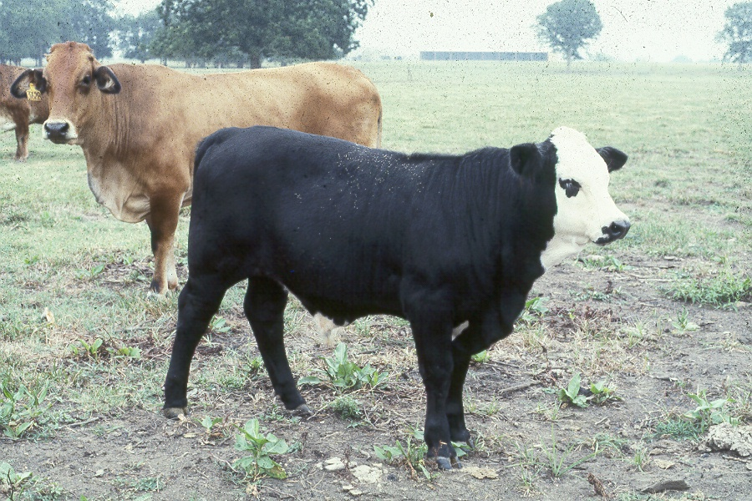
Bovine Liver Flukes - Clinical Signs
Clinical signs often not seen
Similar to GI parasites
  Loss of appetite
  Weakness
  Weight loss
  Low blood protein

Slide 78
Bovine Liver Flukes
Life Cycle
(eggs shed 8-12 wk
after infection)
Metacercariae
(on grass)
Eggs
(10-12 d)
Cercaria
Miracidium
(4.5-7 wk)
Mud snail

Slide 79
Life Cycle of Liver Flukes in Cattle
One fluke can produce up to 19,000 eggs per day
Each egg potentially produces more than 600 metacercariae
One fluke can potentially produce 11,400,000 flukes from one day of egg production
When conditions are right, fluke numbers can increase very rapidly

Slide 80
Spread of Liver Flukes from Farm to Farm can Occur in Several Ways
Infected cattle are brought in and fluke eggs are passed into the environment
Metacercariae can remain viable for up to 1 year
Environment to support snails must be present before liver flukes can be established

Slide 81
Bovine Liver Flukes
Effects on Productivity
Reduced average daily gain (ADG)
Reduced feed efficiency (F/G)
Condemned livers
Reduced milk production
Delays in reaching puberty
Reduced conception rates
Increased cost of production

Slide 82
Effects of Liver Fluke

Slide 83
Distribution of Liver Flukes in the U.S.
Cattle from these states could be infected with liver flukes.
Fluke Endemic
J.B. Malone: Veterinary Clinics North America, 1986

Slide 84
How is Reproduction Affected by
Liver Flukes?

Slide 85
Louisiana
Effect of Flukes on Gain & Reproduction in Beef Heifers
Objective
  Evaluate the effect of avermectin treatment alone, fluke control alone, and both avermectin treatment and fluke control on weight gain and pregnancy rates in beef heifers infected with Fasciola hepatica
A.F. Loyacano et al: LSU Annual Research Summary, 1997

Slide 86
Louisiana
Effect of Flukes on Gain & Reproduction in Beef Heifers
Results - Wt. Gain to Pregnancy Palpation
Total Gain (lb) Diff. $ / head**
No Control 287ª 0 0
Avermectin (A) Only 353^{b} +66 $46.20
Flukicide (F) Only 303ª +16 $11.20
A + F Control 375^{c} +88 $61.60
^{abc} Differing superscripts indicate statistical significance (P<0.05)
** Calculated at $0.70 per pound
ND = Not done
A.F. Loyacano: LSU Annual Research Summary, 1999

Slide 87
Louisiana
Effect of Flukes on Gain & Reproduction in Beef Heifers
Results - Pregnancy Rate (%) at Palpation
Pregnancy % Diff. (%) $/100 head**
No Control 54ª -- ---
Avermectin (A) Only 63^{a,b} + 9 ND
Flukicide (F) Only 67^{a,b} + 13 ND
A + F Control 77^{b} + 23 $8,050.
^{a,b} Differing superscripts indicate statistical significance (P<0.05) ** Calculated at 500 lb. per calf and $0.70 per lb
ND = Not done
A.F. Loyacano: LSU Annual Research Summary, 1999

Slide 88
Louisiana
Effect of Flukes on Calf Production
Results - Weaning Weight of First-born Calf
Weaning Wt. (lb) Diff. $ / head**
No Control 496^{c} ---
Avermectin (A) Only 530^{d} + 34 ND
Flukicide (F) Only 512^{cd} + 16 ND
A & F Control 529^{d} + 33 $23.10
^{c,d} Values with different superscripts are different at (0.05<P<0.10)
** Calculated at $0.70 per pound
ND = Not done
A.F. Loyacano : LSU Annual Research Summary, 1999

Slide 89
Louisiana
Effect of Flukes Gain & Reproduction in Beef Heifers
Summary
  Previous studies and this work indicate...
    Internal and external parasites can reduce weight gains
    Liver flukes can reduce weight gains
  This study indicates liver fluke infections may...
    Reduce conception rates
    Reduce weaning of first born calves
A.F. Loyacano: LSU Annual Research Summary, 1997

Slide 90
Louisiana
Effect of Flukes Gain & Reproduction in Beef Heifers
Summary
  This study supports that optimal benefits can be derived from controlling both nematodes and external parasites as well as liver flukes simultaneously

Slide 91
Parasites of Beef Cattle
External Parasites:
Mites - Scab, Tailhead and Mange Mite
Ticks - Lone Star Tick
Lice - Biting & Sucking Lice
Grubs - Larvae of Heel Fly
Flies - Horn Fly
Notes:
SCRIPT: External parasites of cattle are divided into two main groups, arachnids (mites and ticks) and insects (lice and flies). These parasites, as a group, are responsible for serious economic losses in cattle production in most climatic conditions throughout the United States. Ticks and flies tend to be most prevalent in summer months in warm areas, while mites and lice are more frequently encountered in winter months in cooler climates.
REFERENCE: Parasites of Cattle (MSD AgVet, 1981), IVP-5-1539-FDP,

Slide 92
Parasite of Beef Cattle
Economic Loss from External Parasites:
Anemia from blood feeding
Hide damage
Gadding causing decrease feed time
Decreased resistance to other diseases
Damage premises due to rubbing/scratching
Transmission of other diseases by parasite
Notes:
SCRIPT: Economic losses to external parasites can be extensive if the parasites are not controlled. These losses include anemia, hide damage, decreased feed intake from pest annoyance, decreased resistance to other diseases, reduced weight gains, milk production, reproductive efficiency, damage to facilities, and transmission of other diseases by the parasite from animal to animal.
REFERENCE: TTB-6-96024-FTB, TTB-6-96027-FTB

Slide 93
Parasites of Beef Cattle
Most damaging external parasites are:
Horn Fly (Haematobia irritans)
$730 million in losses annually
Grub (Hypoderma bovis, H. lineatum)
$607 million in losses annually
Lice (Damalinia bovis, Haematopinus eurysternus, Linognathus vituli, Solenopotes capillatus) $126 million in losses annually
Notes:
SCRIPT: As with internal parasites, you should help your customers understand which of the external parasites cause them the most productivity losses. Then you can help them select the most economically effective and safe treatment program. In order of most damaging, according to USDA estimates, the external parasites that cost cattlemen the most are; horn flies (losses of over $730 million annually), grubs (losses of over $607 million each year), and lice (losses of over $126 million per year). The horn fly feeds on blood and tissue fluids. Economic loss occurs when 50 to 200 flies are present on each side of the animal. The irritation caused by the horn fly leads to decreased weight gain and/or weight loss and decreased milk production in the brood cow. An integrated approach to control of the horn fly is called for using ear tags, animal and premise sprays, backrubbers and IVOMEC Pour-On. Grubs, the larvae of the heel fly, are the second most economically damaging of all external parasites. Losses occur in hides when the grub is allowed to migrate and emerge from the animal. Treatment should take place in the fall as soon after the end of heel fly season as possible before the larvae begin to migrate. Biting and sucking lice cause injury to the skin/hide. Heavy infestations can lead to anemia resulting in weight loss and unthriftiness. Lice flourish in cold weather.
REFERENCE: IVB-5-1539-FDP, TTB-6-96024-FTB, IVB-8-2072-DEM-E, TTB-6-96027-FTB

Slide 94

Parasites of Beef Cattle
Life Cycle of Hornfly
Manure
Adult
Pupa
Eggs
Larvae
Notes:
SCRIPT: Adult horn flies are half the size of house flies. Both sexes have piercing and sucking mouth parts for blood and fluid feeding. They feed primarily on pastured cattle, spending most of their lives on the cattle feeding as many as 20-40 times per day. They only leave the cow to lay eggs in fresh manure or move to another animal. Females lay 20-24 eggs at a time. A single female may lay up to 400 eggs during her lifetime. Eggs hatch in 10 to 24 hours. The larvae feed on microorganisms in the manure and go through three larval stages in 3-10 days. The pupal stage lasts a minimum of 6-8 days unless the temperature is too low. Then the pupal becomes dormant and overwinters to emerge as an adult in the spring starting the life cycle over. The entire cycle can take as little as 9-10 days.
REFERENCE: TTB-6-96024-FTB

Slide 95
Parasites of Beef Cattle
Life Cycle of Cattle Grubs
Larvae migrate through tissue to back
Larvae under skin of back with breathing hole
Eggs hatch and larvae penetrate skin
Larvae fall to ground and pupate in soil. Adult fly emerges from pupa
Adult flies lay eggs on hair
Notes:
SCRIPT: The heel fly deposits its eggs on the cow’s hair during warm months. Within a few days, the grub larvae hatch and crawl down the hair, penetrating the hair follicles as they migrate toward the diaphragm. Feeding as they travel, the grub goes either to the spinal canal or the esophagus, depending on the species of grub, and rests during the winter. During this time the grub larvae molts through three instar stages. In the spring, they emerge from the hide, falling to the ground. The grub pupates under vegetation or leaves for five weeks until the adult fly emerges, breeds and, within two weeks, the female lays eggs on the hair coat of cattle once again.
REFERENCE: IVB-8-2072-DEM-E

Slide 96
Parasites of Beef Cattle
Life Cycle of Lice
Adults lay eggs cemented to hairs
Eggs hatch to nymphs
Nymphs feed and molt 3 times to become adults
Notes:
SCRIPT: The life cycles of all lice are similar. Adults are small wingless insects that depend on cattle for survival. Adult females lay eggs about every 24 hours. Thirty - fifty eggs may be laid by each female. The eggs attach to the hair coat close to the skin and hatch in 1-2 weeks. The nymph feeds for 3-7 days and molts. The complete cycle can be as short as 26-31 days. Lice are found on the head, neck, shoulders, brisket, tailhead and perineum.
REFERENCE: TTB-6-96027-FTB

Slide 97
Strategic Parasite Control
Best Treatment Timing in the South
IVOMEC
Spring
IVOMEC
Summer
IVOMEC
Fall
200
150
100
50
#Worms x 1000
JAN FEB MAR APR MAY JUN JUL AUG SEP OCT NOV DEC
Notes:
SCRIPT: In the South, internal parasites can harm grazing cattle in the fall, spring and mid-summer because parasite conditions are right for maximum parasite transmission. Help your customers to understand that they can receive an economic benefit from treating their animals with the appropriate IVOMEC formulation three times a year. You will also create more turns in your IVOMEC brands inventory by educating your customers about the benefits of a three times per year treatment schedule.
Treat with IVOMEC EPRINEX, IVOMEC Plus, or IVOMEC Pour-On in spring to:
1. Remove gastrointestinal worms and reduce pasture contamination.
2. Provide up to 28 days horn fly control and clean-up remaining lice infestations.*
3. Remove existing/suspected adult liver fluke (i.e. unknown origin cattle).**
Treat with IVOMEC EPRINEX, IVOMEC Plus, or IVOMEC Pour-On in mid-summer to:
1. Remove inhibited brown stomach worm before development resumes and control other gastrointestinal worms.
2. Provide up to 28 day horn fly control and remove cattle grubs.*
3. Remove existing/suspected liver flukes.**
Treat with IVOMEC EPRINEX, IVOMEC Plus, or IVOMEC Pour-On in fall to:
1. Remove gastrointestinal worms to prevent buildup in cattle and on pastures.
2. Attack biting and sucking lice before they become a problem (IVOMEC Plus for sucking lice only).
3. Provide up to 28 day horn fly control.*
4. Remove existing/suspected liver flukes in the most susceptible adult stage.**
*If flies-IVOMEC Pour-On, **If flukes-IVOMEC Plus
For best overall parasite control use IVOMEC EPRINEX!!!
REFERENCE: IVB-5-1539-FDP, IVOMEC EPRINEX Electronic Detailer script

Slide 98
Parasites of Beef Cattle
IVOMEC-
EPRINEX
IVOMEC
Plus
IVOMEC
Pour On
DECTOMAX
Injectable
DECTOMAX
Pour On
CYDECTIN
SAFE-
GUARD
Externals
Yes
(7 days)
No
Yes
(up to
28 days)
No
No
Yes
(7 days)
No
Horn Fly
Sucking
Lice
Yes
Yes
Yes
Yes
Yes
Yes
No
Biting Lice
Yes
No
Yes
No
Yes
Yes
No
Grubs
Yes
Yes
Yes
Yes
Yes
Yes
No
Notes:
SCRIPT: Here again is a chart of various products and their claims against the major external parasites that cause the most economic losses. When compared to other endoctocides, only IVOMEC Pour-On controls hornflies for up to 28 days. DECTOMAX products and CYDECTIN don’t. IVOMEC Pour-On even controls flies resistant to other products such as pyrethoids. You can help your customers understand that they are getting less value for their money with DECTOMAX Injection when it comes to external parasites and no value from SAFE-GUARD if they have an external parasite control need.
REFERENCE: F.O.I., Product labels, IVB-8-2093-DPL

Slide 99
Flies
Face fly and Horn fly
  Suck blood and irritate cattle
  In some areas flies have developed resistance to certain products.
  Producers should alternate between:
      Sprays, dust bags, backrubbers, pour-ons and feed additives, as well as ear tags or tape.

Slide 100
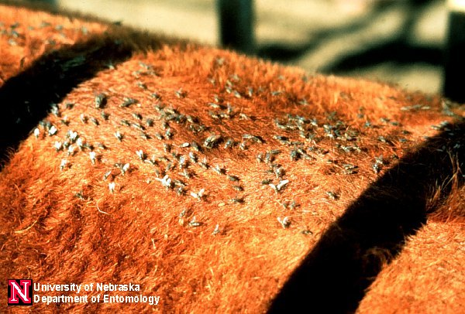
Fly Infestation
Horn Flies

Slide 101
Lice
Most abundant during winter and spring.
Only treat in in the late fall and early winter
Treat with pour-ons, injections as well as backrubbers or periodic spraying of insecticides
    Be sure to watch withdrawal periods on all products used to control parasites.

Slide 102
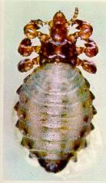
Lice

Slide 103

Ticks

Slide 104
Grubs/Heelfly
Reduce milk production
Reduce weight gain
And diminish hide value
A big loss is due to carcass trim andf lower meat quality
They are the larval stage of the heel fly

Slide 105
Grub
Prevention is best when the life cycle of the grub worm is learned
Effective treatments are:
Co-Ral, Ivomec, Spotton, Tiguron
Warbex, Dectomax

Slide 106
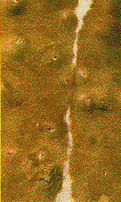
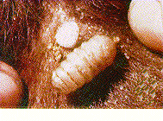
Grub Infestation

