Slide 1
Forces
Learning objectives:
1. To know the units forces
are measured in.
2. To know what equipment is used to measure a force.
3. To be able to measure the force of objects in the classroom.

Slide 2
What is a force?
Here are some ways of describing forces:
A push
A pull
A stretch
A squeeze
A catch
A twist
We can’t see forces but we can see the effects of a force.

Slide 3
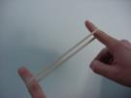
Forces can make things:
Speed up
Slow down
Change direction
Change shape

Slide 4
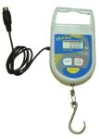
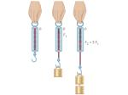
Measuring forces
Forces are measured in newtons.
We can write this as N.
We use a Newton meter to measure forces.
It is sometimes called a force meter.

Slide 5
Have a look at the Newton meter:
What do you notice about this instrument that measures forces?
What objects would this instrument not be able to measure the force of and why?

Slide 6
Today’s tasks:
You are going to complete worksheet 1.
You are going to work in groups and measure the force of different objects in the classroom using a Newton meter. You will record your findings in a table.
We will then discuss our findings.

Slide 7
What did we find out?
What object had the biggest force?
What object had the smallest force?
Challenge: can you find an object that has a force of exactly 3 N?
Which object has a force greater than 5 N?

Slide 8
Quick quiz!
1. What is a force?
2. Can you see forces?
3. Can you name any effects that forces have?
4. What units do we measure forces in?
5. What instrument do we use to measure force?
6. What is this instrument also known as?
How did you score??!

