Slide 1
Session 1

Slide 2
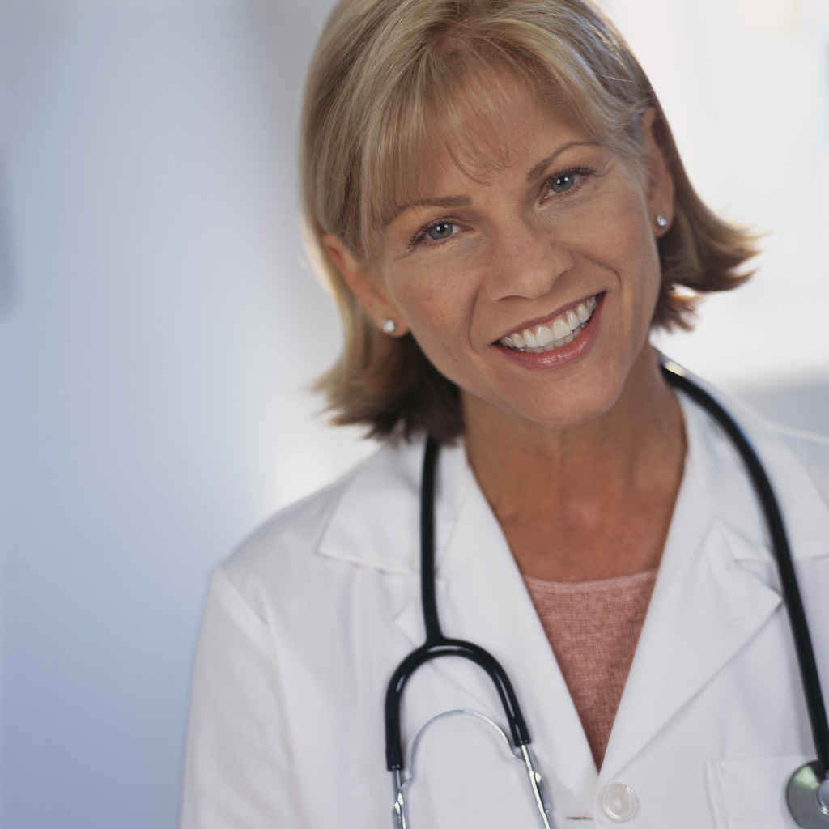
Learning Objectives Today I am Learning…
To ask questions about medicines and health
That sometimes we take medicines when we get ill, these
help us to get better
That some people need medicines
to keep them alive and healthy
That medicines are useful but are
drugs not foods, and can be
dangerous

Slide 3
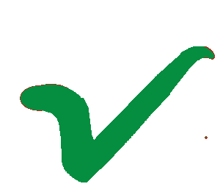
Success Criteria I need to…
Think of a question about health to ask the nurse
Talk about the dangers of medicine

Slide 4
A visit to the doctor or nurse
When have you been to see the doctor or nurse?
What happened when you were there?
How did they make you get better?
If you could ask the nurse a question about her work, what would it be?
What? Why? Which? Where? When? Who? How?

Slide 5
Session 2

Slide 6
Learning Objectives Today I am Learning…
That medicines can be dangerous if we take them without
asking our parents or a doctor
To know why medicines are
dangerous and how we can
stop them being so
To talk about how to
use medicines safely

Slide 7
Success Criteria I need to…
Explain why it is important only to take medicines when
a proper adult tells us
Explain why we should not eat things unless we know
what they are

Slide 8
Activity
Look at some packaging. Is it for food or sweets?
Sort it into two piles: dangerous and not dangerous.
Make a collage to show how packaging tells us when it is
dangerous.
Remember to add a HEADING to your collage.

