Slide 1
Melting and Freezing

Slide 2
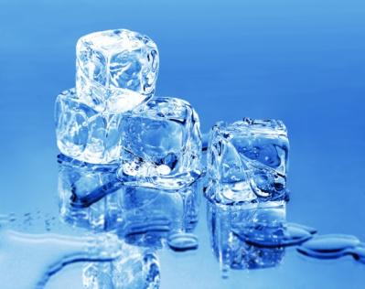
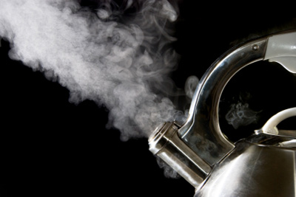
Cold
Hot

Slide 3
Cold
Solid
Liquid
Liquid
Gas
Hot

Slide 4
Cold
Melting
Freezing
Condensing
Evaporating
Hot

