Slide 1
MICROBES
Here are some of the things we shall learn -

Slide 2
Microbes
Are invisible to the naked eye, you need a powerful microscope to see them.
Are everywhere around us, inside us, on us, in our food, in our homes, in the air we breathe and the water we wash in.
Are mostly useful, but some are harmful
Have been around for 3.8 bn years.
Are vital for life on Earth.

Slide 3


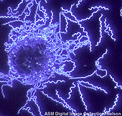
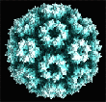
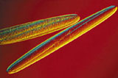
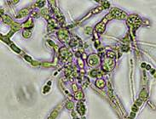
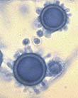
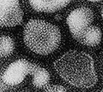
What do Microbes look like ?
Magnified 1000’s of times and coloured using
dye, we see -

Slide 4
Microbes exist in huge numbers
In one single teaspoon of garden soil, there are over 100,000 microbes. In 1ltr of seawater, there are over 1bn microbes.
On your hands there are more microbes than there are people in the world.
There are so many microbes, that scientists have only named 0.5% of them.
Microbes outnumber all other species and make up most of the living matter on the planet. See www.cellsalive.com How Big is a ... ?

Slide 5
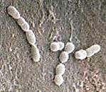
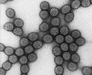
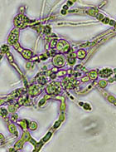
Microbes – three types
Bacteria strep bacteria
Virus rotavirus
Fungi
mould

Slide 6
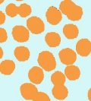


Bacteria
Have three main shapes
spira l(boriella) little balls(-cocci) rods (-bacilli)
Can move about on their own
Join up together to form chains
called ‘bio-films’. As on teeth !

Slide 7
What can bacteria do ?
Bacteria in the Cafeteria - lets find out using this webpage.
We have learnt that bacteria do many good things, such as decompose waste and give texture and flavour to food. However, they can also cause illness. They give off oxygen when they ‘eat’. Half of all the oxygen in the world, comes from bacteria.

Slide 8
Virus
Come in 1000s of different shapes and sizes.
They hang about waiting to meet a ‘host’ which they then invade, hijacking the host’s cells. Beware the air you breathe and door handles !

Slide 9
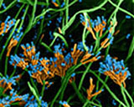
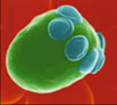
Fungi
Not just mushrooms –
athlete’s foot, penicillin, and yeast.
Yeast is used in bread making,
and brewing

Slide 10

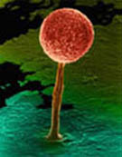
Algae are also Microbes
Algae photosynthesise – taking their energy from the sun, and producing oxygen in the process. Algae are thought to produce over 50% of the oxygen in the world.

Slide 11
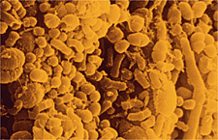
Microbes live among us
In our food
Cleaning up our waste
Killing pests
Making medicines
In the making of such things as leather, soy sauce, cheese and paper.
In our bodies. Microbes in
our mouths

Slide 12
And finally
Without microbes, life on this planet would be entirely different – they generate oxygen, are part of the carbon and nitrogen cycles, and can survive the harshest conditions.
Without microbes, our bodies would not process the food we eat.
They drive the chemistry of life, breaking things down into their parts so that life can being again.
Microbes are small but mighty !

Slide 13
To find out more
www.microbe.org
www.amnh.org/exhibitions/epidemic
www.mikeymicrobe.com
www.cellsalive.com/howbig

